Slide 1
The Wonder of Water
Properties of Water

Slide 2
Experiments for Water Properties
Perform experiments 1 – 6 as shown on the following slides.
The expected results are shown for each experiment (in case you fail!). ☺
Create a WORD document.
Take a picture of each experiment.
Label each image appropriately.
Give the property of water shown.

Slide 3
Experiment 1
Paper Towel Follies

Slide 4
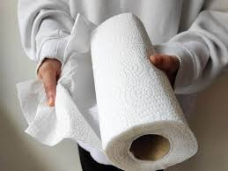
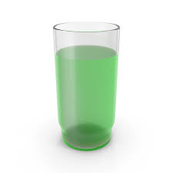
Capillary Action
Includes cohesion,
adhesion, surface tension
Experiment 1
Paper Towel Follies
Materials
Paper Towel
Glass
Water
Green food coloring
Procedures
Add some green food coloring to a glass with water (1/4-1/2 full).
Fold Paper Towel piece into a long rectangle and suspend in the glass.
Wait and watch!

Slide 5
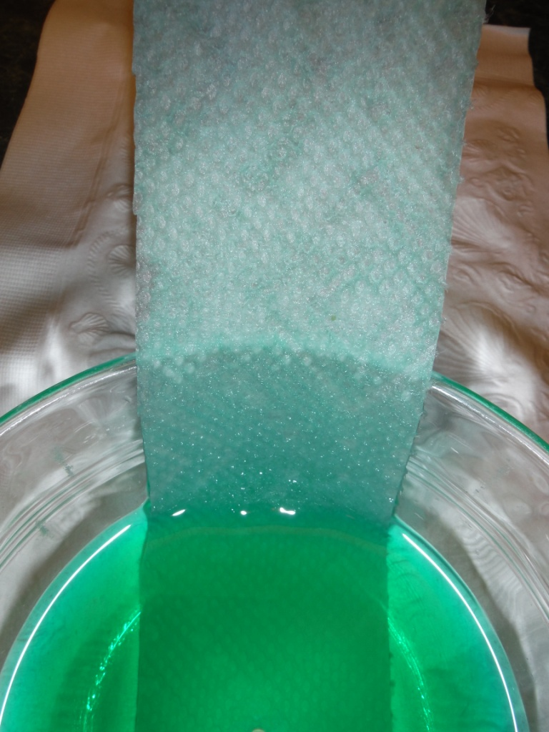
Paper Towel Follies.
Capillary Action
Includes cohesion,
adhesion, surface tension

Slide 6
Experiment 2
Bridge the Gap

Slide 7
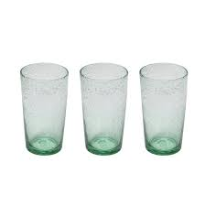
Capillary Action
Experiment 2
Bridge the Gap
Procedures
Set up 3 glasses as shown.
Fill the outside glasses ¾ with water. The middle glass should be empty.
Add blue coloring to the right glass, yellow to the left glass. Stir to mix.
Materials
Paper Towel
3 Glasses
Water
Blue & yellow food coloring
Use 2 folded Paper Towels to bridge the glasses as shown. They should be submersed in the outside glasses. & touch the bottom of the middle glass.
Wait and watch!

Slide 8
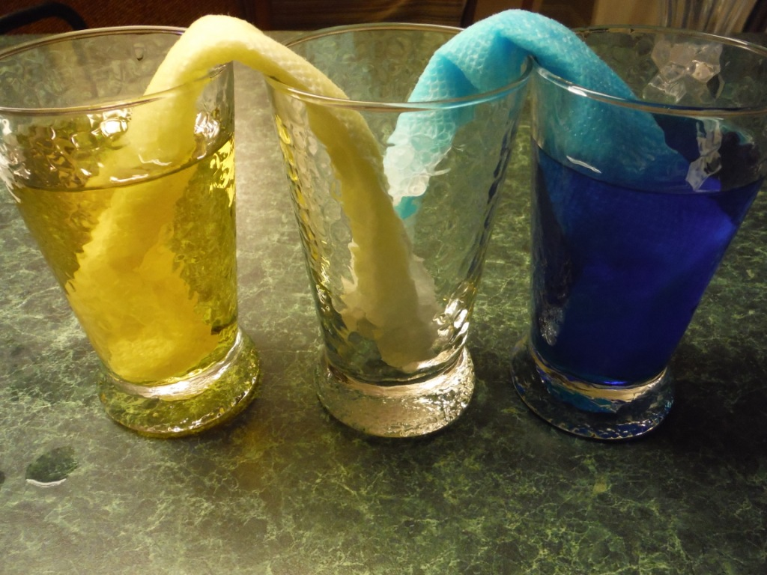
Capillary Action
Includes cohesion, adhesion

Slide 9
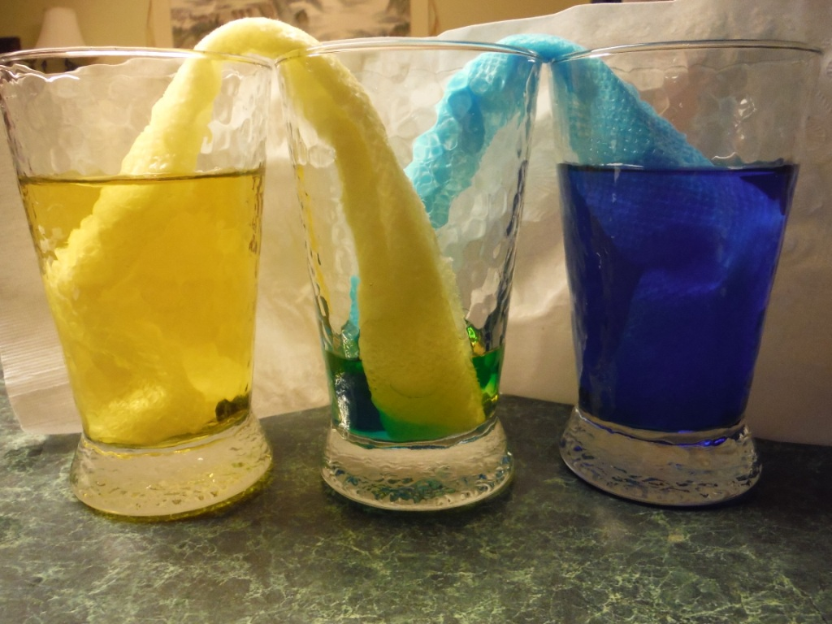
Notice the Middle color.

Slide 10
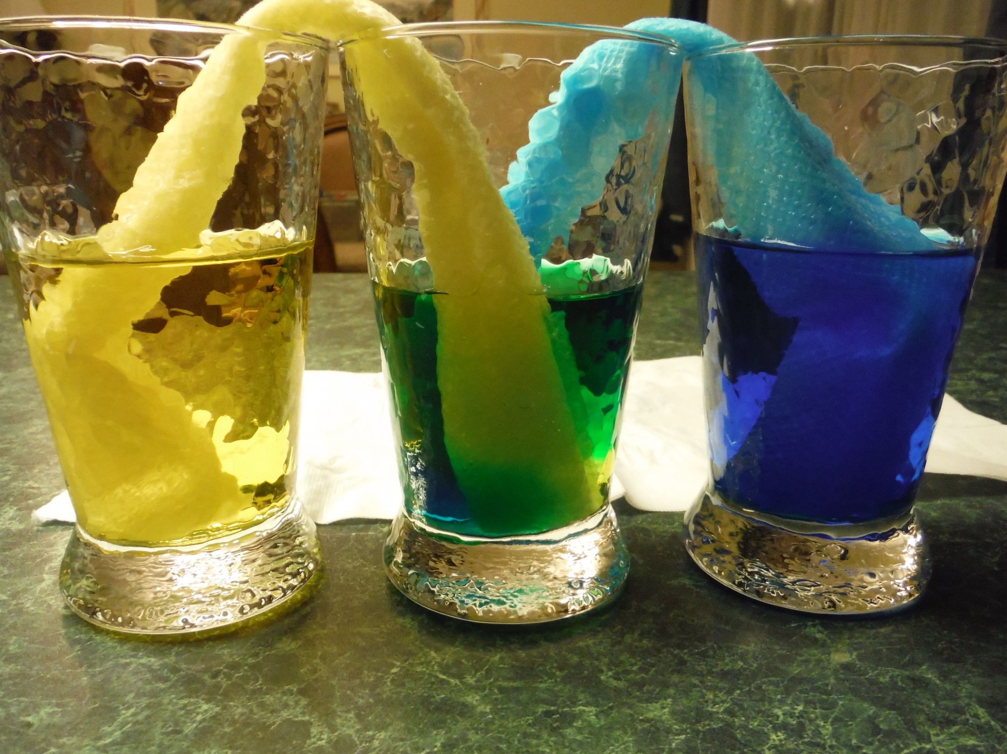
Capillary Action
Includes cohesion, adhesion

Slide 11
Experiment 3
A Salt & Battery

Slide 12
Composition of Water
Experiment 3
A Salt & Battery
Materials
Water
Epsom Salt or baking soda
9 Volt battery
Alligator clips
2 pencils without eraser end
Card board

Slide 13
Experiment 3
A Salt & Battery
Procedures
Set up the experiment as shown to the left.
Add Epsom salt or baking soda to the water in the glass.
Cut the pencils so the graphite is exposed on both ends.
Connect the battery to the pencils as shown. Be sure to note which terminal (+ or -) the pencil is connected to.
Look for bubbles by each submersed pencil.
Composition of Water

Slide 14
Experiment 4
Oil in Troubled
Waters!

Slide 15
Density
D = mass/volume
Experiment 4
Oil in Troubled Waters
Procedures
Fill one glass with water (not quite full).
Fill the other glass with vegetable oil (not quite full).
Set the 2 glasses next to each other.
Place one large ice cube in each glass and observe.
Materials
2 small glasses (8 oz. of less)
Vegetable oil
Water
2 large ice cubes

Slide 16
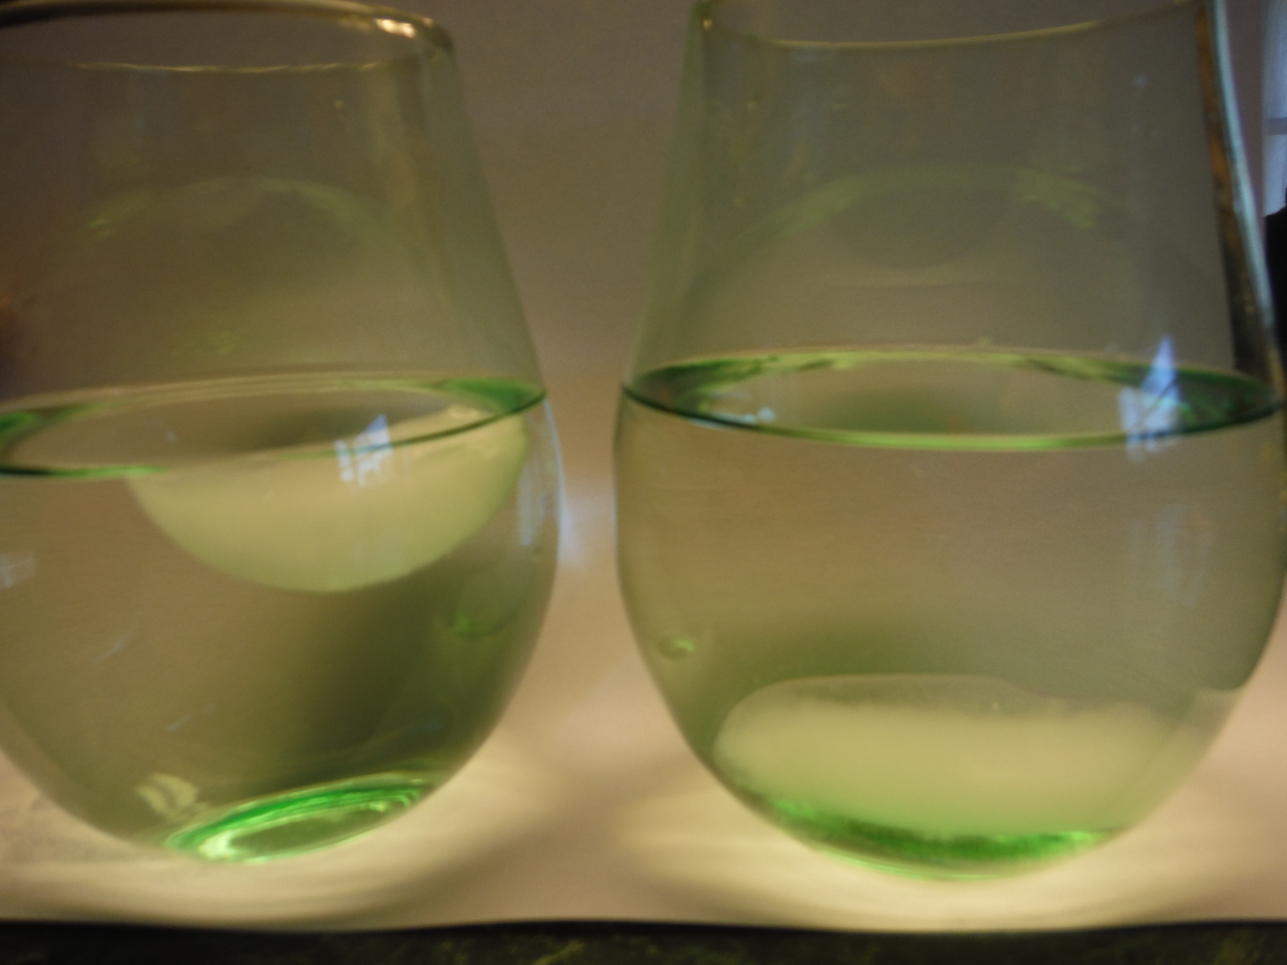
Notice the ice in each container

Slide 17
Experiment 4
Oil in Troubled Waters
Continued
Density
D = mass/volume
Procedures
Obtain a large glass (at least 20 ounces so the contents of the 2 glasses can fit).
Pour the contents of both glasses into the larger glass at the same time or one directly after the other.
Allow the mixture to settle and observe.
Take a picture.

Slide 18
Experiment 5
Floating in the toilet!

Slide 19
Experiment 5
Floaties in the Toilet
Surface Tension
Procedures
Fill the bowl with water.
Cut the toilet paper square so that it is about 2 inches wider and 2 inches longer than the paper clip.
Set the paper clip on the cut piece of toilet paper.
GENTLY set the toilet paper with clip on the water in the bowl.
The toilet paper should sink.
Materials
1 square of toilet paper
Bowl
Water
SMALL paper clip

Slide 20
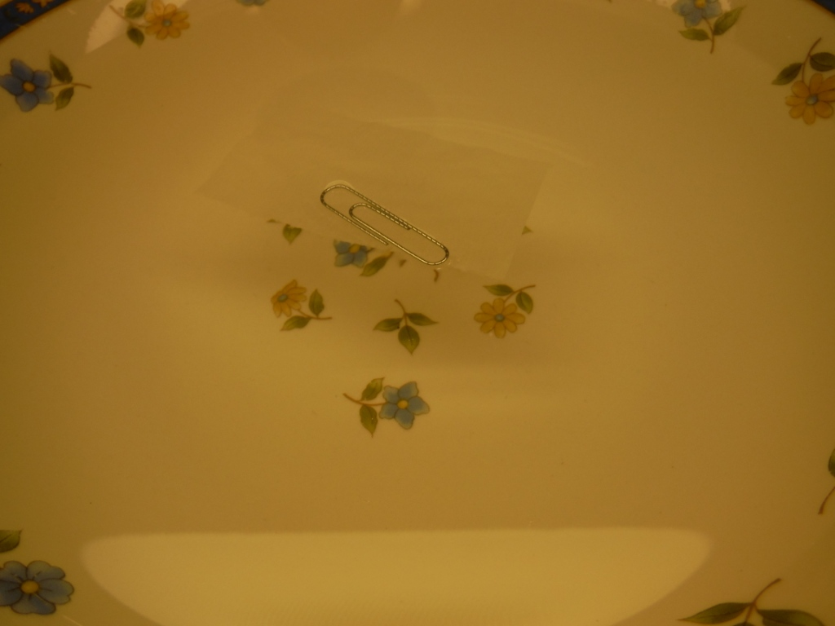
Surface Tension
Experiment 5
Floaties in the Toilet

Slide 21
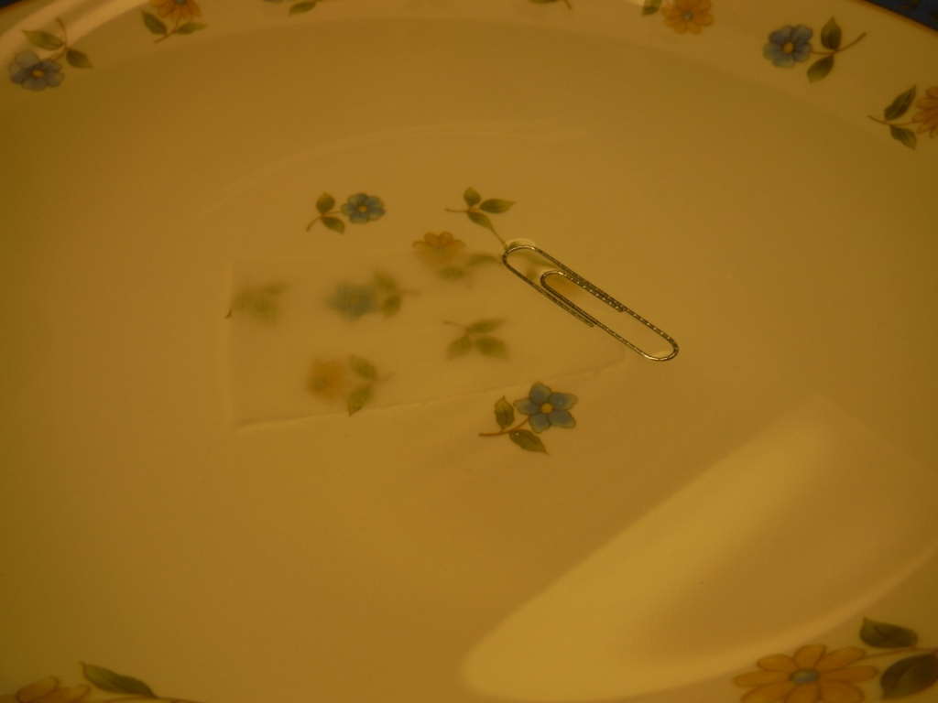
Surface Tension
Experiment 5
Floaties in the Toilet

Slide 22
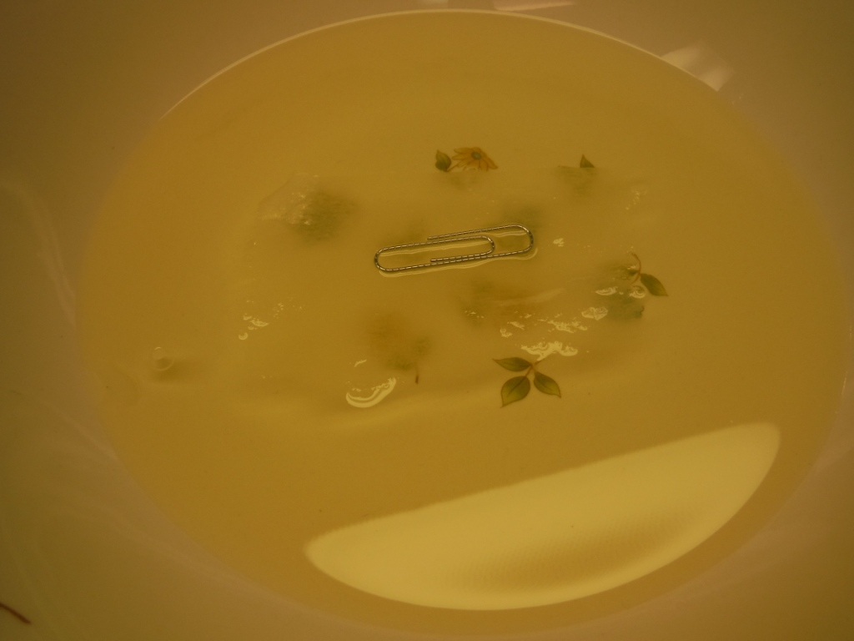
Surface Tension
Experiment 5
Floaties in the Toilet

Slide 23
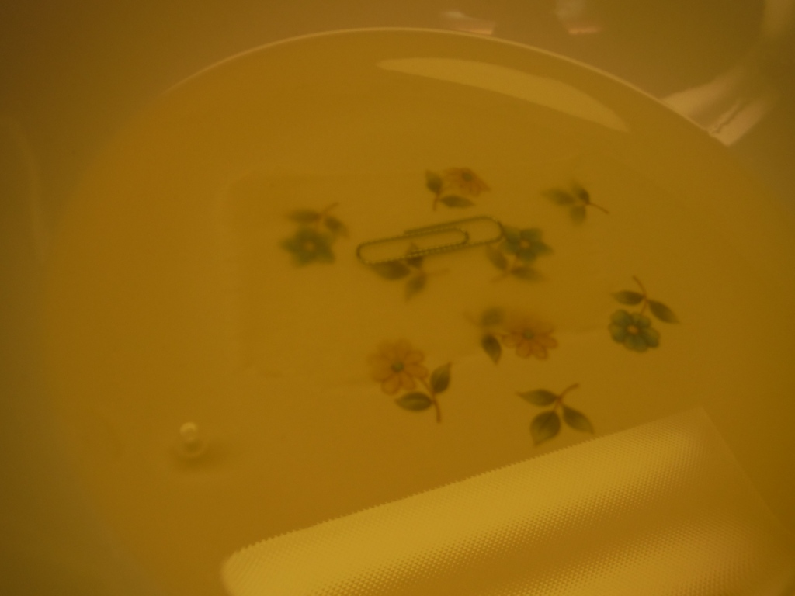
Surface Tension
Experiment 5
Floaties in the Toilet

Slide 24
Experiment 6
Floating in the toilet!

Slide 25
Polarity of Water
Due to Hydrogen Bonds
Experiment 6
Combing the Territory
Procedures
Turn on the cold water faucet and create a thin stream of water that is consistent.
Rub the comb vigorously with the wool or fur cloth.
Bring the rubbed comb NEAR the stream of water (start 3 inches away and move closer SLOWLY).
Observe the stream of water.
Materials
Plastic hair comb or latex balloon
Wool (sweater, cloth) or fur
Water faucet

Slide 26
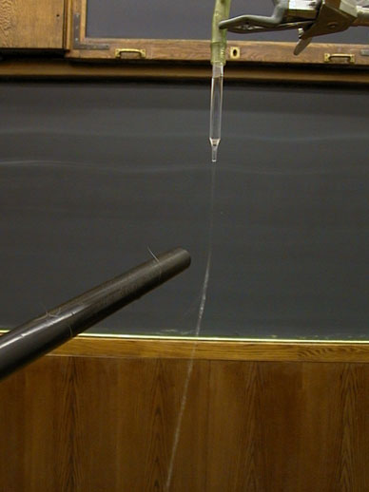
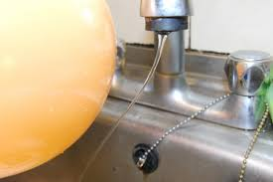
Polarity of Water
Due to Hydrogen Bonds
Experiment 6
Combing the Territory

Slide 27
Experiments for Water Properties
REMEMBER:
Create a WORD document
Take a picture of each experiment
Label each image appropriately
Give the property of water shown.

