Slide 1
Go to the “Slide Show” shade above
Click on “Play from Beginning”

Slide 2

Kingdom
PLANTAE
Chapters 24 & 25

Slide 3
Distinguishing Kingdoms
What is the one major difference between viruses, bacteria, protists and fungi (related to life)?
Of bacteria, protists and fungi, which are prokaryotic and eukaryotic?
Why are fungi not considered plants?
What two types of organisms exist related to food production?

Slide 4
Distinguishing Kingdoms
What is the one major difference between viruses, bacteria, protists and fungi (related to life)?
Viruses are non-living; the other kingdoms are living.
Of bacteria, protists and fungi, which are prokaryotic and eukaryotic?
Bacteria are prokaryotic (no membranes); protists and fungi are eukayotic (organelles, nuclear membrane).
Why are fungi not considered plants?
Fungi do NOT have vascular tissue (xylem and phloem).
What two types of organisms exist related to food production?
Heterotrophs cannot make their own food (Fungi, Animals). Consumers.
Autotrophs can make their own food (some bacteria, protists, all plants). Producers.

Slide 5
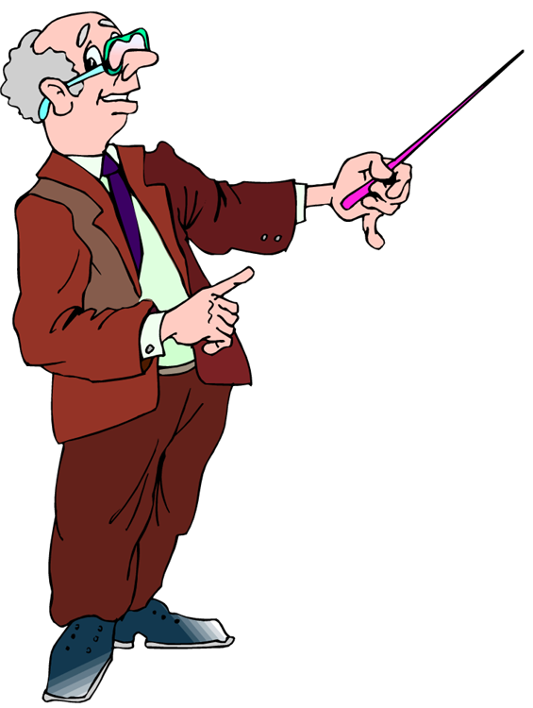
What is a
Plant?

Slide 6
What is a
Plant?
1. Plants are members of the Kingdom PLANTAE.
2. All plants are MULTICELLULAR and are composed of EUKARYOTIC cells.
3. All plants have CELL WALLS composed of CELLULOSE.
All plants carry out PHOTOSYNTHESIS (Autotrophs) using the green pigment, chlorophyll.
Life Cycle exhibits Alternation of Generations.
Plant Embryo is protected.

Slide 7
Lesson Objectives
  By the end of this lesson, you should be able to:
Explain the importance of plants and their general life cycle?
Describe the taxonomic diversity of plants (bryophytes and tracheophytes).
Distinguish characteristics of bryophytes (gametophytes, rhizoids, etc.) and tracheophytes (seedless, seeds, cones, flowers, cotyledons).
Understand the basic tissues found in all tracheophytes and how plants grow.
Learn to use a dichotomous key to identify plants (trees).
  Science Practice: Lab Tree Identification – Dichotomous Key
Notes:
#frame
instructional video
Timing ≈ 0.5 minutes
Living organisms need energy to accomplish the wide variety of tasks they attempt each day.
You will begin learning about how energy is captured from the Sun and stored in organic molecules.
[read objectives]

Slide 8
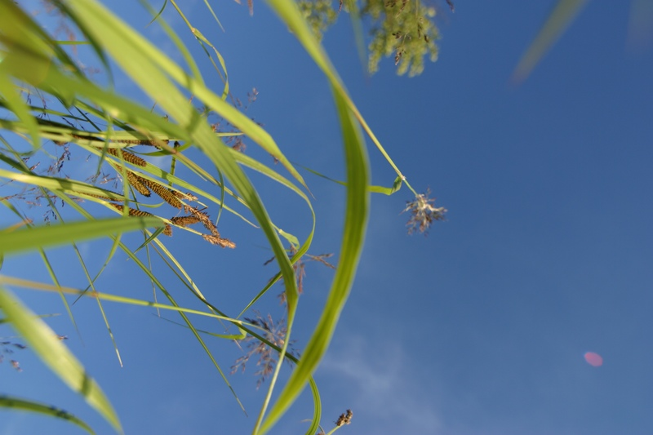
BOTANY = Study of Plants
Life could not exist on earth without plants.
1. Plants are the primary producers in every food chain.
2. Plants carry out photosynthesis, producing glucose from CO₂ and H₂O.

Slide 9
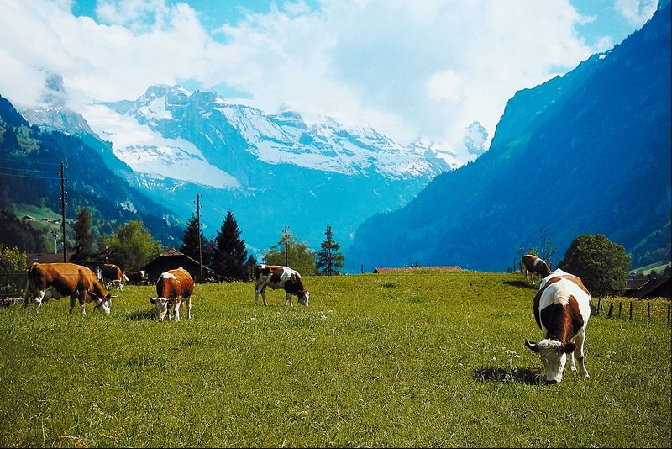
3. The plant uses this glucose as a source of energy, but much of this glucose is passed up the food chain. Herbivores eat the plants and carnivores eat the herbivores.
As a result, an amount of the glucose produced by the plant is passed to the next step in the food chain.

Slide 10
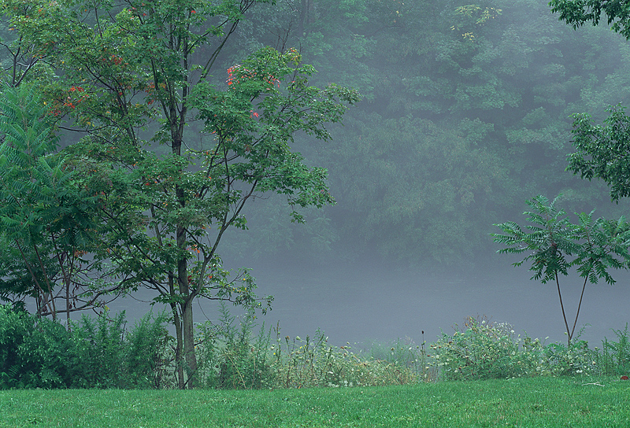
4. Not only do plants provide the base for food chains, they provide oxygen for animals as well as shelter and nesting sites.

Slide 11
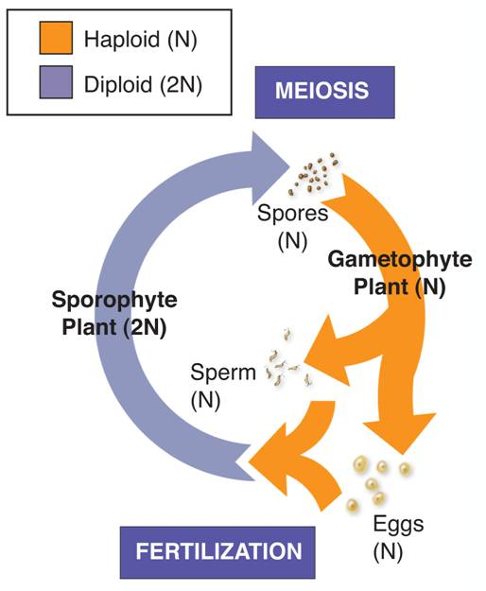
Alternation of Generations
All Plants exhibit Alternation of Generations.
They have 2 different forms in which they exist:
  Sporophyte (spore producing) (diploid-2n)
  Gametophyte (gamete-producing) (haploid-n)

Slide 12
Alternation of Generations
Diploid (2n) sporophyte stage produces haploid spores by meiosis.
Haploid spores undergo mitosis to produce gametophyte stage.
Gametophyte makes gametes (eggs and sperm) by mitosis.
Fertilization: Zygote (2n) produces the new sporophyte (2n).

Slide 13


2
1
3
4
10
6
8
9
5
7
Let’s summarize these details by filling in the flow chart

Slide 14
Sporophyte
Plant
(2N)
Sporophyte plant produces spores by meiosis
Spores
(1N)
Spores develop into new individuals called Gametophytes.
The zygote develops into the sporophyte plant.
Egg (1N)
Zygote
2N
Gametophytes produce gametes by mitosis.
Fertilization of gametes
Sperm (1N)
Let’s summarize these details by filling in the flow chart

Slide 15
Plant Diversity

Slide 16
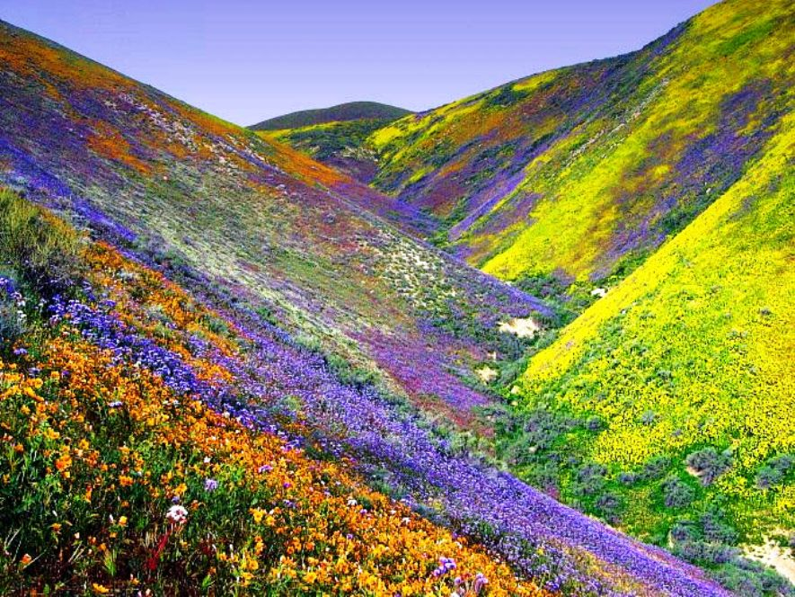
Creation of the Plant Kingdom
Genesis 1: 11-13
¹¹ And God said, Let the earth bring forth grass, the herb yielding seed, and the fruit tree yielding fruit after his kind, whose seed is in itself, upon the earth: and it was so.
¹² And the earth brought forth grass, and herb yielding seed after his kind, and the tree yielding fruit, whose seed was in itself, after his kind: and God saw that it was good.
¹³ And the evening and the morning were a third day.”

Slide 17
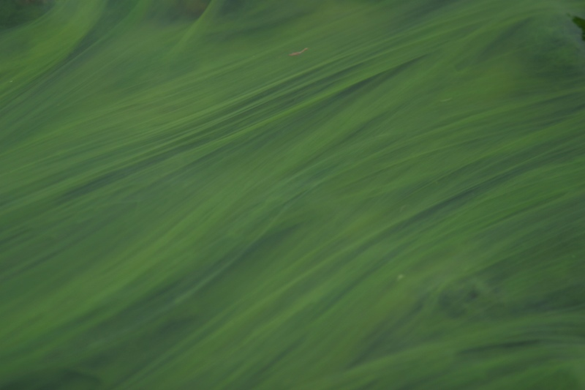
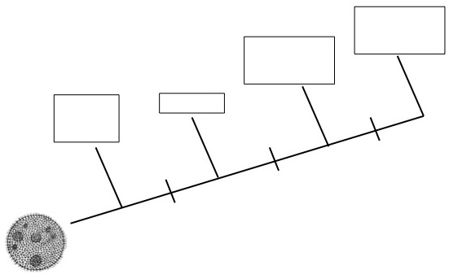
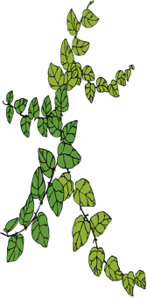
“Ancestral” Green (photosynthetic) Algae are thought to have led to the evolution of 4 major groups of living land plants:
Angiosperms
(Flowering plants)
Gymnosperms
(Cone-bearing plants)
Mosses and Liverworts
Ferns
Flowers and seeds inside fruits
Seeds
Vascular
Tissue
Green algae
ancestor

Slide 18
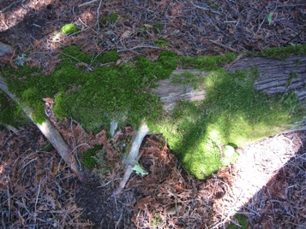
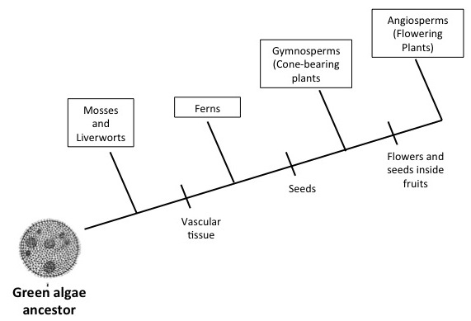
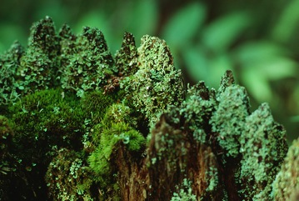

What group of plants was the first to “evolve” from the green algae ancestor (which are simplest)?
Notes:
Answer: The mosses and liverworts.

Slide 19
Do the mosses and liverworts have vascular tissue?
Notes:
Answer: NO

Slide 20
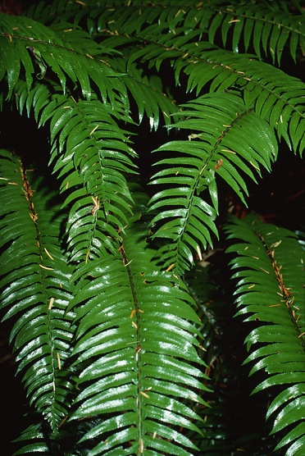
Do the ferns have
vascular tissue?
Do the ferns have seeds?
Notes:
Answer: YES

Slide 21
What two features allowed the gymnosperms and the angiosperms to thrive in terrestrial environments?
Notes:
Answer:
Vascular tissue and seeds.

Slide 22


How are the angiosperms different than the gymnosperms?
Notes:
Answer: Angiosperms have a flower as the reproductive structure, and produce seeds that are contained inside fruits.

Slide 23

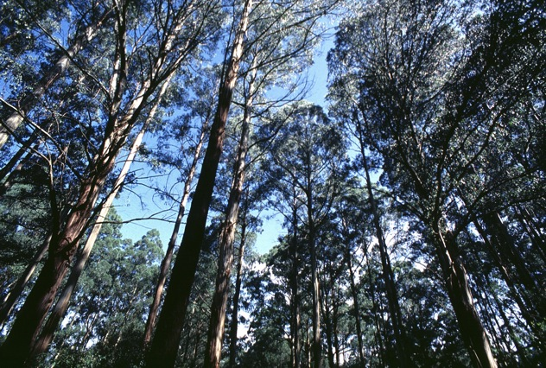
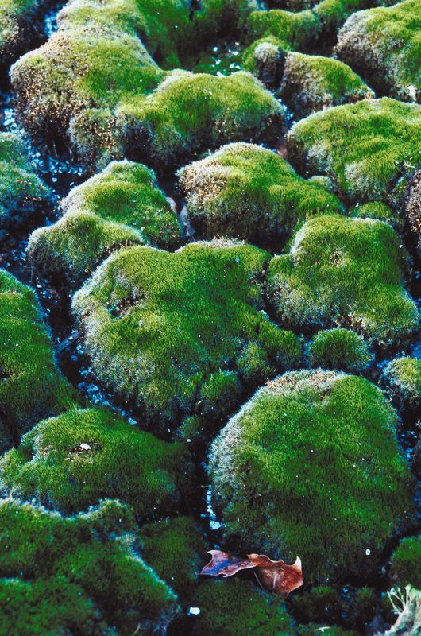
Classification of Plants
All plants are either Vascular plants or Nonvascular plants.
Vascular Plants have vascular tissue and Nonvascular Plants do not have vascular tissue.
Vascular tissue is tissue that conducts food and water throughout the plant.

Slide 24
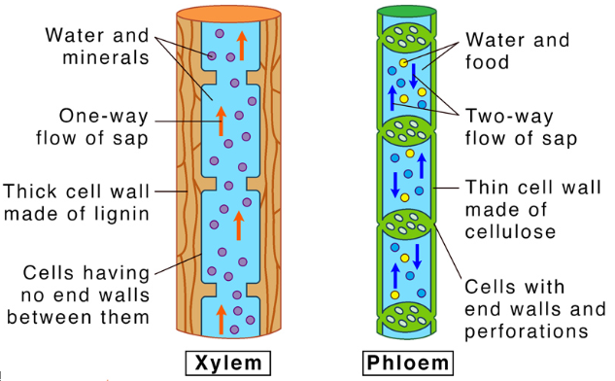
Classification of Plants
Xylem
Carries water and minerals up the plant from the roots; consists of dead cells.
Phloem
Carries food (sugars) down the plant
from the leaves; consists of living cells.

Slide 25
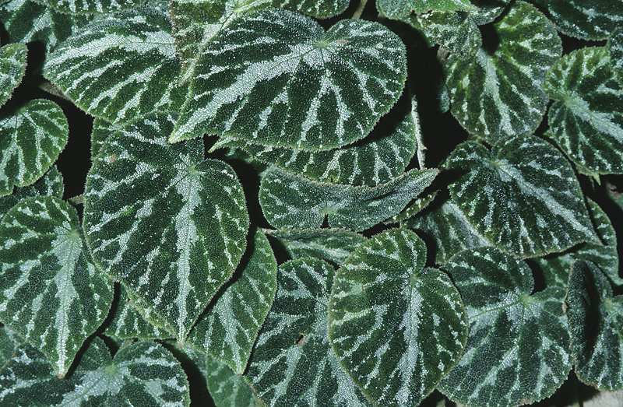
VASCULAR plants are referred to as “Tracheophytes”.

Slide 26
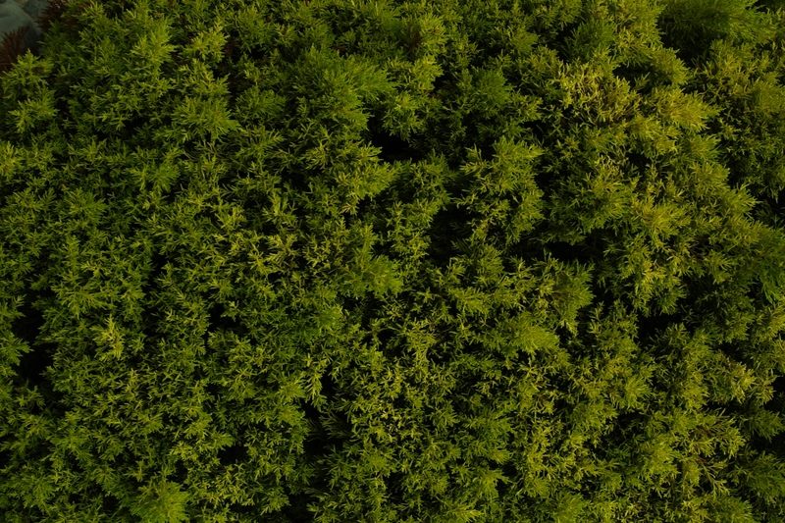
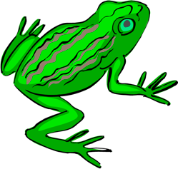
NONVASCULAR plants are referred to as “Bryophytes.”
They DO NOT have vascular tissue.
The bryophytes include Mosses and Liverworts.

Slide 27

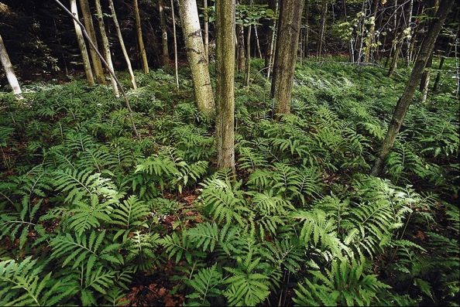
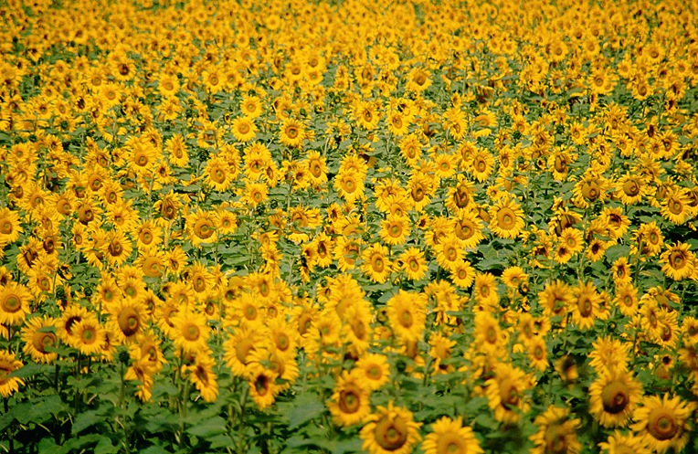
Tracheophytes (Vascular Plants) are further subdivided into "Seed Plants" and "Seedless Plants".
The seedless plants do not produce seeds.
Seedless plants include the Ferns.
The seed plants do produce seeds.

Slide 28

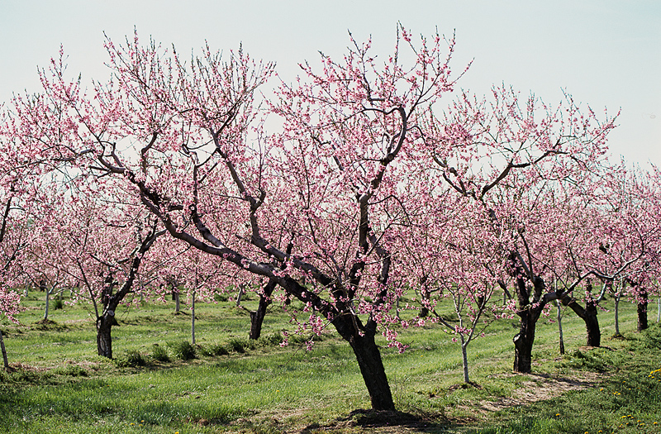
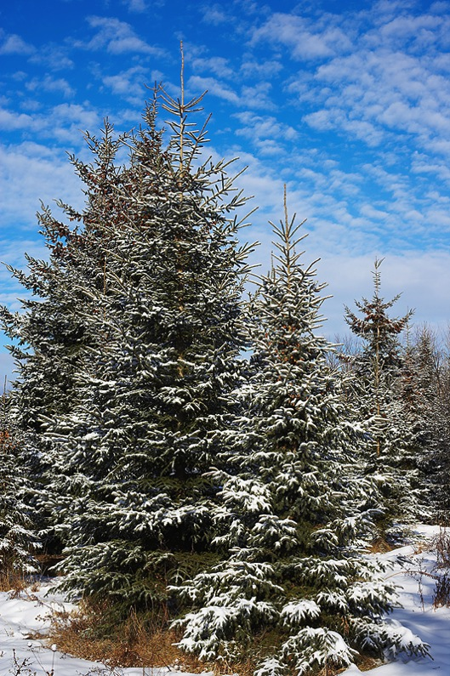
The Seed Plants are divided into:
Angiosperms and Gymnosperms
Angiosperms are the Flowering Plants.
Gymnosperms are the Cone-bearing Plants.

Slide 29

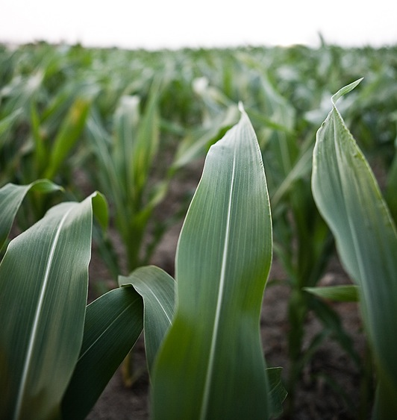
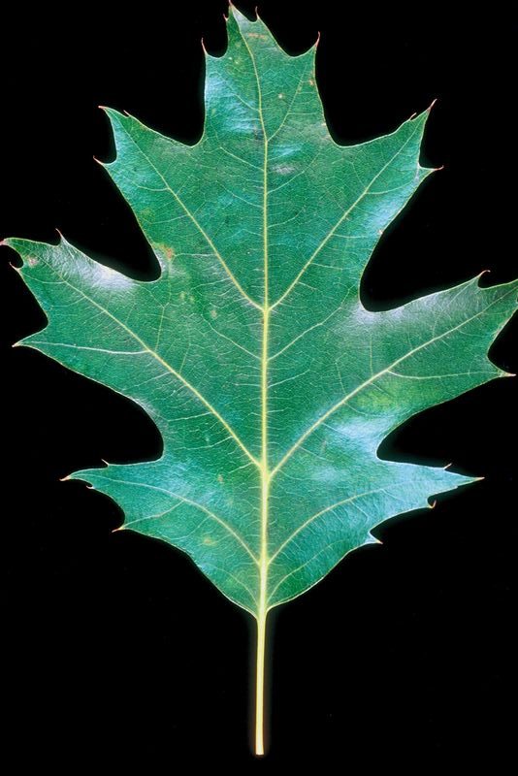
The Angiosperms are divided into:
Monocots and Dicots
← Corn is a Monocot.
Oak trees are Dicots. →
The differences between monocot and dicots will be discussed later in the Unit.

Slide 30
Kingdom Plantae
Complete the graphic organizer for plant classification.

Slide 31
Kingdom Plantae
Nonvascular Plants
(Bryophytes)
Vascular Plants
(Tracheophytes)
Seedless Plants
Seed Plants
Liverworts and Mosses
Ferns
Let’s summarize this information on the flow chart
Gymnosperms
(cone-bearing)
Angiosperms
(flowering)
Monocots
Dicots

Slide 32

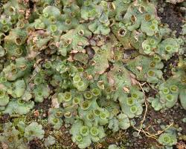
BRYOPHYTES…
Bryophytes are Nonvascular Plants.
This means they have no…
… vascular tissue (xylem or phloem).
These plants can draw up water by osmosis only a few centimeters above the ground.
This prevents them from growing very big.
Have Life Cycles dominated by Gametophytes.

Slide 33

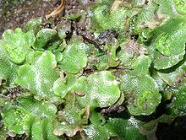
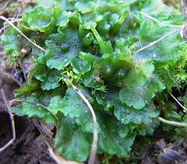
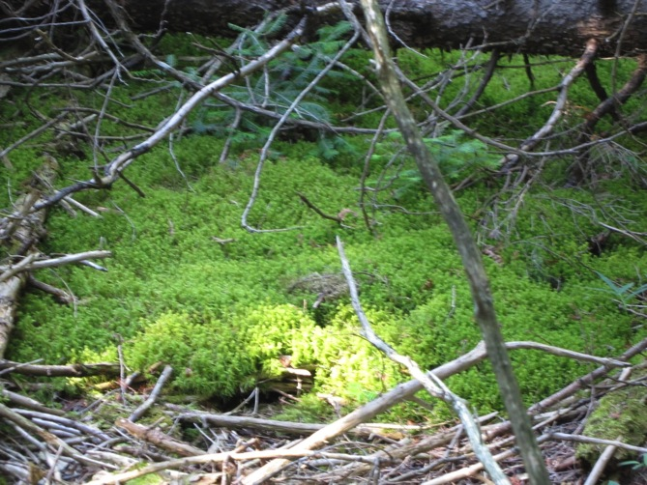
Bryophytes include…..
Liverworts
Hornworts
Mosses

Slide 34
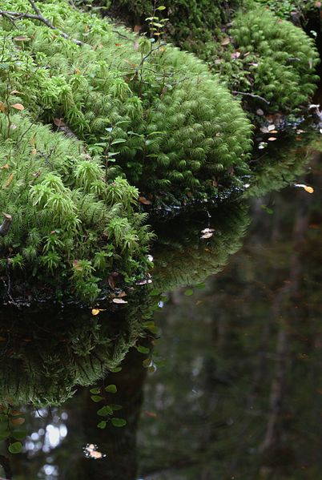
Bryophytes produce motile gametes
and must have water to reproduce.
During part of their life cycle, they produce sperm that must swim
through water to reach the egg.
They must live in places where there is rainfall or dew for at least part of the year.

Slide 35

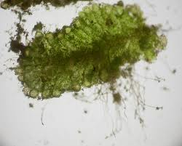
Bryophytes have no…
…true roots, stems and leaves.
They have Rhizoids.
Rhizoids are root-like structures that anchor the plant to the ground.
RHIZOIDS
Rhizoids are capable of:
absorbing water and minerals from the soil.
Water moves from cell to cell by osmosis, through the rhizoids, and into the rest of the plant.
This limits the growth of the plant.
Bryophytes are small and grow close to the ground because they have no way to transport water large distances.

Slide 36

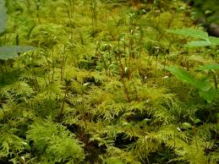
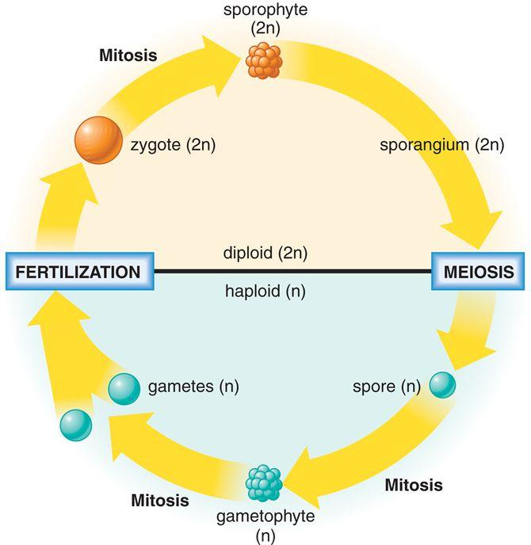
Bryophytes show Alternation of Generations
In bryophytes, the GAMETOPHYTE (haploid) is the dominant, recognizable stage of the life cycle and is the stage that carries out most of the plant’s photosynthesis.
As members of the plant kingdom, they do possess chlorophyll and carry out photosynthesis.

Slide 37
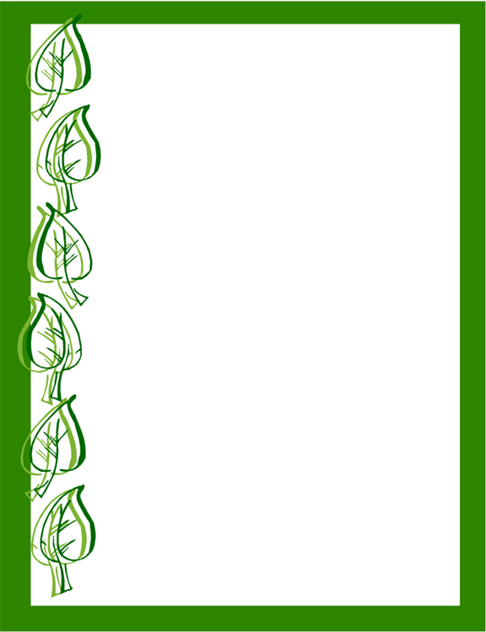
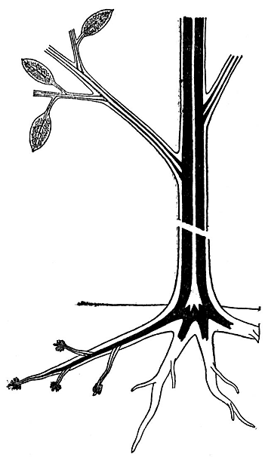
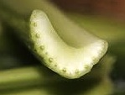
The Vascular Plants (Tracheophytes)
Transport system called Vascular Tissue.
Vascular Tissue is specialized to conduct Water and Nutrients throughout the plant.
The two types of vascular tissue are:
XYLEM AND PHLOEM.
Vascular
tissue

Slide 38
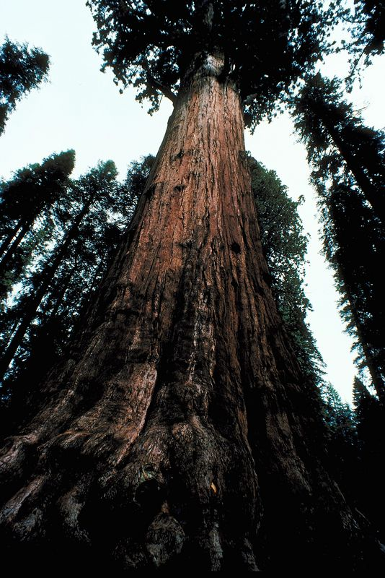
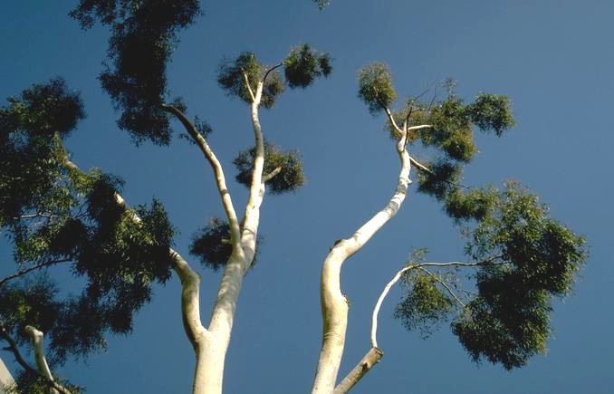
VASCULAR TISSUE enables plants to grow upward, away from the surface of the ground.

Slide 39
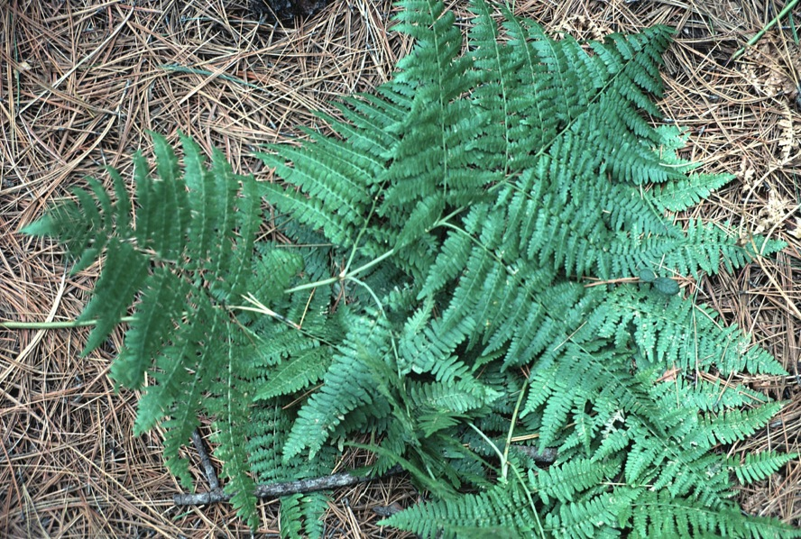
FERNS are SEEDLESS
Vascular (Tracheophytes) plants
Ferns have true roots, stems and leaves.
The SPOROPHYTE (diploid) generation is dominant.
Ferns have vascular tissue (xylem and phloem).
4. Like the nonvascular plants, they have motile, swimming sperm.
Water must be present for the fertilization of the Egg.

Slide 40
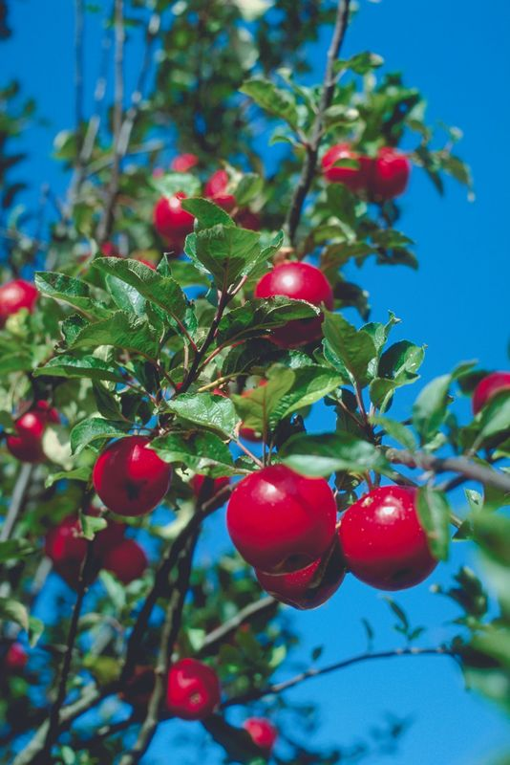
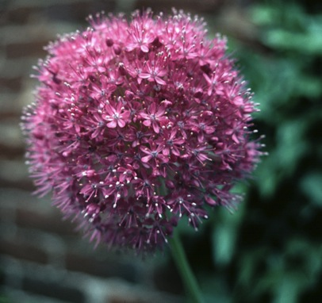
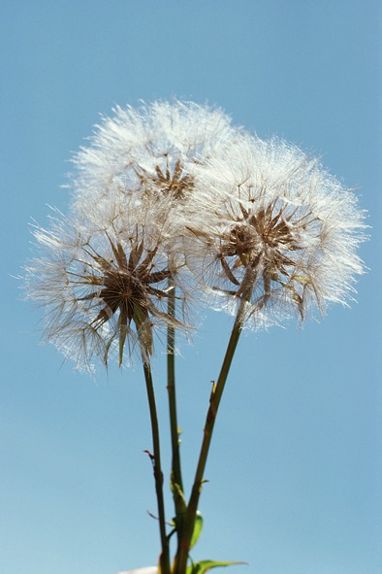

The Seed Plants
SEEDED Vascular Plants (Tracheophytes):
Plants with the ability to form seeds.

Slide 41

What features are seen in the seed plants that allow reproduction without water?
The Seed Plants have:
1. Flowers or Cones
2. The transfer of sperm by Pollination.
3. The protection of embryos within Seeds.

Slide 42
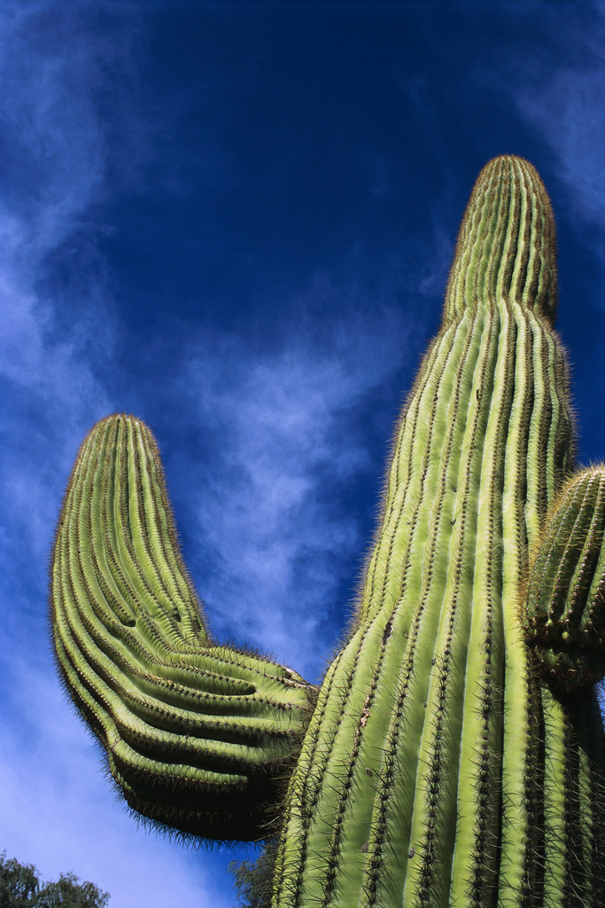
REPRODUCTION FREE FROM WATER :
HUGE ADVANTAGE!!
Like the bryophytes and ferns, all seed plants show Alternation of Generations, alternating between the gametophyte and sporophyte stages.
Unlike the bryophytes and ferns, the seed plants do NOT require water for the fertilization of the gametes.
This allows the seed plants to occupy many more types of habitats than the bryophytes and the ferns.

Slide 43
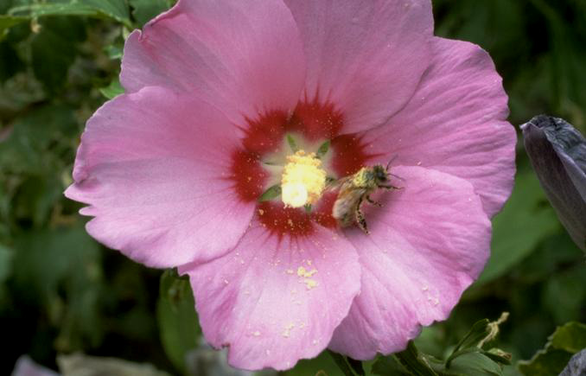
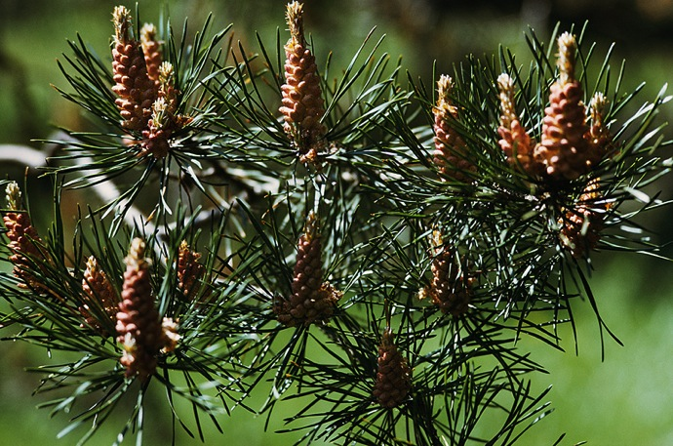
In the seed plants, the SPOROPHYTE (diploid) generation is the dominant, recognizable stage of the life cycle and is the stage that carries out most of the plant’s photosynthesis.
CONES AND FLOWERS
Cones and Flowers are SPOROPHYTE structures.
The gametophytes grow and mature within these sporophyte structures.

Slide 44
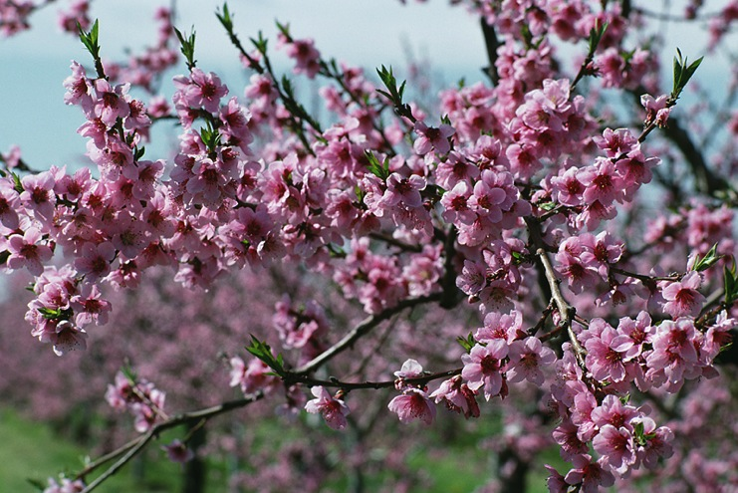
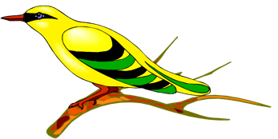
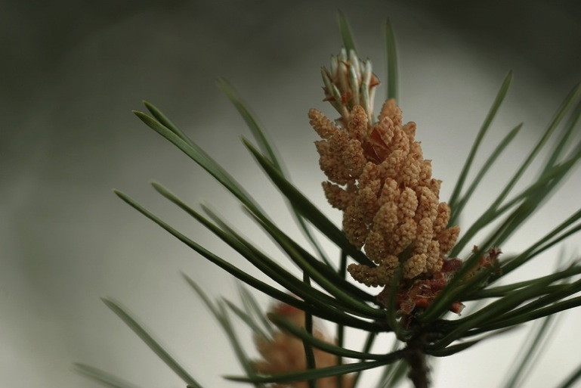

The Seed Plants are divided into 2 groups:
← Angiosperms
Gymnosperms →

Slide 45
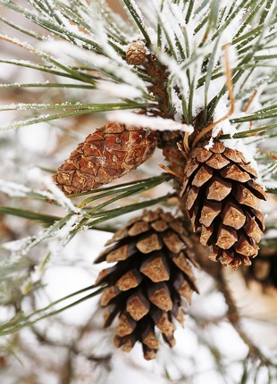
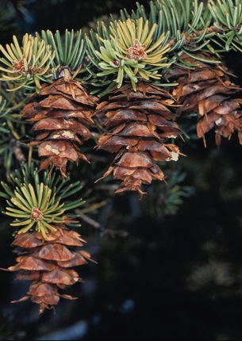



Cones are the seed bearing structures of…
… GYMNOSPERMS
The Gametophyte generations of seed plants live INSIDE Cones and Flowers.
Flowers are the seed bearing structures of the ANGIOSPERMS.

Slide 46





Pollen
MALE GAMETOPHYTE
contained within the POLLEN GRAIN
Pollen grains contain Sperm cells.
Rather than the sperm swimming through water, the pollen (sperm) is carried to the female gametophyte by: wind, insects, or small animals.
POLLINATION is the transfer of pollen from the male reproductive structures to the female reproductive structures.

Slide 47

A seed consists of an EMBRYO and a Food Supply that is enclosed inside of a protective outer covering.
SEEDS
The plant embryo is diploid and is in the early developmental stage of the SPOROPHYTE plant.

Slide 48

The seed contains a food supply that nourishes the embryo.
This food supply sustains the embryo until the seed has sprouted and has grown enough to become fully photosynthetic.
The outer Seed Coat surrounds and protects the embryo and keeps the contents of the seed from drying out.

Slide 49

The EMBRYO remains in a dormant stage within the seed for weeks, months or even years.

Slide 50

The seed can survive long periods of bitter cold, extreme heat or drought. When growing conditions become favorable, the seed germinates and begins to grow.

Slide 51

GYMNOSPERMS
Bear their seeds directly on the surfaces of CONES.
Include the: CONIFERS such as pines and spruces.

Slide 52


The term “Gymnosperm” means “Naked Seed”.
The Cone is the seed bearing structure and all seeds are exposed.

Slide 53



The Gymnosperms
Cycads
Ginkgoes

Slide 54






Pine
Spruce
Cypress
Fir
Cedar
Redwood

Slide 55

ANGIOSPERMS
Also called FLOWERING plants.
Bear their seeds within a layer of tissue that protects the seed.
Angiosperms include grasses, flowering trees, and shrubs.

Slide 56

According to evolutionists, Angiosperms appeared in the fossil record “only” 135 million years ago, making them the most “recent” of all plants.
Flowering plants are thought to be the dominating form of plant life on Earth.
ANGIOSPERMS:
The Flowering Plants
They have a method of reproduction and development that involves FLOWERS AND FRUITS.

Slide 57




Flowers and Fruits
Unique to the angiosperms is the development of the FLOWER as the reproductive structure.
Flowers are an advantage to plants because they attract insects and other small animals to the flower.
These insects and animals then transport pollen from one flower to another.
This means of pollination is much more efficient than the wind pollination of most gymnosperms.

Slide 58

The FRUIT is also a structure found only in Angiosperms.
The fruit is…
…a wall of tissue surrounding the seed.
The fruit protects the seed, but also aids in seed dispersal by attracting animals to the fruit.

Slide 59

Angiosperm Diversity
The phylum containing the Angiosperms is divided into two classes:
MONOCOTS
DICOTS

Slide 60

The Monocots and Dicots are named for the number of COTYLEDONS their seeds contain.
Monocots have one cotyledon and dicots have two cotyledons.
A COTYLEDON is….
….the first leaf or the first pair of leaves produced by the embryo of a seed plant.

Slide 61

Seed leaves
Leaf veins
Stems
Flowers
Roots
MONOCOTS
Vascular
One
cotyledon
bundles scattered in
complex arrangement
Floral parts usually
in multiples of three
Fibrous
root system
Veins usually parallel
EUDICOTS
Two
cotyledons
Vascular bundles
arranged in ring
Floral parts usually
in multiples of
four or five
Taproot
usually present
Veins usually
branched
Notes:
Figure 31.2-0 A comparison of monocots and dicots

Slide 62
Seed leaves
Leaf veins
Stems
Flowers
Roots
MONOCOTS
Vascular
One
cotyledon
bundles scattered in
complex arrangement
Floral parts usually
in multiples of three
Fibrous
root system
Veins usually parallel
EUDICOTS
Two
cotyledons
Vascular bundles
arranged in ring
Floral parts usually
in multiples of
four or five
Taproot
usually present
Veins usually
branched
Notes:
Figure 31.2-0 A comparison of monocots and dicots

Slide 63
Seed leaves
Leaf veins
Stems
Flowers
Roots
MONOCOTS
Vascular
One
cotyledon
bundles scattered in
complex arrangement
Floral parts usually
in multiples of three
Fibrous
root system
Veins usually parallel
EUDICOTS
Two
cotyledons
Vascular bundles
arranged in ring
Floral parts usually
in multiples of
four or five
Taproot
usually present
Veins usually
branched
Notes:
Figure 31.2-0 A comparison of monocots and dicots

Slide 64
Seed leaves
Leaf veins
Stems
Flowers
Roots
MONOCOTS
Vascular
One
cotyledon
bundles scattered in
complex arrangement
Floral parts usually
in multiples of three
Fibrous
root system
Veins usually parallel
EUDICOTS
Two
cotyledons
Vascular bundles
arranged in ring
Floral parts usually
in multiples of
four or five
Taproot
usually present
Veins usually
branched
Notes:
Figure 31.2-0 A comparison of monocots and dicots

Slide 65
Seed leaves
Leaf veins
Stems
Flowers
Roots
MONOCOTS
Vascular
One
cotyledon
bundles scattered in
complex arrangement
Floral parts usually
in multiples of three
Fibrous
root system
Veins usually parallel
EUDICOTS
Two
cotyledons
Vascular bundles
arranged in ring
Floral parts usually
in multiples of
four or five
Taproot
usually present
Veins usually
branched
Notes:
Figure 31.2-0 A comparison of monocots and dicots

Slide 66

Monocots

Slide 67

Dicots
Most deciduous trees are dicots.

Slide 68
Kingdom Plantae Graphic Organizer

Slide 69
Kingdom Plantae Graphic Organizer
Notes:
DO NOT UPLOAD TO GP5!!

Slide 70
Basic Plant Tissue Types
Each plant organ (roots, stems, leaves) contain all three types.
Tissue | Components | Function
Dermal | Epidermis | Protective outer covering Prevent loss of water
Ground | Lies between dermal and vascular tissues Parenchyma Collenchyma Sclerenchyma | Bulk of plant body Metabolism (Photosynthesis, Cell Respiration, etc.) Storage of Sugars Physical Support
Vascular | Xylem Phloem | Transport water and nutrients Supports the plant body

Slide 71

Plant Organs have 3 Tissue Types

Slide 72


Slide 73

Dicot leaf
Cuticle
Xylem
Upper epidermis
Vein
Phloem
Mesophyll
Guard
cells
Lower epidermis
Stoma
Sheath
Vascular
bundle
Dicot stem
Monocot stem
Vascular
bundle
Cortex
Pith
Epidermis
Epidermis
Epidermis
Vascular
cylinder
Xylem
Dicot root
Phloem
Monocot root
Phloem
Vascular
cylinder
Xylem
Central
core of
cells
Epidermis
Epidermis
Key
Cortex
Dermal tissue system
Cortex
Endodermis
Ground tissue system
Endodermis
Vascular tissue system
Notes:
Figure 31.5-0 The three tissue systems

Slide 74
Vascular Tissue is made up of:
  Xylem:
    Carries Water and Minerals from the roots to the rest of the plant.
    Composed of Dead Cells (Cell Walls remain).
    Cell Walls are lignified, which provide support for the plant (helps it grow tall).
    In Trees it is the Wood.
  Phloem:
    Carries the food made in the leaves during photosynthesis, to other plant structures.
    Living Tissue, but arranged in tubes.

Slide 75

Vascular Tissue
Xylem and Phloem form a continuous network from the tip of the roots, through the stem, all the way to the leaves, and vice versa.

Slide 76

Vascular Tissue

Slide 77
Ground Tissue
Lies between dermal and vascular tissue.
Divided into: Pith and Cortex.
Leaf Ground Tissue is called Mesophyll.
Includes PARENCHYMA (photosynthesis in the leaves, and storage in the roots).
COLLENCHYMA (shoot support in areas of active growth).
SCHLERENCHYMA (shoot support in areas where growth has ceased).

Slide 78
Eudicot leaf
Cuticle
Xylem
Upper epidermis
Vein
Phloem
Mesophyll
Guard
cells
Lower epidermis
Stoma
Sheath
Vascular
bundle
Eudicot stem
Monocot stem
Vascular
bundle
Cortex
Pith
Epidermis
Epidermis
Epidermis
Vascular
cylinder
Xylem
Eudicot root
Phloem
Monocot root
Phloem
Vascular
cylinder
Xylem
Central
core of
cells
Epidermis
Epidermis
Key
Cortex
Dermal tissue system
Cortex
Endodermis
Ground tissue system
Endodermis
Vascular tissue system
Notes:
Figure 31.5-0 The three tissue systems

Slide 79
Plant Growth
Most plants have indeterminate growth, continuing to grow throughout a plant’s life.
Plants are categorized based on the length of their life cycle:
  Annuals complete their life cycle in one year.
  Biennials complete their life cycle in two years.
  Perennials live for many years.

Slide 80



Plant Growth
Biennial
Annual
Perennial

Slide 81
Plant Growth
Occurs in specialized tissues called Meristems, consisting of undifferentiated cells that divide when conditions permit.
Apical Meristems are found at the tips of roots and in the buds of shoots.
Primary Growth
  occurs at apical meristems.
  allows roots to push downward through the soil.
  allows shoots to grow upward, increasing exposure to light and CO₂.

Slide 82

Meristems: Growth Tissue
STEM Apical Meristem
ROOT Apical Meristem

Slide 83

Terminal bud
Arrows → direction of growth
Axillary buds
Root tips
Notes:
Figure 31.7b Primary growth involves lengthening of plant shoots and roots.

Slide 84
Classifying Organism Using a Dichotomous Key
How to use a Dichotomous Key:
  1. Read the first pair of statements. Decide which statement (1a or 1b) applies to the organism you are trying to identify.
  2. Follow the direction at the end of the statement.
  3. Continue reading the paired statements and following the directions until you determine the identity of the organism.

Slide 85
Classifying Organism Using a Dichotomous Key
1a. The leaf is a compound leaf; it is divided into leaflets ……………………….. Go to step 2
1b. The leaf is a simple leaf; it is not divided into leaflets ……………………….. Go to step 4
2a. Leaflets are palmate; they are attached at one central point …………………… Buckeye
2b. Leaflets are pinnate; they are attached at several points ………………………. Go to step 3
3a. Leaflets taper to pointed tips ……………………………………………….….. Pecan
3b. Leaflets are oval with rounded tips ……………………………………………. Locust
4a. Veins branch from one central point ………………………………………….. Go to step 5
4b. Veins branch from a main vein in the middle of the leaf …………………….. Go to step 6
5a. The leaf is heart shaped……………………………………………………….. Redbud
5b. The leaf is star shaped …………………………………………………..…… Sweet gum
6a. The leaf has a jagged edge …………………………………………………… Birch
6b. The leaf has a smooth edge ………………………………………………….. Magnolia

Slide 86







Classifying Organisms Using a Dichotomous Key
Here are the leaves from seven trees.
Use the dichotomous key to classify each leaf.
1
2
3
Magnolia
Buckeye
Redbud
7
4
5
6
Pecan
Birch
Sweet Gum
Locust

Slide 87
Classifying Organisms Using a Dichotomous Key
Here are the leaves from seven trees.
Use the dichotomous key to classify each leaf.
1
2
3
Magnolia
Buckeye
Redbud
7
4
5
6
Pecan
Birch
Sweet Gum
Locust

Slide 88

Classifying Organism Using a Dichotomous Key
1a. The leaf is a compound leaf; it is divided into leaflets ……………………….. Go to step 2
1b. The leaf is a simple leaf; it is not divided into leaflets ……………………….. Go to step 4

Slide 89
Classifying Organism Using a Dichotomous Key
1a. The leaf is a compound leaf; it is divided into leaflets ……………………….. Go to step 2
1b. The leaf is a simple leaf; it is not divided into leaflets ……………………….. Go to step 4
Pecan
Buckeye
Locust
Birch
Redbud
Sweet Gum
Magnolia

Slide 90
Classifying Organism Using a Dichotomous Key
1a. The leaf is a COMPOUND leaf; it is divided into leaflets ……………………….. Go to step 2
2a. Leaflets are palmate; they are attached at one central point ……………… Buckeye
2b. Leaflets are pinnate; they are attached at several points ……………………. Go to step 3
Buckeye 1a 2a
Pecan
Locust

Slide 91
Classifying Organism Using a Dichotomous Key
2b. Leaflets are pinnate; they are attached at several points ………………………. Go to step 3
3a. Leaflets taper to pointed tips ……………………………………………….….. Pecan
3b. Leaflets are oval with rounded tips ……………………………………………. Locust
Pecan 1a 2b 3a
Locust 1a 2b 3b

Slide 92
Classifying Organism Using a Dichotomous Key
1b. The leaf is a SIMPLE leaf; it is not divided into leaflets ……………………….. Go to step 4
4a. Veins branch from one central point ………………………………………….. Go to step 5
4b. Veins branch from a main vein in the middle of the leaf …………………….. Go to step 6
Birch
Redbud
Sweet Gum
Magnolia

Slide 93
Classifying Organism Using a Dichotomous Key
1b. The leaf is a simple leaf; it is not divided into leaflets ……………………….. Go to step 4
4a. Veins branch from one central point ………………………………………….. Go to step 5
5a. The leaf is heart shaped……………………………………………………….. Redbud
5b. The leaf is star shaped …………………………………………………..…… Sweet gum
Sweet Gum 1b 4a 5b
Redbud 1b 4a 5a

Slide 94
Classifying Organism Using a Dichotomous Key
1b. The leaf is a simple leaf; it is not divided into leaflets ……………………….. Go to step 4
4b. Veins branch from a main vein in the middle of the leaf …………………….. Go to step 6
6a. The leaf has a jagged edge …………………………………………………… Birch
6b. The leaf has a smooth edge ………………………………………………….. Magnolia
Birch 1b 4b 6a
Magnolia 1b 4b 6b

