Slide 1
Go to the “Slide Show” shade above
Click on “Play from Beginning”

Slide 2

Kingdom
PLANTAE
Chapters 25

Slide 3
Reproduction of Flowering Plants
HONORS

Slide 4
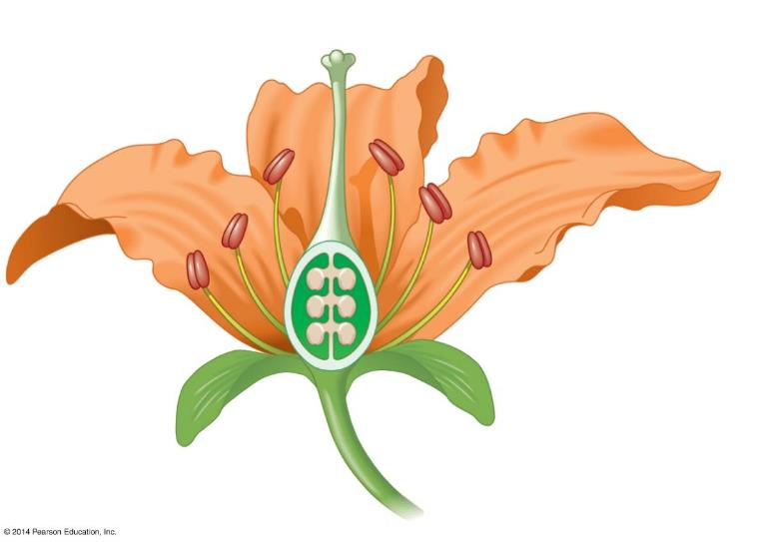
Flowers
  Sepals
  enclose the flower before it opens.
  Petals attract animal pollinators.
Petal
Sepal
Receptacle
Notes:
Figure 17.6b The parts of a flower

Slide 5
  The male reproductive organ in flowers are Stamens
  include a Filament
Anther
Stamen
Filament
Petal
Sepal
Receptacle
  and Anther (a sac at the top of each filament that contains male sporangia and releases pollen.).
Notes:
Figure 17.6b The parts of a flower

Slide 6
  The female reproductive organ in flowers are Carpels
    Include the Stigma
    the Style
Stigma
Style
Carpel
Ovary
Anther
Stamen
Filament
Petal
Sepal
Ovule
Receptacle
    the Ovary,
    which encloses the ovules (“Eggs”).
Notes:
Figure 17.6b The parts of a flower

Slide 7
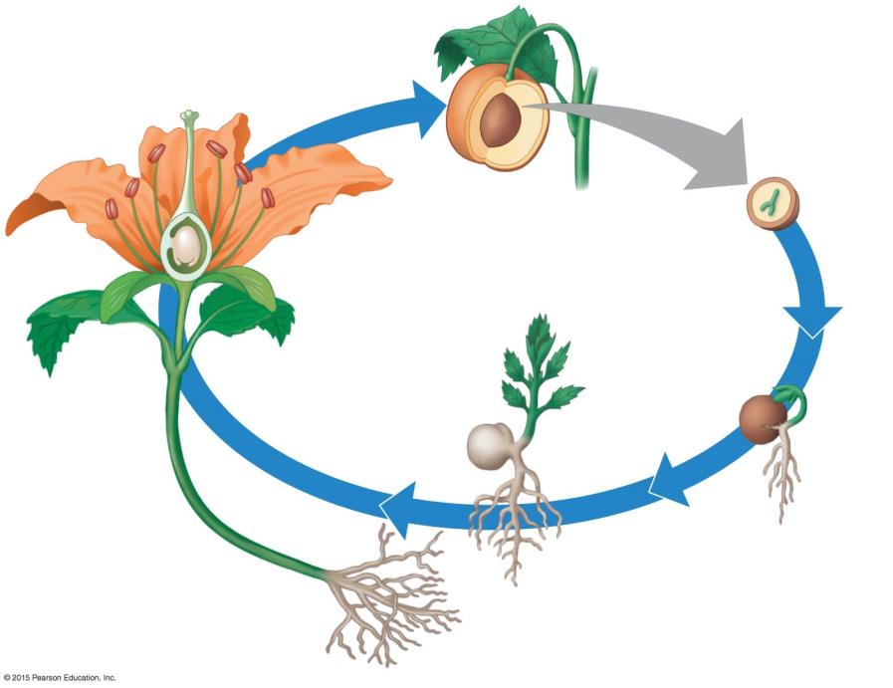
Ovary, containing
ovule
Reproduction of Flowering Plants
In the life cycle of a generalized angiosperm:
  Fertilization occurs in an ovule within a flower.
1
Mature plant with
flowers, where
fertilization occurs
Notes:
Figure 31.9c Life cycle of a generalized angiosperm

Slide 8
Ovary, containing
ovule
2
Fruit (mature ovary),
containing seeds
1
Mature plant with
flowers, where
fertilization occurs
  2. The ovary develops into a fruit.
Notes:
Figure 31.9c Life cycle of a generalized angiosperm

Slide 9
Ovary, containing
ovule
Embryo
3
Seed
2
Fruit (mature ovary),
containing seeds
  The ovule develops into the seed containing the embryo.
  The fruit protects the seed and aids in dispersing it.
1
Mature plant with
flowers, where
fertilization occurs
Notes:
Figure 31.9c Life cycle of a generalized angiosperm

Slide 10
Ovary, containing
ovule
Embryo
3
Seed
2
Fruit (mature ovary),
containing seeds
  4. Completing the life cycle, the seed then germinates (begins to grow) in a suitable habitat.
1
Mature plant with
flowers, where
fertilization occurs
4
Germinating
seed
Notes:
Figure 31.9c Life cycle of a generalized angiosperm

Slide 11
Ovary, containing
ovule
Embryo
3
Seed
2
Fruit (mature ovary),
containing seeds
1
Mature plant with
flowers, where
fertilization occurs
5
Seedling
  5. The embryo develops into a seedling, and the seedling grows into a mature plant.
4
Germinating
seed
Notes:
Figure 31.9c Life cycle of a generalized angiosperm

Slide 12
Alternation of Generations Summary
Plant life cycles involve alternating diploid (2n) and haploid (n) generations.
  The diploid plant is called the Sporophyte.
    Specialized diploid cells in anthers and ovules undergo meiosis to produce haploid spores.
    The haploid spores undergo mitosis and produce the haploid generation.
  The haploid generation is called the Gametophyte, which produces haploid gametes via mitosis.
  At fertilization, gametes from male and female gametophytes unite to produce a Diploid Zygote.

Slide 13
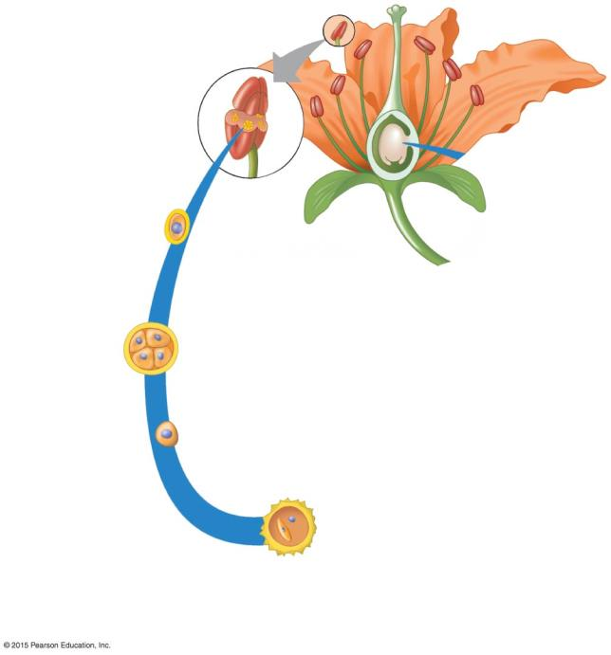
Development of male
gametophyte
(pollen grain)
Anther
Pollen Grains are the Male Gametophytes.
The cells that develop into pollen grains are found within a flower’s Anthers.
Meiosis
1
Four haploid
spores
Single spore
Mitosis
Wall
2
(of each spore)
Nucleus of
tube cell
Generative cell
3
Pollen grain
released
from anther
Notes:
Figure 31.10-1 Gametophyte development and fertilization in an angiosperm (part 1)

Slide 14
Development of male
gametophyte
(pollen grain)
Anther
Cell within
anther
Meiosis
1
Four haploid
spores
The cells that develop into pollen grains are found within a flower’s Anthers.
  Each cell first undergoes meiosis,
  forming four haploid spores.
Single spore
Mitosis
Wall
2
(of each spore)
Nucleus of
tube cell
Generative cell
3
Pollen grain
released
from anther
Notes:
Figure 31.10-1 Gametophyte development and fertilization in an angiosperm (part 1)

Slide 15
Development of male
gametophyte
(pollen grain)
Anther
Cell within
anther
  Each spore
  then divides by mitosis,
  forming two haploid cells,
  the tube cell
  and the generative cell.
Meiosis
1
Four haploid
spores
Single spore
Mitosis
Wall
2
(of each spore)
Nucleus of
tube cell
Generative cell
3
Notes:
Figure 31.10-1 Gametophyte development and fertilization in an angiosperm (part 1)

Slide 16
Development of male
gametophyte
(pollen grain)
Anther
Cell within
anther
Meiosis
  The resulting Pollen Grain is ready for release from the anther.
1
Four haploid
spores
Single spore
Mitosis
Wall
2
(of each spore)
Nucleus of
tube cell
Generative cell
3
Pollen grain
released
from anther
Notes:
Figure 31.10-1 Gametophyte development and fertilization in an angiosperm (part 1)

Slide 17
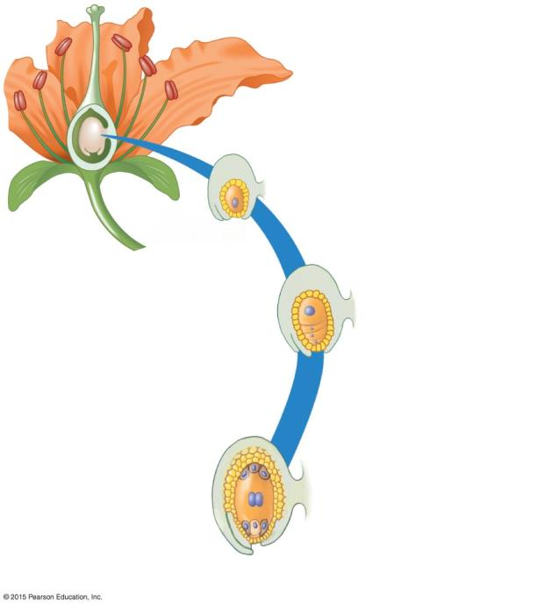
Development of female
gametophyte
(embryo sac)
Ovule
The Female Gametophyte is an Embryo Sac.
Ovary
1
Meiosis
Surviving
cell (haploid
spore)
2
Mitosis
Embryo
sac
Egg cell
Notes:
Figure 31.10-2 Gametophyte development and fertilization in an angiosperm (part 2)

Slide 18
Development of female
gametophyte
(embryo sac)
Ovule
Ovary
1
Meiosis
Surviving
cell (haploid
spore)
  A cell in the ovule undergoes meiosis
  to produce four haploid spores.
    Three of the spores degenerate.
2
Mitosis
Embryo
sac
Egg cell
Notes:
Figure 31.10-2 Gametophyte development and fertilization in an angiosperm (part 2)

Slide 19
Development of female
gametophyte
(embryo sac)
Ovule
  2) The surviving spore undergoes a series of mitotic divisions
Ovary
1
Meiosis
    The sac contains a large central cell with two haploid nuclei.
    One of its other cells is the Haploid Egg, ready to be fertilized.
Surviving
cell (haploid
spore)
2
Mitosis
  to produce the Embryo Sac, the female gametophyte.
Embryo
sac
Egg cell
Notes:
Figure 31.10-2 Gametophyte development and fertilization in an angiosperm (part 2)

Slide 20
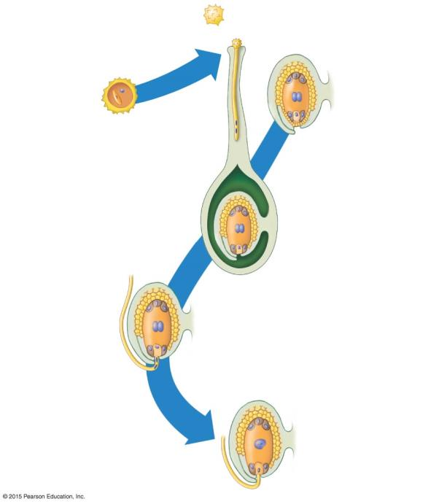
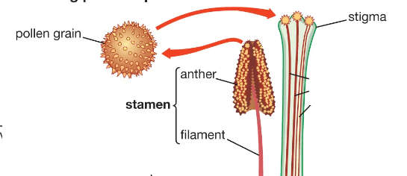
Pollination
Germinated pollen grain on stigma
3
Wall
Pollen grain
released
from anther
Egg cell
Pollination is the transfer of pollen from anther to stigma.
    Pollen may be carried by wind, water, and animals.
Two sperm
in pollen
tube
Pollen
tube
enters
embryo
sac
4
Two sperm
discharged
Triploid (3n)
endosperm
nucleus
Double
fertilization
occurs
Diploid (2n) zygote
(egg plus sperm)
5
Notes:
Figure 31.10-3 Gametophyte development and fertilization in an angiosperm (part 3)

Slide 21
Pollen grain
released
from anther
Germinated pollen grain on stigma
Pollination
3
Nucleus of
tube cell
Generative
cell
Embryo
sac
Egg cell
pollen
tube
Two sperm
    3) After pollination, the pollen grain germinates on the stigma.
      Its tube cell gives rise to the pollen tube, which grows downward into the ovary.
      Meanwhile, the generative cell divides by mitosis, forming two sperm.
Pollen
tube
enters
embryo
sac
4
Two sperm
discharged
Triploid (3n)
endosperm
nucleus
Double
fertilization
occurs
Diploid (2n) zygote
(egg plus sperm)
5
Notes:
Figure 31.10-3 Gametophyte development and fertilization in an angiosperm (part 3)

Slide 22
Pollen grain
released
from anther
Germinated pollen grain on stigma
Pollination
3
Nucleus of
tube cell
Generative
cell
Embryo
sac
Egg cell
Two sperm
in pollen
tube
Pollen
tube
enters
embryo
sac
4
When the pollen tube reaches the base of the ovule, it enters the ovary.
Double
fertilization
occurs
Diploid (2n) zygote
(egg plus sperm)
5
Notes:
Figure 31.10-3 Gametophyte development and fertilization in an angiosperm (part 3)

Slide 23
Pollination
Germinated pollen grain on stigma
3
Wall
Nucleus of
tube cell
Generative
cell
Pollen grain
released
from anther
Embryo
sac
Egg cell
Two sperm
in pollen
tube
The two sperm are discharged near the embryo sac.
One sperm fertilizes the egg, forming the diploid zygote.
Pollen
tube
enters
embryo
sac
4
Two sperm
discharged
Double
fertilization
occurs
Diploid (2n) zygote
(egg plus sperm)
5
Notes:
Figure 31.10-3 Gametophyte development and fertilization in an angiosperm (part 3)

Slide 24
Pollination
Germinated pollen grain on stigma
3
Wall
Nucleus of
tube cell
Generative
cell
Pollen grain
released
from anther
Embryo
sac
Egg cell
The other contributes its haploid nucleus to the large diploid central cell of the embryo sac forming the triploid (3n) endosperm.
Two sperm
in pollen
tube
Pollen
tube
enters
embryo
sac
4
Two sperm
discharged
Triploid (3n)
endosperm
nucleus
Double
fertilization
occurs
Diploid (2n) zygote
(egg plus sperm)
5
Notes:
Figure 31.10-3 Gametophyte development and fertilization in an angiosperm (part 3)

Slide 25
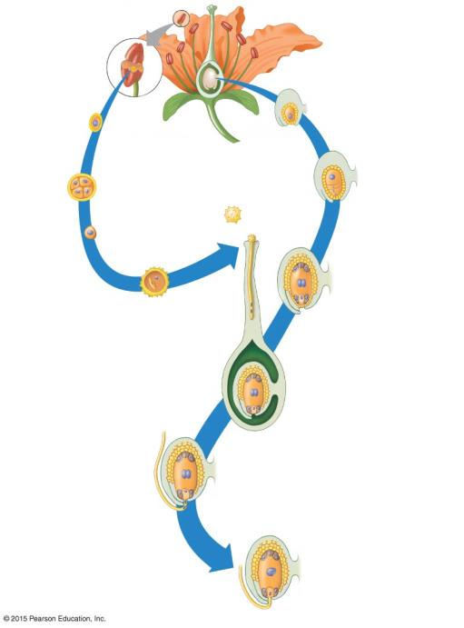
Development of male
gametophyte
(pollen grain)
Development of female
gametophyte
(embryo sac)
Anther
Ovule
Cell within
anther
Ovary
1
Meiosis
1
Meiosis
Surviving
cell (haploid
spore)
Four haploid
spores
Germinated
pollen grain
on stigma
2
Single spore
Pollination
3
Mitosis
2
Mitosis
tube cell
Pollen grain
released
from anther
Embryo
sac
3
Generative
cell
Egg cell
Two sperm
in pollen
tube
Pollen
tube
enters
embryo
sac
4
Two sperm
discharged
Triploid (3n)
endosperm
nucleus
Double
fertilization
occurs
5
Diploid (2n) zygote
(egg plus sperm)
Notes:
Figure 31.10-0 Gametophyte development and fertilization in an angiosperm

