Slide 1
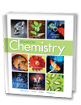
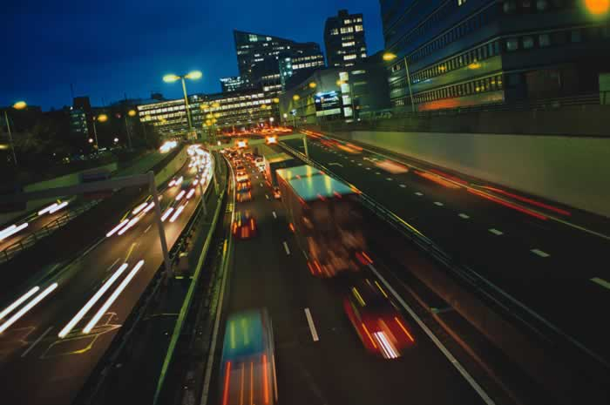
Chapter 18
Reaction Rates and Equilibrium
Rates of Reaction
The Progress of Chemical
Reactions
Reversible Reactions
and Equilibrium
Solubility Equilibrium
Free Energy and Entropy

Slide 2
Spontaneous vs Nonspontaneous Processes
?

Slide 3
Spontaneous vs Nonspontaneous Processes
Spontaneity (Free Energy): ∆G
How can one predict whether a reaction will occur under certain conditions in a given amount of time?
How can one decide whether a reaction at certain temperature and pressure will be spontaneous?
Spontaneous Reactions
Reactions that take place without exertion of outside forces.
Ice melts when placed on a table (room temperature)
Iron III Hydroxide (rust) forms on metals in the outdoors
Spontaneity does NOT relate to RATE of Reaction

Slide 4
Spontaneous vs Nonspontaneous Processes
Spontaneity (Free Energy): ∆G
The free energy of a system is a measure of the amount of usable energy (energy that can do work) in that system.
The concept of Free Energy provides a measure of how much usable energy is released (or consumed) when that reaction takes place.
Free energy depends on three main factors:
Enthalpy in chemistry refers to energy stored in bonds, and the change in enthalpy is the difference in bond energies between the products and the reactants.
Entropy is the change of the system during a reaction (becoming more or less orderly).
Temperature (KE of the molecules in the system).

Slide 5
Free Energy Change
Gibbs Free Energy Equation
∆G = ∆ H - T ∆S
Free Energy = Enthalpy - (Temperature)(Entropy)
The energy change for a chemical reaction (∆G) depends on:
a. breaking bonds and making bonds (∆H)
b. randomness (∆S)
c. absolute temperature (K)
The equation: ΔG = ΔH - T ΔS is used to calculate the change in Gibbs free energy (ΔG).
ΔH is the change in enthalpy
ΔS is the change in entropy
T is the temperature in Kelvins.

Slide 6
Free Energy ∆G
Free Energy combines ENTHALPY and ENTROPY to measure the spontaneity of a reaction
∆G = ∆ H - T ∆S [T in K = C + 273]
If ∆G is negative (-), the reaction is spontaneous
If ∆G is positive (+), the reaction is NOT spontaneous … the reverse reaction would be spontaneous

Slide 7
Determine whether the following reaction is spontaneous.
The entropy change, ΔS, is 138 J/mol·K. The enthalpy change, ΔH, is –75.9 kJ/mol with the system being at 273 K.

Slide 8
PREDICT
Reaction Spontaneity: ∆G = ∆ H - T ∆S [T in K = C + 273]
∆ H (system) ∆S (system) ∆G (system) Reaction Spontaneity
–75.9 kJ/mol 138 J/mol·K
Notice the need to convert “j/mol” to “kj/mol”
negative positive always negative always spontaneous
exothermic disorderly

Slide 9
Determine whether the following reaction is spontaneous.
The entropy change, ΔS, is 138 J/mol·K. The enthalpy change, ΔH, is –75.9 kJ/mol with the system being at 273 K.
∆G = ∆ H - T ∆S
ΔG = –75.9 kJ/mol – (273 K )(0.138 kJ/mol·K)
ΔG = –114 kJ/mol
The reaction is spontaneous (as indicated by the –ΔG).
Exothermic, standard temperature, increased entropy (more disorder)
Notice the need to convert “j/mol” to “kj/mol”

Slide 10
Determine whether the following reaction is spontaneous.
The entropy change, ΔS, is -55.2 J/mol·K. The enthalpy change, ΔH, is –27.6 kJ/mol with the system being at 535 K.

Slide 11
PREDICT
Reaction Spontaneity: ∆G = ∆ H - T ∆S [T in K = C + 273]
∆ H (system) ∆S (system) ∆G (system) Reaction Spontaneity
–27.6 kJ/mol -55.2 J/mol·K
Notice the need to convert “j/mol” to “kj/mol”
negative negative - or + spontaneous (low T)
exothermic orderly 535 K (808 C) is high T
NON-spontaneous

Slide 12
Determine whether the following reaction is spontaneous.
The entropy change, ΔS, is -55.2 J/mol·K. The enthalpy change, ΔH, is –27.6 kJ/mol with the system being at 535 K.
∆G = ∆ H - T ∆S
ΔG = –27.6 kJ/mol – (535 K )(-0.0552 kJ/mol·K)
ΔG = +1.93 kJ/mol
The reaction is NON-spontaneous (as indicated by the +ΔG).
Exothermic, increased temperature, DEcreased entropy (more order / less random)
Notice the need to convert “j/mol” to “kj/mol”

Slide 13
Determine whether the following reaction is spontaneous.
The entropy change, ΔS, is +55.7 J/mol·K. The enthalpy change, ΔH, is 452 kJ/mol with the system being at 165 K.

Slide 14
PREDICT
Reaction Spontaneity: ∆G = ∆ H - T ∆S [T in K = C + 273]
∆ H (system) ∆S (system) ∆G (system) Reaction Spontaneity
452 kJ/mol +55.7 J/mol·K
Notice the need to convert “j/mol” to “kj/mol”
positive positive - or + spontaneous (high T)
endothermic disorderly 165 K (-108 C) is lower T
NON-spontaneous

Slide 15
Determine whether the following reaction is spontaneous.
The entropy change, ΔS, is +55.7 J/mol·K. The enthalpy change, ΔH, is 452 kJ/mol with the system being at 165 K.
∆G = ∆ H - T ∆S
ΔG = 452 kJ/mol – (165 K )(+0.0557 kJ/mol·K)
ΔG = +443 kJ/mol
The reaction is NON-spontaneous (as indicated by the +ΔG).
Endothermic, INcreased entropy (more disorder / more random)
Notice the need to convert “j/mol” to “kj/mol”

Slide 16
Determine whether the following reaction is spontaneous.
The entropy change, ΔS, is -55.2 J/mol·K. The enthalpy change, ΔH, is 365 kJ/mol with the system being at 115 C.

Slide 17
PREDICT
Reaction Spontaneity: ∆G = ∆ H - T ∆S [T in K = C + 273]
∆ H (system) ∆S (system) ∆G (system) Reaction Spontaneity
365 kJ/mol -55.2 J/mol·K
Notice the need to convert “j/mol” to “kj/mol”
positive negative always positive never spontaneous
endothermic orderly

Slide 18
Determine whether the following reaction is spontaneous.
The entropy change, ΔS, is -55.2 J/mol·K. The enthalpy change, ΔH, is 365 kJ/mol with the system being at 115 C.
∆G = ∆ H - T ∆S
ΔG = 365 kJ/mol – (388 K )(-0.0552 kJ/mol K)
ΔG = +386 kJ/mol
The reaction is NONspontaneous (as indicated by +ΔG).
Endothermic, Decreased entropy (less random)
Notice the need to convert “j/mol” to “kj/mol”
And to convert “115 C” to “388 K”

Slide 19
Key Concepts
ΔG = ΔH – TΔS
When a reaction is exothermic (- Δ H), and entropy increases (phases goes to disorder, e.g. l → g; +ΔS), the reaction is spontaneous (- Δ G).

Slide 20
Reaction Spontaneity: ∆G = ∆ H - T ∆S [T in K = C + 273]
∆ H (system) ∆S (system) ∆G (system) Reaction Spontaneity
negative positive always negative always spontaneous
exothermic disorderly
negative negative - or + spontaneous (low T)
exothermic orderly
positive positive - or + spontaneous (high T)
endothermic disorderly
positive negative always positive never spontaneous
endothermic orderly

