Slide 1
Go to the “Slide Show” shade above
Click on “Play from Beginning”

Slide 2
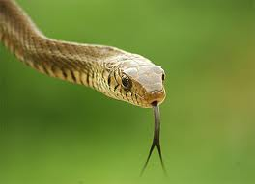
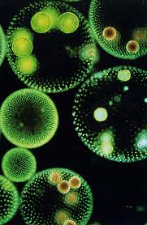
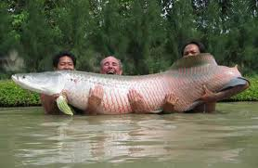
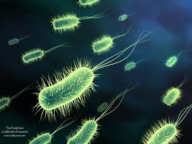
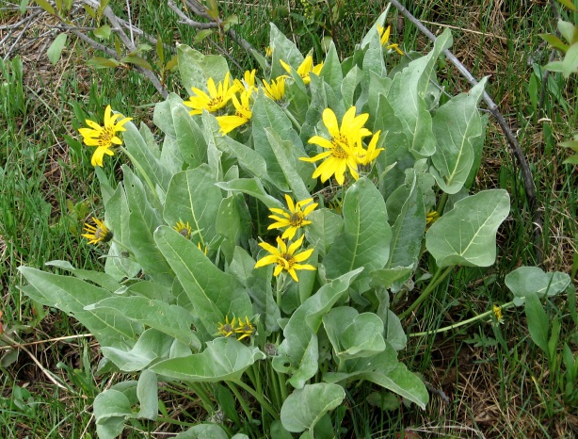
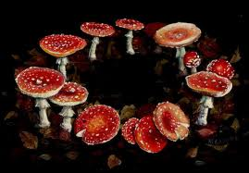
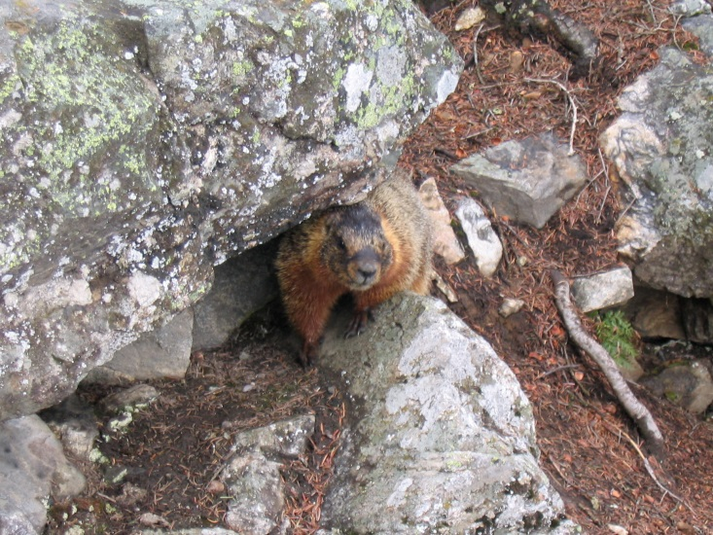
Classification
CHAPTER 20
of
Living
Things

Slide 3
Classify the Family
Classify the members of your family so that you can describe them to an outsider and they could figure out who you are talking about.

Slide 4
Classify the Family
Classify the members of your family so that you can describe them to an outsider and they could figure out who you are talking about.
Height, skin color, hair color, eye color, body build, facial features, etc.

Slide 5
Lesson Objectives
  By the end of this lesson, you should be able to:
Explain the need for and benefits of classification. What is the scientific name for classification?
Describe the process (history) of the modern system of classification (People, Basis, Language, Categories).
Explain how modern taxonomy takes into account other types of evidence when attempting to classify an organism.
Understand the progression of classifying kingdoms and domains.
Define a virus and its components, noting why they are significant.
  Science Practice: Six Kingdom Identification & Viruses
Notes:
#frame
instructional video
Timing ≈ 0.5 minutes
Living organisms need energy to accomplish the wide variety of tasks they attempt each day.
You will begin learning about how energy is captured from the Sun and stored in organic molecules.
[read objectives]

Slide 6
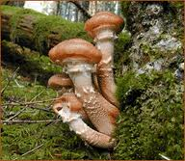
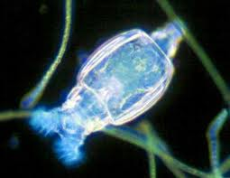
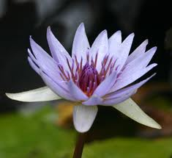
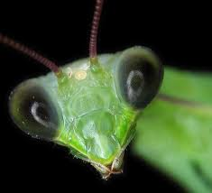
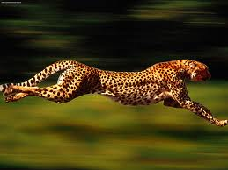
Scientists have described and named over:
1.5 million species.
It is estimated that the total number of species is about:
10 million.

Slide 7
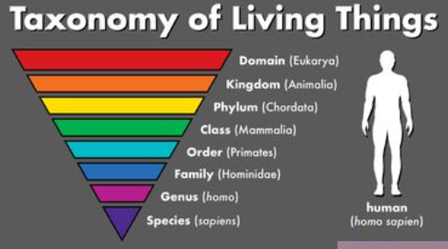
Why is there a need for classification?
Innate need for order and organization
New organisms can be added more easily
Elimination of the problem of communication between scientists of the same country, different countries, language, culture, etc.

Slide 8
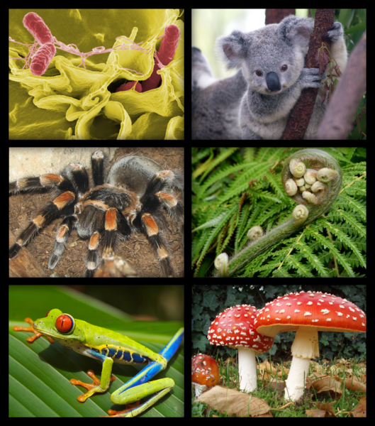
Scientists attempt to order the natural world by grouping and classifying all living organisms.
As technologies improve, so have our systems of classification.

Slide 9
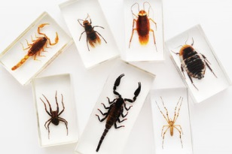
To study the diversity of life, biologists use a classification system to name organisms and group them in a logical manner.
TAXONOMY
The branch of biology that classifies organisms and assigns each organism a universally accepted name.

Slide 10

Benefits of Taxonomical Classification
Accurately and uniformly names organisms.
Prevents misnomers such as “starfish” and “jellyfish” that aren't really fish.
Uses same language (Latin) for all names.
Sea ”Horse”

Slide 11
Theory of Classification
~400 BC
Aristotle
Plants (categorized according to structure)
Herbs – soft stems
Shrubs – several woody stems
Trees – single woody stem
Animals (categorized according to where they live)
Water dwellers
Land dwellers
Air dwellers

Slide 12
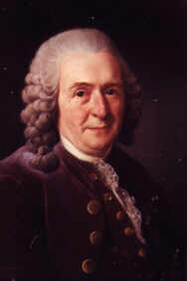
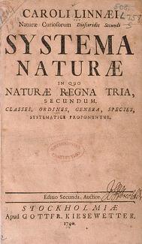
Carolus Linnaeus
1707 – 1778
“Father of Taxonomy”
Classified organisms by their structure (Morphology).
Discarded common names and used Latin (universal): Binomial Nomenclature
  Two-Name naming system (Genus and species)

Slide 13
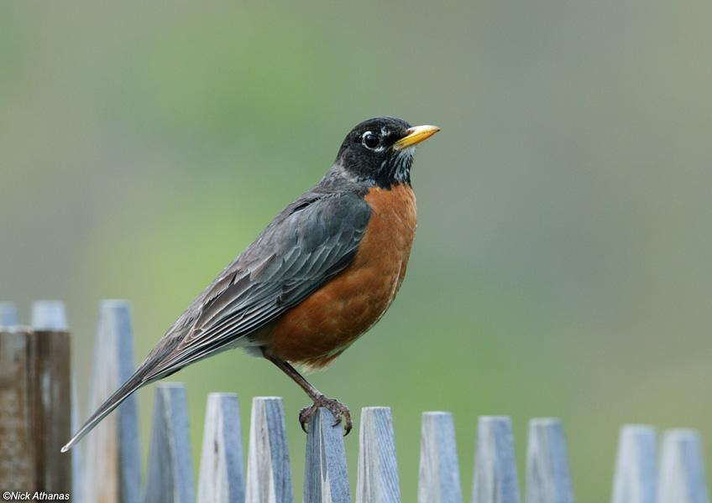
Standardized Naming
Binomial nomenclature
Latin
Genus species
CAPITALIZE Genus, but NOT species
ITALICIZE in print
UNDERLINE when handwriting
Turdus migratorius
American Robin
No two organisms can have the same name.

Slide 14
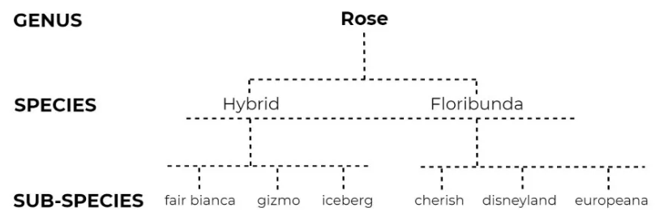
Genus
A group of closely related species.
The name is CAPITALIZED & underlined or italicized.
“variety”

Slide 15
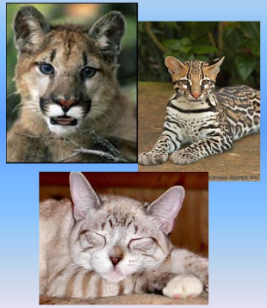
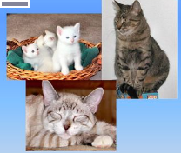
species
Structurally similar (identical) to each other and different from all other organisms.
Can interbreed to produce viable offspring.
The name is Uncapitalized and underlined or italicized.
Homo sapiens or Homo sapiens
Same Genus
Different species
Different Genus
Same species

Slide 16
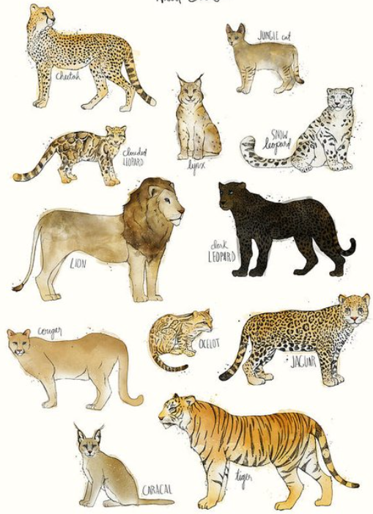
Standardized Naming
Binomial nomenclature
Felis leo (lion)
Felis tigris (tiger)
Felis domestica (cat)
Felis concolor (panther, silver lion, american lion, mountain screamer, king cat, varmit, brown tiger, red tiger, deer killer, mountain demon)

Slide 17
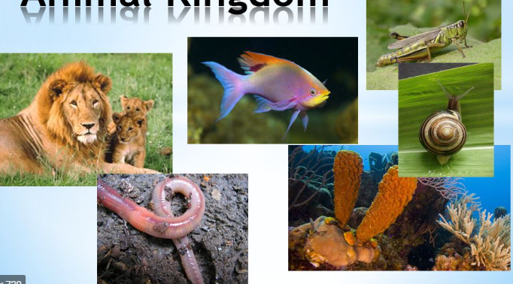
Basis of Classification
A. Homologous structures
Appendages – arms/wings, legs, antennae
Organs – heart, brain, lungs
Tissues – nervous, muscle, blood vessels
B. Biochemical similarities
Proteins
Carbohydrates
Water
DNA, RNA, etc.

Slide 18
SYSTEM of Classification
A. Establishment of categories from general (broad) to specific (narrow)
Using GPS, how would you relay your address information to someone in another country so they can locate you?

Slide 19
SYSTEM of Classification
A. Establishment of categories from general (broad) to specific (narrow)
Using GPS, how would you relay your address information to someone in another country so they can locate you?
Continent
Country
State
County
City
Street
House # or Apartment Building #
Apartment # or Letter

Slide 20
SYSTEM of Classification
B. Standard Nomenclature
King Phillip Came Over From Germany Smiling
King Phillip Cried Out For Goodness Sake!
Kingdom
Phylum
Class
Order
Family
Genus
species
variety

Slide 21
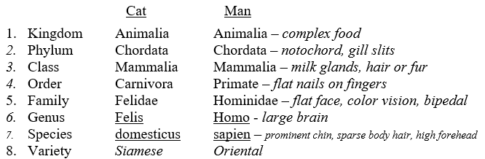
SYSTEM of Classification

Slide 22
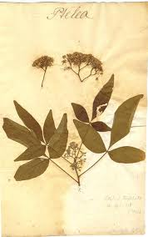
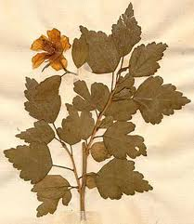
Linnaeus first divided all organisms into large groups that he called kingdoms. He based his classification on TWO kingdoms: plants & animals.
A kingdom would be further subdivided into smaller groups.
Kingdoms
Each subdivision of a kingdom is called a phylum in the animal kingdom,
or a division in the plant kingdom.
Plant
Animal
Division Division
Phylum Phylum
Each subset was further subdivided until he had developed 7 levels or TAXONS of classification.

Slide 23
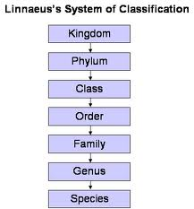
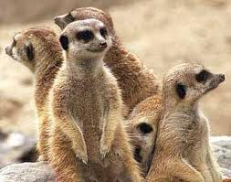
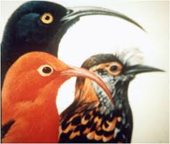
Organisms are placed in the same species if:
they can mate
and produce fertile offspring.
In the system developed by Linnaeus, the kingdom was the biggest, broadest group. More recently scientists have added an additional level above the kingdom called a “domain”.
A Species contains
only one type of organism.

Slide 24
Hierarchy-Taxonomic Groups
Kingdom
Phylum or Division
Class
Order
Family
Genus
Species
BROADEST
MOST SPECIFIC
Species are subdivided into “varieties”
Notes:
Genus and species are the two names used to identify specific organisms in the binomial system of classification. Division is used for plants.

Slide 25
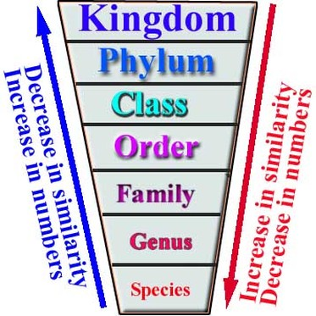
Hierarchy-Taxonomic Groups
“variety”
Notes:
Genus and species are the two names used to identify specific organisms in the binomial system of classification. Division is used for plants.

Slide 26
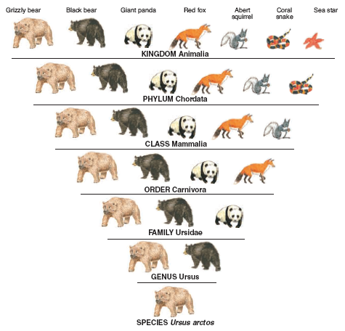
King
Phillip
Cried
Out
For
Goodness
Sake!

Slide 27
Below is a chart showing the classification of four different animals. Use the chart to answer the questions below.
Animal #1 | Animal #2 | Animal #3 | Animal #4
Animalia | Animalia | Animalia | Animalia
Arthropoda | Arthropoda | Arthropoda | Arthropoda
Hexapoda | Hexapoda | Hexapoda | Hexapoda
Lepidoptera | Lepidoptera | Lepidoptera | Lepidoptera
Nymphalidae | Nymphalidae | Papilionidae | Nymphalidae
Danaus | Vanessa | Papilio | Danaus
plexippus | atalanta | rutulus | gilippus
What is the scientific name of Animal #1?
Which of these animals belong to the same phylum?
Which of these animals belong to the same order?

Slide 28
Below is a chart showing the classification of four different animals. Use the chart to answer the questions below.
Animal #1 | Animal #2 | Animal #3 | Animal #4
Animalia | Animalia | Animalia | Animalia
Arthropoda | Arthropoda | Arthropoda | Arthropoda
Hexapoda | Hexapoda | Hexapoda | Hexapoda
Lepidoptera | Lepidoptera | Lepidoptera | Lepidoptera
Nymphalidae | Nymphalidae | Papilionidae | Nymphalidae
Danaus | Vanessa | Papilio | Danaus
plexippus | atalanta | rutulus | gilippus
What is the scientific name of Animal #1?
Which of these animals belong to the same phylum?
Which of these animals belong to the same order?
Danaus plexippus
1, 2, 3, and 4
1, 2, 3, and 4

Slide 29
Below is a chart showing the classification of four different animals. Use the chart to answer the questions below.
Animal #1 | Animal #2 | Animal #3 | Animal #4
Animalia | Animalia | Animalia | Animalia
Arthropoda | Arthropoda | Arthropoda | Arthropoda
Hexapoda | Hexapoda | Hexapoda | Hexapoda
Lepidoptera | Lepidoptera | Lepidoptera | Lepidoptera
Nymphalidae | Nymphalidae | Papilionidae | Nymphalidae
Danaus | Vanessa | Papilio | Danaus
plexippus | atalanta | rutulus | gilippus
Which of these animals is the most distantly related to the others?
Which of these animals belong to the same family?

Slide 30
Below is a chart showing the classification of four different animals. Use the chart to answer the questions below.
Animal #1 | Animal #2 | Animal #3 | Animal #4
Animalia | Animalia | Animalia | Animalia
Arthropoda | Arthropoda | Arthropoda | Arthropoda
Hexapoda | Hexapoda | Hexapoda | Hexapoda
Lepidoptera | Lepidoptera | Lepidoptera | Lepidoptera
Nymphalidae | Nymphalidae | Papilionidae | Nymphalidae
Danaus | Vanessa | Papilio | Danaus
plexippus | atalanta | rutulus | gilippus
Which of these animals is the most distantly related to the others?
Which of these animals belong to the same family?
Animal #3
1, 2, & 4 Nymphalidae

Slide 31
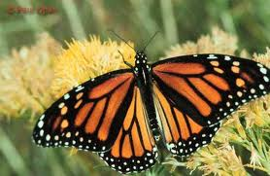
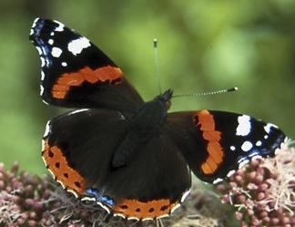
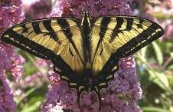
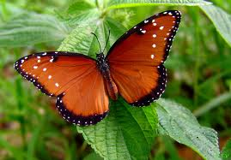
Below is a chart showing the classification of four different animals. Use the chart to answer the questions below.
Animal #1 | Animal #2 | Animal #3 | Animal #4
Animalia | Animalia | Animalia | Animalia
Arthropoda | Arthropoda | Arthropoda | Arthropoda
Hexapoda | Hexapoda | Hexapoda | Hexapoda
Lepidoptera | Lepidoptera | Lepidoptera | Lepidoptera
Nymphalidae | Nymphalidae | Papilionidae | Nymphalidae
Danaus | Vanessa | Papilio | Danaus
plexippus | atalanta | rutulus | gilippus
Which two of these animals are the most closely related? How do you know?

Slide 32
Below is a chart showing the classification of four different animals. Use the chart to answer the questions below.
Animal #1 | Animal #2 | Animal #3 | Animal #4
Animalia | Animalia | Animalia | Animalia
Arthropoda | Arthropoda | Arthropoda | Arthropoda
Hexapoda | Hexapoda | Hexapoda | Hexapoda
Lepidoptera | Lepidoptera | Lepidoptera | Lepidoptera
Nymphalidae | Nymphalidae | Papilionidae | Nymphalidae
Danaus | Vanessa | Papilio | Danaus
plexippus | atalanta | rutulus | gilippus
Which two of these animals are the most closely related? How do you know?
Animals 1 and 4 are the most closely related. They belong to the same genus.

Slide 33
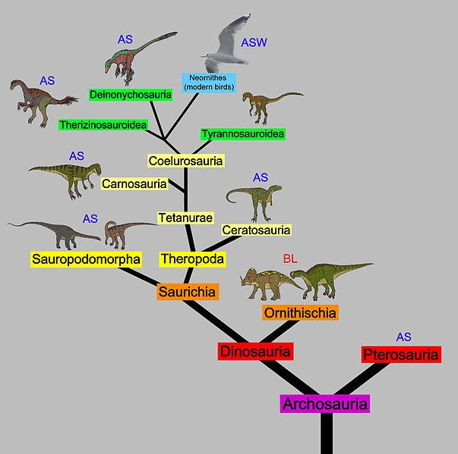
Modern Taxonomy
Modern taxonomists consider the phylogeny of an organism when attempting to classify it.
PHYLOGENY: The evolutionary history of an organism.
To show the evolutionary relationship between different groups of organisms, scientists construct PHYLOGENETIC TREES.
Evolutionists believe that diversity on Earth has arisen through evolution, therefore they believe that Classification should reflect this history.
A phylogenetic tree is a family tree that shows:
the evolutionary relationships thought to exist among different groups of organisms.

Slide 34
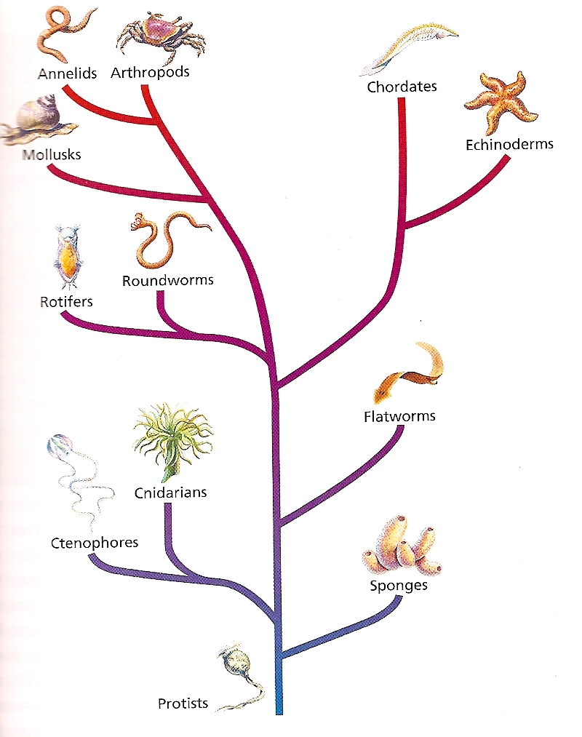
The phylogenetic tree to the left shows a few of the phyla of the Animal Kingdom.
According to this diagram, what is the common ancestor of all organisms shown on this tree?
According to this diagram, are the Cnidarians more closely related to the sponges or to the comb jellies (Ctenophores)?
According to this diagram, what is the closest relative to the Rotifers?
What does a branch point represent?

Slide 35
The phylogenetic tree to the left shows a few of the phyla of the Animal Kingdom.
What is the common ancestor of all organisms shown on this tree?
Protists
Are the Cnidarians more closely related to the sponges or to the comb jellies (Ctenophores)?
The Ctenophores
Roundworms
What is the closest relative to the Rotifers?
What does a branch point
represent?
The last common ancestor shared by two or more organisms.

Slide 36
Traditionally, the morphology (structure) of the organism was the basis for its classification. Modern taxonomy now takes into account other types of evidence when attempting to classify an organism.
Cellular
Organization
Organismal
Relationships
Morphology
Biochemical Similarities

Slide 37
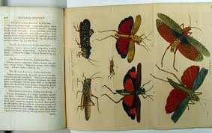
Morphology
Morphology is classification based on the STRUCTURES possessed by the organism.
This was the basis for Linnaeus’ system of classification.
For Example: Color, Size, etc.

Slide 38
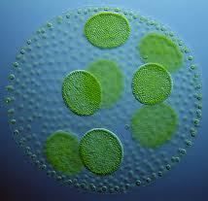
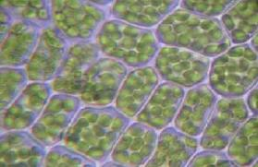
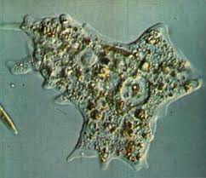
Cellular Organization
Similarity in cell structures
provides evidence that organisms may be related.
Does the cell possess a nucleus?
Is there a cell wall present?
What is the cell wall composed of?

Slide 39
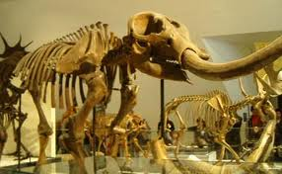
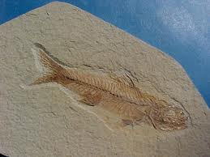
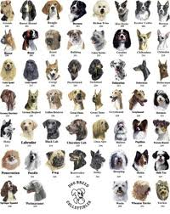
Organismal Relationships
Fossils show that organisms alive today are similar to organisms that are now extinct.
Example: 25 breeds of dogs all came from a wolf-like ancestor.

Slide 40
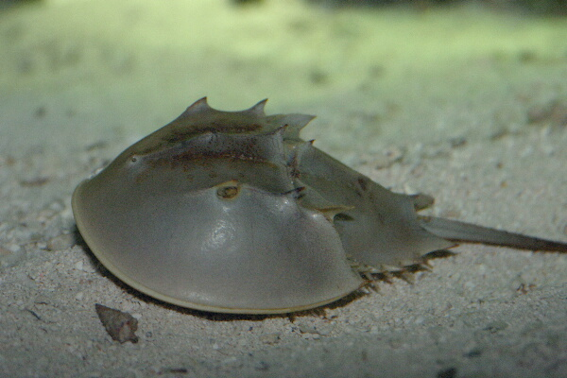
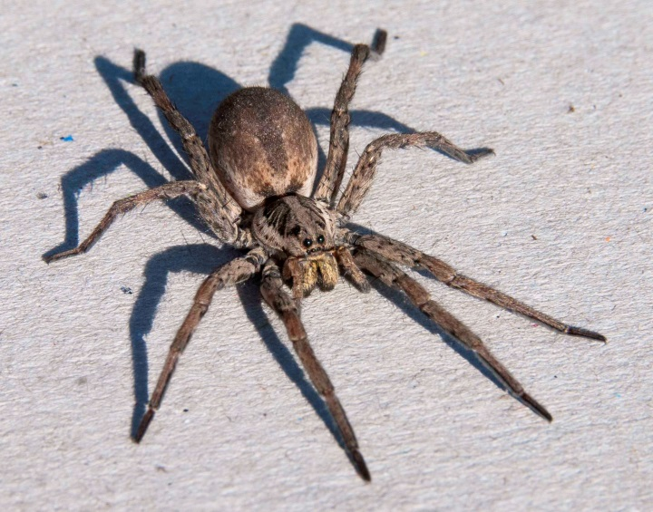
Biochemical
Similarities
Sometimes as more is learned about a particular organism’s biochemistry, its particular classification may change.
For Example, Horseshoe Crabs (Limulus polyphemus) were considered true crabs.
As their biochemistry has been better understood, they have been found to be more similar to other arthropods: Spiders.
Their subphylum was changed from Crustacea (crabs) to Chelicerata (spiders).

Slide 41
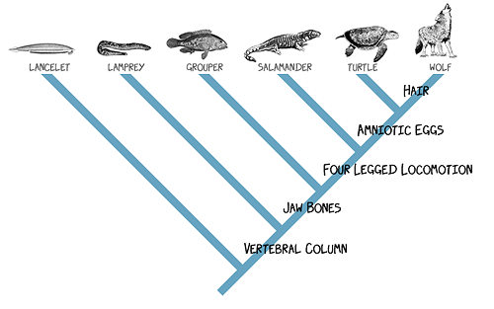
Cladogram
Diagram that shows the evolutionary relationships among a group of organisms based on shared, derived characteristics such as feathers, hair, or scales.
Notes:
What are the derived characteristics shown in this cladogram? According to the cladogram which group arose first? (Lancelets) Do salamanders have amniotic eggs? No. Do Turtles have amniotic eggs? Yes. Which two groups on the cladogram seem to be most closely related? Turtles and Wolves. List the groups that have 4-legged motion? Salamander, Turtle, Wolves. List the groups that have amniotic eggs? Turtles and Wolves

Slide 42
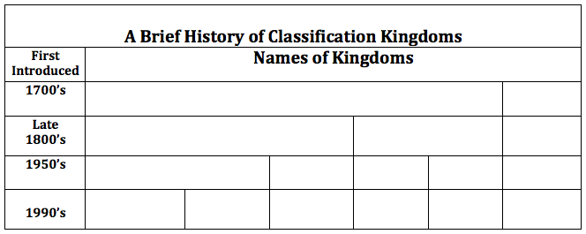
As new discoveries have been made, the systems of classification had to be changed. The first attempt at scientific classification was Linnaeus with his 2-kingdom system. Since the time of Linnaeus, many changes have been made in the ways that scientists classify organisms.
Kingdoms & Domains
Plantae
Animalia
Protista
Plantae
Animalia
Monera
Protista
Fungi
Plantae
Animalia
Archae-
bacteria
Eubacteria
Protista
Fungi
Animalia
Plantae

Slide 43
Progression of Kingdoms
A. Two Kingdoms (Linnaeus)
Plants
Animals
B. Three Kingdoms
Plants (carry on photosynthesis, AUTOTROPH)
Animals (require complex nutrients, most are motile, HETEROTROPH)
Protist (cells that lack a nuclear envelope and many internal cell structures; simple, unicellular organisms; e.g. bacteria, blue-green algae)

Slide 44
Progression of Kingdoms
Five Kingdoms
Prokaryotes (cells that lack a nuclear envelope and many internal cell structures; simple, unicellular organisms; e.g. bacteria, blue-green algae)
Protists (unicellular protozoans; e.g. amoeba, paramecia, volvox, more complex algae)
Fungi (multi-cellular organisms that do not carry on photosynthesis [HETEROTROPHIC]; not green; e.g. mushrooms, yeast)
Plants (photosynthesis [AUTOTROPHIC]; green; differentiated organs)
Animals (locomotion; not rigid; complex foods ingested)

Slide 45
Progression of Kingdoms
D. Six Kingdoms (modern taxonomy)
Archaebacteria → live in extreme environments (mostly anaerobic), [halococcus]
Eubacteria → “small rod” → cell wall, [cyanobacteria, streptococcus, e coli]
Protists (unicellular protozoans; e.g. amoeba, paramecia, volvox, more complex algae)
Fungi (multi-cellular organisms that do not carry on photosynthesis [HETEROTROPHIC]; not green; e.g. mushrooms, yeast)
Plants (photosynthesis [AUTOTROPHIC]; green; differentiated organs)
Animals (locomotion; not rigid; complex foods ingested)

Slide 46

Scientists noticed that all living things seem to fall naturally into three broad groups.
In recent years, this led to the establishment of a 3-DOMAIN SYSTEM
DOMAINS are essentially: super kingdoms, a taxonomic level even higher than the kingdom level.
THE 6-KINGDOM SYSTEM with THREE DOMAINS:
Kingdom
Archae-
bacteria
Kingdom
Eubacteria
Kingdom
Protista
Kingdom
Plantae
Kingdom
Fungi
Kingdom
Animalia
Domain
Bacteria
Domain
Archaea
Domain Eukarya (all eukaryotes)

Slide 47
THE 6-KINGDOM SYSTEM with THREE DOMAINS:
Kingdom
Archae-
bacteria
Kingdom
Eubacteria
Kingdom
Protista
Kingdom
Plantae
Kingdom
Fungi
Kingdom
Animalia
Domain
Bacteria
Domain
Archaea
Domain Eukarya (all eukaryotes)
The domain BACTERIA contains the Kingdom Eubacteria.
The domain ARCHAEA contains the Kingdom Archaebacteria.
The domain EUKARYA contains the Kingdoms Protista, Plantae, Fungi, and Animalia.

Slide 48
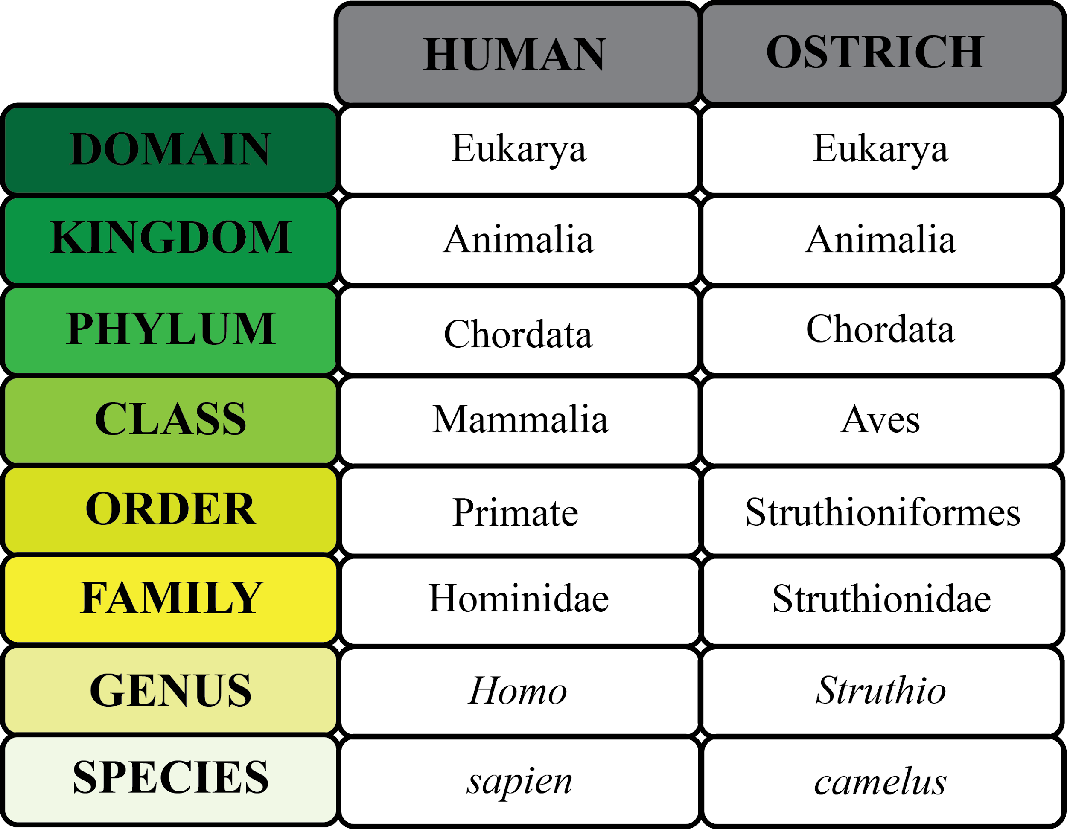
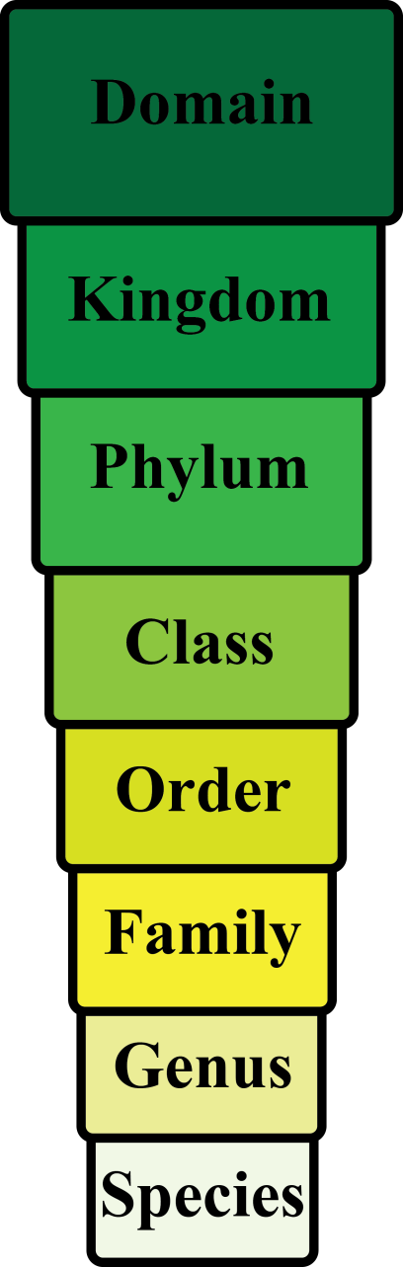
Hierarchy-Taxonomic Groups
variety 5 subspecies 4 subspecies

Slide 49
Six Kingdoms
Archaebacteria
Eubacteria
Protista
Fungi
Plantae
Animalia

Slide 50





Domain
Kingdom
Cell Type
Cell Structures
Cell Organization
Food Getting?
Examples:
Bacteria
Eubacteria
Prokaryotic
Cell walls composed of Peptidoglycans
Unicellular
Autotrophs or heterotrophs
Strep, staph, E. coli
Kingdom
Comparison
cyanobacteria
strep
staph
E. coli

Slide 51


Domain
Kingdom
Cell Type
Cell Structures
Cell Organization
Food Getting?
Examples:
Archaea
Archaebacteria
Prokaryotic
Cell walls do NOT contain peptidoglycans.
Considered very “ancient” and primitive organisms.
Unicellular
Autotroph or heterotrophs
Methanogens
Halophiles
Thermophiles
Kingdom
Comparison
Halophiles:
(salt loving)
Thermophiles:
(heat loving)

Slide 52









Domain
Kingdom
Cell Type
Cell Structures
Cell Organization
Food Getting?
Examples:
Eukarya
Protista
Eukaryotic
Cell walls composed of cellulose in some.
Some have chloroplasts.
Most are unicellular. Some are colonial. Some multicellular.
Autotrophs or heterotrophs
Ameba, Paramecium, Algae, Slime molds, giant kelp.
Ameba
Paramecium
Stentor
Volvox
Spirogyra
Slime mold
Slime mold
Diatoms
Euglena

Slide 53








Domain
Kingdom
Cell Type
Cell Structures
Cell Organization
Food Getting?
Examples:
Eukarya
Fungi
Eukaryotic
Cell walls are composed of Chitin.
NO chloroplasts
Most are multicellular. Some are unicellular.
Heterotrophs
Mushrooms, yeasts, puffballs, molds, mildews, smuts, and rusts.
Bracket
fungus
Coral
fungus
mold
Yeasts
Corn
smut
rusts
Morels

Slide 54








moss
Domain
Kingdom
Cell Type
Cell Structures
Cell Organization
Food Getting?
Examples:
Eukarya
Plantae
Eukaryotic
Cells walls are composed of Cellulose.
Chloroplasts are present.
Multicellular
Autotrophs
Mosses, ferns, liverworts, cone-bearing plants, flowering plants
liverworts
gingko
ferns

Slide 55








Domain
Kingdom
Cell Type
Cell Structures
Cell Organization
Food Getting?
Examples:
Eukarya
Animalia
Eukaryotic
No cell walls.
No chloroplasts
Multicellular
Heterotrophs
Sponges, worms, mollusks, arthropods, fish, amphibians, birds, reptiles, mammals.

Slide 56

Hierarchy-Taxonomic Groups

Slide 57

Viruses

Slide 58


What is a virus?
A Virus is an infectious particle that is NONLIVING.
The word virus comes from the Latin word meaning “poison”.

Slide 59


All viruses are Parasites
All viruses Require A Host
Parasites:
Parasites live in or on other living organisms, causing them harm.
Host:
The host is the living organism the parasite lives in or on.

Slide 60



Characteristics of Viruses
Viruses are extremely small.
Most can be seen only with an electron microscope.

Slide 61


A virus is active only when inside a living cell.
When removed from a living cell, it ceases all activities, but retains its ability to infect the cell.
They may be crystallized and stored indefinitely,
but even after longs periods of time, they retain their ability to infect a living cell.

Slide 62

Viruses vary widely in terms of size and structure, but they all have one thing in common:
They enter living cells and use the machinery of the cell to produce more viruses.

Slide 63

Characteristics
Viruses are NON-CELLULAR.
They are NOT made of cells and have NO cell parts.
Anatomy of a Virus:
  Envelope: Lipid bilayer derived from host membrane when virus is formed.
  Capsid: Protein coat that protects the nucleic acid.
  Have a Nucleic Acid core containing either DNA or RNA.

Slide 64



The
Viral
Capsid
The capsid is made of proteins that enable the virus to enter a host cell.
These capsid proteins have a particular shape that must match receptors on the surface of a host cell.
When the virus attaches to these receptors, the cell is “tricked” into letting the virus inside.

Slide 65

Viruses can reproduce, but only inside a living cell.
They reproduce inside a cell by getting the cell to produce viral parts instead of cell parts.

Slide 66


Since viruses must bind precisely to proteins on the cell surface, they are highly specific to the cells they infect.
Plant viruses can only infect plant cells.
Human viruses can only infect human cells.
Virus-free Cells are RARE

Slide 67

Viruses of eukaryotes are usually tissue specific.
Example:
Human cold viruses infect only the cells lining the upper respiratory system, ignoring all other tissues.

Slide 68


Bacteriophages
Bacteriophages are viruses that infect only certain types of bacteria.

Slide 69


VIRUSES – ARE THEY LIVING OR NONLIVING?
Living Characteristics of Viruses:
They can reproduce--but only inside a living cell.
They can mutate or change.
They have DNA or RNA. Their genome may consist of only four genes, or up to a hundred genes.

Slide 70


VIRUSES – ARE THEY LIVING OR NONLIVING?
NON-living Characteristics of Viruses:
They are non-cellular.
They have no metabolism. They have no food or energy requirements.
They can be crystallized and dehydrated and stored indefinitely. They come to "life" only when injected inside a living cell.

Slide 71


Viral Reproduction :
How Do They Do It?
Since viruses have no enzymes and no cell parts, they force the host cell to: start making viral parts.
A viral infection begins when:
the genetic material (DNA or RNA) of a virus makes its way into a host cell.
3. Once inside, the virus hijacks the cell, reprogramming the cell.

Slide 72


The viral genome takes over the host cell and makes the host cell start producing viral parts.
The host cell will begin to make copies of the viral DNA and producing the protein capsids_.
The host cell assembles the parts into viruses.
The reproductive cycle ends with:
the exit of hundreds or thousands of viruses from the infected host cell.
This often destroys the host cell.
Each of these viral progeny has the capacity to infect neighboring cells thereby spreading the infection.

Slide 73


The Two Reproductive Possibilities:
Once a virus is inside a host cell, two different processes may occur.
Some viruses replicate themselves immediately, killing the host cell.
Other viruses replicate themselves in a way that does not destroy the host cell.
These two processes are
a) The Lytic Cycle
b) The Lysogenic Cycle

Slide 74
The Lytic Cycle
In a lytic infection, a virus enters a cell, makes copies of itself, and causes the cell to burst.
Bacteriophage T4 is an example of a virus that causes a lytic infection.

Slide 75

The Lytic
Cycle
(5 Steps)
Attachment.
Tail fibers are used to attach to receptor sites on the surface of the host cell.
2) Entry.
Phage DNA is injected. Empty capsid remains outside. Host cell DNA is destroyed.
5) Release.
The cell swells, bursts, and releases 100’s of new viruses.
3) Synthesis.
The host cell is directed to produce viral genomes and protein capsids.
4) Assembly.
The viral DNA or RNA is assembled inside the protein coat.

Slide 76

A phage that reproduces only by a lytic cycle is called a Virulent Virus.
The Lytic Cycle
Examples of Virulent Viruses
West Nile
Avian Flu
HIV
Ebola
SARS
Covid 19

Slide 77

The Lysogenic
Cycle
In this type of viral reproduction the host cell makes copies of the viral genetic material indefinitely.
2. The virus incorporates its DNA into the DNA of the host cell. The viral DNA is then replicated along with the host cell’s own DNA.
3. Lysogenic viruses do not kill the cell right away. A lysogenic virus may remain inactive for a period of time.

Slide 78

Phage attaches and injects its DNA.
Daughter cell with prophage
Many cell divisions may occur, producing a large population of bacteria that are infected with the prophage.
Bacterial
chromosome
Bacteriophage
(phage)
LYTIC
LYSOGENIC
Bacterial cell divides by binary fission normally. The viral genome is copied and passed to daughter cells.
The host
cell bursts, releasing the new viruses.
Certain features determine whether:
Lytic cycle
is induced
Lysogenic cycle
Is entered
Prophage
Viral DNA is incorporated into the bacterial chromosome, forming a prophage.
New viruses are produced.

Slide 79

The Lysogenic
Cycle
Prophage:
The viral DNA embedded into the host cell’s DNA.
The prophage may remain part of the host for many generations before becoming active.
Eventually, certain environmental conditions (chemicals, radiation) may trigger the switchover from the lysogenic cycle to the lytic cycle.

Slide 80


Retroviruses have RNA as their genetic information rather than DNA.
Retroviruses
These viruses have an enzyme called Reverse Transcriptase, which transcribes their RNA template into DNA.
The newly made DNA then enters the cell’s nucleus and integrates into the DNA of a chromosome.
In this way, the retrovirus may remain dormant for a length of time.

Slide 81
Retroviruses
It will eventually becomes active, causing the host cell to make new viruses, and causing the death of the host cell.
Retroviruses are responsible for some types of cancer.
The AIDS virus is a retrovirus.

Slide 82

Comparison of Viruses and Cells
Have DNA or RNA and a protein capsid
Only within a host cell
Cell membrane, cytoplasm, nucleus, cytoplasmic organelles
Reproduce independently, either sexually or asexually
DNA or RNA (not both)
DNA
None
Yes, in multicellular organisms
No
Yes
No
Yes
Yes
Yes

Slide 83

Comparison of Viruses and Cells

Slide 84





Common Viral
Diseases Include:
Colds
Hepatitis
AIDS
Ebola
Flu
West Nile
Virus
Chicken pox

Slide 85


Viroids
1. They are known for their extreme simplicity and small size.
2. They are much smaller than a virus.
They consist of small, circular molecules of RNA, but they have no protein coat. They are tiny molecules of naked circular RNA.
They have only been identified in plants. But, they are suspected of causing some diseases in animals for which no pathogen has ever been isolated.
The important lesson we have learned from viroids is that
a molecule can be an infectious agent and cause disease.

Slide 86

Prions
These are disease-causing particles
that do not contain DNA or RNA.
2. They are tiny bits of protein.
3. Prions cause degenerative brain diseases such as Mad Cow Disease.
4. How can a protein, which cannot replicate itself, be a pathogen?
The leading hypothesis is that a prion is a misfolded form of a protein normally present in brain cells. When a prion enters a cell that contains the normal form of the protein, the prion converts the normal protein to the prion version.

Slide 87


