Slide 1
Go to the “Slide Show” shade above
Click on “Play from Beginning”

Slide 2
Chapter 14
Genetic Variation
& Selective Breeding

Slide 3
Review
Name three major human genetic patterns of inheritance and give examples of each.
What is heterozygous advantage related to genetic disorders?
Define affected and carrier related to genetic disorders?
What genetic tool maps chromosomes for study of disorders?
Decipher the following chart:
1
2
3
4
5
6
7
8
9
10
11
12
13
14
15
16
17
18
19

Slide 4
Review
Name three major human genetic patterns of inheritance and give examples of each.
  Autosomal Recessive Inheritance (Sickle Cell, Phenylketonuria, Cystic Fibrosis)
  Autosomal Dominant Inheritance (Huntington’s, Achondroplasia, Aneuploidy)
  Sex-linked inheritance (e.g. hemophilia, pattern baldness)
What is heterozygous advantage related to genetic disorders?
The condition of the heterozygous form being protective against some disease or illness
This is the protection that the heterozygous condition can give to people who are carriers of a recessive allele.
Define affected and carrier related to genetic disorders?
Affected persons have a genetic disease or condition.
Carriers do not have a genetic disease, but carry the gene which causes the disease.
  Carriers have one normal/dominant allele + one recessive allele for a disease.
What genetic tool maps chromosomes for study of disorders?
  karyotype

Slide 5
Review
Decipher the following chart:
Generation: row
Males: squares
Females: circles
Horizontal lines between circle and square: matings
Vertical lines: offspring of a mating
Different colors or shading are used to show individuals with and without a trait.
1
2
3
4
5
6
7
8
9
10
11
12
13
14
15
16
17
18
19

Slide 6
Lesson Objectives
  By the end of this lesson, you should be able to:
Explain how traits are expressed and understand conditions that lead to mutations.
Define mutation and distinguish non-genetic mutations from gene mutations.
Define and identify mutations that involve chromosome number and structure.
Describe mutations in somatic cells versus sex cells.
Understand how genetics is used to produce desired traits in an organism (selective breeding; applied genetics).
  Science Practice: Bug Karyotype Lab
Notes:
#frame
instructional video
Timing ≈ 0.5 minutes
Living organisms need energy to accomplish the wide variety of tasks they attempt each day.
You will begin learning about how energy is captured from the Sun and stored in organic molecules.
[read objectives]

Slide 7
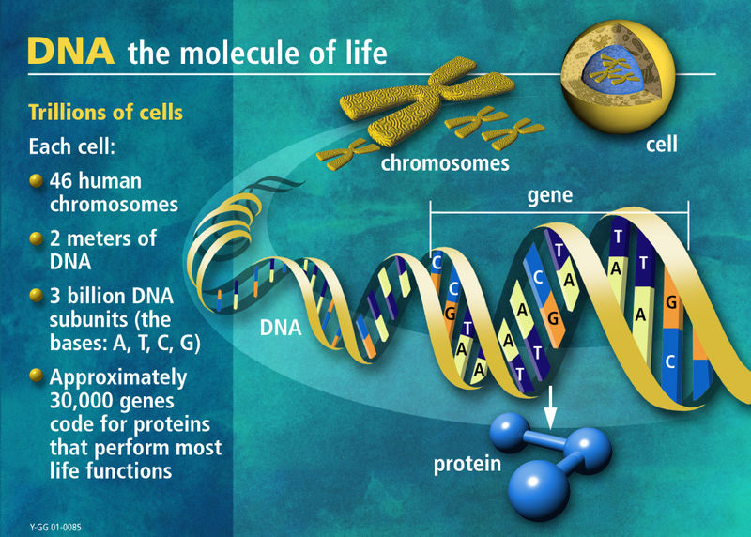

Slide 8
Genes control Phenotypic Traits through the Synthesis of Proteins
DNA specifies Traits by dictating Protein Synthesis.
Proteins are the links between genotype and phenotype.
The molecular chain of command is from
  DNA in the nucleus to mRNA,
  RNA in the cytoplasm to ribosomes,
  where amino acids → protein.

Slide 9
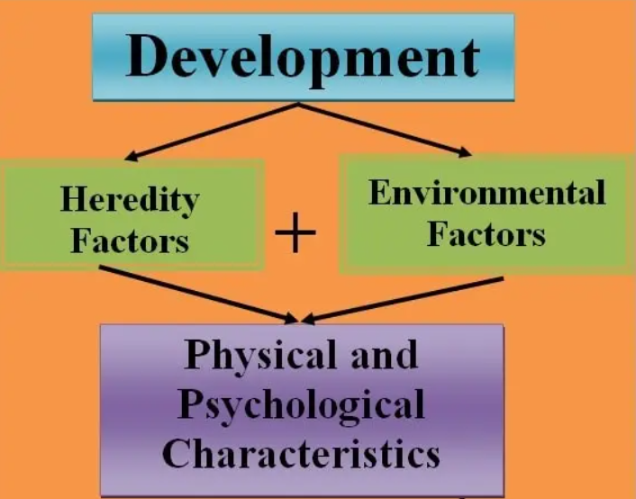
Expression of Traits
  Genes only determine potential capacities.
  Environmental factors play a large role in genetic expression.

Slide 10
Genetic Variation
Normal and Abnormal types of genetic variation exist.
Variation is critical for the survival of a population (e.g. adaptation).
Occurs as a result of different alleles for a trait.

Slide 11
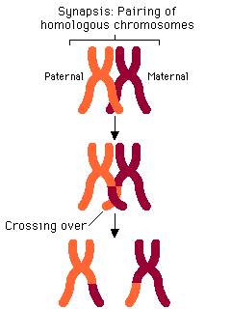
Normal Genetic Variation
Occurs in Meiosis by
  Independent Assortment
  Crossing Over
  when homologous chromosomes exchange pieces of the chromosomes as they are twisted around one another.
  This results in an equal swap of the genes involved.

Slide 12
ABNORMAL Genetic Variation Mutation
May occur in somatic cells (are not passed to offspring).
May occur in gametes (germ cells) (eggs and sperm) and be passed to offspring.
Can affect one nucleotide only or larger segments of chromosomes.

Slide 13
Mutation
A mutation is any change in structure or genetic material.
Any change in a cell can be considered a mutation and may NOT be inherited or passed on to offspring.
  Tumors, warts, moles.
A gene mutation is a change in the DNA and will be inherited or passed onto offspring. However, many mutations involved recessive traits and are masked.

Slide 14
Gene Mutations
Changes in the normal nucleotide sequence of a gene.
Almost all cause harm or death to the organism.
They arise from a number of different mechanisms.

Slide 15
Types of Gene Mutations
Change in Chromosome Number
  Aneuploidy
    Non-disjunction
    Having more or less chromosomes
  Polyploidy
    Multiples of the 2n (diploid) number
Somatic Cells (not inherited)
vs Sex Cells (inherited)
Change in Chromosome Structure
  Deletions, Translocations, Duplications, Inversions
  Point Mutations

Slide 16
Point Mutations
  Substitutions
    "Silent”
    "Missense” – new protein (Amino Acid Substitutions)
    "Nonsense” – stop codon
  Additions and Deletions
    Triplet Repeats
    Frameshift Mutations

Slide 17
Point Mutation
Change of a single nucleotide.
Includes the deletion, addition, or substitution of ONE nucleotide in a gene.
Occurs when DNA is replicated during mitosis and meiosis, and a mistake occurs.

Slide 18
Point Mutations: Substitutions
An incorrect nucleotide is inserted into the DNA instead of the correct one.
Example:
  A-T-A-G-G-G-C
  A-T-A-A-G-G-C

Slide 19
Point Mutations: Substitutions
Silent Mutation
A substitution mutation that does not cause any observable change in the protein or the function of the protein that the gene codes for.

Slide 20
Point Mutations: Substitutions
Silent Mutation
Example:
  Both AAA and AAG code for phenylalanine.
  If the third A in AAA undergoes a substitution mutation so that A is changed to a G, then it still codes for phenylalanine.

Slide 21
Point Mutations: Substitutions
Silent Mutation
Example:
  A substitution mutation can occur that alters a group of nucleotides in such a way that the amino acid is changed.
  But, if the new amino acid has similar properties to the original amino acid, then the protein may still function normally.

Slide 22
Point Mutation: Substitutions
Missense Mutation
Caused by Substitutions
It changes the group of nucleotides and results in the insertion of the incorrect amino acid into the protein during protein synthesis.
The results could be severe or silent.

Slide 23
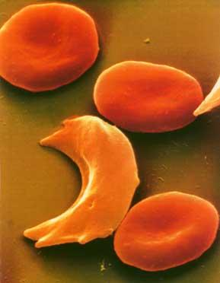
Point Mutation: Substitutions
Missense Mutation
Sickle Cell Disease is the result of one nucleotide substitution.
Occurs in the hemoglobin gene.
Hemoglobin is a protein that carries oxygen to our cells and carbon dioxide away from the cells. Exists inside our red blood cells.

Slide 24
Point Mutation: Substitutions
Missense Mutation
This mutation changes the “A” in “GAG” to a “T”.
During translation, this results in the amino acid valine being inserted into the protein instead of the correct amino acid: glutamic acid.
Because of this “minor” change a completely dysfunctional hemoglobin molecule is formed.
Causes Sickle Cell Disease, a very severe blood disease that mainly affects people of African descent.

Slide 25
Point Mutation: Substitutions
Nonsense Mutations
Caused by Substitutions
It alters an amino acid encoding a group of nucleotides into a STOP signaling group.
When the message is read by the ribosome, the protein will stop being made … too early.
It will be smaller and minimally functional.

Slide 26
Deletion and Addition Point Mutations
Deletions: occur when a nucleotide is left out of its proper sequence.
Additions: occur when a single nucleotide is added during replication.

Slide 27
Point Mutation - Reading Frame
Since RNA translates DNA 3 base sequences (codons), the exact sequence must be maintained = READING FRAME.
Substitution mutations DO NOT alter the reading frame.
Deletion and addition mutations alter the READING FRAME.

Slide 28
Point Mutation - Reading Frame → Frame Shift Mutations
FRAME SHIFT MUTATIONS result from deletion or addition point mutations.
These are usually more harmful than substitution mutations.

Slide 29
Point Mutation - Reading Frame → Frame Shift Mutations
Normal:
THE DOG RAN AND ATE THE PIG
Mutated:
THE DGR ANA NDA TET HEP IG
This is a deletion mutation (“O” in DOG).

Slide 30
Frameshift Mutation
Original:
THE FAT CAT ATE THE WEE RAT
Frame Shift (“a” added):
THE FAT CAA TET HEW EER AT
This was due to an addition point mutation.

Slide 31
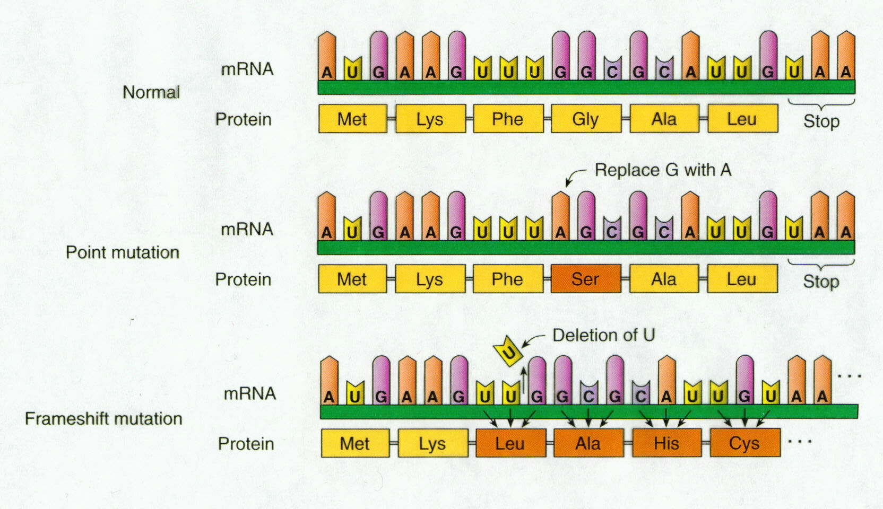
What type of mutation is shown here?
What type of mutation is shown here?

Slide 33
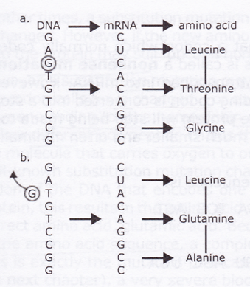
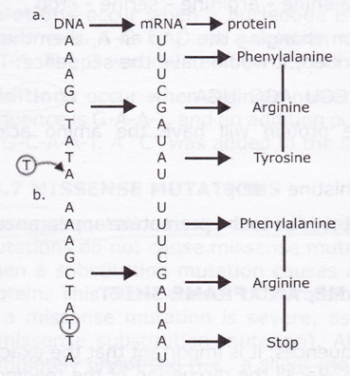
Amino Acid Sequence Changed
Deletion Mutation
Addition Mutation

Slide 34
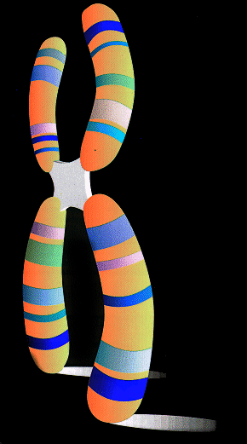
Chromosome Mutations
May Involve changing the STRUCTURE of a chromosome.
  The loss or gain of part of a chromosome.
  Most occur during mitosis and meiosis.

Slide 35
Chromosome Structure Mutations
Five types exist:
  Deletion
  Inversion
  Duplication
  Translocation
  Nondisjunction

Slide 36
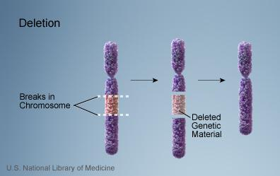
Structural Deletion Mutation
Due to breakage.
A piece of a chromosome is lost.
Usually results in death of organism.

Slide 37
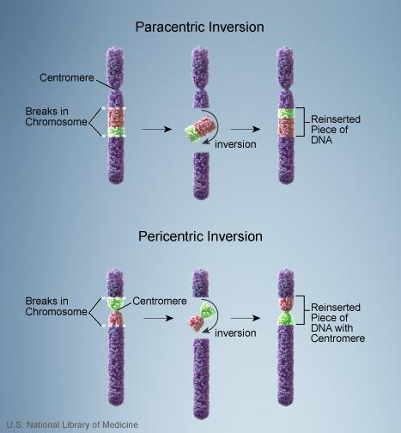
Structural Inversion Mutation
Chromosome segment breaks off.
Segment flips around backwards.
Segment reinserts into the same chromosome.

Slide 38
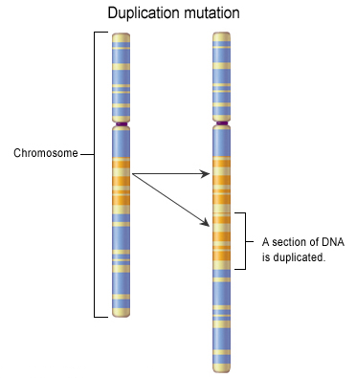
Structural Duplication Mutation
Occurs when a piece of one homologous chromosome breaks off and is inserted into the other homologous chromosome.

Slide 39
Structural Duplication Mutation
Since the chromosomes are homologues, the chromosome that donated the segment has undergone a deletion mutation.
And the chromosome that receives the segment has DUPLICATION of genes.
deletion

Slide 40
Structural Translocation Mutation
Involves two chromosomes that aren’t homologous.
A segment of a chromosome breaks off of one chromosome and inserts into a non-homologous chromosome.

Slide 41
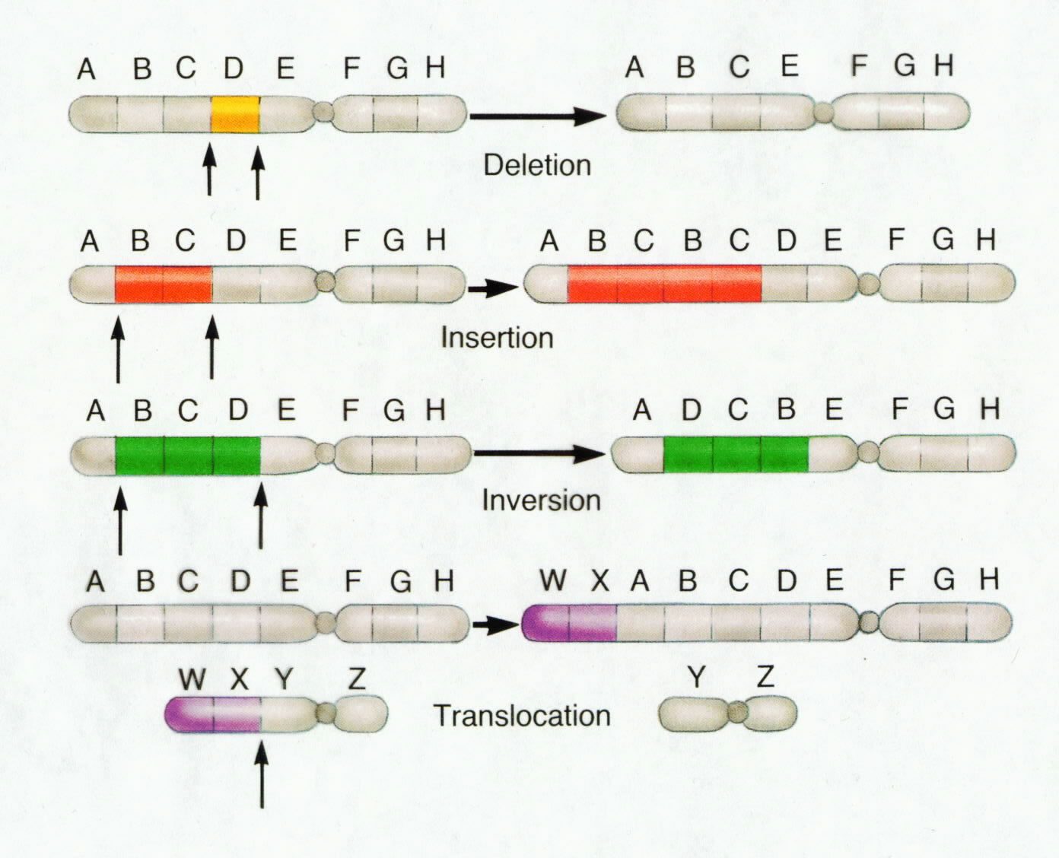
What type of mutation is shown in each case?

Slide 43
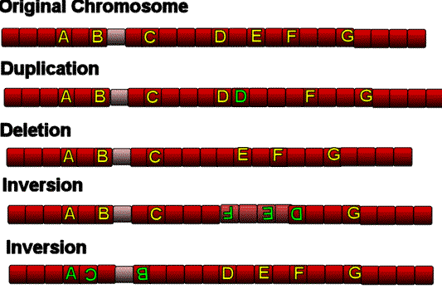
What type of mutation is shown in each case?

Slide 45
Nondisjunction
Chromosomal Mutation
Failure of chromosomes to separate during meiosis.
Causes gamete to have too many or too few chromosomes.
E.g. Down Syndrome (Trisomy-21)

Slide 46
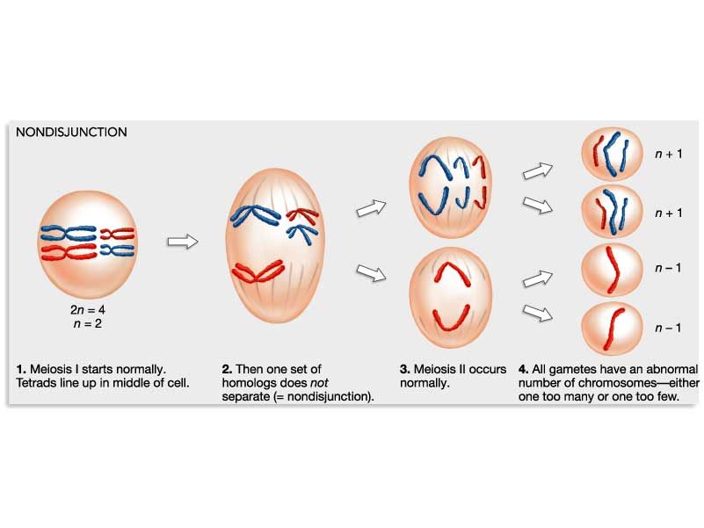

Slide 47
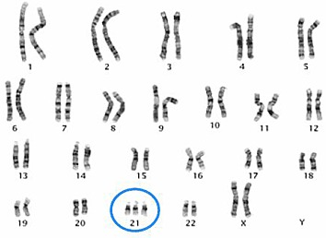
An extra copy of Chromosome 21 Causes Down Syndrome
Trisomy 21
  involves the inheritance of three copies of chromosome 21.
  the MOST COMMON human chromosome abnormality.

Slide 48
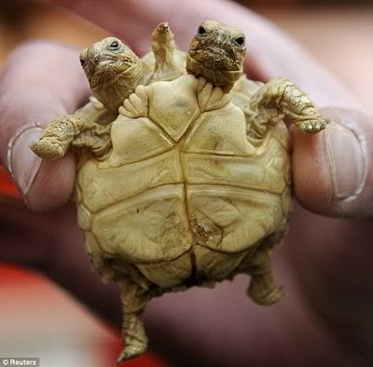
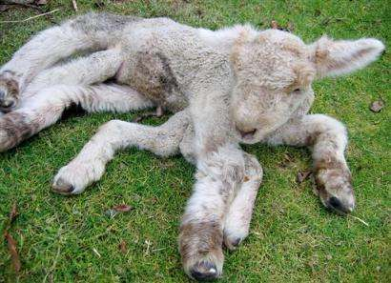
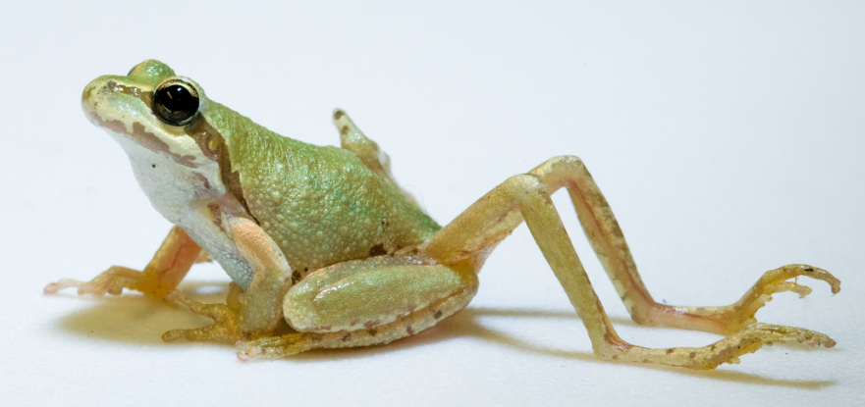
MUTAGENS
Factors that are known to cause mutations (changes in DNA which lead to cancer).

Slide 49
Cancer
ENVIRONMENTAL CONDITIONS might trigger a cell to become cancerous.
Radiation
Drugs & Medication
Viruses
Chemicals
Materials (e.g. asbestos)

Slide 50
Cancer
https://somup.com/c310FDtM3u
(6:12)

Slide 51
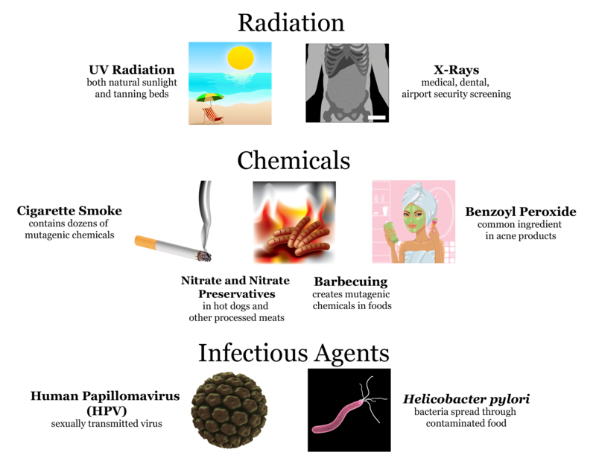
Carcinogens

Slide 52
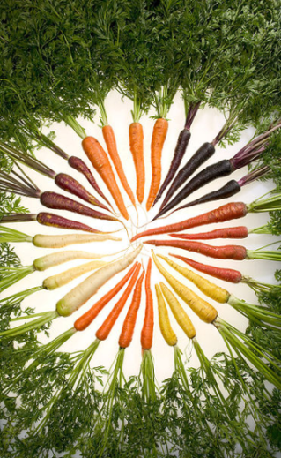
How is genetics used to produce desired traits in an organism?
Many-colored carrots
Scientists bred carrots for high levels of the orange pigment beta-carotene, which is high in vitamin A.
Other pigments such as red, yellow, purple, and white are high in other types of nutrients.
Notes:
#framechain
anchor video
Timing ≈ 0.5 minutes
Recap: “In this lesson, you will consider how genetics is used to produce desired traits in an organism. You just saw that people have bred specific traits in dogs in order to develop dogs of many shapes and sizes.”
[animate text on slide] Connect: “Here you can see the result of breeding specific characteristics in a plant. Selection for nutritional value led to carrots having colors other than the familiar orange. Dogs and carrots are just two examples of how people have manipulated the genes of organisms to make those organisms more useful.”
Preview: “Now you will learn just what selective breeding is, and how it has helped increase food production and made foods more diverse.”
SOURCES:
Carrots of Many Colors. “Carrots of many colors,” Stephen Ausmus. 2006 as PD, digital image. http://commons.wikimedia.org/wiki/File:Carrots_of_many_colors.jpg (accessed 5/9/12)

Slide 53
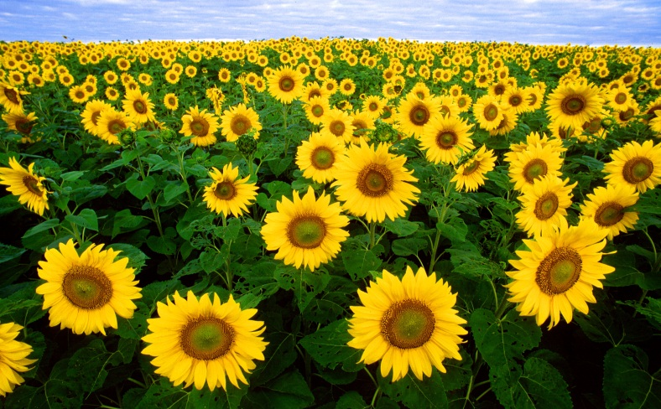
Selective Breeding and Society
The world food supply has been greatly enhanced by selective breeding and genetic engineering.
Hybridization is very important in producing new varieties of organisms.
Selective breeding produced many kinds of flowers, pets, and other organisms.
Notes:
Timing ≈ 0.5 minutes
[Teacher reads bullet points, expanding or providing examples.]

Slide 54
Selective Breeding Is Artificial Selection
Artificial selection
Selective breeding is the same as artificial selection.
Human intervention in animal or plant reproduction to ensure that certain desirable traits or combinations of traits are passed on to future generations.
Artificial selection is goal-directed and purposeful.
Natural selection is directed by survival in the environment.
Notes:
#frame
Instructional video
Timing ≈ 0.5 minutes
Let’s begin by defining selective breeding. Selective breeding is artificial selection.
[animate] Artificial selection is human intervention in animal or plant reproduction to ensure that certain desirable traits or combinations of traits are passed on to future generations.
[animate] Selective breeding refers to humans selecting the parents of the next generation of a plant or animal – same as the term ‘artificial selection.’
In both natural and artificial selection, the genetic make-up of a population is changed from generation to generation. In other words, the species continues to adapt and evolve through genetic mutation.
[animate] In artificial selection, humans choose the individuals who have the most desired genetic mutations/characteristics. The goal could be improving crop yield, improving milk production, making plants more resistant to disease, etc.
[animate] In natural selection, changes occur randomly through natural genetic mutations. The individuals that are most adapted and able to thrive in their environments are also the most likely to have offspring that carry on the mutations.

Slide 55
Selective Breeding of Organisms for Food
Plants:
    Faster growth
    Higher yield
    Disease resistance
    Higher nutritional value
Animals:
    Faster growth
    Greater docility (less aggression)
    Higher milk, egg, honey, or meat production
Genetic engineering makes breeding specific – they target by adding specific genes.
Notes:
#frame
Instructional video
Timing ≈ 1.0 minute
Explain there are many reasons for carrying out selective breeding. In plants and animals, selective breeding often involves increasing the amount of food produced. In plants, this is done several ways:
[animate each bullet]
[animate Plants and first 2 bullets] Developing plants that grow faster, and plants that have higher yield. This often involves changes in the size and/or shape of plant, such as shorter stalks, larger seed heads, etc.
[animate third bullet] More recently, genetic engineering is used to specifically target certain genes. For example, disease resistance.
[animate fourth bullet] Genetic engineering also targets higher nutritional value – greater levels of vitamins in vegetables, etc.
[animate animals heading] Genetic engineering is also used with animals.
[animate first bullet] The goal may be faster growth from birth to market.
[animate second bullet] The breeder may want a more docile, less aggressive, and easier to handle animal. This can be done not only with bigger animals such as cattle, but also with smaller ones, such as honeybees.
[animate third bullet] Another goal may be greater production of a food product, such as milk, eggs, honey, or meat.
[animate last line] Again, genetic engineering has allowed breeders to become more specific. Golden rice was engineered by adding a carrot gene that produces beta-carotene. Beta-carotene is needed for vitamin A production, and golden rice was intended to be grown in countries where people’s diets have too little vitamin A.

Slide 56
Process of Selective Breeding
Each generation, desired characteristics increase in population.
Step 1
Choose which characteristics to breed for.
Step 2
Breed individuals having those characteristics.
Selective
breeding
Step 4
Breed individuals having those characteristics.
Step 3
Choose which characteristics to breed for.
Notes:
Timing ≈ 0.5 minutes
Explain that selective breeding requires several simple steps repeated over and over; then list and describe the steps shown. [Teacher points out and animates each step as discussed, follows flow of chart] [animate each orange box/step as teacher talks about it]
Explain that these steps are done over and over. Breeders keep careful records to track which individuals show the traits in each generation.
Desired traits should become more common in each generation.
Also, sometimes traits are combined – one parent has rapid growth, other has high yield. The goal is to have offspring with both traits.

Slide 57
Selective Breeding
Selective breeding is a form of artificial selection to produce plants and animals with more desirable traits.
Selective breeding is goal-directed, not random like natural selection.
The process involves choosing the best parents to breed, then breeding offspring to build up traits in a population.
Some problems include inbreeding—buildup of negative genes—and decreased population diversity.
Wild mustard and wild cattle have been extensively selected.
Notes:
#frame
Instructional video
Timing ≈ 0.5 minutes
[Teacher reads bullet points, expanding or providing examples.]

Slide 58
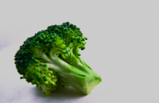
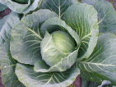
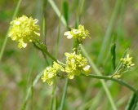
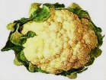
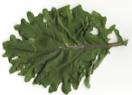
From the Wild to the Garden
Broccoli
Cabbage
Wild mustard
Cauliflower
Kale
Notes:
#frame
Instructional video
Timing ≈ 1 minute
“Let’s look at some examples of selective breeding.”
[Teacher points to, or circles, specific vegetable as each is discussed.]
Explain that many vegetable varieties are actually all the same species. They were made different by selective breeding for specific traits.
Members of the wild mustard family include those shown here.
Broccoli and cauliflower resulted from selection for specific flower characteristics.
For broccoli it was suppression of flower development.
For cauliflower, it was sterility of flowers.
To produce cabbage, the distance between branches - the internode length - was reduced and size of leaves increased.
To produce kale, leaf size was enlarged.
Other vegetables produced from wild mustard were kohlrabi and Brussels sprouts. To produce kohlrabi, enlarged lateral meristems – regions of growth along stem – were selected. Brussels sprouts resulted from selection for large bud size.
SOURCES:
Content Information http://labho.com/wp-content/uploads/2011/05/Salective-Breeding.jpg
Cabbage. “Cabbage Estonia.jpg,” Epukas. 2007 as PD, digital image. http://commons.wikimedia.org/wiki/File:Cabbage_Estonia.jpg (accessed 5/10/12)
Kale. “Kale.png,” Josiedraus. 2010 as PD, PNG. http://commons.wikimedia.org/wiki/File:Kale.png (accessed 5/10/12)
Wild Mustard. “Brassica.campestris1.jpg,” NPS. 2004 as PD, Digital Image. http://commons.wikimedia.org/wiki/File:Brassica.campestris1.jpg (accessed 5/10/12)
Broccoli. “Broccoli666.jpg,” Chadwick Moyer. 2010 as PD, digital image. http://commons.wikimedia.org/wiki/File:Broccoli666.jpg (accessed 5/10/12)
Cauliflower. “Cauliflower.jpg,” Anthony diPierro for CDC. 2004 as PD, digital image. http://commons.wikimedia.org/wiki/File:Cauliflower.JPG (accessed 5/10/12)

Slide 59
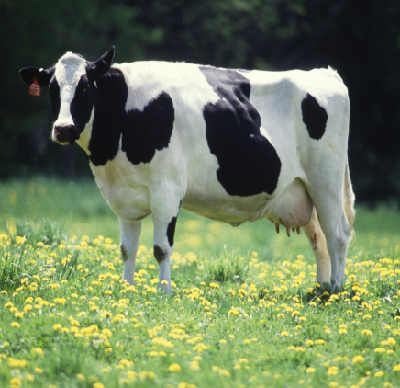
Selectively Bred Cow Traits
Cows that are domesticated:
are herbivores.
are large and relatively inactive.
can be herded.
provide milk.
Cows used for beef:
are short and stocky
have lots of muscle.
    Cows used for dairy production:
    have long limbs & body build.
    have large udders.
    produce high volumes of milk.
Notes:
Timing ≈ 1.0 minute
An example of selective breeding in animals is found in cattle. Describe early domestication of cattle during hunter-gatherer times. [animate “Traits for domestication:”] List traits that make cattle suitable for domestication:
[animate first bullet and image] herbivores – don’t compete with humans for scarce meat
[animate second bullet] large (provide a lot of meat), relatively inactive (not difficult to catch or control)
[animate third bullet] can be herded (important for keeping large numbers and for keeping available for use)
[animate fourth bullet] provide milk as well as meat (can get food without killing animal; more efficient)
[animate “Traits for beef or dairy production:”] Later in the history of domestication, cattle were selectively bred for either meat (beef cattle) or milk (dairy cattle). There are now a wide range of breeds for each purpose.
[animate first bullet] Beef cattle tend to be stocky, with short legs and lots of muscle to provide large amounts of meat. Some, such as Belgian blues, are perhaps ‘over bred.’ They have ‘double muscling’ (twice the size of regular muscles in back) providing a large amount of meat. However they have trouble giving birth and calves are usually born by Caesarean.
[animate second bullet] Dairy cattle have rangier builds, with longer legs and more slender bodies, as well as very large udders. Dairy cattle are bred to produce large amounts of milk. Holsteins, a major dairy breed, have doubled milk production since 1960s, but genetic changes have also made them less fertile. The average Holstein now produces more than 23,000 pounds of milk per year.
SOURCES:
Cow Female Black and White. “Cow female black white.jpg,” USDA. 2002 as PD. http://commons.wikimedia.org/wiki/File:Cow_female_black_white.jpg (accessed 5/10/12)

Slide 60
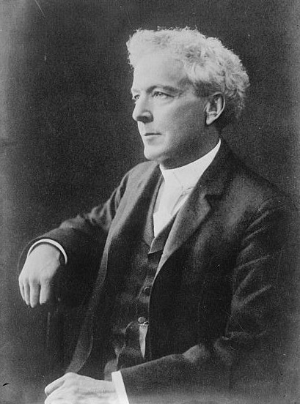
Luther Burbank
(1849–1926)
Was an American plant breeder.
Was famous for “Burbank potato”.
Developed more than 800 new strains and varieties of plants.
Increased world food supply.
Notes:
#frame
Instructional video
Timing ≈ 1.0 minute
You have learned about the impact of selective breeding on food production from both plants and animals. [animate first bullet and picture] Luther Burbank was one person who made this happen in plants. Burbank was born in Massachusetts.
[animate second bullet] He developed the Burbank potato, a variety now know as the ‘Idaho potato.’ The Burbank potato is still very popular with consumers and farmers. The Idaho is what many people think of when they think of a baked potato. Burbank moved to California in 1871 after selling the rights to his famous ‘Burbank potato.’ He started a huge experimental nursery with greenhouses in Santa Rosa, CA. The nursery is still famous around the world.
[animate third bullet] He developed more than 800 new strains and varieties of plants. He did thousands of crosses with native and foreign varieties, produced seedlings, and grafted them. He tested over 30,000 plum varieties. He maintained about 3,000 experiments at a time.
[animate fourth bullet] Burbank’s work had a major effect on increasing the food supply around the world. This is one way society has been changed by selective breeding.
SOURCES:
Information: http://www.invent.org/hall_of_fame/21.html (Hall of Fame, Inventor Profile)
Information: http://web.mit.edu/invent/iow/burbank.html
Luther Burbank. “Luther Burbank.jpg,” Bain News Service, publisher. Cited and sources in the Library of Congress. 1909, uploaded 2007 as PD, digital image. http://commons.wikimedia.org/wiki/File:Luther_Burbank.jpg (accessed 5/10/12)

Slide 61
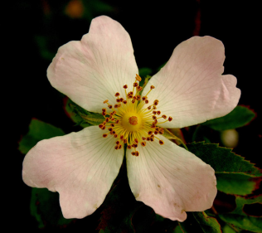
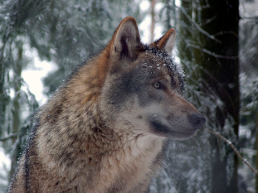
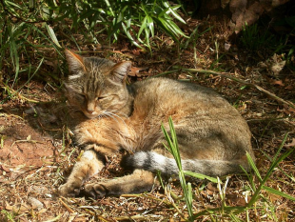
Origins: Flowers and Pets
Today’s flowers and pets came from ancient wild ancestors.
Wild rose –
ancestor of today’s hothouse roses
Grey wolf –
ancestor of today’s dogs
African wild cat –
likely ancestor of today’s house cats
Notes:
Timing ≈ 1.0 minute
[animate first sentence] Explain that food production is not the only area where selective breeding has been important. Whole industries have grown up around selective breeding.
[animate rose picture and wording underneath] Horticulture is the breeding of flowers, such as roses, orchids, many others, development of houseplants, and landscaping plants, etc. The wild rose is the ancestor of the roses you see in gardens.
[animate wolf picture and wording underneath] Pets, such as dogs and [animate wild cat picture and wording underneath] cats, are important for individuals. Pets provide companionship, hobbies, and a huge industry breeding, feeding, and taking care of them. The ancestors of dogs and cats are shown here.
Another example is racehorses. Horseracing is an ancient sport, dating back to at least 4500 BCE. After the Industrial Revolution, horses were much less important for heavy labor and transportation. Horses began to be bred more for racing.
SOURCES:
Wild rose. “Wild Rose Flower on Hedon Flyover - geograph.org.uk - 1360886.jpg,” Andy Beecroft. 2009 CC Attribution Share-Alike, digital image. http://commons.wikimedia.org/wiki/File:Wild_Rose_Flower_on_Hedon_Flyover_-_geograph.org.uk_-_1360886.jpg (accessed 5/10/12)
Grauwolf. “Grauwolf P1130275.jpg,” Gunnar Ries. 2009 as CC-share alike, digital image. http://commons.wikimedia.org/wiki/File:Grauwolf_P1130275.jpg (accessed May 22nd 2012)
Wild Cat. “AfricanWildCat.jpg,” catSonelle. 2005 as CC/GNU, digital image. http://commons.wikimedia.org/wiki/File:AfricanWildCat.jpg (accessed 5/10/12)
Approx. date for horseracing
http://www.mrmike.com/explore/hrhist.htm

Slide 62
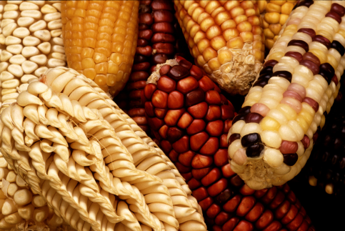
Hybridization
Hybridization
Breeding between individual organisms with different parentage; reproduction between organisms that are distantly related
Mendel is the best-known early plant hybridizer.
Many crops are hybrids, combining good traits from different sources to restore “hybrid vigor.”
Notes:
Timing ≈ 1.0 minute
A more advanced technique in selective breeding is hybridization.
[animate definition] Hybridization is breeding between individual organisms with different parentage; reproduction between organisms that are distantly related. The Burbank potato is one of many kinds of potatoes that have been developed for food through selective breeding. Other crop varieties have resulted from work creating hybrid organisms.
[animate first bullet] Mendel’s early work on genetics showed the significance of hybrids in plant genetics. Plants are easy to hybridize – the pollen from one plant can be hand-transferred to another.
[animate second bullet and image] Explain that many of today’s plants, including food crops such as corn and flowers grown in gardens, are hybrids. They combine good traits from different sources, such as different plant varieties or even different species. Ninety-five percent of today’s corn is hybrid. Hybrids give new generations ‘hybrid vigor’ – that is, restore health and productivity of the particular plant line by adding new genes that dilute the bad effects of inbreeding.
Genetic engineering, in which specific genes are transferred from one organism to another, is even more advanced than hybridization. Genetic engineering means that hybridizers can zero in on specific traits and change them. How do you think society in the future might be different as selective breeding, including genetic engineering, continues?
SOURCES:
Modified corn Keith Weller from USDA PD http://commons.wikimedia.org/wiki/File:GEM_corn.jpg 9/30/2011

Slide 63
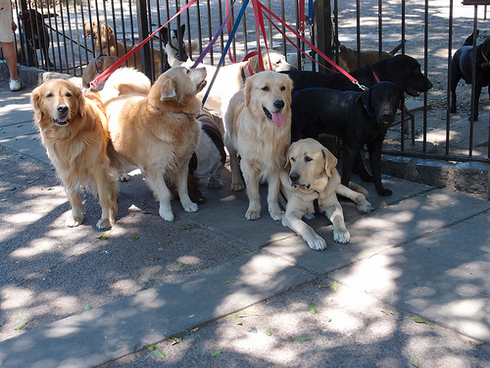
Which of the following are potential benefits of selective breeding?
[ ] Crops with higher yield.
[ ] Crops with better nutritional value.
[ ] More aggressive farm animals.
[ ] Higher milk, egg, or meat production.
[ ] Decreased diversity of wild populations.
Notes:
#frame
anchor video
Timing ≈ 0.5 minutes
Recap: “In this lesson, you are learning how genetics is used to produce desired traits in an organism. In the last segment, you considered the selective breeding of organisms produced for food.”
Connect: “But how does selective breeding relate to genetics? What genetic principles are involved and how does the breeder take advantage of these principles?”
Preview: “In this section, you will use Punnett squares and pedigrees to look at the results of selectively breeding organisms.”
SOURCES:

Slide 64
Which of the following are potential benefits of selective breeding?
[X] Crops with higher yield.
[X] Crops with better nutritional value.
[ ] More aggressive farm animals.
[X] Higher milk, egg, or meat production.
[ ] Decreased diversity of wild populations.
Notes:
#frame
anchor video
Timing ≈ 0.5 minutes
Recap: “In this lesson, you are learning how genetics is used to produce desired traits in an organism. In the last segment, you considered the selective breeding of organisms produced for food.”
Connect: “But how does selective breeding relate to genetics? What genetic principles are involved and how does the breeder take advantage of these principles?”
Preview: “In this section, you will use Punnett squares and pedigrees to look at the results of selectively breeding organisms.”
SOURCES:

Slide 65
Comparing Artificial and Natural Selection
Decide if the following statements apply only to artificial selection (A), only to natural selection (C), or to both (B).
Results in genetic change in next generation.
Is goal-directed.
Is a result of individuals that best survive in their environment and reproduce.
Artificial selection
Natural selection
A
B
C
Notes:
#frame
Timing ≈ 1 minute
Entry Audio: “You have learned the definition of artificial selection, also known as selective breeding. Now, see if you understand how it compares with natural selection. Read the question and study the Venn diagram. Then select your answer to each question from its drop-down list.”
Hint1 Audio: “Think about the result of each selection process. Are the results the same or different?”
Hint2 Audio: “Do either or both selection processes have a specific goal or desired outcome?”
Hint3 Audio: “Parents who are best adapted to their environment often lead to offspring who are adapted to the environment.”
Exit Audio: “Both processes result in genetic change in the next generation. Artificial selection is goal-directed and purposeful, while natural selection is directed by survival in the environment.”

Slide 66
Comparing Artificial and Natural Selection
Decide if the following statements apply only to artificial selection (A), only to natural selection (C), or to both (B).
Results in genetic change in next generation. B
Is goal-directed. A
Is a result of individuals that best survive in their environment and reproduce. C
Artificial selection
Natural selection
A
B
C
Notes:
#frame
Timing ≈ 1 minute
Entry Audio: “You have learned the definition of artificial selection, also known as selective breeding. Now, see if you understand how it compares with natural selection. Read the question and study the Venn diagram. Then select your answer to each question from its drop-down list.”
Hint1 Audio: “Think about the result of each selection process. Are the results the same or different?”
Hint2 Audio: “Do either or both selection processes have a specific goal or desired outcome?”
Hint3 Audio: “Parents who are best adapted to their environment often lead to offspring who are adapted to the environment.”
Exit Audio: “Both processes result in genetic change in the next generation. Artificial selection is goal-directed and purposeful, while natural selection is directed by survival in the environment.”

Slide 67
Potential Problems with Artificial Selection - Inbreeding
Inbreeding
Breeding between individual organisms who share similar genetic makeup or parentage; reproduction between organisms that are closely related.
Inbreeding causes unintended consequences:
Negative, recessive traits build up in the population.
The population becomes weaker and has less resilience.
Diversity decreases in populations.
Notes:
Timing ≈ 0.5 minutes
You’ve learned that selective breeding can produce desired traits in organisms such as dogs. However, sometimes selective breeding can produce negative outcomes and result in inbreeding.
[animate] Inbreeding is breeding between individual organisms who share similar parentage; reproduction between organisms that are closely related.
[animate] Inbreeding often causes unintended or undesired consequences in populations.
[animate first bullet] If too much inbreeding occurs, negative traits, such as diseases and weaknesses, may build up in the selected population. These are often recessive traits – retained in the population but not often genetically expressed. When closely-related organisms are bred to each other, recessive traits are expressed more often.
[animate second bullet] Inbred populations tend to become weaker and less resilient in the face of stresses. Some inbred dogs have joint problems, such as hip dysplasia. Others that inbred showed higher proportions of stillborn and deformed offspring. This is also called ‘inbreeding depression’ and is often counteracted by deliberately cross-breeding with outside populations to make populations stronger, or restore ‘hybrid vigor.’
[animate third bullet] Also, selective breeding tends to decrease genetic diversity in the population. There are fewer genes to choose from because some are ‘bred out.’ This might be a problem for the future because genetic diversity is an important factor for the health of populations and for finding new genes for further breeding.
SOURCES:
http://evolution.berkeley.edu/evosite/relevance/IIIA1Inbreeding.shtml [snakes]

Slide 68
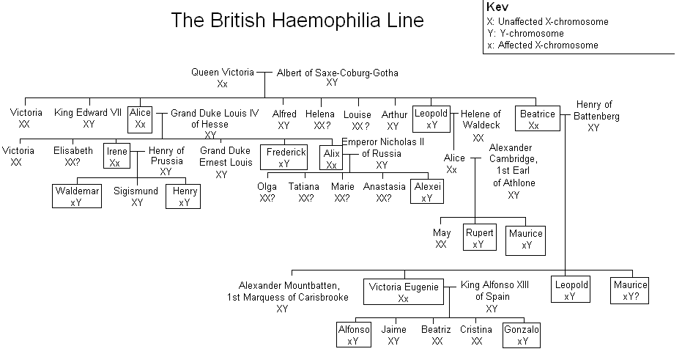
Human Inbreeding: Hemophilia
KEY
Notes:
Timing ≈ 1.0 minute
Explain that one consequence of inbreeding – mating of individuals that are closely related – is that recessive genes tend to be expressed more. The reason for that is both members of the mating pair are more likely to have the recessive gene if they are closely related.
An example of this is the occurrence of the hemophilia gene in the royal families of Europe, who tend to marry cousins and other close relatives.
Explain that hemophilia is a blood disorder in which the blood fails to clot properly. Explain that it is sex-linked (on X chromosome), so females tend to be carriers (not affected), but males have the disease (and tend to die young).
In the British Royal family, it first appeared, apparently as a spontaneous mutation, in Queen Victoria of England. [Show affected X Chromosome (small x) on the pedigree for Queen Victoria.]
Explain that this chart is a pedigree showing the royal family and the occurrence of hemophilia. A pedigree shows how individuals are related and allows the tracing of some genetic traits. Follow the progression of genes through generations, starting with Queen Victoria to show the increase in the recessive gene as inbreeding occurs.
Use the chart to follow hemophilia’s progression through the families of Europe and Russia as they intermarried. [Teacher points out occurrence of hemophilia beginning with Queen Victoria and follows it through pedigree. Teacher should circle in bright color each incidence of the recessive gene.]
SOURCES:
BritishHaemophilia Family Tree. “Haemophilia family tree.GIF,” Matjlav. 2005 as PD, gif image. http://en.wikipedia.org/wiki/File:Haemophilia_family_tree.GIF (accessed 5/10/12)

Slide 69
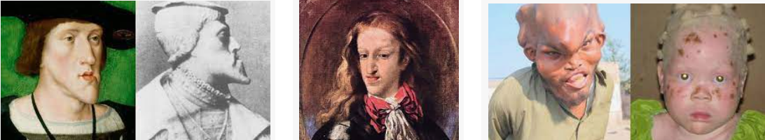
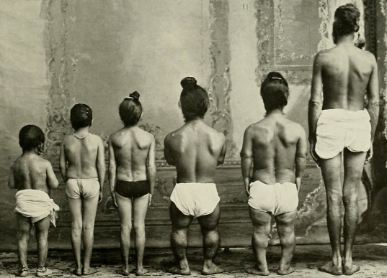
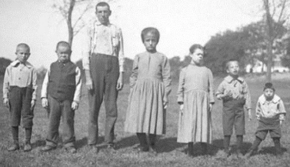
Human Inbreeding: Hemophilia

Slide 70
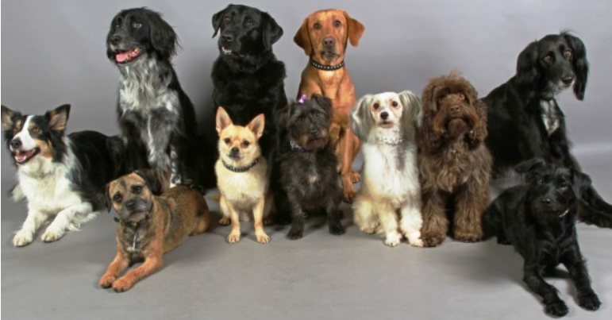
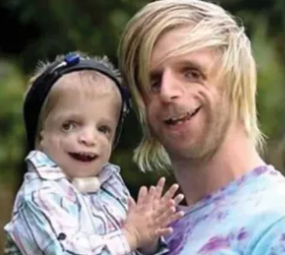
Why can inbreeding be potentially harmful to populations? Check all that apply.
[ ] Negative traits, such as diseases, may build up in the population.
[ ] Useful traits may be “bred out” of the population.
[ ] Genetic diversity of the population is increased.
[ ] The population becomes weaker and less resilient.
Notes:
#frame
anchor video
Timing ≈ 0.5 minutes
Recap: “In this lesson, you are learning how genetics is used to produce desired traits in an organism. In the last segment, you considered the selective breeding of organisms produced for food.”
Connect: “But how does selective breeding relate to genetics? What genetic principles are involved and how does the breeder take advantage of these principles?”
Preview: “In this section, you will use Punnett squares and pedigrees to look at the results of selectively breeding organisms.”
SOURCES:

Slide 71
Why can inbreeding be potentially harmful to populations? Check all that apply.
[X] Negative traits, such as diseases, may build up in the population.
[X] Useful traits may be “bred out” of the population.
[ ] Genetic diversity of the population is increased.
[X] The population becomes weaker and less resilient.
Notes:
#frame
anchor video
Timing ≈ 0.5 minutes
Recap: “In this lesson, you are learning how genetics is used to produce desired traits in an organism. In the last segment, you considered the selective breeding of organisms produced for food.”
Connect: “But how does selective breeding relate to genetics? What genetic principles are involved and how does the breeder take advantage of these principles?”
Preview: “In this section, you will use Punnett squares and pedigrees to look at the results of selectively breeding organisms.”
SOURCES:

Slide 72
Identifying Future Traits For Breeding
Agricultural geneticists research and brainstorming future plant foods that could be developed using selective breeding either by general methods or genetic engineering.
resistance to pesticides
addition of genes to make animal protein
resistance to insects, fungi, and other pests
addition of genes to improve color and taste
modifications for specific climates (heat, cold, drought)
addition of genes to increase concentrations of essential vitamins
modification of food’s appearance to make it more attractive to consumers
Notes:
#frame
Timing ≈ 1.0 minute
Entry Audio: “Imagine that you are a geneticist who can make any changes to food crops. What traits do you think would be most important to change? Which would be most useful from a nutritional viewpoint? Are some simply unnecessary or a waste of time? Check all that you think would be useful.”
Hint Audio: “Some of these changes have already been made to some foods. Other foods could be improved in the same way. Or new changes could be made.”
Exit Audio: “Of this list, only ‘modifications for extremely large or small size of fruit of vegetable’ is not likely to be considered. Some people do compete to grow the largest tomato, pumpkin, etc., but standard sizes are more practical for selling. Some unusual genetic modifications have been made to foods as a result of genetic engineering. For example, an ‘antifreeze’ gene found in a fish, the Arctic char which lives in very cold water, has been added to strawberries and tomatoes, making these plants more resistant to cold temperatures. Many changes can be made using simple selective breeding, but genetic engineering can produce more specific changes.”

