Slide 1
Click on “Slide Show”
Click “From Current Slide”
Or
“From Beginning”

Slide 2
Jeopardy
Review Game for Projects in Science A
Instructions

Slide 3
Jeopardy
Click the begin button below to begin
After reading the categories there will be a home screen button: click this button to go to the main screen
After each question click this button to return to the home screen.
At the end click the final jeopardy button.
Begin

Slide 4
Hydro-
power
Energy
Summary
Final Jeopardy
Misc.
Movies
& Such
Energy In
General
100
100
100
100
100
200
200
200
200
200
300
300
300
300
300
400
400
400
400
400
500
500
500
500
500

Slide 5
During times of low energy need or low water supply, this process is used to restore the level of the “head” even though it requires energy.

Slide 6
What is pumped storage?

Slide 7
The red item in the dam. The penstock allows water to flow downward as shown.

Slide 8
What is a generator?

Slide 9
The amount of hydroelectricity that a power plant can produce depends mostly on - size of the turbine and generators - discharge and flow - height of the reservoir and water falling and the amount of flow - solar energy and dam size

Slide 10
What is the height of the reservoir and water falling and the amount of flow ?

Slide 11
NOT a principal advantage of hydropower:
absence of polluting emissions
low operating costs
- non-renewable resource
- capability to respond quickly to utility load demands.

Slide 12
What is non-renewable resource ?

Slide 13
When electricity is interchanged among several utility systems to meet varying demands .

Slide 14
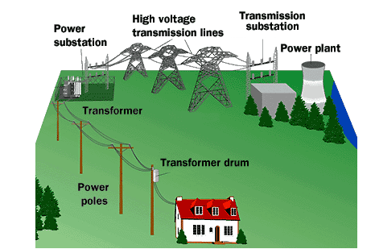
What is a grid system?

Slide 15
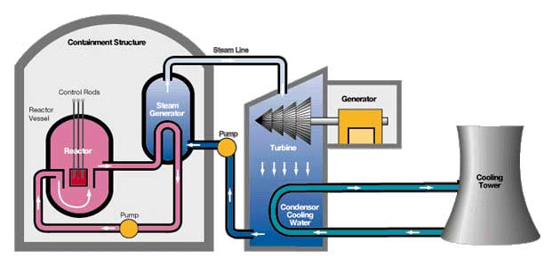
The source of the energy produced in the picture.

Slide 16
What is nuclear?

Slide 17
Uranium-235 absorbs free-moving neutrons, it splits to form fission fragments and releases more neutrons. These neutrons strike other Uranium-235 atoms and split them.

Slide 18
What is a nuclear chain reaction?

Slide 19
The type of fuel that will run out first at its present rate of usage. - coal - hydropower - natural gas - oil

Slide 20
What is oil?

Slide 21
The most efficient way to save energy to the least efficient way to save energy in a home. 1= weather stripping doors and windows; 2= buying and maintaining a more efficient heating system; 3= installing 6 inches of insulation in an uninsulated attic; 4= insulating the walls of your home

Slide 22
What is: 2 = buying and maintaining a more efficient heating system?

Slide 23
Produces the most light for the same amount of electricity? - 40 watt fluorescent tube - two 100 watt, regular (incandescent) bulbs - one 200 watt bulb - a popcorn kernel

Slide 24
What is one 200 watt bulb ?

Slide 25
Not considered a renewable resource.
- solar
- coal
- hydropower
- wind

Slide 26
What is coal?

Slide 27
Most of the electrical generation in the United states uses - oil - steam - nuclear fuel - direct current

Slide 28
What is oil?

Slide 29
The United States has approximately __% of the world’s people and we consume approximately __% of the world’s energy supply: - 20, 20 - 6, 50 - 15, 10 - 6, 30

Slide 30
What is 6, 30?

Slide 31
If you commuted to work 50 miles every day and wanted to save gasoline, which of the following ways would save the most gasoline? - buy/drive a car that gets five miles to the gallon more than your present car - carpool - drive 55 miles per hour rather than 65 miles per hour

Slide 32
What is carpool ?

Slide 33
Which factor effects wind generation the LEAST in regard to power output? - tower height - rotor size - condenser capacity - wind speed

Slide 34
What is condenser capacity ?

Slide 35
The basic unit of electrical cost.

Slide 36
What is kilowatt-hour (kWhr)?

Slide 37
Greatest demand for energy in the home.

Slide 38
What is heating / cooling?

Slide 39
Most electricity producing plants include these three elements.

Slide 40
What are steam, turbine, and generator?

Slide 41
The waste products of nuclear, hydropower, and coal energy production that people are aware of?

Slide 42
What are radioactive waste, none, and carbon dioxide?

Slide 43
The energy source that Einstein was considering in E = mc². Then, an even more powerful energy became the topic of much research.

Slide 44
What are fission and fusion?

Slide 45
A hydroelectric power plant originated from the idea of irrigation in the desert.

Slide 46
What is Building Hoover Dam?

Slide 47
Discovered a new radioactive element.

Slide 48
What is Madame Curie?

Slide 49
Invented a better solution for light than natural gas.

Slide 50
What is Edison the Man?

Slide 51
Category of resources that produce most of the energy in the world.

Slide 52
What are fossil fuels?

Slide 53
Patents were stolen related to currents in a wire.

Slide 54
What is Alexander Graham Bell?

Slide 55
Jeopardy
Review Game for Projects in Science A

Slide 56
Today’s Categories Are:

Slide 57
Today’s Categories Are:
HydroPower

Slide 58
Today’s Categories Are:
Energy Summary

Slide 59
Today’s Categories Are:
Energy In General

Slide 60
Today’s Categories Are:
Miscellaneous

Slide 61
Today’s Categories Are:
Movies
& Such
Click on the house

Slide 62
Final Jeopardy Category
Hydroelectric Power

Slide 63
Final Jeopardy
Hydropower normally would be most efficiently used for.

Slide 64
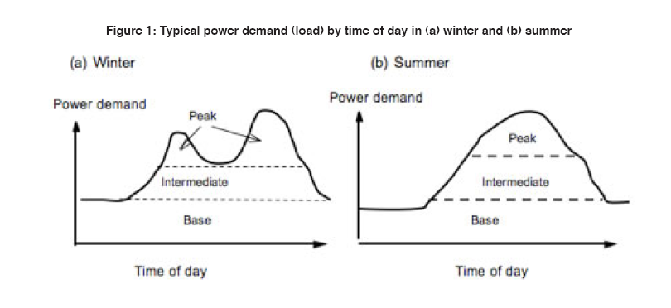
Final Jeopardy
What is peakload?
Done

