Slide 1
Click “Slide Show”
Click “From Beginning”
or
“From Current Slide”

Slide 2
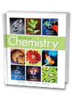
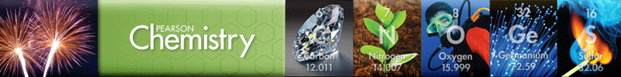
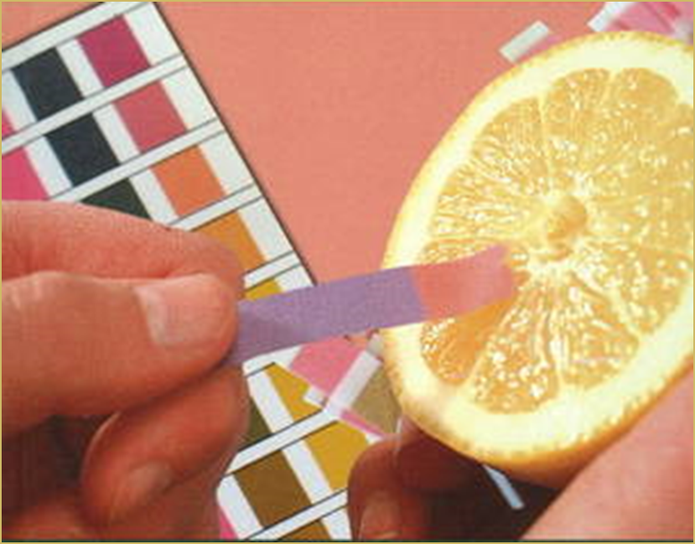
Chapter 19B
Acids, Bases, and Salts
Acid-Base Theories
Hydrogen Ions and Acidity
Strengths of Acids and Bases
Neutralization Reactions
Salts in Solution
Notes:
2

Slide 3
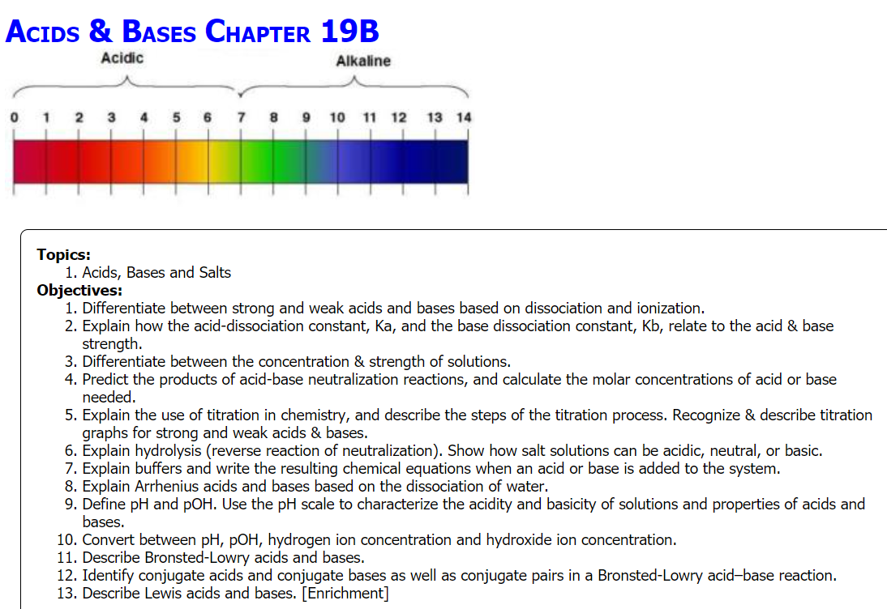
Notes:
3

Slide 4

Interpreting Equilibrium
Which shows the correct expression for the equilibrium constant for the following system?
2POCl₃ 2PCl₃ + O₂
1
2
3
4
What would be the magnitude of the equilibrium constant, K_{eq}?
K < 1 K = 1 K > 1
Rank the equilibrium systems in order from most products to least.
System | K (at 25°C)
A | 1.5 × 10⁻²
B | 9.2 × 10⁻⁶
C | 4.7 × 10⁻¹
D | 2.3 × 10⁻¹⁰
Notes:
Time ≈ 1 minute (2 slides)
Entry Audio: Use what you know about equilibrium expressions and equilibrium constants to answer the following questions.
Hint 1: Remember that you can use the balanced chemical equation to write the expression for the equilibrium constant.
Hint 2: Remember that the equilibrium constant is based on a ratio of products divided by reactants.
(task continues on next slide)
Hint 3: Think about how an equilibrium constant would look if that equilibrium favored products. Would the numerator or denominator be larger?
Exit Audio: Each chemical system is unique. Each chemical system that establishes an equilibrium has a unique equilibrium constant based on the equilibrium concentrations of the components of the system. Some systems favor reactants; others favor products. Occasionally there are systems where products and reactants are equal in concentration. In any case, the magnitude of the equilibrium constant, K, gives you a general indication of the position of equilibrium—whether reactants are favored (when K < 1) or whether products are favored (when K >1).

Slide 5
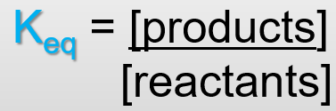
Interpreting Equilibrium
Which shows the correct expression for the equilibrium constant for the following system?
2POCl₃ 2PCl₃ + O₂
What would be the magnitude of the equilibrium constant, K_{eq}?
K < 1 favors reverse rxn (longer arrow to the left)
Rank the equilibrium systems in order from most products to least.
C > A > B > D
System | K (at 25°C)
A | 1.5 × 10⁻²
B | 9.2 × 10⁻⁶
C | 4.7 × 10⁻¹
D | 2.3 × 10⁻¹⁰
Notes:
Time ≈ 1 minute (2 slides)
Entry Audio: Use what you know about equilibrium expressions and equilibrium constants to answer the following questions.
Hint 1: Remember that you can use the balanced chemical equation to write the expression for the equilibrium constant.
Hint 2: Remember that the equilibrium constant is based on a ratio of products divided by reactants.
(task continues on next slide)
Hint 3: Think about how an equilibrium constant would look if that equilibrium favored products. Would the numerator or denominator be larger?
Exit Audio: Each chemical system is unique. Each chemical system that establishes an equilibrium has a unique equilibrium constant based on the equilibrium concentrations of the components of the system. Some systems favor reactants; others favor products. Occasionally there are systems where products and reactants are equal in concentration. In any case, the magnitude of the equilibrium constant, K, gives you a general indication of the position of equilibrium—whether reactants are favored (when K < 1) or whether products are favored (when K >1).

Slide 6
Lesson Objectives
  Differentiate between strong and weak acids and bases based on dissociation and ionization.
  Explain how the acid-dissociation constant, K_{a}, and the base-dissociation constant, K_{b}, relate to the acid & base strength.
  Differentiate between the concentration & strength of solutions.
  Predict the products of acid-base neutralization reactions, and calculate the molar concentrations of acid or base needed.
  Explain the use of titration in chemistry, and describe the steps of the titration process. Recognize & describe titration graphs for strong and weak acids & bases.
  Show how salt solutions can be acidic, neutral, or basic.
  Explain buffers and write the resulting chemical equations when an acid or base is added to the system.
Notes:
Timing ≈ 0.5 minute
You have already looked at what equilibrium expressions and equilibrium constants are and how to interpret them. In this lesson you will learn about additional equilibrium constants that can give you information about the relative strengths of acids and bases.

Slide 7

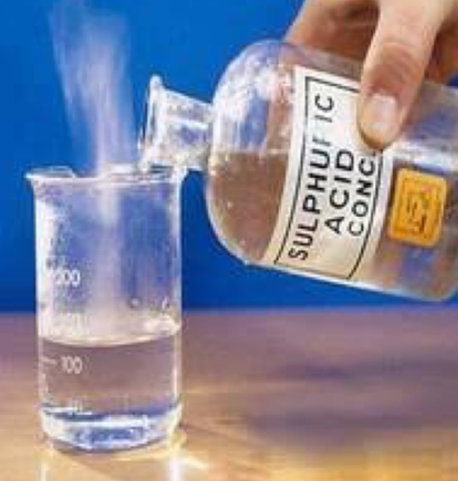
Strong and Weak Acids and Bases
What makes one acid safer than another?
Lemon juice, which contains citric acid, has a pH of about 2.3 which is relatively strong. Yet, most people love lemonade!
Battery acid is very dangerous (sulfuric acid: H₂SO_{4 (aq)}).
pH = 1
_{diluted}
Notes:
7

Slide 8
Strong and Weak Acids and Bases
Ionization
The foundational concept of Acids and Bases is their ability to ionize in solution.
Electrolytes: acids and bases can conduct electricity due to the presence of free moving ions which exist because of ionization.
i.e. HCl _{(aq)} is a strong electrolyte (acid)
NaOH _{(aq)} is a strong electrolyte (base)
CH₃COOH _{(aq)} is a weak electrolyte (acid)
Pure water does NOT conduct electricity
Notes:
8

Slide 9

Strong and Weak Acids and Bases
Acids and bases are classified as strong or weak based on the degree to which they ionize in water.
In general, a strong acid completely ionizes in aqueous solution. Hydrochloric and sulfuric acid are examples of strong acids.
  HCl(g) + H₂O(l) → H₃O⁺(aq) + Cl–(aq)
  H₂SO₄(s) + 2H₂O(l) → 2H₃O⁺(aq) + SO₄^{–2}(aq)
A weak acid ionizes only slightly in aqueous solution.
The ionization of acetic acid (CH₃COOH), a typical weak acid, is not complete. NOTICE THE EQUILIBRIUM (arrows):
Notes:
9

Slide 10
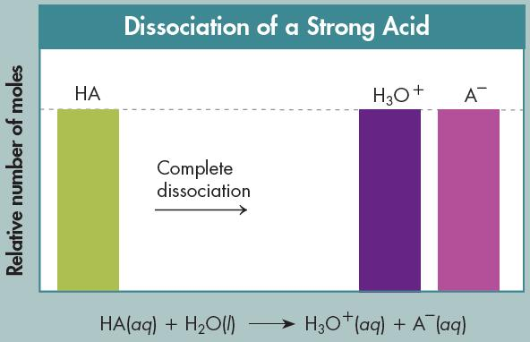
Strong and Weak Acids
Dissociation
of a strong acid
HX _{(aq)} H⁺_{(aq)} + X⁻ _{(aq)}
Ionize completely (100%) … no reactant remains
Goes to “completion” (FORWARD rxn favored)
100% dissociation, strong electrolyte
Notes:
10

Slide 11
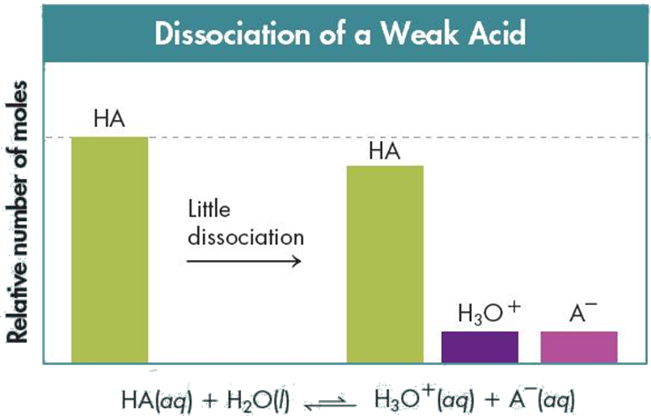
Strong and Weak Acids
Dissociation of a weak acid
HX _{(aq)} H⁺_{(aq)} + X⁻ _{(aq)}
Fewer ions produced, weak electrolyte
Favors the REVERSE reaction
Low % dissociation
Notes:
11

Slide 12
Strong and Weak Acids
Dissociation of a strong acid
HX _{(aq)} H⁺_{(aq)} + X⁻ _{(aq)}
Ionize completely (100%)
Goes to “completion” (forward rxn)
100% dissociation, strong electrolyte
Dissociation of a weak acid
HX _{(aq)} H⁺_{(aq)} + X⁻ _{(aq)}
Fewer ions, weak electrolyte
Favors the reverse rxn
Low % dissociation
Notes:
12

Slide 13
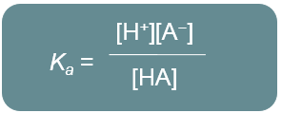

Strong and Weak Acids
Acid Dissociation Constant
The equilibrium-constant expression for any acid:
HX _{(aq)} ↔ H⁺_{(aq)} + X⁻ _{(aq)}
K_{a} = [H⁺][ X⁻] / [HX]
The acid dissociation constant (K_{a}) indicates the amount of ions produced and which reaction (forward/reverse) is favored.
K_{a} = 5.7 x 10⁻¹⁰ → describe strength, ions, favored rxn
K_{a} = 2.4 x 10⁴ → describe strength, ions, favored rxn
Notes:
13

Slide 14
Strong and Weak Acids
Acid Dissociation Constant
The equilibrium-constant expression for any acid:
HX _{(aq)} ↔ H⁺_{(aq)} + X⁻ _{(aq)}
K_{a} = [H⁺][ X⁻] / [HX]
The acid dissociation constant (K_{a}) indicates the amount of ions produced and which reaction (forward/reverse) is favored.
K_{a} = 5.7 x 10⁻¹⁰ (very small) →
WEAK acid, few ions, reverse reaction
K_{a} = 2.4 x 10⁴ (large) →
STRONG acid, many ions, forward rxn
Notes:
14

Slide 15
Strong vs. Weak Acids
Strong acid: is an acid which fully dissociates (ionizes) in solution.
HCl(aq) + H₂O(l) → H₃O⁺(aq) + Cl⁻(aq)
Greater than 99.99% ionized
6 Strong Acids:
HCl – Hydrochloric acid
HI - Hydroiodic acid
HNO₃ - Nitric acid
HBr - Hydrobromic acid
H₂SO₄ - Sulfuric acid
HClO₄ - Perchloric acid
Weak acids: do not fully ionize (dissociate) in solution.
(Any acid that is not one of the strong acids listed above)

Slide 16
Strong and Weak Bases
Base Dissociation Constant
The equilibrium-constant expression for any base:
NH₃ _{(aq)} + H₂O NH₄⁺_{(aq)} + OH⁻ _{(aq)}
K_{b} = [NH₄⁺][ OH ⁻] / [NH₃]
K_{b} = 1.8 x 10⁻⁴
[H₂O] is 55 M just as in the acidic aqueous solutions, and is therefore, incorporated into the equilibrium constant.
The Base dissociation constant (K_{b}) indicates the amount of ions produced and which reaction (forward/reverse) is favored.
K_{b} = 1.8 x 10⁻⁴ → describe strength, ions, favored rxn
K_{b} = 7.2 x 10⁶ → describe strength, ions, favored rxn
Notes:
16

Slide 17
Strong and Weak Bases
Base Dissociation Constant
The equilibrium-constant expression for any base:
NH₃ _{(aq)} + H₂O NH₄⁺_{(aq)} + OH⁻ _{(aq)}
K_{b} = [NH₄⁺][ OH ⁻] / [NH₃]
K_{b} = 1.8 x 10⁻⁴
The Base dissociation constant (K_{b}) indicates the amount of ions produced and which reaction (forward/reverse) is favored.
K_{b} = 1.8 x 10⁻⁴ (small) →
WEAK base, few ions, reverse reaction
K_{b} = 7.2 x 10⁶ (large) →
STRONG base, many ions, forward rxn
Notes:
17

Slide 18
Strong vs. Weak Bases
Strong bases: like sodium hydroxide or potassium hydroxide which are fully ionized.
A strong base is a compound that is 100% split up into metal ions and hydroxide ions in solution.
All strong bases will contain a hydroxide group.
NaOH → Na⁺ + (OH)⁻
KOH → K⁺ + (OH)⁻
Weak bases: do not dissociate fully into hydroxide ions in solution. Example: Ammonia NH₃
NH_{3(aq)} NH₄⁺_{(aq)} + (OH)⁻ _{(aq)}

Slide 19
Strong and Weak Acids and Bases
Strong (acid or base) |  | Weak (acid or base)
K_{a} and K_{b} are very ____ |  | K_{a} and K_{b} are ____
Favors _______ rxn |  | Favors ________ rxn
Near ______ dissociation |  | _______ % dissociation
_______ ions |  | _______ ions
_______ electrolyte |  | _______ electrolyte
Strong Acids |  | Strong Bases
Hydrochloric Acid | ?
Hydrobromic Acid | ? | Hydroxides of the Group 1 (IA) metals Examples??
Hydroiodic Acid | HI
Nitric Acid | NO₃
Perchloric Acid | HClO₄ | Hydroxides of the Group 2 (IIA) metals Examples??
Sulfuric Acid | ?
Notes:
19

Slide 20
Strong and Weak Acids and Bases
Strong (acid or base) |  | Weak (acid or base)
K_{a} and K_{b} are very large |  | K_{a} and K_{b} are small
Favors forward rxn |  | Favors reverse rxn
Near 100% dissociation |  | Low % dissociation
Many ions |  | Fewer ions
Strong electrolyte |  | Weak electrolyte
Strong Acids |  | Strong Bases
Hydrochloric Acid | HCl
Hydrobromic Acid | HBr | Hydroxides of the Group 1 (IA) metals LiOH NaOH KOH RbOH CsOH
Hydroiodic Acid | HI
Nitric Acid | NO₃
Perchloric Acid | HClO₄ | Hydroxides of the Group 2 (IIA) metals Mg(OH)₂ Ca(OH)₂ Sn(OH)₂ Ba(OH)₂
Sulfuric Acid | H₂SO₄
Notes:
20

Slide 21
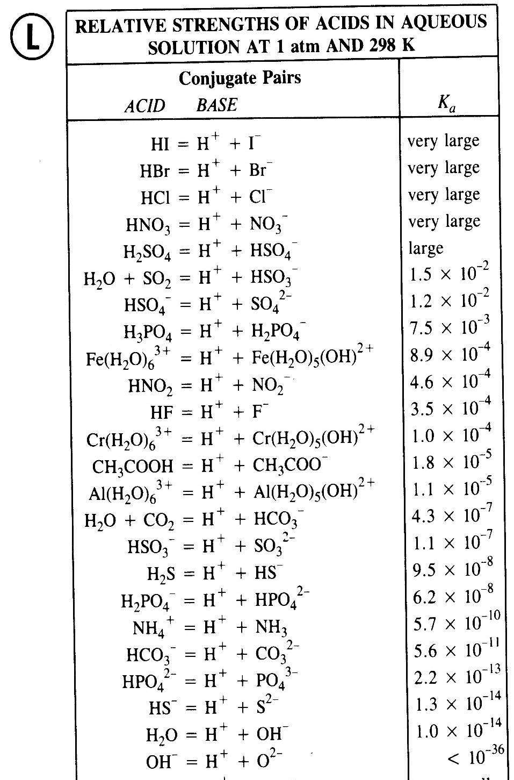
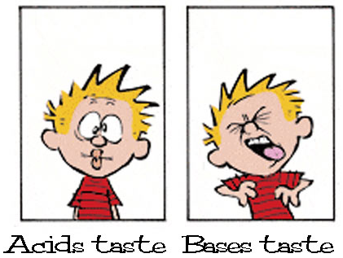
Strong and Weak Acids and Bases
Reference Table L
Notes:
21

Slide 22
Comparing Strengths of Acids and of Bases
  Which is the strongest acid listed in the table at right?
  Which base(s) is/are stronger than ammonia?
  Which acid(s) listed in the table is/are weaker than benzoic acid?
  Which base will yield the least ions in solution?
  Which acid is the weakest electrolyte in solution?
Acid | K_{a} (at 25°C)
Acetic acid | 1.8 × 10⁻⁵
Benzoic acid | 6.5 × 10⁻⁵
Hydrofluoric acid | 6.8 × 10⁻⁴
Hypochlorous acid | 3.0 × 10⁻⁸
Base | K_{b} (at 25°C)
Ammonia | 1.8 × 10⁻⁵
Hydroxylamine | 1.1 × 10⁻⁸
Methylamine | 4.4 × 10⁻⁴
Pyridine | 1.7 × 10⁻⁹
Notes:
Time ≈1.0 minute
Entry Audio: Apply your understanding of acid-dissociation constants and base-dissociation constants to compare the strengths of various acids and the strengths of various bases.
Hint 1: Remember that you can compare the acid-dissociation constants of two acids to determine which is stronger.
Hint 2: Remember that stronger bases have larger base-dissociation constants.
Hint 3: Remember that stronger acids have larger acid-dissociation constants.
Hint 4:Remember that the larger the base-dissociation constant, the stronger the base.
Exit Audio: When comparing two different acids, the magnitudes of the K_{a}’s for the two acids give you a means for evaluating the relative strengths of the acids. The larger the K_{a}, the stronger the acid. The same analysis can be done with two bases using their K_{b} values. The larger the K_{b}, the stronger the base.
Source: dissociation constants found in: Brown, T.L., LeMay, H.E., and Bursten, B.E., Chemistry, the Central Science, 6th Edition, Prentice Hall, Englewood Cliffs, NJ, 1994.

Slide 23
Comparing Strengths of Acids and of Bases
  Which is the strongest acid listed in the table at right?
  Hydrofluoric acid
  Which base(s) is/are stronger than ammonia?
  methylamine
  Which acid(s) listed in the table is weaker than benzoic acid?
  hypochlorous acid, acetic acid
  Which base will yield the least ions in solution?
  pyridine
  Which acid is the weakest electrolyte in solution?
  hypochlorous acid
Acid | K_{a} (at 25°C)
Acetic acid | 1.8 × 10⁻⁵
Benzoic acid | 6.5 × 10⁻⁵
Hydrofluoric acid | 6.8 × 10⁻⁴
Hypochlorous acid | 3.0 × 10⁻⁸
Base | K_{b} (at 25°C)
Ammonia | 1.8 × 10⁻⁵
Hydroxylamine | 1.1 × 10⁻⁸
Methylamine | 4.4 × 10⁻⁴
Pyridine | 1.7 × 10⁻⁹
Notes:
Time ≈1.0 minute
Entry Audio: Apply your understanding of acid-dissociation constants and base-dissociation constants to compare the strengths of various acids and the strengths of various bases.
Hint 1: Remember that you can compare the acid-dissociation constants of two acids to determine which is stronger.
Hint 2: Remember that stronger bases have larger base-dissociation constants.
Hint 3: Remember that stronger acids have larger acid-dissociation constants.
Hint 4:Remember that the larger the base-dissociation constant, the stronger the base.
Exit Audio: When comparing two different acids, the magnitudes of the K_{a}’s for the two acids give you a means for evaluating the relative strengths of the acids. The larger the K_{a}, the stronger the acid. The same analysis can be done with two bases using their K_{b} values. The larger the K_{b}, the stronger the base.
Source: dissociation constants found in: Brown, T.L., LeMay, H.E., and Bursten, B.E., Chemistry, the Central Science, 6th Edition, Prentice Hall, Englewood Cliffs, NJ, 1994.

Slide 24
Strength vs. Concentration
It is important that you don't confuse the words strong and weak with the terms concentrated and dilute.
The strength of an acid or base is related the degree of dissociation in water to produce ions.
The concentration tells you about how much of the original acid (solute) is dissolved in the solution.
It is entirely possible to have a concentrated solution of a weak acid, or a dilute solution of a strong acid or base.

Slide 25
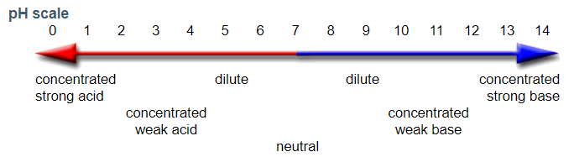
Concentration Versus Strength
Concentrated and dilute indicate how much of an acid or base is dissolved in solution and refer to the number of moles of the acid or base in a given volume (solute dissolved).
The words strong and weak refer to the extent of ionization or dissociation of an acid or base (K_{a} or K_{b})… ions produced.
Notes:
25

Slide 26
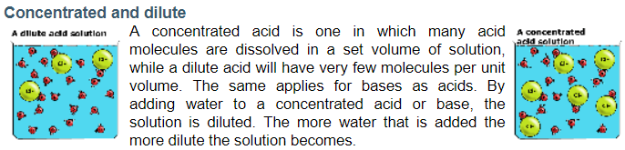
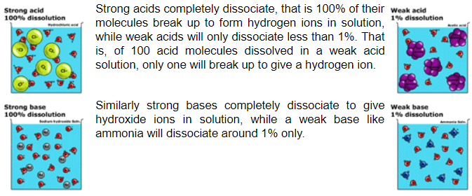
Concentration Versus Strength
Notes:
26

Slide 27
Concentration Versus Strength
Concentrated and dilute indicate how much of an acid or base is dissolved in solution and refer to the number of moles of the acid or base in a given volume (solute dissolved).
The words strong and weak refer to the extent of ionization or dissociation of an acid or base (K_{a} or K_{b})… ions produced.
Comparing Concentration and Strength of Acids & Bases
Solution | Concentration |  | Acid/Base Strength
 | Quantitative (or Molar) | Relative
Hydrochloric acid | 12M HCl | Concentrated | Strong
Gastric juice | 0.8M HCl | Dilute | Strong
Ethanoic acid | 17M CH₃COOH | Concentrated | Weak
Vinegar | 0.2M CH₃COOH | Dilute | Weak
Sodium Hydroxide | 19.4 M NaOH | Concentrated | Strong
Lye | 5 M NaOH | Dilute | Strong
Ammonium Hydroxide | 14.5 M NaOH | Concentrated | Weak
Ammonia | 5 M NaOH | Dilute | Weak
Notes:
27

Slide 28

Acid-Base Indicators
Either acid-base indicators or pH meters can be used to measure pH.
An indicator (HIn) is an acid or a base that dissociates in a known pH range. Indicators work because their acid form and base form have different colors in solution.
The acid form of the indicator (HIn) is dominant at low pH and high [H⁺]. The base form (In⁻) is dominant at high pH and high [OH⁻].
Chemists have created a blend of indicators to create universal indicators such as litmus paper.
Acids turn blue litmus paper red.
Bases turn red litmus paper blue.
Notes:
28

Slide 29
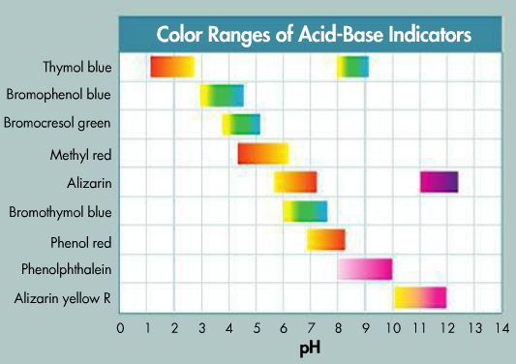
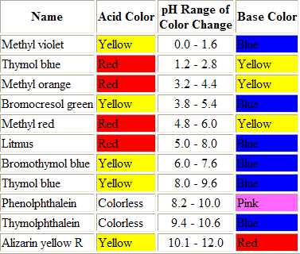
Acid-Base Indicators
Temperature, dissolved salts, and any color in a tested solution can alter expected results of indicators.
Indicator strips were developed to overcome these issues and they can cover a wide range of pH values (e.g. pH or Hydrion paper).
Notes:
29

Slide 30
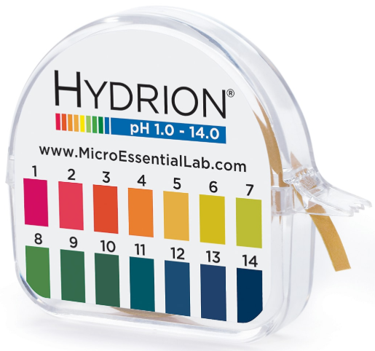
Acid-Base Indicators
Indicator strips were developed to overcome these issues and they can cover a wide range of pH values (e.g. pH or Hydrion paper).
Notes:
30

Slide 31
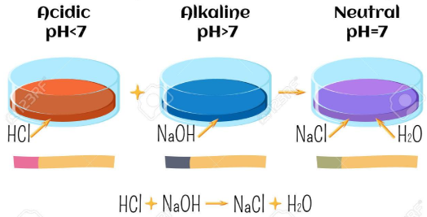
Neutralization
Neutralization is the complete reaction of a STRONG acid with a STRONG base to produce a neutral solution.
A neutral solution has a pH of 7 because it contains equal concentrations of hydrogen ions (H+) and hydroxide ions (OH-).
[H⁺] = [OH⁻]

Slide 32
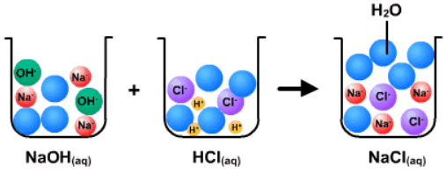
Neutralization
The general equation for an acid base neutralization:
Acid + Base → Salt + Water

Slide 33
Neutralization
The general equation for an acid base neutralization:
Acid + Base → Salt + Water
Salt = the anion from an acid and the cation from a base
KOH K⁺ + OH⁻
HBr H⁺ + Br⁻
KOH + HBr KBr + H₂O
Salt

Slide 34
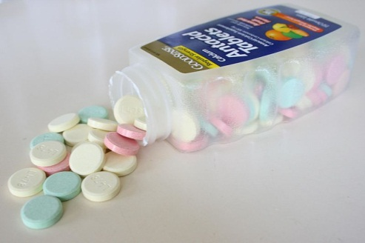
Neutralization Reactions in Everyday Life
Antacids neutralize excess stomach acid
NaHCO₃ + HCl → H₂O + NaCl + CO₂
Ca(OH)₂ + 2HCl → CaCl₂ + 2H₂O
Toothpaste contains antacids to cancel acids that would damage teeth.
Lime (calcium hydroxide) is used to neutralize acidic soil.
Notes:
Timing: ~1 minute
Excess stomach acid caused by overeating can be treated with commercially available antacids. Two common types are sodium bicarbonate (common baking soda) and calcium hydroxide. Aluminum hydroxide is also found in some commercial preparations.
Source: https://commons.wikimedia.org/wiki/File:Antacid-L478.jpg

Slide 35
Neutralization
A reaction between an acid and a base will go to completion when the solutions contain equal numbers of hydrogen ions and hydroxide ions. This can occur between strong acids and strong bases because both dissociate completely.
The balanced equation provides the correct ratio of moles of acid to moles of base to produce the neutralization.
For hydrochloric acid and sodium hydroxide, the mole ratio is 1:1 so equal quantities of the acid and base neutralize.
HCl(aq) + NaOH(aq) → NaCl(aq) + H₂O(l)
Acid Base Salt Water
1 mol
1 mol
1 mol
1 mol
Notes:
35

Slide 36
Neutralization
What is the mole ratio of sulfuric acid to sodium hydroxide?
Similarly, in theory, what is the mole ratio of hydrochloric acid to calcium hydroxide?
HCl(aq) + Ca(OH)₂(aq) CaCl₂(aq) + H₂O(l)
H₂SO₄(aq) + NaOH(aq) → Na₂SO₄(aq) + H₂O(l)
Notes:
36

Slide 37


Neutralization
What is the mole ratio of sulfuric acid to sodium hydroxide?
Two moles of the strong base are required to neutralize one mole of the strong acid.
Similarly, in theory, what is the mole ratio of hydrochloric acid to calcium hydroxide react in a 2:1 ratio. In theory two moles of the acid are required to neutralize one mole of the base.
2HCl(aq) + Ca(OH)₂(aq) CaCl₂(aq) + 2H(OH)(l)
Acid Base Salt Water
H₂SO₄(aq) + 2NaOH(aq) → Na₂SO₄(aq) + 2H(OH)(l)
1 mol
2 mol
1 mol
2 mol
Notes:
37

Slide 38
Neutralization
Each of the following incomplete reactions are neutralization reactions. What is the formula of the salt formed?
H₂SO_{4 (aq)} + NH₄OH _{(aq)} → ?
NaOH _{(aq)} + H₂CO_{3 (aq)} → ?
HNO_{3 (aq)} + KOH _{(aq)} → ?
H₃PO_{4 (aq)} + NaOH _{(aq)} → ?
Notes:
Timing: ~ 1 minute
Entry: Match each incomplete reaction with the salt formed.
Hint audio: Water is the other product of each reaction.
Exit: Next, we will learn more about salts and their properties.

Slide 39
Neutralization
Each of the following incomplete reactions are neutralization reactions. What is the formula of the salt formed?
H₂SO_{4 (aq)}+ 2NH₄OH _{(aq)}→ (NH₄)₂⁺(SO₄)⁻² _{(aq)}+ 2H⁺(OH)⁻ _{(aq)}
2NaOH _{(aq)} + H₂CO_{3 (aq)} → Na₂⁺(CO₃)⁻² _{(aq)} + 2H⁺(OH)⁻ _{(aq)}
HNO_{3 (aq)} + KOH _{(aq)} → K⁺(NO₃)⁻ _{(aq)} + H⁺(OH)⁻ _{(aq)}
H₃PO_{4 (aq)} + 3NaOH _{(aq)} → Na₃⁺(PO₄)⁻³ _{(aq)} + 3H⁺(OH)⁻ _{(aq)}
Neutralization: Acid + Base → Salt + Water
Notes:
Timing: ~ 1 minute
Entry: Match each incomplete reaction with the salt formed.
Hint audio: Water is the other product of each reaction.
Exit: Next, we will learn more about salts and their properties.

Slide 40
Hydrolysis of a Salt
Show the acid and base used to form each salt in a neutralizing reaction.
K₂SO₄
NaBr
MgCl₂
(NH₄)₃PO₄
Notes:
Timing: ~ 1 minute
Entry: Match each incomplete reaction with the salt formed.
Hint audio: Water is the other product of each reaction.
Exit: Next, we will learn more about salts and their properties.

Slide 41
Hydrolysis of a Salt
Show the acid and base used to form each salt in a neutralizing reaction.
K₂SO₄ + 2H⁺(OH)⁻ → H₂⁺(SO₄)⁻² _{(aq)} + 2K⁺(OH)⁻ _{(aq)}
NaBr + H⁺(OH)⁻ → H⁺Br⁻ _{(aq)} + Na⁺(OH)⁻ _{(aq)}
MgCl₂ + 2H⁺(OH)⁻ → 2H⁺Cl⁻ _{(aq)} + Mg⁺²(OH)₂⁻ _{(aq)}
(NH₄)₃PO₄ + 3H⁺(OH)⁻ → H₃⁺(PO₄)⁻³_{(aq)} + 3NH₄⁺(OH)⁻_{(aq)}
Hydrolysis: Salt + Water → Acid + Base
Neutralization: Acid + Base → Salt + Water
Notes:
Timing: ~ 1 minute
Entry: Match each incomplete reaction with the salt formed.
Hint audio: Water is the other product of each reaction.
Exit: Next, we will learn more about salts and their properties.

Slide 42
Neutralization Reactions
  Indicate the number corresponding to each coefficient required to write the balanced equation given.
  aHNO_{3 (aq)} + bMg(OH)_{2 (aq)} → cH₂O + dMg(NO₃)_{2 (aq)}
  a = b = c = d =
  How many moles of Mg(OH)₂ are needed to completely neutralize 2.48 mol HNO₃?
  aH₂SO_{4 (aq)} + bKOH _{(aq)} → cH₂O + dK₂SO_{4 (aq)}
  a = b = c = d =
  How many moles of H₂SO₄ are needed to completely neutralize 0.0164 mol KOH?
Notes:
Timing ≈ 2 min
Entry Audio: Apply your knowledge of neutralization reactions and stoichiometric problem-solving to work through some problems.
Hint 1 Audio: Remember that one hydroxide ion, OH⁻, reacts with one hydrogen ion, H⁺, to form one water molecule.
Hint 2 Audio: Remember that the same number of atoms of each type must be present on each side of a balanced chemical equation.
Hint 3 Audio: Remember that you can use the coefficients from the balanced chemical equation to set up a mole ratio as a conversion factor.
Hint 4 Audio: Remember that when you multiply a value by a conversion factor that the conversion factor contains the desired units in the numerator and the units that will cancel in the denominator.
Exit Audio: Knowing how to solve stoichiometric problems is very useful when you want to determine the concentration of an acid or a base. You can carry out a neutralization reaction in which you react a known amount of one reactant with an unknown amount of the other. The results of this reaction can be used to determine the concentration of the unknown.

Slide 43
Neutralization Reactions
  Indicate the number corresponding to each coefficient required to write the balanced equation given.
  2HNO_{3 (aq)} + Mg(OH)_{2 (aq)} → 2H(OH) + Mg(NO₃)_{2 (aq)}
  How many moles of Mg(OH)₂ are needed to completely neutralize 2.48 mol HNO₃?
  The mol ratio is 2:1. Therefore, 2.48 mol/2 mol = X/1 mol = 1.24 mol Mg(OH)₂
  H₂SO_{4 (aq)} + 2KOH _{(aq)} → 2H(OH) + K₂SO_{4 (aq)}
  How many moles of H₂SO₄ are needed to completely neutralize 0.0164 mol KOH?
  The mol ratio is 1:2. Therefore, 0.0164 mol/2 mol = X/1 mol = 0.0082 mol H₂SO₄
M_{b}V_{b} = M_{a}V_{a}
Notes:
Timing ≈ 2 min
Entry Audio: Apply your knowledge of neutralization reactions and stoichiometric problem-solving to work through some problems.
Hint 1 Audio: Remember that one hydroxide ion, OH⁻, reacts with one hydrogen ion, H⁺, to form one water molecule.
Hint 2 Audio: Remember that the same number of atoms of each type must be present on each side of a balanced chemical equation.
Hint 3 Audio: Remember that you can use the coefficients from the balanced chemical equation to set up a mole ratio as a conversion factor.
Hint 4 Audio: Remember that when you multiply a value by a conversion factor that the conversion factor contains the desired units in the numerator and the units that will cancel in the denominator.
Exit Audio: Knowing how to solve stoichiometric problems is very useful when you want to determine the concentration of an acid or a base. You can carry out a neutralization reaction in which you react a known amount of one reactant with an unknown amount of the other. The results of this reaction can be used to determine the concentration of the unknown.

Slide 44
Neutralization
The term neutralization is used to describe both the reaction and the point at which a neutralization reaction is complete.
How many moles of sulfuric acid are required to neutralize 0.50 mol of sodium hydroxide?
H₂SO₄(aq) + 2NaOH(aq) → Na₂SO₄(aq) + 2H₂O.
Notes:
44

Slide 45
Neutralization
The term neutralization is used to describe both the reaction and the point at which a neutralization reaction is complete.
How many moles of sulfuric acid are required to neutralize 0.50 mol of sodium hydroxide?
Use the mole ratio of acid (A) to base (B) to determine the number of moles of acid:
  The mol ratio is 1:2. Therefore, X/1 mol A = 0.50 mol/2 mol B = 0.25 mol H₂SO₄
  OR
H₂SO₄(aq) + 2NaOH(aq) → Na₂SO₄(aq) + 2H₂O.
1 mol H₂SO₄
0.50 mol NaOH x
= 0.25 mol H₂SO₄
2 mol NaOH
Notes:
45

Slide 46
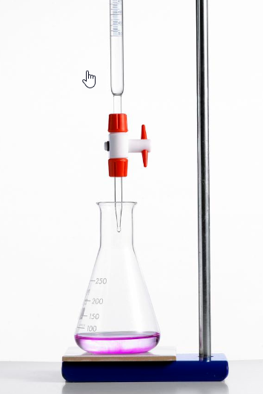
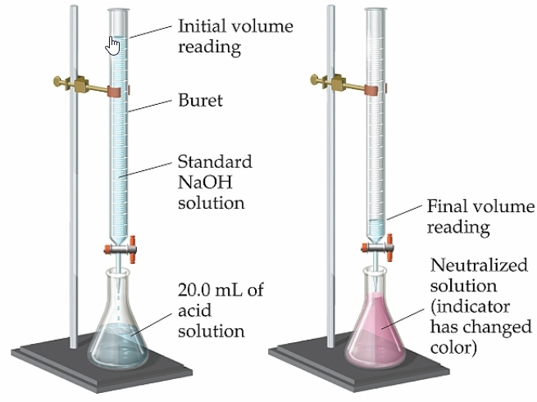
Titration
Notes:
46

Slide 47
Titration
Chemists use a neutralization reaction to determine the concentration of an acid or base.
The process of adding a measured amount of a solution of known concentration (titrant) to a solution of unknown concentration (analyte) is called a titration.
Notes:
47

Slide 48
Titration
The picture to the left shows a titration.
A measured volume of an acid solution of unknown concentration is added to a flask (analyte).
Several drops of an indicator (phenolphthalein) are added to the solution.
Measured volumes of a base of known concentration (titrant) are mixed into the acid until the indicator shows a stable color change.
Notes:
48

Slide 49
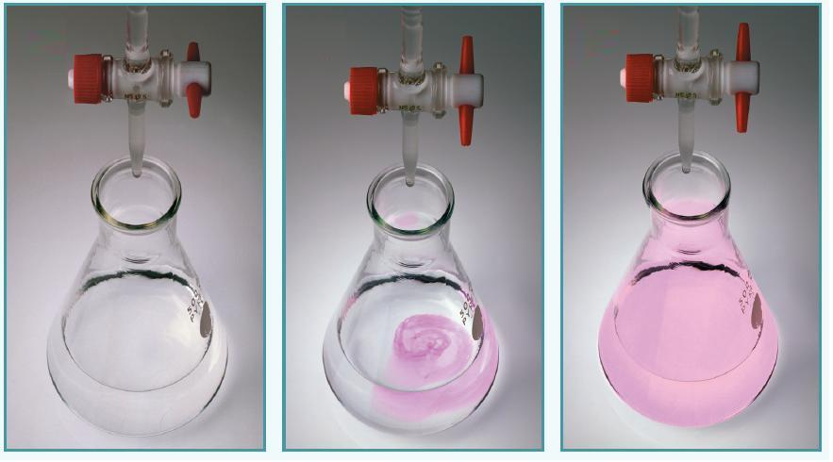
Titration
1
2
3
A flask with a known volume of acid (and an indicator) is placed beneath a burette that is filled with a base of known concentration.
The base is slowly added from the burette to the acid.
A stable change in the color of the solution is the signal that neutralization has occurred.
Notes:
49

Slide 50
Titration
Used to determine the composition or concentration of acids and bases in solution.
Used to analyze mixtures.
Used in nearly every laboratory: university, power plants, breweries, etc.
Titration is one of the most precise methods of chemical analysis [“Coke,” “Pepsi,” candy bars, prescription drugs, medicines, coloring in foods & clothing, flavorings, sewage treatment, paint mixing, food testing, water testing, fuels, pregnancy tests, etc.]
Example: Something splashes in your eyes. You’re not sure what it is … it burns. What should you do?
Get a sample of what went into your eye
Dilute your eye with water for about 15-20 minutes
Get to the hospital … the lab will TITRATE the substance to determine if it is an acid or a base … then neutralize it.
Notes:
50

Slide 51
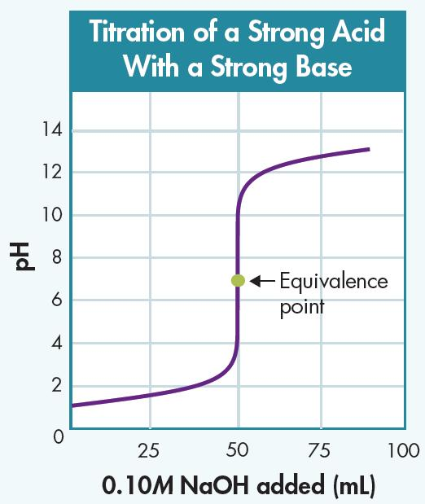
Titration
Equivalence Point
The point at which neutralization occurs.
  The point at which moles of one reactant (acid) have been added in stoichiometric quantity to react completely with the moles of the other reactant (base).
  The indicator chosen for this titration changes color at or near the pH of the equivalence point (7).
The point at which the indicator forms a stable color change is the end point of the titration.
https://screencast-o-matic.com/watch/cqfZDaZyxB
Notes:
51

Slide 52
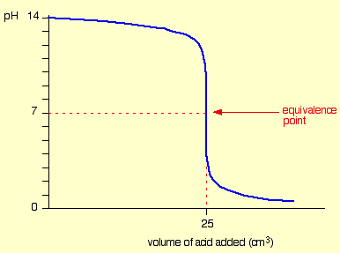
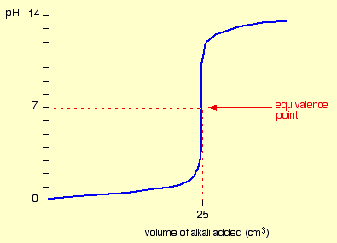
Titration
Titrations can be done by adding strong acid to strong base or strong base to strong acid.
Adding Acid to Base
Adding Base to Acid
Strong Base
Basic pH ~13
pH ~7
pH ~7
Acidic pH ~1
Strong Acid
    The pH changes gradually until near the equivalence point where equal moles of acid and base react completely (pH = 7).
    At the equivalence point pH changes dramatically.
Notes:
52

Slide 53
What Is a Titration?
Definition
Goal
Role of an Indicator
a lab technique based on reaching the equivalence point in a chemical reaction
  use a known concentration of one reactant to find an unknown concentration of another reactant
Allows accurate signaling that equivalence point has been reached
Notes:
Timing ≈ 0.5 minute
A titration is a laboratory technique. It is based on a chemical reaction between known compounds with known stoichiometric relationships.
During a titration one reactant is added to the other slowly until both reactants are present in stoichiometric amounts. At this point—called the equivalence point—the titration is complete.
The information collected during the titration and the known concentration of one of the reactants allows for the calculation of the concentration of the other reactant. This is the goal of a titration—to determine the concentration of a solution.
An indicator is included in the titration process as a means for determining when the equivalence point has been reached during the titration.

Slide 54
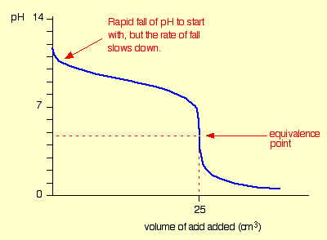
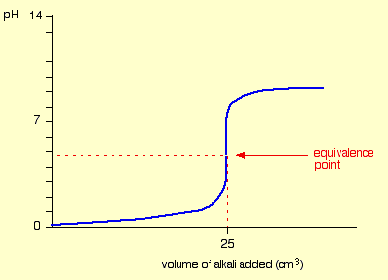
Titration
What type of Titrations is shown here?
(strong or weak) acid with a (strong or weak) base
Adding ? Acid to ? Base
Adding ? Base to ? Acid
    Describe the process for each graph (i.e. strong acid or base, pH of equivalence point, final solution).
Notes:
54

Slide 55
Titration
Titrations of a STRONG acid with a WEAK base.
Adding STRONG Acid to WEAK Base
Adding WEAK Base to STRONG Acid
Weak Base
Basic pH ~9
pH ~4.8
pH ~4.8
Acidic pH ~1
Strong Acid
    The equivalence point is NO longer at a pH of 7 as with the strong acids and strong bases. At the equivalence point:
    LEFT: ACIDIC (pH below 7) RIGHT: ACIDIC (pH below 7)
Notes:
55

Slide 56
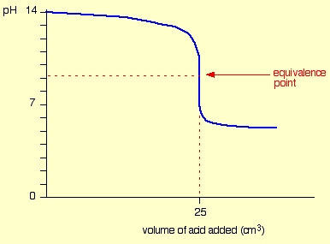
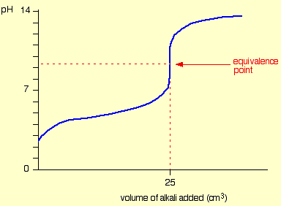
Titration
What type of Titrations is shown here?
(strong or weak) acid with a (strong or weak) base
Adding ? Acid to ? Base Adding ? Base to ? Acid
    Describe the process for each graph (i.e. strong acid or base, pH of equivalence point, final solution).
Notes:
56

Slide 57
Titration
Titrations of a WEAK acid with a STRONG base.
Adding WEAK Acid to STRONG Base
Adding STRONG Base to WEAK Acid
Basic pH ~13
Strong Base
pH ~9.1
pH ~9.1
Acidic pH ~5
Weak Acid
    The equivalence point is NO longer at a pH of 7 as with the strong acids and strong bases. At the equivalence point:
    LEFT: Basic (pH above 7). RIGHT: Basic (pH above 7).
Notes:
57

Slide 58
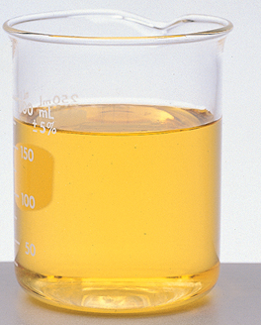
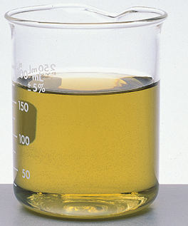
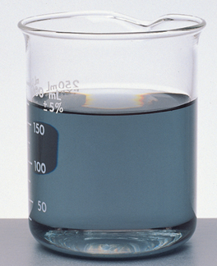
Salt Hydrolysis
  Titration depends on neutralization:
  acid + base → SALT + water
  The strength of the acids & bases used will determine the type of salt solution produced: acidic, neutral, or basic.
Ammonium chloride, NH₄Cl(aq), is acidic (pH of about 5.3).
Sodium chloride, NaCl(aq), is neutral (pH of 7).
Sodium acetate, NaCH₂COOH(aq), is basic (pH of about 8.7).
Notes:
58

Slide 59
Salt Hydrolysis
59
Ammonium chloride, NH₄Cl(aq), is acidic (pH of about 5.3).
NH₄⁺Cl⁻(aq) → NH₄⁺(OH)⁻(aq), + H⁺Cl⁻(aq)
salt weak base strong acid
Sodium chloride, NaCl(aq), is neutral (pH of 7).
NaCl(aq) → HCl(aq), + NaOH(aq)
salt strong acid strong base
Sodium acetate, NaCH₂COOH(aq), is basic (pH of about 8.7).
NaCH₂COOH(aq) → CH₃COOH(aq) + NaOH(aq)
salt weak acid strong base
Notes:
59

Slide 60
Salt Hydrolysis
  When a STRONG acid is titrated with a WEAK base, an ACIDIC salt solution is produced.
  Strong acid + Weak base → Acidic solution
  When a STRONG acid is titrated with a STRONG base, a NEUTRAL salt solution is produced.
  Strong acid + Strong base → Neutral solution
  When a WEAK acid is titrated with a STRONG base, a BASIC salt solution is produced.
Weak acid + Strong base → Basic solution
Notes:
60

Slide 61
Calculating in Titrations
Calculations involving titration is identical to “dilutions” in molar concentrations (M₁V₁ = M₂V₂):
Titration is based on the Molarity and Volume of the acids and bases involved.
M_{b}V_{b} = M_{a}V_{a}
This calculation can be applied to all concentrations and strengths of the acids and bases (include the mole factor of a balanced chemical reaction).
Notes:
61

Slide 62
Calculating in Titrations
Example: Titrate 0.4 M KOH (50 ml solution) with 0.6 M HCl
Notes:
62

Slide 63
Calculating in Titrations
Example: Titrate 0.4 M KOH (50 ml solution) with 0.6 M HCl
Step 1 Equation: KOH_{(aq)} + HCl_{(aq)} → HOH + KCl _{(aq)}
Step 2 Determine the mole ratio between the acid & base 1:1
Step 3 M_{a}V_{a} = M_{b}V_{b} (0.4 M)(50 ml) = (0.6 M)(V_{HCl})= 33.3 ml
The final volume of acid (HCl) would be 33.3 ml needed to neutralize the 50 ml of base (KOH).
Notes:
63

Slide 64
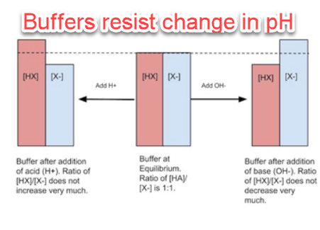
Buffers
A buffer is an aqueous solution that has a highly stable pH.
If you add acid or base to a buffered solution, its pH will not change significantly.
Notes:
64

Slide 65
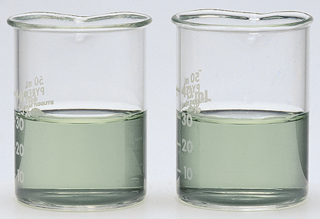
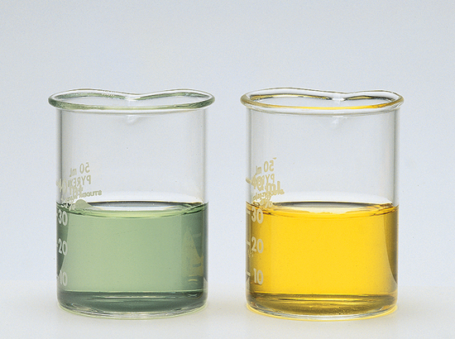
Buffers
Observe what happens when 1.0 mL of 0.10M HCl solution is added to buffered and unbuffered solutions.
HCl is added to each solution.
buffered
unbuffered
buffered
unbuffered
PRIOR to adding acid, the indicator shows that both solutions are basic (pH of about 8).
The indicator shows no visible pH change in the buffered solution.
The color change in the unbuffered solution indicates a change in pH from 8 to about 3.
Notes:
65

Slide 66
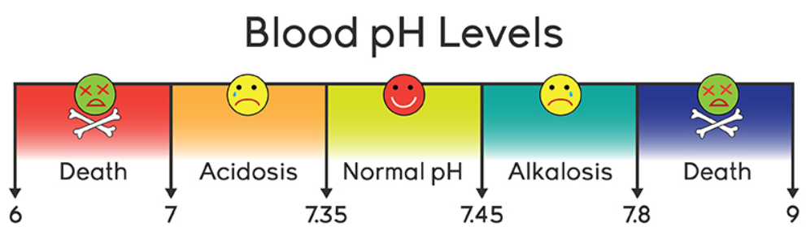
Buffers
A buffer is made by mixing a large volume of a weak acid or weak base together with its conjugate.
A weak acid and its conjugate base (salt) can remain in solution without neutralizing each other.
A weak base and its conjugate acid (salt) do not neutralize.
Notes:
66

Slide 67
Buffers
Buffers cause neutralization reactions that will not have much effect on the overall pH of the buffer solution.
When hydrogen ions are added to a buffer, they will be neutralized by the base in the buffer.
Hydroxide ions will be neutralized by the acid.
Notes:
67

Slide 68
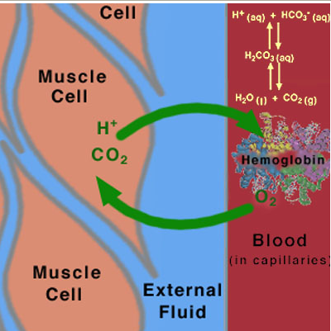
Buffers
How Buffers Work
A buffer solution is better able to resist drastic changes in pH than pure water since water dissociates so little (k_{w} = 10⁻¹⁴).
A buffer solution contains one component that can react with hydrogen ions (hydrogen-ion acceptor) and one that can react with hydroxide ions (hydrogen-ion donor).
These components act as “reservoirs” of neutralizing power that can be tapped when either hydrogen ions or hydroxide ions are added to the solution.
Buffer systems often include amphoteric substances.
Notes:
68

Slide 69
Buffers
Carbonic acid - Bicarbonate buffer system in the blood
HCO₃⁻_{(aq)} + (H⁺)_{(aq)} ↔ H₂CO_{3(aq)}
When an acid is added to the buffer system, the HCO₃⁻ reacts with the hydrogen ions of the added acid to produce carbonic acid (favors the forward reaction):
HCO₃⁻_{(aq)} + (H⁺)_{(aq)} → H₂CO_{3(aq)}
When a base is added to the buffer system, the H₂CO₃ dissociates to produce H+ ions that neutralize the added base (favors the reverse reaction):
HCO₃⁻_{(aq)} + (H⁺)_{(aq)} ← H₂CO_{3(aq)}
A buffer solution contains compounds that are able to neutralize both acids and bases. It performs acid-base neutralization reactions without significant change in pH.
Notes:
69

Slide 70
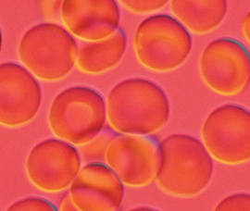
Carbonic acid - Bicarbonate Buffer System in the Blood
A person cannot survive for more than a few minutes if the pH of blood drops below 6.8 or rises above 7.8.
The pH of human blood must be kept close to 7.4.
The equilibrium between CO₂ (lungs), carbonic acid (H₂CO₃) and bicarbonate ions (HCO₃–) helps keep the blood within a narrow pH range (7.35 – 7.45).
2 H₂O + CO₂ ↔ H₂CO₃ + H₂O ↔ H₃O⁺ + HCO₃⁻
Notes:
70

Slide 71
Carbonic acid - Bicarbonate Buffer System in the Blood
pH too high?
pH rises because of excess base in the blood which reduces the hydronium ions.
2 H₂O + CO₂ ↔ H₂CO₃ + (OH)⁻ → H₃O⁺ + HCO₃⁻
Therefore, the BUFFER generates H₃O⁺ by having carbonic acid dissociate into hydronium ions to neutralize the base, favoring the forward reaction.
pH too low?
pH drops because of excess acid in the blood which increases the hydronium ions.
2 H₂O + CO₂ ↔ H₂CO₃ + H₂O ← H₃O⁺ + HCO₃⁻
Therefore, the BUFFER reduces H₃O⁺ by having bicarbonate ions accept hydronium ions to neutralize the acid (reverse rxn favored).
Notes:
71

Slide 72
Buffers
Another buffer system that helps maintain human blood pH:
H₂O + H₃PO_{4(aq)} ↔ H₂PO₄⁻_{(aq)} + H₃O⁺_{(aq)}
How does the equilibrium change when:
pH is too high?
pH is too low?
Notes:
72

Slide 73
Buffers
Another buffer system that helps maintain human blood pH:
H₂O + H₃PO_{4(aq)} ↔ H₂PO₄⁻_{(aq)} + H₃O⁺_{(aq)}
pH is too high?
The pH is too high because of excess base. In order to neutralize the base the buffer generates H₃O⁺. Therefore, the forward reaction is favored (→).
(OH)⁻ + H₃PO_{4(aq)} → H₂PO₄⁻_{(aq)} + H₃O⁺_{(aq)}
pH is too low?
The pH is too low because of excess acid. In order to neutralize the acid the buffer removes H₃O⁺ by reacting with H₂PO₄⁻_{(aq)}. Therefore, the reverse reaction is favored (←).
H₂O + H₃PO_{4(aq)} ← H₂PO₄⁻_{(aq)} + H₃O⁺_{(aq)}
Notes:
73

Slide 74
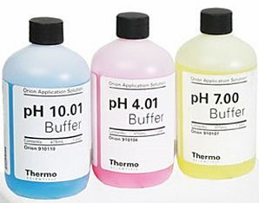
Buffer Capacity
Buffer solutions have their limits.
Adding too much acid or base will exceed the buffer capacity of a solution.
The buffer capacity is the amount of acid or base that can be added to a buffer solution before a significant change in pH occurs.
Buffers work best in environments with specific pH ranges.
For basic solutions, use a buffer with higher pH range (10.01).
For acidic solutions, use a buffer with lower pH range (4.01).
For neutral solutions, use a buffer with neutral pH range (7.00).
Notes:
74

Slide 75

Evaluating Strong & Weak Acids & Bases
Strong Acids | Strong Bases | Weak Acids | Weak Bases
HCl | NaOH | HOCl | NH₃
H₂SO₄ | KOH | HCOOH | CH₃NH₂
HNO₃ | MgOH₂ | CH₃COOH | NH₂NH₂
Of the following, which will form the fewest ions in water?
HNO₃ CH₃NH₂ H₂SO₄ NaOH
  Of the following bases, which will have the largest K_{b}?
MgOH₂ CH₃NH₂ NH₃ NH₂NH₂
  Which of these two acids is the stronger? 6M CH₃COOH 1M H₂SO₄ Which solution will have the higher pH? 0.1 M CH₃COOH 0.1 M HCl
  Which solution will be most consumed in a reaction?
CH₃NH₂ NH₃ NH₂NH₂ KOH
Notes:
Time ≈2.0 minute
Entry Audio: How well can you evaluate the properties of strong and weak acids and bases?
Hint 1: Remember that weak acids and bases are weak because they dissociate only partially.
Hint 2: Remember that a large K_{b} means that products (ions) are favored compared to reactants (the original acid or base).
Hint 3: Remember that concentration and strength refer to two different things when you are dealing with acids and bases. Strength is an intensive property.
Hint 4: Remember that the stronger acid will have a lower pH because it forms more H+ ions in solution than a weaker acid. Remember that when a strong base is placed in water, it dissociates completely so that the original, associated form, is no longer present.
Hint 5: Remember that when a strong base is placed in water, it dissociates completely so that the original, associated form, is no longer present.
Exit Audio: Each acid and base has its own characteristic tendency to dissociate. Therefore, each acid or base is considered either strong or weak depending on how strong the tendency is for that acid or base to dissociate. If the tendency is very strong, the acid or base dissociates completely and it is consider to be a strong acid or a strong base. If the tendency to dissociate is weak, the acid or base only dissociates a small amount and it is considered to be a weak acid or base. Knowing these fundamental differences between strong and weak acids and bases will be helpful as you move ahead with this lesson.

Slide 76
Evaluating Strong & Weak Acids & Bases
Strong Acids | Strong Bases | Weak Acids | Weak Bases
HCl | NaOH | HOCl | NH₃
H₂SO₄ | KOH | HCOOH | CH₃NH₂
HNO₃ | MgOH₂ | CH₃COOH | NH₂NH₂
Of the following, which will form the fewest ions in water?
HNO₃ CH₃NH₂ H₂SO₄ NaOH … weak acids/bases dissociate less
  Of the following bases, which will have the largest K_{b}?
MgOH₂ CH₃NH₂ NH₃ NH₂NH₂ … strong bases dissociate more (larger Kb)
  Which of these two acids is the stronger? 6M CH₃COOH 1M H₂SO₄
  Which solution will have the higher pH? 0.1 M CH₃COOH 0.1 M HCl
  Which solution will be most consumed in a reaction?
CH₃NH₂ NH₃ NH₂NH₂ KOH … Strong acids/bases favor forward rxn
Notes:
Time ≈2.0 minute
Entry Audio: How well can you evaluate the properties of strong and weak acids and bases?
Hint 1: Remember that weak acids and bases are weak because they dissociate only partially.
Hint 2: Remember that a large K_{b} means that products (ions) are favored compared to reactants (the original acid or base).
Hint 3: Remember that concentration and strength refer to two different things when you are dealing with acids and bases. Strength is an intensive property.
Hint 4: Remember that the stronger acid will have a lower pH because it forms more H+ ions in solution than a weaker acid. Remember that when a strong base is placed in water, it dissociates completely so that the original, associated form, is no longer present.
Hint 5: Remember that when a strong base is placed in water, it dissociates completely so that the original, associated form, is no longer present.
Exit Audio: Each acid and base has its own characteristic tendency to dissociate. Therefore, each acid or base is considered either strong or weak depending on how strong the tendency is for that acid or base to dissociate. If the tendency is very strong, the acid or base dissociates completely and it is consider to be a strong acid or a strong base. If the tendency to dissociate is weak, the acid or base only dissociates a small amount and it is considered to be a weak acid or base. Knowing these fundamental differences between strong and weak acids and bases will be helpful as you move ahead with this lesson.

