Slide 1
Go to the “Slide Show” shade above
Click on “Play from Beginning”

Slide 2
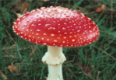
Bacteria, Protists, Fungi
Chapters 21-23

Slide 3
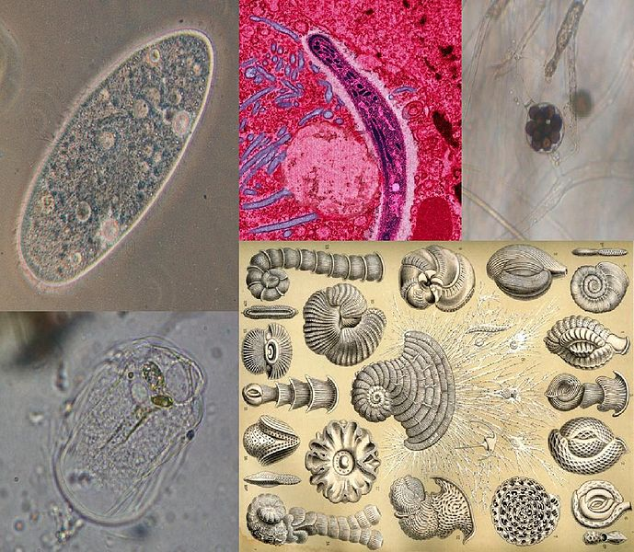
Kingdom Protista
Chapter 22
https://somup.com/c3j6qEu7Xf Bacteria Protists Fungi Lab (14:44)

Slide 4
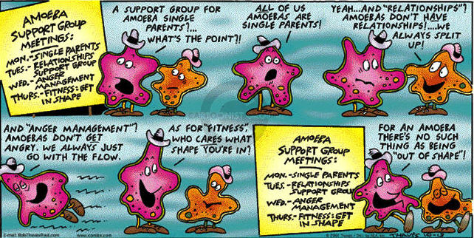

Slide 5
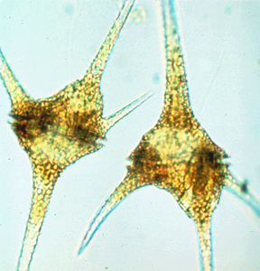
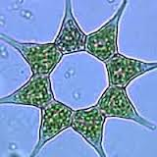
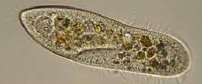
What is a Protist?
There is much debate about this very diverse group of organisms.
Scientists have been arguing for years over how best to classify these organisms.
Eventually the protists may be divided into many separate kingdoms.
For now, we will consider the protists as a single kingdom.
A protist is any organism that is not a plant, an animal, a fungus or a prokaryote.

Slide 6
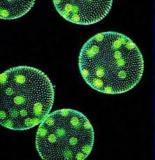
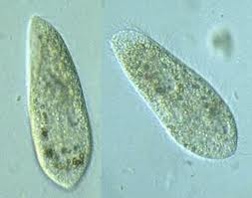
Protists are eukaryotes that are not members of the kingdoms:
Plantae, Animalia, or Fungi.
The range and variety of organisms in this kingdom is huge. It is thought that this group may contain over 200,000 different species.
Most protists are unicellular, but a few are colonial and a few are multicellular.

Slide 7
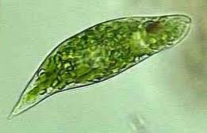
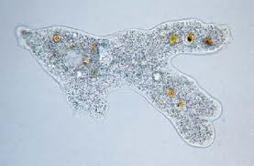
Because most protists are unicellular they are considered the simplest eukaryotic organisms, but their cells are extremely complex.
They must carry out within a single cell all the basic functions performed by specialized cells, such as:
digestion, gas exchange, circulation & excretion.

Slide 8
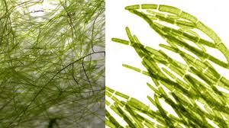
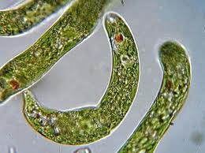
In multicellular organisms, essential biological functions are carried out by organs.
Unicellular protists carry out the same essential functions, but they do so using subcellular organelles, rather than with multicellular organs.

Slide 9
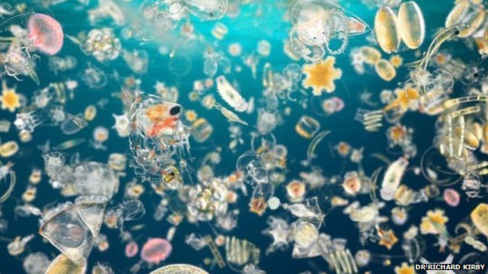
Protists
Protists make up a significant part of PLANKTON
Starting point in food chains
Produces majority of oxygen in atmosphere
Phytoplankton: Algae
Zooplankton: Protozoa

Slide 10
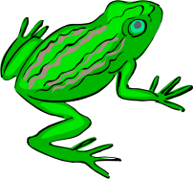
Protists can be divided into three categories:
Protozoa:
Ingestive (Heterotrophs) Animal-like protists
Algae:
Photosynthetic
(Autotrophs) Plant-like protists
Slime Molds:
Absorptive (External Digestion), Fungus-like protists.

Slide 11
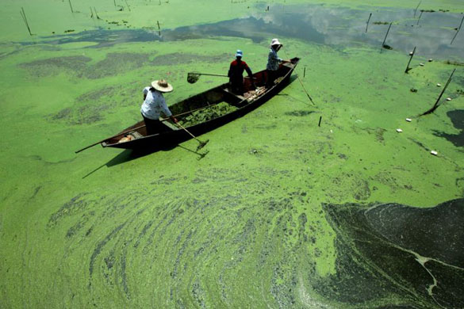
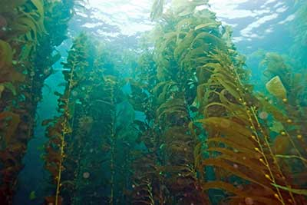
Algae
Plant-like Protists

Slide 12
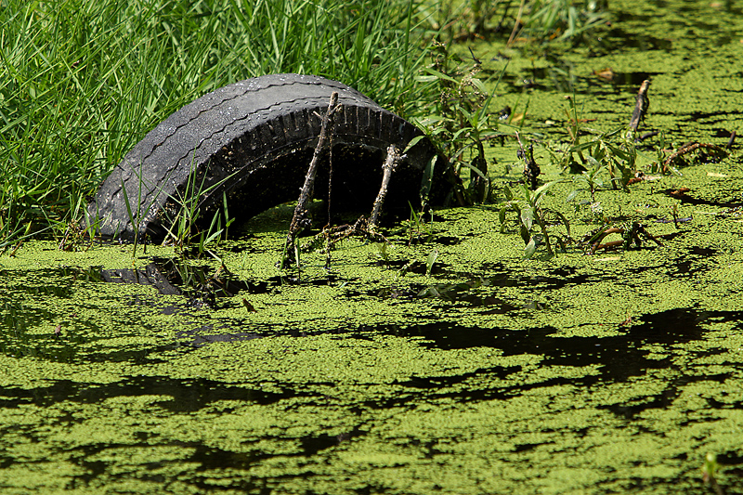
Algae are a very diverse group of protists. They range in size from microscopic single-celled organisms to large multicellular seaweeds.
All of the algae are autotrophs. They are eukaryotic, have chloroplasts, and make their own food by photosynthesis.

Slide 13
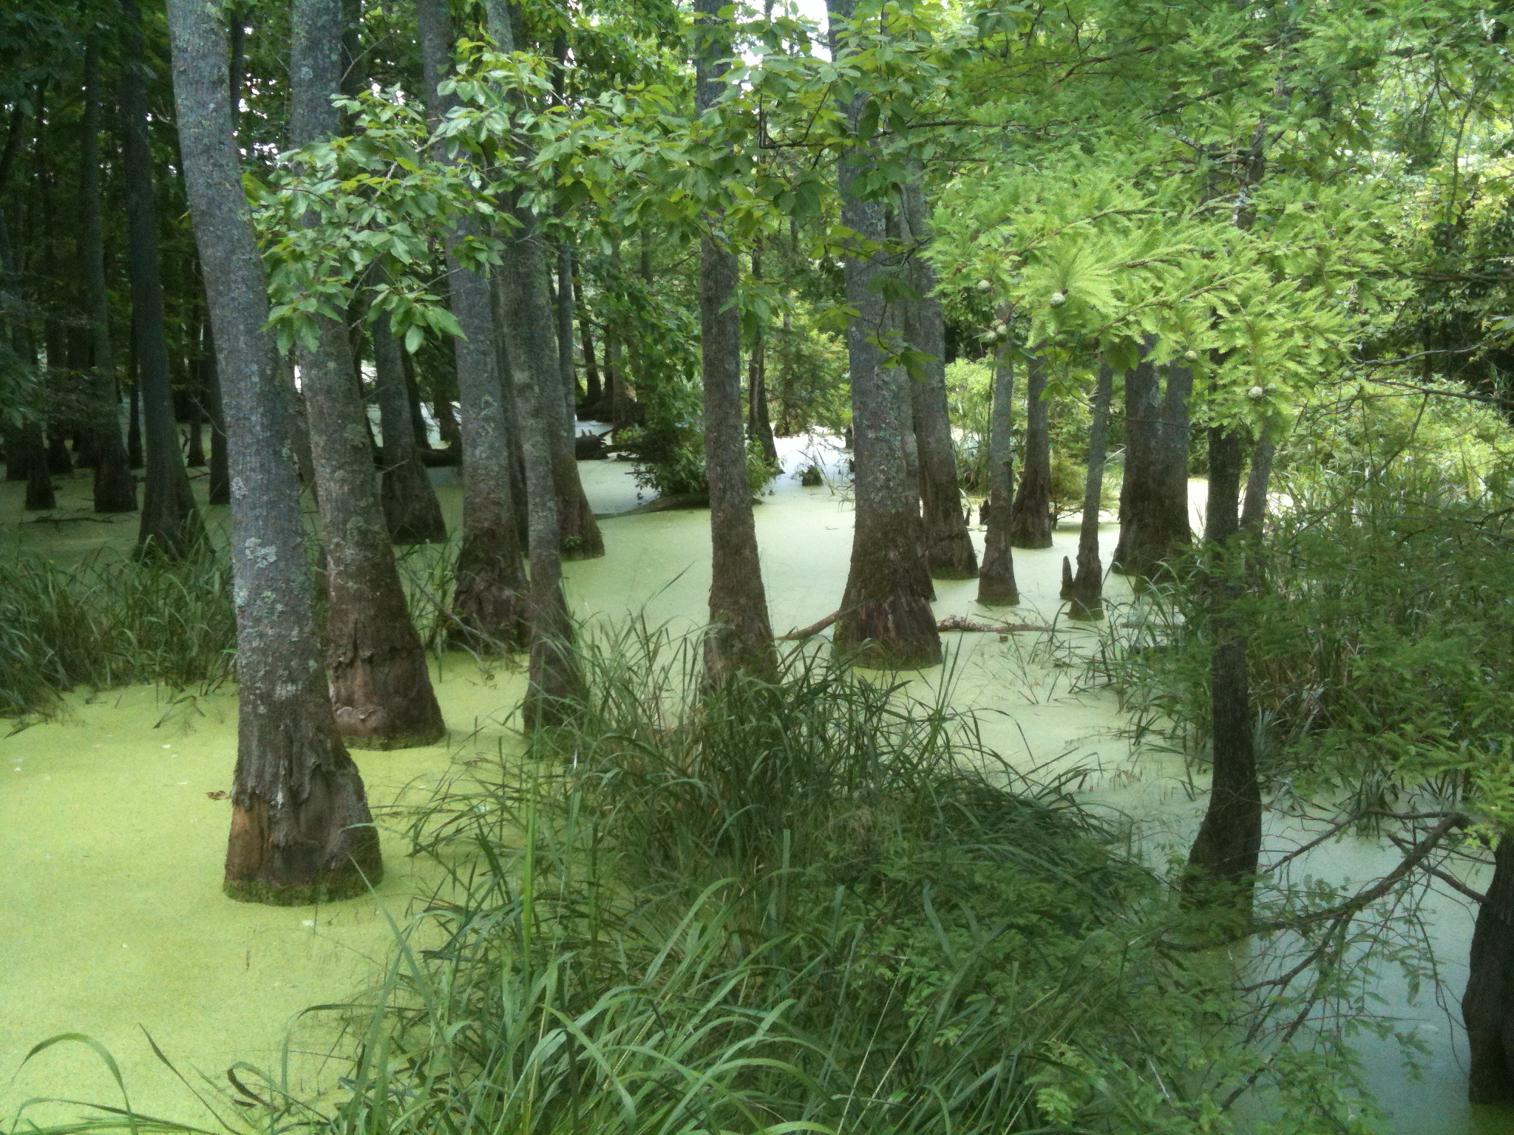
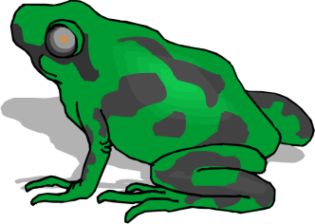
The unicellular algae are found floating near the surface of the oceans and inland waters.
Together with small invertebrates, they form the Plankton of the oceans.

Slide 14
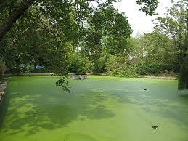
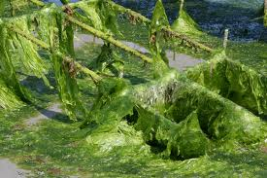
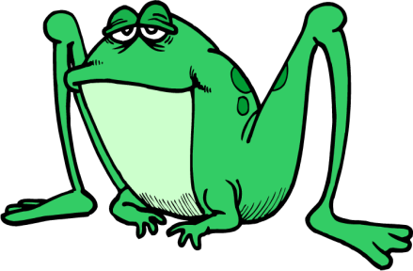
They are classified by color.
They all contain chlorophyll, but the green chlorophyll may be masked by other pigments.
There are green algae, red algae, brown algae, golden brown, and yellow algae.
Algae are producers in the food chain.
They are responsible for much of the atmospheric oxygen.

Slide 15
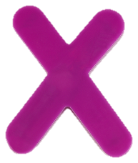
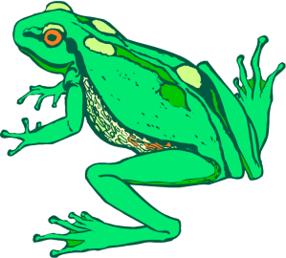
In the past, the algae were classified as plants and placed in the Kingdom Plantae.
They are now classified as Protists and are no longer a part of the plant kingdom for the following reasons:
PLANT KINGDOM
Algae LACK the specialized tissues that are found in the true plants.
Algae LACK vascular tissue (xylem and phloem) that is found in the true plants.
Algae LACK true roots, stems & leaves.
Algae form gametes in single-celled gametangia. True plants produced gametes in multicellular gametangia. (Gametangia are “gamete chambers” where sex cells are produced.)

Slide 16
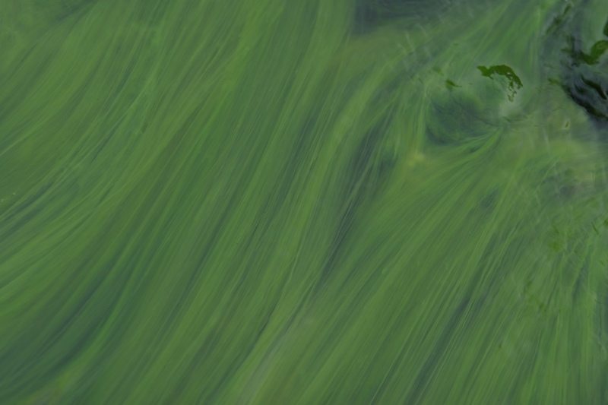
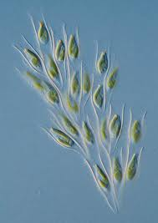
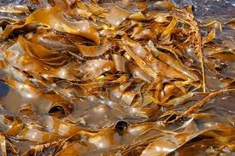
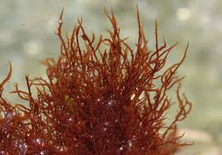
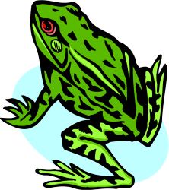
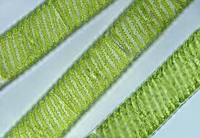
Algae are divided and classified into 7 phyla,
based on the Pigment Color:
BROWN
RED
GOLDEN
All algae contain chlorophyll, which is required for photosynthesis.
Some phyla have accessory pigments that give them a characteristic color.
GREEN

Slide 17
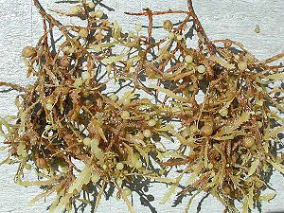
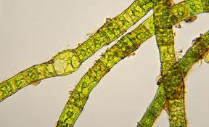
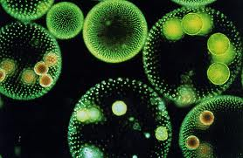
Structure of Algae
The body of an alga is called a “Thallus”.
multicellular
Based on the plant thallus, four types of algae are recognized:
Unicellular, Colonial, Filamentous, and Multicellular.
filamentous
colonial
unicellular

Slide 18
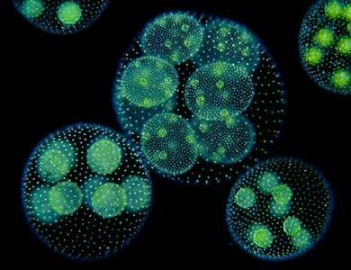
Types of Algae
Unicellular: mostly Phytoplankton
Colonial: Groups of individual algal cells that function together in a coordinated way
Volvox

Slide 19
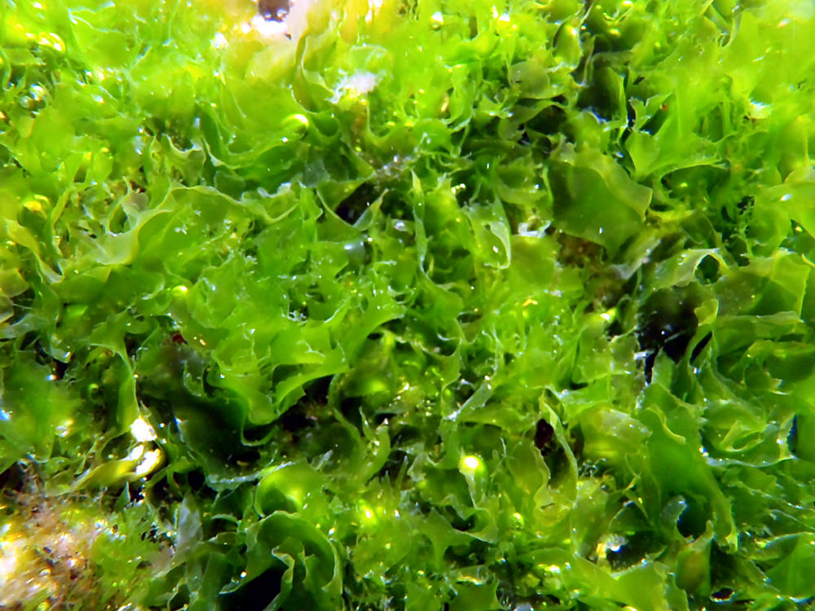
Types of Algae
Filamentous: Body made of rows of algal cells linked together end to end
Spyrogyra
Multicellular: Large, complex thallus
Ulva (sea lettuce)

Slide 20
Phyla of Algae
GREEN algae:
Exhibit all 4 types of algae
“Closest relative to land plants”
BROWN algae:
Seaweed or Kelp
Many are edible
Used to thicken processed foods: Pudding, ice cream, salad dressing, etc.
RED algae:
Seaweed or Kelp
Source of Agar, used for culturing bacteria and other microbes

Slide 21
Phyla of Algae
Diatoms:
Most abundant algae
Cell walls made of Silica, which is the primary component of glass
Dinoflagellates:
Some emit their own light (Bioluminescence)
Severe bloom causes Red Tide
Golden Algae
Euglenoids:
Euglena
Plant-like and Animal-Like characteristics
Contractile vacuole to eliminate excess water

Slide 22
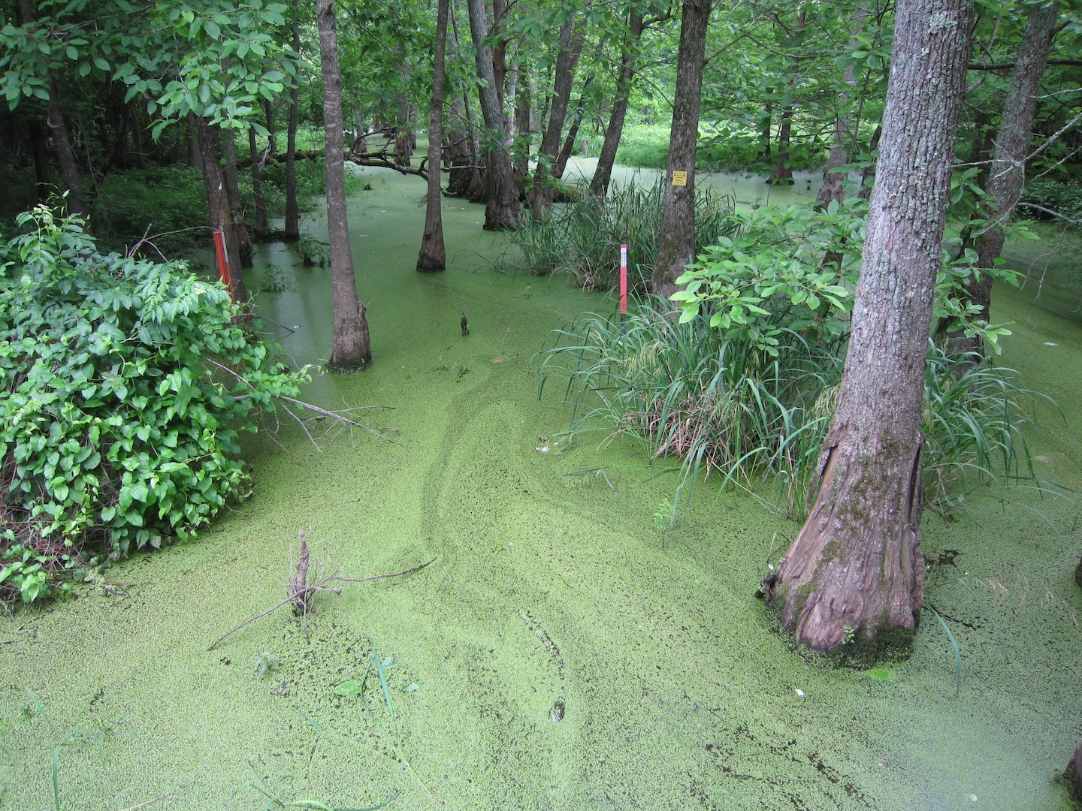
The Green Algae

Slide 23
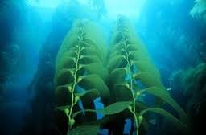
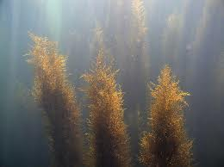
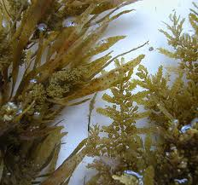
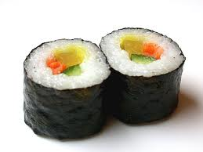
The Brown Algae

Slide 24
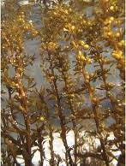
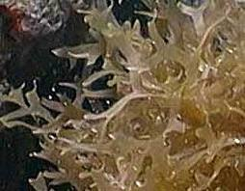
Brown Algae are the most complex of all algae.
They posses specialized tissues and organs that resemble those found in true plants.

Slide 25
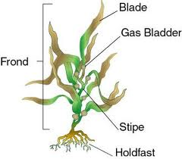
The body of Brown Algae consists of three general regions:
a) Holdfast – a root like structure that anchors the algae
b) Stipe – a stem like structure that supports the leaf like structure
c) Blade – a leaf like structure that is the photosynthetic surface
NOTE:
True roots, stems and leaves must contain vascular tissue (xylem and phloem).
The algae have no vascular tissue.

Slide 26
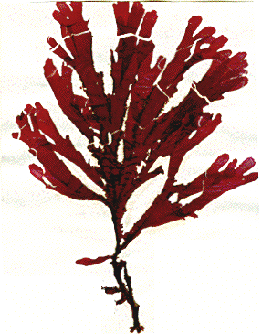
Red Algae

Slide 27
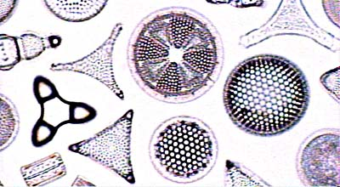
Diatoms

Slide 28
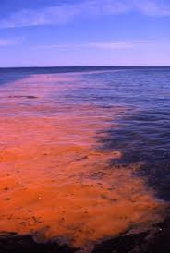
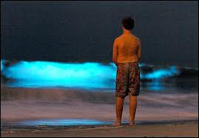
Some Dinoflagellates bloom in the ocean and create red tides.
They have an abundance of carotenoids turning the water a reddish color.
They produce toxins which can kill fish and invertebrates in the area.
Some species can produce bioluminescence, a display of light that can be seen at night.

Slide 29
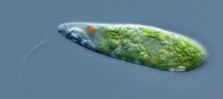
Euglenoids have both plant and animal characteristics:
Animal – like Characteristics:
Plant – like Characteristics:
a) They are highly motile and move with a flagella.
b) They can take in food through the cell membrane.
c) There is no cell wall.
They have chloroplasts and carry out photosynthesis.

Slide 30
Reproduction in Multicellular Algae
Ex. Ulva (Sea Lettuce)
Alternation of Generations:
Life cycle in which the organism exists in the
Haploid state (n) in one generation: Gametophyte
and in the Diploid state (2n) on the next generation: Sporophyte

Slide 31
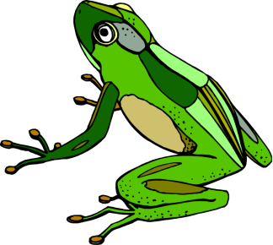
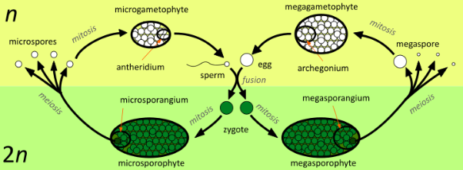
ALTERNATION OF GENERATIONS alternates between:
(1) a sexual and asexual stage.
(2) a haploid and diploid generation.
(3) a sporophyte and a gametophyte generation.

Slide 32
ALTERNATION OF GENERATIONS
The SPOROPHYTE generation is always diploid and the GAMETOPHYTE generation is always haploid.
The diploid sporophyte produces haploid spores by meiosis.
The spores divide by mitosis to produce the male and female gametophytes.
The haploid gametophytes produce gametes.
Fertilization of haploid gametes results in a diploid zygote.
This diploid zygote is the first step to the sporophyte generation.

Slide 33
Remember:
In animals, meiosis results in …
… haploid gametes (egg and sperm).
In plants (and algae), meiosis results in….
… haploid spores.

Slide 34
Reproduction in Multicellular Algae
Ulva (sea lettuce) lives as a gamete producing, haploid (n) Gametophyte in one generation.
Gametophyte produces haploid (n) “plus” and “minus” gametes (by mitosis).
Gametes fuse with one another to form a Zygote (2n).

Slide 35
Reproduction in Multicellular Algae
Zygote (2n) grows in size by mitosis into a spore-producing, diploid (2n) Sporophyte
Sporophyte produces haploid (n) spores by meiosis
Spores grow into the haploid (n) Gametophytes

Slide 36
Protozoans
Animal-like Protists

Slide 37
Protozoans
Heterotrophic; some Parasitic
Unicellular
Make a large part of the Zooplankton population
They have a Food Vacuole: membrane-bound chamber in which they break down their nutrients with enzymes.
Classified by how they move: flagella, cilia, pseudopods, spores.

Slide 38
The protozoa are generally classified into four groups
based on their Method Of Movement.
Pseudopodia (Amoebas)
Cilia (Ciliates)
Flagella (Zooflagellates)
No movement (Sporozoans)

Slide 39
Amoebas: the “Blobs”
Pseudopodia
Move by Cytoplasmic Streaming:
Cytoplasm moves inside the amoeba, which causes the surface of the cell membrane to move in different directions
As cytoplasm and cell membrane move, it pulls the amoeba
Pseudopods: extension of cell membrane formed as a result of cytoplasmic streaming

Slide 40
Amoebas: the “Blobs”
They can form pseudopods to surround and trap food.
Then form a FOOD vacuole to break down food in the cytoplasm.

Slide 41
Amoebas: the “Blobs”
CONTRACTILE Vacuole – collects extra water and expels it from cell.
Some species cause Amoebic Dysentery (fever, diarrhea, bleeding, damage to intestinal wall).

Slide 42
Ciliates: the “Hairy Ones”
Paramecium
Move beating tiny hairs called Cilia: help organisms move, get food, and sense its environment.

Slide 43
Ciliates: the “Hairy Ones”
Paramecium

Slide 44
Ciliates: the “Hairy Ones”
Have at least 2 nuclei:
Macronucleus: cell’s metabolism
Micronucleus: cell’s reproduction
Asexual and Sexual Reproduction
Sexual Reproduction by Conjugation

Slide 45
Ciliates: Paramecium Conjugation

Slide 46
Zooflagellates: the “Motorboats”
Use whip-like extension called flagella to move
Some cause diseases:
Trypanosoma: African Sleeping Sickness
Giardia: Hiker’s Diarrhea
Trichomonas: Sexually Transmitted Disease (STD)

Slide 47
Zooflagellates: the “Motorboats”
Most reproduce by binary fission.

Slide 48
Sporozoans: the Parasites
Cause the most human disease of any organisms on earth (parasites)
Adult forms cannot move
Vector: Organism that transports the parasite
Host: Organism infected
Plasmodium sp.

Slide 49
Sporozoans: the Parasites
Malaria caused by Plasmodium.
Causes fever, tiredness, anemia, kidney failure, and death.
Vector: Anopheles mosquito
Sporozoite and Gametocyte forms
Host: Humans
Sporozoite, Merozoite, and Gametocyte forms

Slide 50
Sporozoans: Plasmodium Life Cycle
Mosquito that has Gametocytes in the stomach (which fuse to form Sporozoites) bites a human – Sporozoites introduced in the host’s blood.
Sporozoites infect liver and mature into Merozoites – infect Red Blood Cells (RBCs).
At regular intervals, RBCs break open causing fevers, anemia, and other symptoms.

Slide 51
Sporozoans: Plasmodium Life Cycle
Some merozoites mature into Gametocytes in the RBCs.
When infected person is bitten by mosquito, gametocytes are taken into the stomach – combine to form Sporozoites.
Whole cycle starts over.

Slide 52
Both the Plasmodium and the Anopheles mosquito have become resistant to drugs and pesticides.
In recent years there has been a resurgence of malaria, killing 2 million people a year.

Slide 53
Fungus-like Protists Slime Molds and Water Molds

Slide 54
SLIME
Slime molds are typically found growing on damp soil, rotting logs, or decaying leaves.
MOLDS
They appear as glistening masses of slime that may be white, red or yellow.

Slide 55
SLIME MOLDS
They spend part of their life in a mobile, amoeba-like feeding form, engulfing organic materials, and part of their life in a stationary reproductive stage.
The slime molds play a key role in the recycling of organic material (Decomposers).

Slide 56
Water Molds
A water mold is a fungus-like organism composed of branching filaments of cells.
Most water molds are aquatic, but some live in the soil, and others are parasitic.
Water molds are sometimes seen as the white fuzz on diseased aquarium fish.
Potato Blight killed potato plants and caused Irish famine in mid 1800s

