Slide 1
Animate slides
Click on “Slide Show”
Click “Play from this Slide”

Slide 2
Heat Transfer
Objectives
Distinguish the three types of heat transfer (radiation, conduction, convection).
Explain the difference between thermal insulators and conductors.
Understand and apply the concept of adiabatic processes.

Slide 3
Energy in the Earth Systems
Energy in the Earth Systems can exist in a number of forms. A few examples are:
Thermal (heat) energy found in Earth
Chemical energy stored in the bonds of fossil fuels
Mechanical (motion) energy like that found in ocean tides

Slide 4
Specific Forms
of Energy
(Each has both PE & KE)

Slide 5
1. Chemical energy The energy associated with chemical changes (energy is also involved with physical changes)
a. Endothermic ΔH = + → heat flows into the reaction mixture from the surroundings
b. Exothermic ΔH = ─ → heat flows from the reaction mixture into the surroundings
c. Activation energy → The energy needed before a chemical reaction can take place (e.g. In order to downhill ski, energy must be available to take you to the top of the hill)

Slide 6
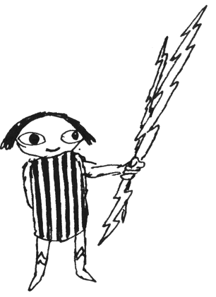
2. Mechanical energy when energy exerts a force
3. Electrical energy the flow of electrons (e-)

Slide 7
4. Light energy (electromagnetic radiation)
a. gamma … highest energy, highest frequency,
shortest wavelength
b. X-ray
c. UV
d. visible (VIBGYOR) … 400 nm to 700 nm
e. infrared
f. microwave
g. radio… lowest energy, lowest frequency,
longest wavelength (> 1 m)

Slide 8
5. Sound energy → sonar, ultrasound
6. Magnetic energy → magnetic field (NMR diagnostic techniques) MRI
7. Heat energy → form of energy that takes into account the quantity of matter
8. Activation energy → The energy needed before a chemical reaction can take place (e.g. In order to downhill ski, energy must be available to take you to the top of the hill)
9. Nuclear Energy → fission (splitting atoms), fusion (combining atoms)

Slide 9
Energy Units
1. Joule (j) → When a force of 1 Newton is applied through a distance of 1 meter, 1 joule of work is done
E (joules) = f (Newtons) x d (meters)
2. Calorie → The amount of energy required to raise 1 gram of water, one degree Celsius.
1 calorie = 4.18 joules
1 j = 2.39 X 10⁻¹ cal
1000 calories = 1 Calorie (kilocalorie)

Slide 10
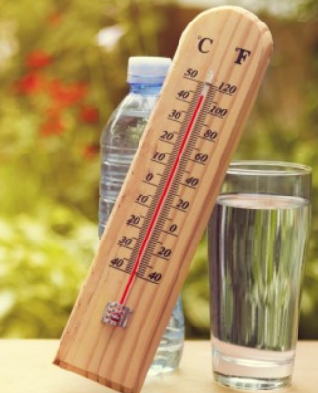
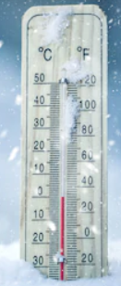
Temperature Scales
Units of Measurement
Temperature
A measure of the average kinetic energy (motion) of molecules in a substance.
Most people equate temperature with how “hot” or “cold” an object is. But an Alaskan or an Egyptian would define hot and cold differently than you and I.
80 ⁰F (27 ⁰C) would be “hot” to an Alaskan
But “cool” to an Egyptian

Slide 11
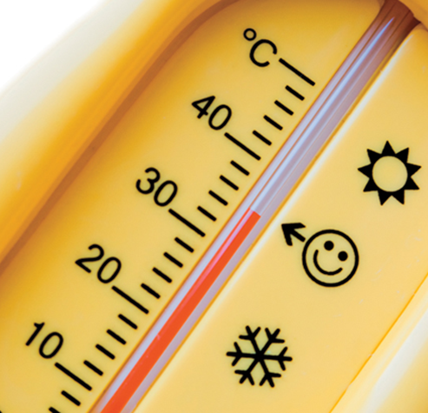
Temperature Scales
Units of Measurement
Temperature
A measure of the average kinetic energy (motion) of molecules in a substance.
Most substances expand with an increase in temperature and contract as the temperature decreases. (e.g. sidewalks in winter versus summer).
This explains how thermometers work (the liquid inside expands & contracts).

Slide 12
Temperature The measure of heat intensity: describes the average kinetic energy (KE) of the molecules in a system
B. Conversions
1. Fahrenheit and Celsius
F = 9/5 C + 32
C = 5/9 (F - 32)
2. Kelvin vs. Celsius
K = C + 273
1 K increment = 1 C
Fill In Values
C | K
0
 | 0
100
 | 100

Slide 13
Temperature The measure of heat intensity: describes the average kinetic energy (KE) of the molecules in a system
B. Conversions
1. Fahrenheit and Celsius
F = 9/5 C + 32
C = 5/9 (F - 32)
2. Kelvin vs. Celsius
K = C + 273
1 K increment = 1 C
Fill In Values
C | K
0 | 273
-273 | 0
100 | 373
-173 | 100

Slide 14
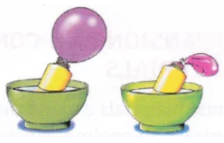
Heat Flow
Thermal expansion occurs when particles of matter move farther apart as temperature increases, therefore, volume increases.
As temperature decreases, there is thermal contraction of particles, therefore, volume decreases, because they slow down, collide less, and exert less force.

Slide 15
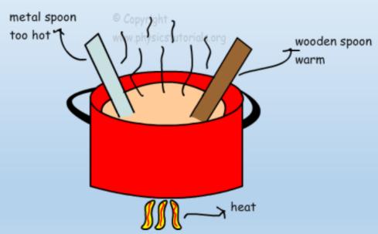
Heat Flow
Temperature relates to the specific heat of a substance.
The metal spoon heats up faster than the wooden spoon.

Slide 16
Heat Transfer

Slide 17
Heat Flow
Heat flows spontaneously from hot objects to cold objects.
The second law of thermodynamics (entropy) states that thermal energy can flow from colder objects to hotter objects only if work is done on the system.
This is because matter goes from order to disorder spontaneously. Hotter objects have particles moving much faster (more random) than cooler objects. Therefore, hotter objects spread out faster than cooler objects.

Slide 18
Heat Flow
Thermal energy depends on the mass, temperature, and phase (solid, liquid, or gas) of an object.
e.g. A cup of tea and a teapot full of tea can have the same temperature, but the number of particles (related to mass) and the phase (s, l, g) affect the heat flow.
On the Kelvin scale, absolute zero is defined as a temperature of 0 kelvins.

Slide 19
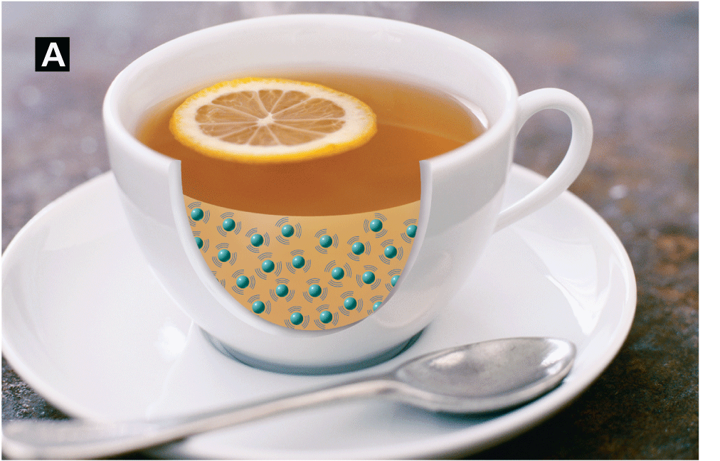
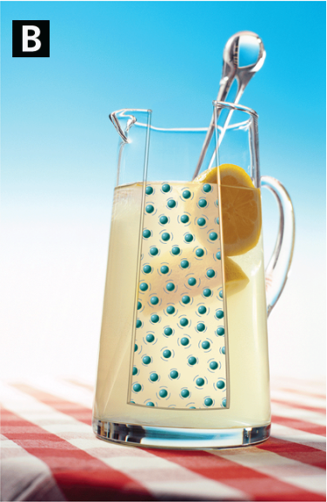
Thermal Energy
Thermal energy depends on mass and temperature.
The tea is at a higher temperature than the lemonade.
The lemonade has more thermal energy because it has many more particles.

Slide 20
Thermal (Heat) Energy Transfer
Like matter, energy can be transformed from one form to another AND can move from one sphere to another
Thermal (Heat) Energy is transferred in one of three ways:
Conduction
Convection
Radiation

Slide 21
Convection
Requires matter for the transfer

Slide 22
Heat Transfer
A. Convection
(requires matter for the transfer)

Slide 23
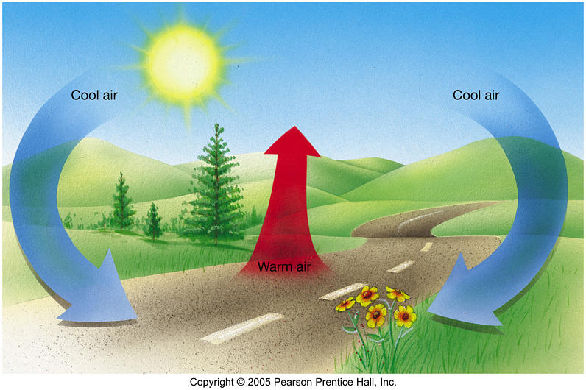
Convection
Energy is transferred due to differences in density or temperature.
The cooler material will sink, warmer material will rise.
This is true for heat IN and ON the Earth.

Slide 24
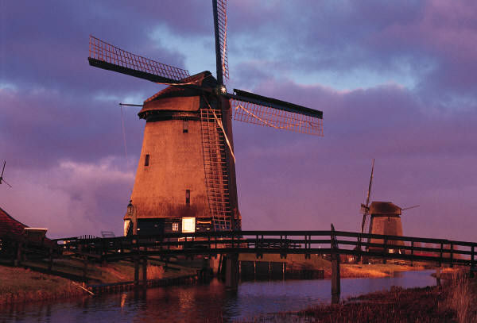
Convection
Causes Air Currents

Slide 25
Convection

Slide 26
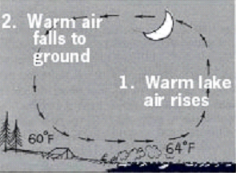
Convection

Slide 27
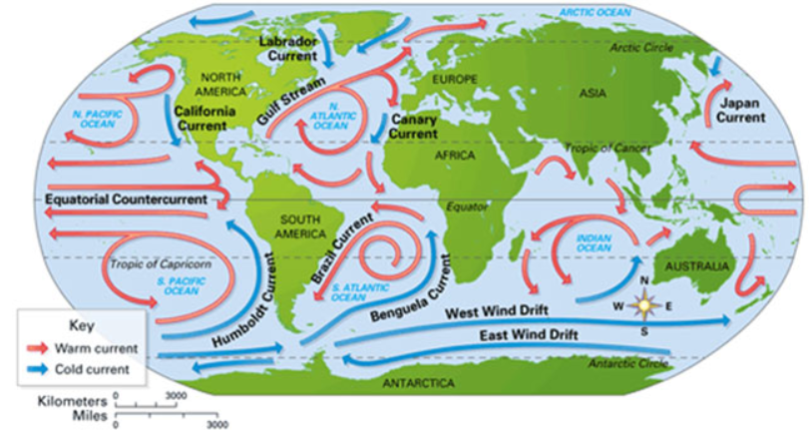
Convection
Ocean currents, Global wind patterns, and movement in the earth’s crust all occur due to convection.

Slide 28
Convection

Slide 29
Heat Transfer
B. Conduction
(requires matter for the transfer)

Slide 30
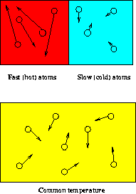
Conduction
Conduction – the transfer of heat by contact between molecules.
Conduction requires matter for the transfer

Slide 31
Conduction

Slide 32
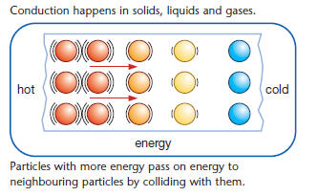
Conduction

Slide 33
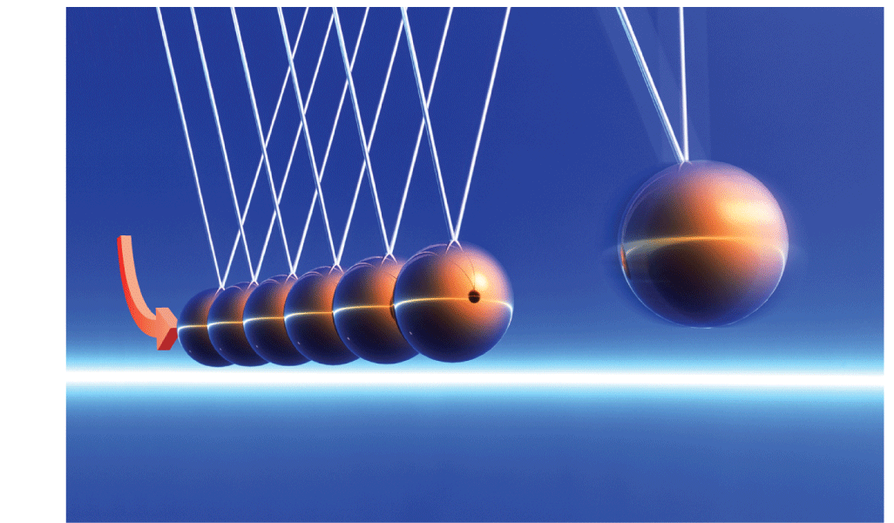
Conduction
Conduction in gases is slower than in liquids and solids because the particles in a gas collide less often.
Newton’s cradle helps to visualize conduction. One ball strikes the rest, and most of the kinetic energy is transferred to one ball on the end.

Slide 34
Conduction
Thermal Conductors
A thermal conductor is a material that conducts thermal energy well.
Metals are good thermal conductors.

Slide 35
Conduction
Thermal Insulators
A material that conducts thermal energy poorly is called a thermal insulator.
Air is a very good insulator. Wool garments and plastic foam cups use trapped air to slow down conduction.

Slide 36
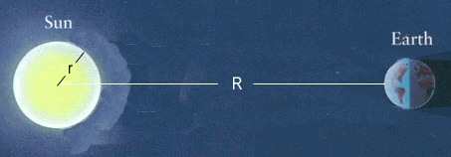
Heat Transfer
C. Radiation
(does NOT require matter for the transfer)

Slide 37
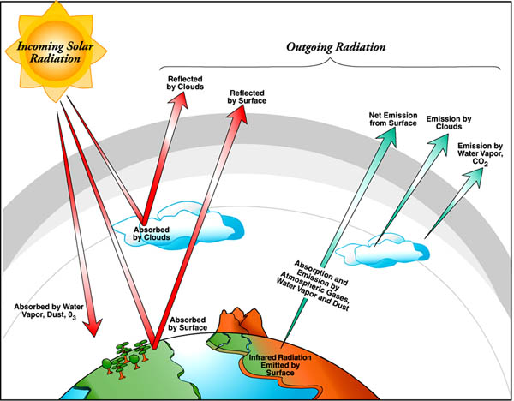
Radiation
Energy that is “given off” by an object AND does NOT require matter for the transfer.
The Earth is most affected by the Sun’s radiation (the heat the Sun gives off (radiates)).

Slide 38
Radiation

Slide 39
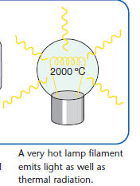
Radiation

Slide 40
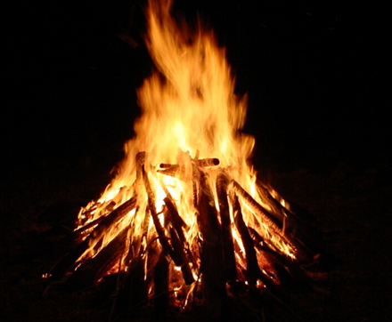
Examples of Radiation
The warmth of a bonfire
Stoves / Ovens radiate heat
A “radiator” in a house
Our bodies radiate heat

Slide 41
Radiation

Slide 42
Thermal (Heat) Energy Transfer
Conduction
(requires matter for the transfer)
Convection
(requires matter for the transfer)
Radiation
(does NOT require matter for the transfer)

Slide 43
Albedo
The reflectivity of a surface to radiant energy or light.
The higher the albedo the more it reflects radiation.
The temperature increase of a surface depends on albedo.
A surface with higher albedo would not gain as much temperature as a surface with lower albedo.

Slide 44
Albedo

Slide 45
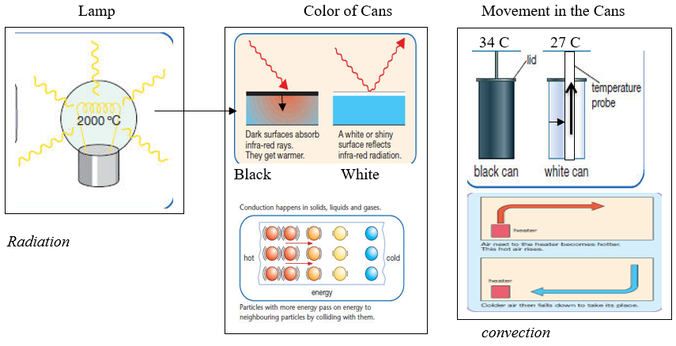
Albedo
The white can has the greatest albedo, meaning its surface reflects light from the lamp the most. In the experiment, we observed that the temperature inside the black can increased the most because it absorbed the radiation rather than reflected it as in the white can.

Slide 46
How Do Clouds Form? (Condensation)
Clouds form when air is cooled (e.g. lower pressure, higher elevation) which condenses the water vapor in the atmosphere.
Water vapor molecules attach to one another because they move slower in cooler air, and eventually attach to dust or smoke particles (condensation nuclei) in the atmosphere.
Once enough water is present – a cloud is formed.

Slide 47
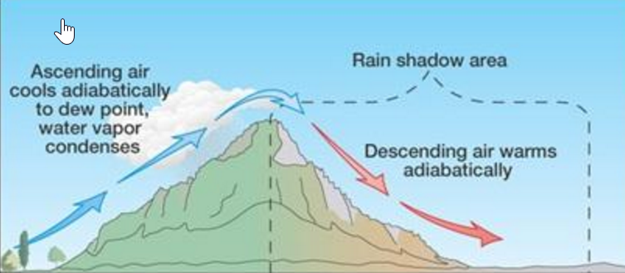
Adiabatic Cooling
The adiabatic process occurs when air rises or descends. No heat is added to or withdrawn from air.
Air pressure decreases with elevation (as air rises) and therefore expands.
The expanding air loses kinetic energy as the molecules slow down, decreasing temperature.
http://somup.com/cF6h2LnVWV (1:05)

Slide 48
Heating Systems
How do most heating systems distribute thermal energy?
Most heating systems use convection to distribute thermal energy.

Slide 49
Heating Systems
A central heating system heats many rooms from one central location.
The most commonly used energy sources for central heating systems are electrical energy, natural gas, oil, and coal.
Heating systems differ in how they transfer thermal energy to the rest of the building.

Slide 50
Heating Systems
Hot-Water Heating
At the boiler, heating oil or natural gas burns and heats the water.
The circulating pump carries the hot water to radiators in each room.
The hot water transfers thermal energy to the radiator by conduction.

Slide 51
Heating Systems
The hot pipes heat the room air by conduction and radiation.
Hot air rises and sets up a convection current in each room.
The cooled water returns to the boiler.

Slide 52
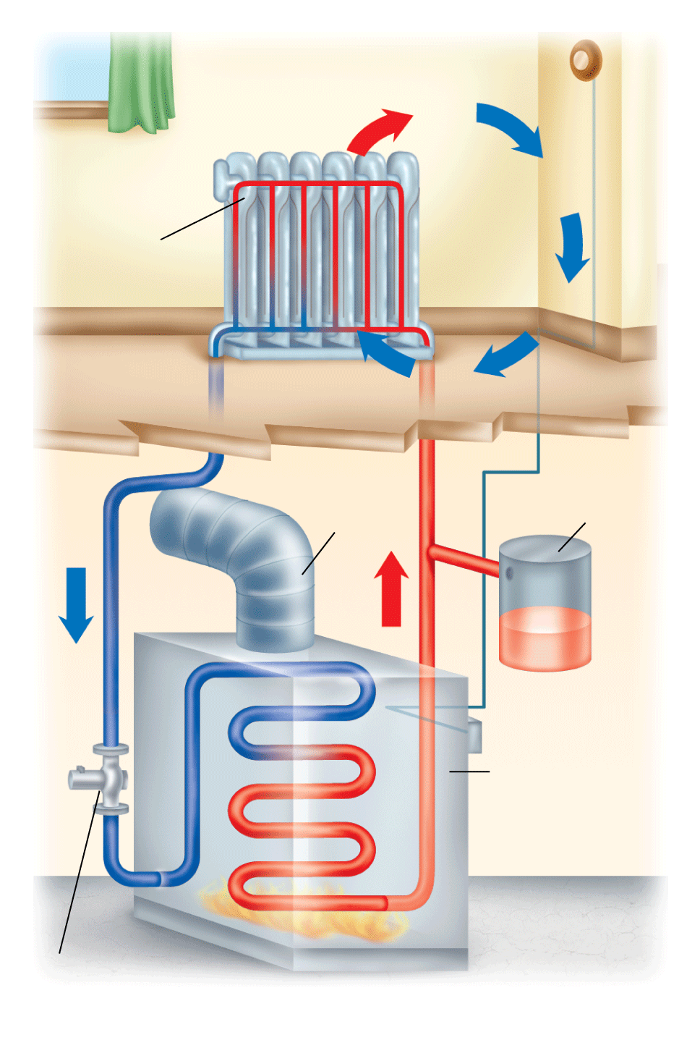
Heating Systems
Thermostat
Within the pipes of this hot-water heating system, the water circulates in a convection current.
In each room, the air moves in a convection current.
Radiator
Exhaust vent
Expansion tank
Boiler
Circulating pump

Slide 53
Heating Systems
Steam Heating
Steam heating is very similar to hot-water heating except that steam is used instead of hot water.
The transfer of heat from the steam-heated radiator to the room still occurs by conduction and radiation.
Steam heating often is used in older buildings or when many buildings are heated from one central location.

Slide 54
Heating Systems
Electric Baseboard Heating
An electric baseboard heater uses electrical energy to heat a room.
A conductor is used to convert electrical energy to thermal energy.
The hot coil heats the air near it by conduction and radiation.
Convection circulates the warm air to heat the room.

Slide 55
Heating Systems
Forced-Air Heating
Forced-air heating systems use fans to circulate warm air through ducts to the rooms of a building.
Convection circulates air in each room.
Warm air entering the room rises toward the ceiling.
Cool room air returns to the furnace through floor vents on the other side of the room.

Slide 56
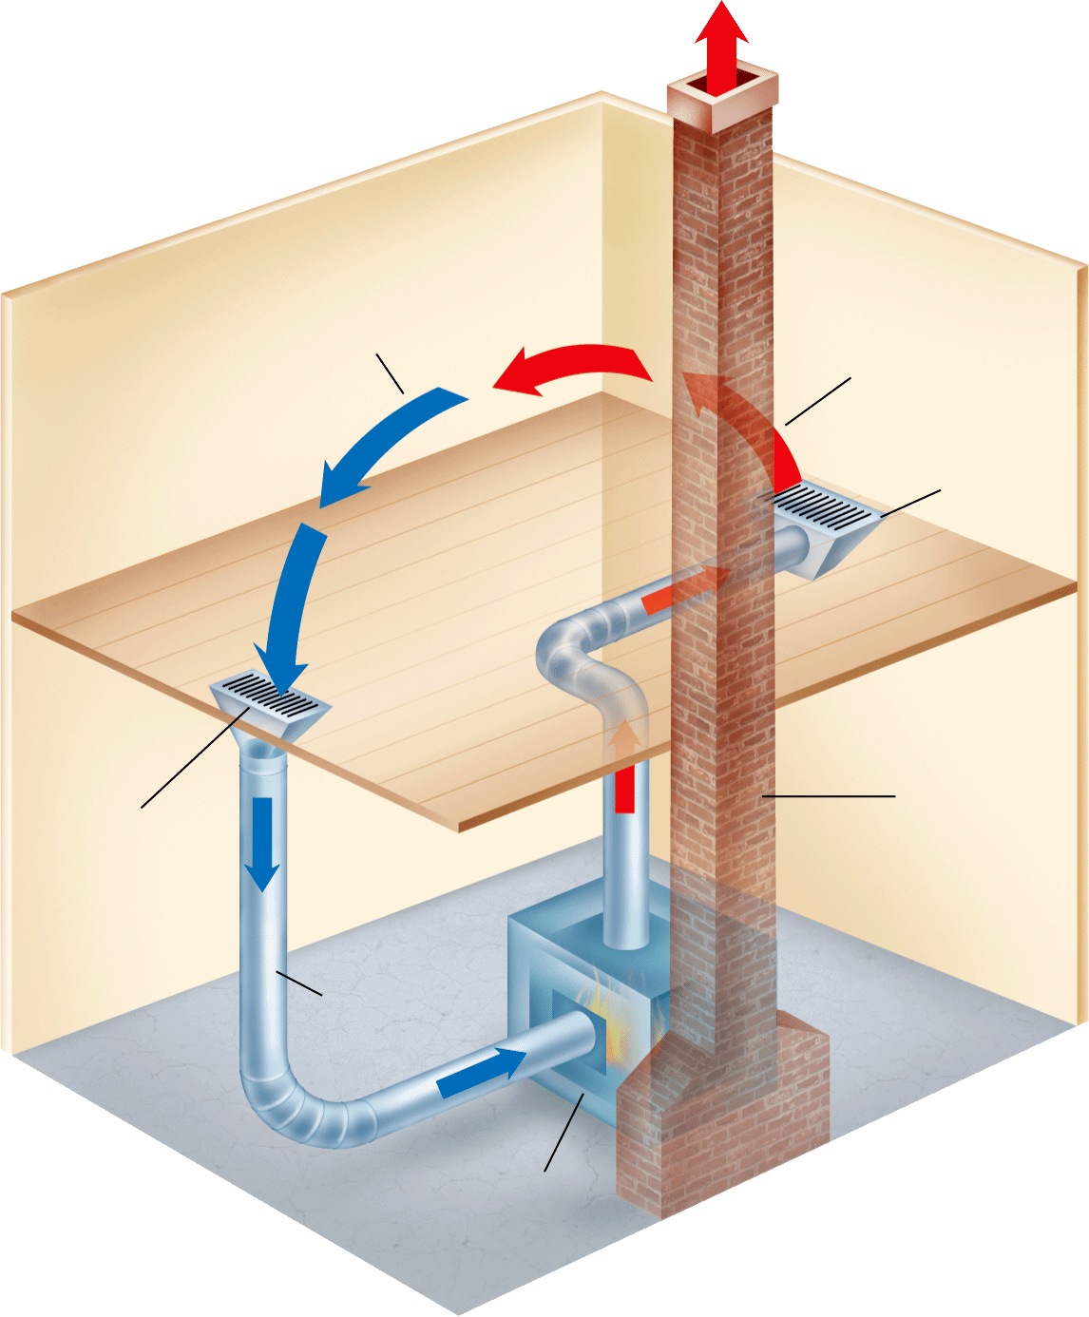
Heating Systems
Hot air enters the room through a supply vent in the floor. The hot air rises as cooler, denser air in the room sinks.
Cool air sinks
Hot air rises
Supply vent
Return vent
Chimney
Duct
Furnace

Slide 57
Cooling Systems
How does a heat pump reverse the normal flow of heat?
A heat pump is a device that reverses the normal flow of thermal energy.
Heat pumps must do work on a refrigerant in order to reverse the normal flow of thermal energy.

Slide 58
Cooling Systems
A refrigerant is a fluid that vaporizes and condenses inside the tubing of a heat pump.
When the refrigerant absorbs heat, it vaporizes, or turns into a gas.
When the refrigerant gives off heat, it condenses, or turns back into a liquid.

Slide 59
Cooling Systems
Refrigerators
A refrigerator is a heat pump—it transfers thermal energy from the cold food compartment to the warm room.
A motor must do work to move refrigerant through tubing inside the refrigerator walls.
Coils of tubing underneath or behind the refrigerator release heat absorbed from the food compartment and thermal energy produced by the work the motor does.

Slide 60
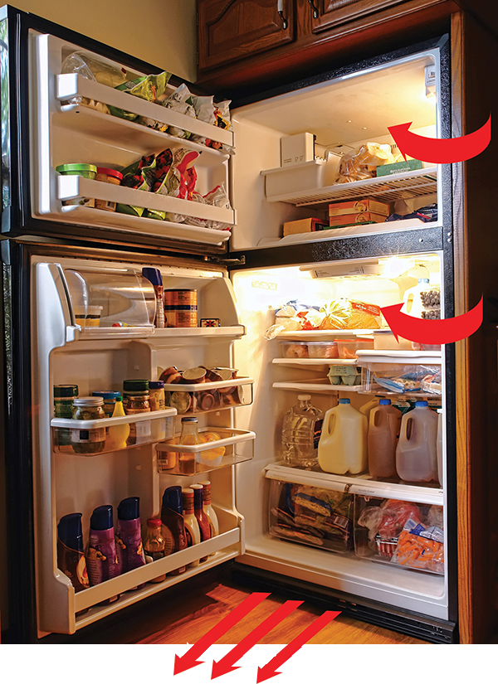
Cooling Systems
Temperature in room: 25°C
When a refrigerator door is open, some thermal energy from the room enters the refrigerator. More thermal energy leaves the refrigerator through the coils.
Temperature in refrigerator: 3°C

Slide 61
Cooling Systems
Air Conditioners
The compressor in a room air conditioner raises the temperature and pressure of the refrigerant, turning it into a hot, high-pressure gas.
The condenser coil is hotter than the outside air, so heat flows spontaneously to the outside air.
The refrigerant cools and condenses into a liquid.

Slide 62
Cooling Systems
The liquid refrigerant then flows through the expansion valve and decreases in temperature.
As the cold refrigerant flows through the evaporator coil, it absorbs thermal energy from the warm room air.
The fan sends cold air back into the room. The refrigerant becomes a vapor, and the process starts all over again.

Slide 63
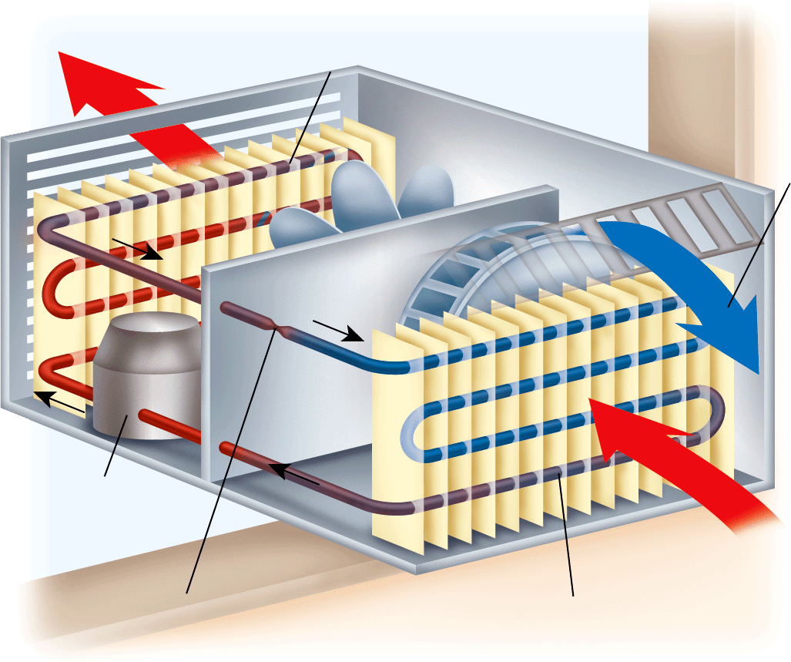
Cooling Systems
In a window air conditioner, outside air is heated as a fan blows it through the condenser coil.
Condenser coil Vapor cools to liquid as heat is removed.
Warm air out
Cold air out
Compressor
Expansion valve Pressure drops, causing liquid refrigerant to become cold.
Warm air in
Evaporator coil Liquid absorbs heat to become vapor.

