Slide 1
To View Slide Show
Click on “Slide Show” above
  Click on “From Current Slide”

Slide 2
Applications Of Energy
Chemistry
Physical Science
Physics

Slide 3
Home Energy Audit
Electric Energy
&
Electric Power

Slide 4
Why Deal With The Issue Of Energy?
Our population continues to increase.
The use of energy by every individual continues to increase.
With more energy usage, pollution increases (air, water, noise, land).
Heavy reliance on foreign sources to supply our energy needs raises costs and causes international tensions.
Our international trade deficit increases, meaning we depend on other countries more.

Slide 5
U.S. Population (Growth & Mortality)
One child is born every 8 seconds.
One person dies every 13 seconds.
One international migrant moves to the United states every 25 seconds
Net gain: one person every 11 seconds
U.S. Census Bureau
http://www.census.gov/cgi-bin/popclock

Slide 6
Electric Energy Consumed (including non-utility sources) in kiloWatthours per Person in the US
14,100 KWh per person in 2005
8,500 KWh per person in 1975
US Dept. of Energy,
US Census

Slide 7
Electric Energy Consumption versus Population - USA
~4.5 trillion kWh of energy
~310 million people in the US
US Dept. of Energy,
US Census
Notes:
ELECTRICITY
In 2000, the United States generated 3,807 billion kilowatthours (kWh) of electricity, including 3,009 billion kWh at electric utilities plus an additional 798 billion kWh at nonutility producers. For utilities, coal-fired plants accounted for 56% of generation, nuclear 23%, natural gas 10%, hydroelectricity 8%, oil 2%, geothermal and "other" 0.1%. For non-utilities, natural gas plants accounted for around 40% of generation, followed by coal at 33%, "geothermal and other" (including geothermal, wind, solar, wood and waste) at about 11%, nuclear at 6%, oil at 5%, hydroelectric at 2%, and "other gaseous fuels" (including refinery still gas and liquefied petroleum gases) at 1%. High (and volatile) gas prices also have increased interest in possible new coal-fired power plants, with several companies (the Peabody Group, Wisconsin Energy, Tucson Electric) announcing plans in this area. Coal-fired power plants generally have been less attractive than gas-fired plants in recent years due to relatively high capital costs, longer construction periods, and lower efficiency than natural gas combined-cycle plants.
http://www.eia.doe.gov/emeu/cabs/usa.html#ELEC

Slide 8
The Near Future
If the present trend between population and consumption per person continues, the Department of Energy (DOE) projects that by 2020 we will need 1,300 additional power plants to produce electric energy.

Slide 9
Sources of U.S. Electric Energy Production in 1999
52% from Coal
20 % from Nuclear
15% from Natural Gas
8% from Hydropower
Oil (3%) plays a minor role in electrical production
Dept. of Energy

Slide 10
How Do We Meet our Needs for Electric Power in the Future?
Reduce consumption
  Smaller population
  Use progressively less energy per person as the population increases
Increase Storage – improve utilization of existing facilities
Interconnect utilities with transmission lines to share extra capacity
Utilize alternative sources and modify lifestyles to match the limitation of the alternative source.
Build more power plants: Gas, Coal, Oil, or Nuclear

Slide 11
Storing Electric Energy
Large amounts of electricity are hard to store (e.g. batteries, “pumped storage”)
Utilities (electricity producing companies) must generate enough electricity to meet “peak” demands
Utilities want to run at reduced capacity most of the time to save costs

Slide 12
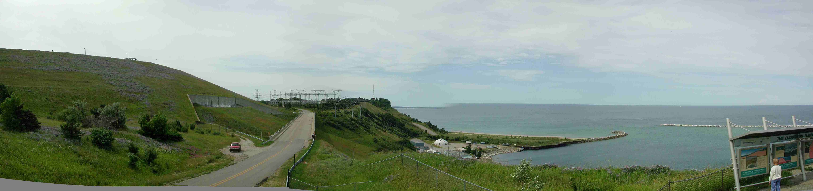
Ludington Pumped Storage
One Example of Electrical Storage
Buried Pipes for water flow
Turbine/Generators for electric energy
S. Lakeshore Drive
Lake
2 miles long

Slide 13
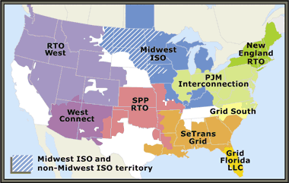
Utilities Connect by Transmission Lines to Share Capacity

Slide 14
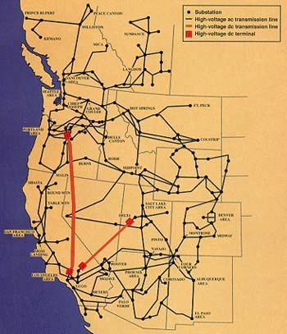
Grids
Transmission lines allow sharing between Utilities
Failure of a major transmission line can cause whole grids to shut down as in the summer of 2003

Slide 15

Wind Power
Wind turbines in California
  1,990 Wind Turbines
  1,697 MW maximum output
  1.5% of California’s Electric Energy
Wind turbines at Mackinaw City Michigan
  2 Wind turbines
  1.8 MW maximum output

Slide 16
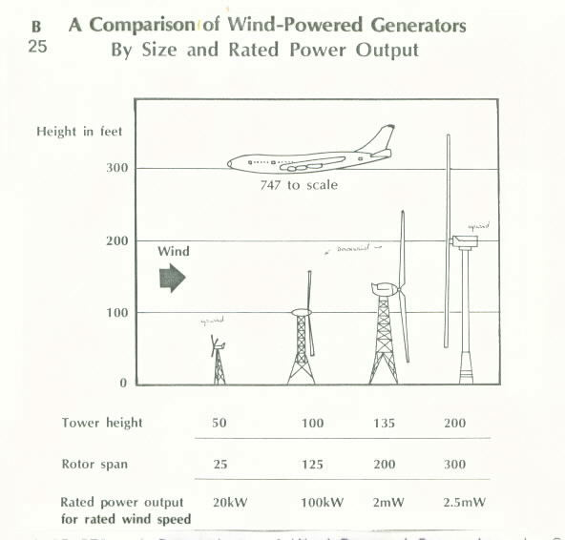

Slide 17
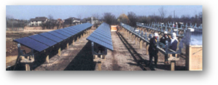
Solar Currents
Corner of Wagner and Scio Church in Ann Arbor
Produces only 38,000 kWh per year compared
to 20 Billion kWh at the Monroe Power Plant

Slide 18
Geothermal Energy
“Geo” = earth “thermal” = heat
Molten rock exists only 20 miles below us which can be piped to the surface for electrical energy production
The technology does not exist yet to drill that deep into the earth’s surface
The corrosive nature of the magma also makes it difficult to keep pipes clean

Slide 19
Tapping Energy From Tides
Most areas have small tides
Tides are available twice a day
There is a large capital expense to build dams, turbines, generators, etc.
Tides vary throughout the year

Slide 20
Biomass As An Energy Source
Comes from living organisms
Capture methane produced by the decomposition of waste (e.g. manure)
Produces CO₂ and CO
Limited amounts of biomass fuels are available

Slide 21
Fuel Cells
Has the potential of producing no pollution
Based on the most abundant element in the universe (hydrogen)
The waste product is water vapor
Test vehicles (Buses, RVs, Cars) are running on hydrogen fuel cells presently … but are limited to ~90 miles

Slide 22
Will Alternative Energy Sources Meet Our Energy Needs?
Take two minutes to discuss
with those at your table.
Have one person present your thoughts.
Alternative Sources like Hydropower, Wind & Solar Generators, Tides, etc. are presently producing less than 10% of our energy needs.
Many of these alternatives are in the experimental stage and will take years to perfect their usage … if even possible

Slide 23

Decisions for the Future
Do you use more or less electricity than your parents did at your age?
Will your children use more electricity than you do when they are your age?
Will energy be available to meet our demands?

Slide 24
Activity
Ask 5 different people ...
A way to save energy in their personal life
A luxury item they would be willing to live without should an energy crisis occur
Once you talk to 5 people,
sit back at your seat

Slide 25
Once everyone is sitting at your table ...
Compile a list of items for your group
Have one person record the items on the white board … you do not have to repeat an item if another group already wrote that one down.

Slide 26
A Home Energy Audit

Slide 27
How do we know how much electricity we use?
And how much does it cost?
We pay our power company (utility) to move the electrons back and forth from the power plant to our homes when we flip a switch

Slide 28
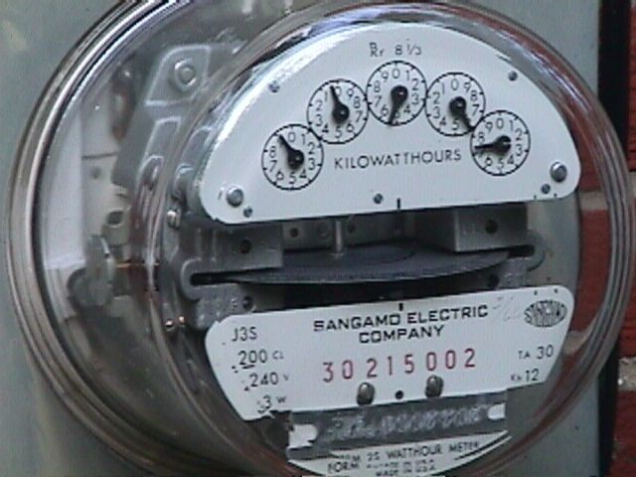
Measuring Home Energy Use
The electricity we use is monitored by a meter
The rotating disk shown is connected to a series of dials
Each dial represents a digit, telling the meter reader how many kilowatts of electricity we have used
Rotating disk

Slide 29
Watts a what?
No
What's a WATT ?

Slide 30
Power
  The rate of energy production or usage - measured in Kilowatts, kW
Power = Work/time
kW = kilojoules/second
Energy
  The Power used over a given period of time - measured in kilowatt-hours, kWh
Energy = Power x Time
kWh = kW x hours

Slide 31
Calculating Energy
A 100 Watt light bulb
left on for 1 hour
kWh = kW x hours
100 Watts = 0.1 kW
kWh = 0.1 kW x 1 hr
would use 0.10 kWh of energy

Slide 32
Calculating Energy
A 1500 Watt hair dryer
running for 15 minutes
kWh = kW x hours
1500 Watts x 1 kW/ 1000 Watts = 1.5 kW
15 minutes x 1 hour/60 minutes = 0.25 hours
kWh = 1.5 kW x 0.25 hr
would use 0.375 kWh of energy

Slide 33
So How Much Does Electricity Cost, Already?!
It depends on who’s using the energy
It depends on what time of day and year the energy is being used

Slide 34
Household Residents
Electrical energy consumption is determined by the average usage over a month’s time
American residents pay ~ 10 cents per kilowatt-hour for electrical energy

Slide 35
Businesses, Large Schools, and Industry
1 kWh used at night costs ~ 3 cents
1 kWh can cost more than $40 if it is used during a time which adds to the annual maximum demand

Slide 36
Businesses, Large Schools, and Industry Pay for Energy based on Demand
When would be a logical time for larger customers to use electricity?
At Night
What time of year do you think corresponds to the annual maximum demand?
The hottest part of Summer → Air Conditioning
The coldest part of Winter → Heating

Slide 37
Calculating The Cost Of Energy
A 100 Watt light bulb left
on for 1 hour at home
Residential Cost = $ 0.10 / kWh
kWh = 0.1 kW x 1 hr = 0.10 kWh
0.10 kWh x $ 0.10 / kWh
would cost $ 0.01

Slide 38
Calculating The Cost Of Energy
A 100 Watt light bulb left
on for 1 hour at school in the coldest part of winter
Industrial Cost = $ 40 / kWh
kWh = 0.1 kW x 1 hr = 0.10 kWh
0.10 kWh x $ 40 / kWh
would cost $ 4.00

Slide 39
Calculating The Cost Of Energy
So what if you have 40 classrooms & offices with an average of ten 100 Watt lights?
$ 4.00/light x 10 lights x 40 rooms
That would cost $ 1600.00 an hour!

Slide 40

Energy Costs Versus Energy Conservation
Most people are concerned about the cost of energy. Therefore, they think about conserving evergy and finding alternative energy sources.
What is the greatest way to save energy and reduce energy costs?
Knowing how much energy we use
Knowing at what time that energy is consumed

Slide 41
So let's be practical

Slide 42
How much electrical energy
do you use at your home?

Slide 43
Your Electricity Usage
The Utility’s meter reader comes to your home and records the positions of the “kilowatt-hour dials” each month
The amount of energy used, measured in kilowatt-hours, is determined by subtracting the previous month’s reading from the latest reading
You can measure your electricity consumption each day by reading the meter yourself
And you will tonight for homework!

Slide 44
Reading The Meter
There are five “kilowatt-hour” dials so the reading will have 5 numbers

Slide 45
Reading The Meter
Dial 1 reads between 7 & 8
So write down 7 as the LAST digit

Slide 46
Reading The Meter
7
So write down 5 as the 2nd to the LAST digit
Dial 2 reads between 5 & 6

Slide 47
Reading The Meter
5
5
0
7
9
90557 kWh

Slide 48
Your Homework Assignment
Go home and read your electric meter.
You will probably find the electric meter in the back of your home.
Take the reading again for at least three days in a row & record the readings.
Calculate the total kWh you used and show your work.
Calculate the cost of electrical usage for those 3 days using “residential” cost and show your work.

