Slide 1
Go to the “Slide Show” shade above
Click on “Play from Beginning”

Slide 2

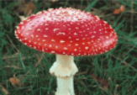
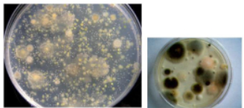
Bacteria, Protists, Fungi
Chapters 21-23

Slide 3
Taxonomy & Viruses
Give the taxonomic order from MOST specific to LEAST specific (8 categories).
How do scientists name organisms?
Define a virus and it s components.
Distinguish virus, viroid, and prions.

Slide 4
Taxonomy & Viruses
Give the taxonomic order from MOST specific to LEAST specific (8 categories).
Variety → species → genus → family → order → class → phylum → kingdom → (DOMAIN)
How do scientists name organisms?
Binomial nomenclature (latin) → GENUS species

Slide 5
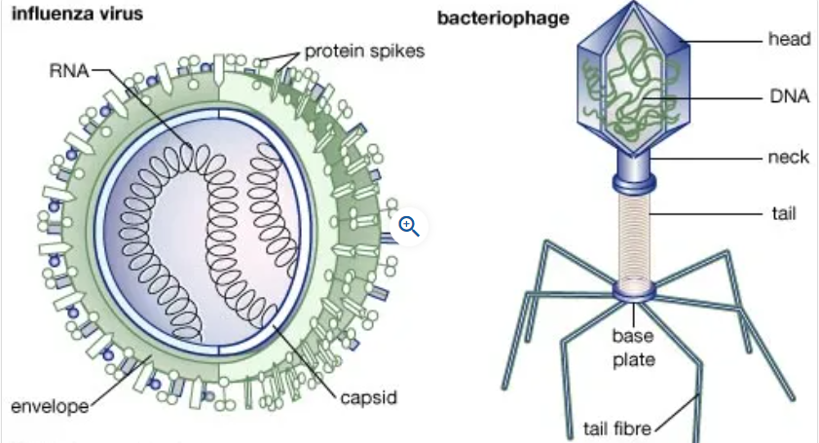
Taxonomy & Viruses
Define a virus and it s components.
Nonliving particle that is active in cells. Anatomy consists of an envelope (lipid bilayer), capsid (protein coat) and a nucleic acid (DNA or RNA).
Bacteriophages attack bacteria.

Slide 6
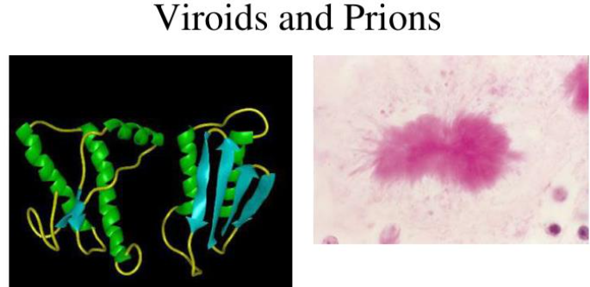
Taxonomy & Viruses
Distinguish virus, viroid, and prions.
 | Virus | Viroid | Prion
Genome | DNA or RNA | RNA | Protein bits
Coat | Capsid or envelope |  | None
Target | Animal, plant, bacteria | Plants | Animals
Host | All cells | Plants | Nervous system

Slide 7
Lesson Objectives
  By the end of this lesson, you should be able to:
Identify the characteristics of bacteria.
Name and describe the two kingdoms related to bacteria.
Discuss the overall importance of bacteria.
Identify the characteristics of Protists.
Describe the three protist groups and their characteristics.
Compare and contrast the three groups of protists.
Identify the characteristics shared by all fungi.
Classify fungi into groups based on their methods of reproduction.
Differentiate among imperfect fungi and all other fungi.
  Science Practice: Bacteria Protists Fungi Lab
Notes:
#frame
instructional video
Timing ≈ 0.5 minutes
Living organisms need energy to accomplish the wide variety of tasks they attempt each day.
You will begin learning about how energy is captured from the Sun and stored in organic molecules.
[read objectives]

Slide 8
Kingdoms Eubacteria and Archaebacteria
Chapter 21
https://somup.com/c3j6qEu7Xf Bacteria Protists Fungi Lab (14:44)

Slide 9
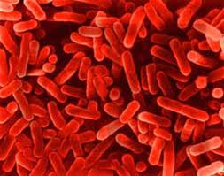
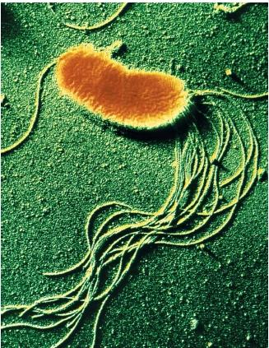
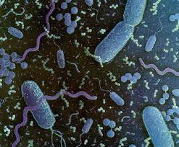
The Bacteria
Bacteria are Prokaryotes.
Prokaryotic Cells:
No true nucleus
No membrane-bound organelles.
Prokaryotes are smaller than Eukaryotic cells

Slide 10
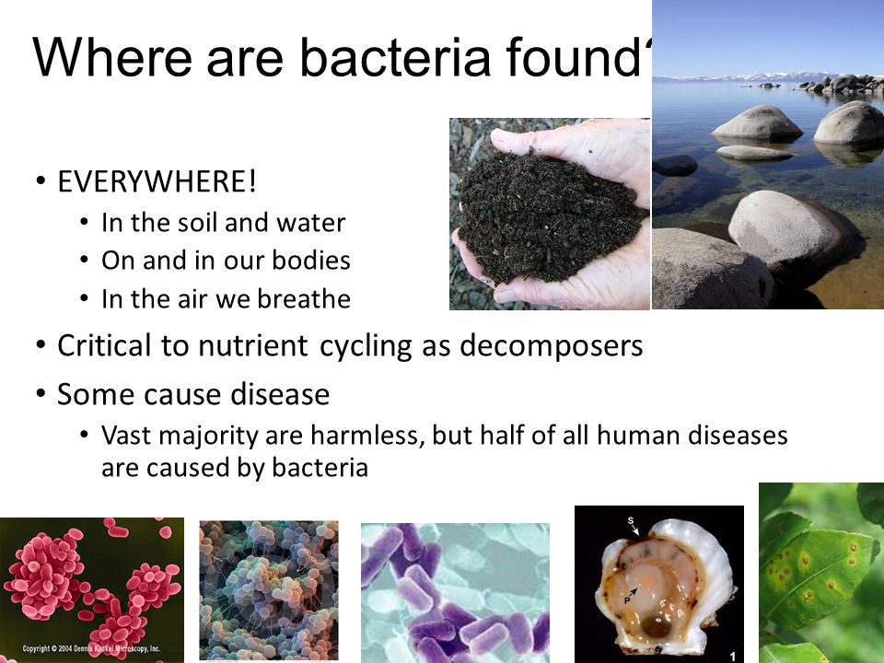
Where are Bacteria found?

Slide 11
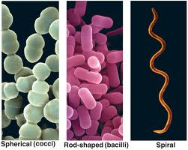
Bacteria exist in three basic shapes:
Cocci spherical
2. Bacilli rod-shaped
Spirilla spiral shaped

Slide 12
External Features contribute to the success of Prokaryotes
Most prokaryotes have a CELL WALL.
CELL WALLS
  provide physical protection
  prevent the cell from bursting in a hypotonic environment.
Main way of classifying bacteria is GRAM STAIN, which is based on the characteristics of bacterial cell walls.
Divides bacteria in two main groups: Gram Positive and Gram Negative.

Slide 13
External Features contribute to the success of Prokaryotes
When stained with GRAM STAIN, cell walls of bacteria are either:
  GRAM-POSITIVE, with simpler cell walls containing Peptidoglycan.
  GRAM-NEGATIVE, with less peptidoglycan. These bacteria are more complex and more likely to cause disease.

Slide 14
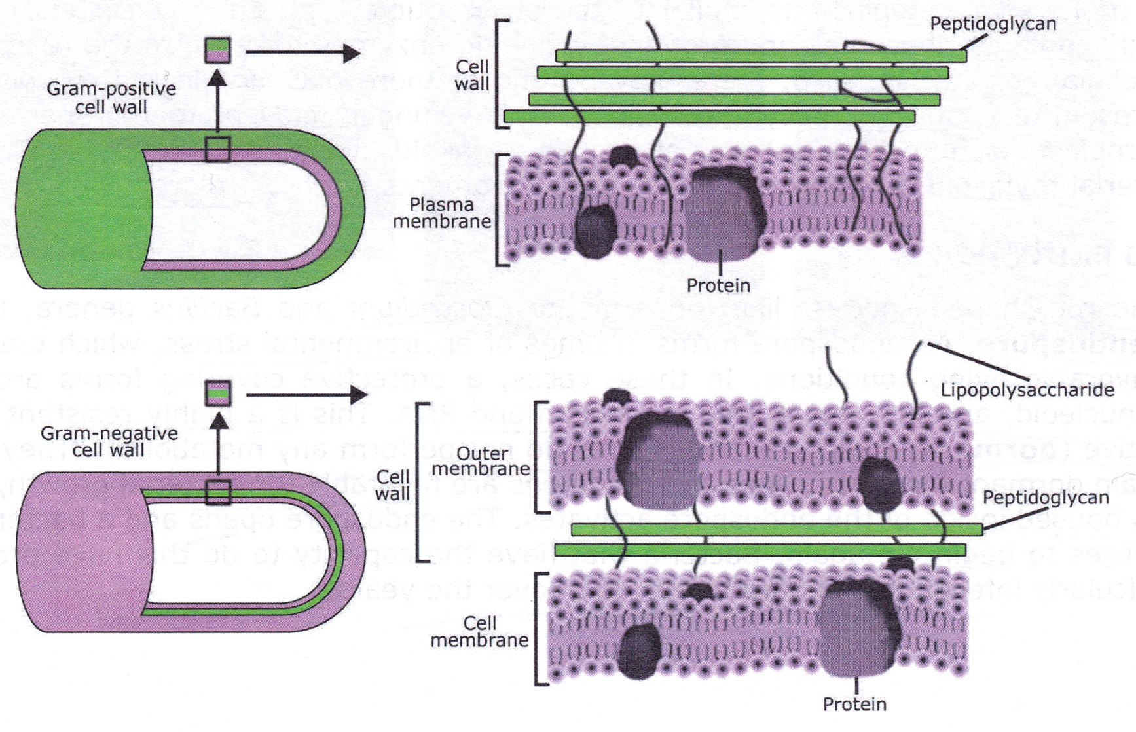
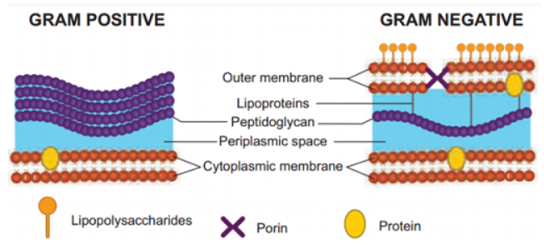
Gram Positive
Have thick outer layer of peptidoglycan
Single lipid bilayer.
Stain purple

Slide 15

Gram Negative
Thin layer of peptidoglycan in cell wall sandwiched between two lipid bi-layer membranes.
Stain pink or reddish

Slide 16
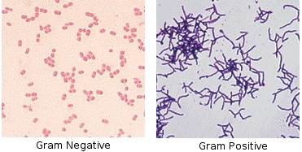
Gram Stain

Slide 17
The Cell Wall of many prokaryotes is covered by a CAPSULE, a sticky layer of sugars or proteins.
The CAPSULE:
  enables prokaryotes to adhere to their substrate.
  shields pathogenic prokaryotes from attacks by their host’s immune system.

Slide 18
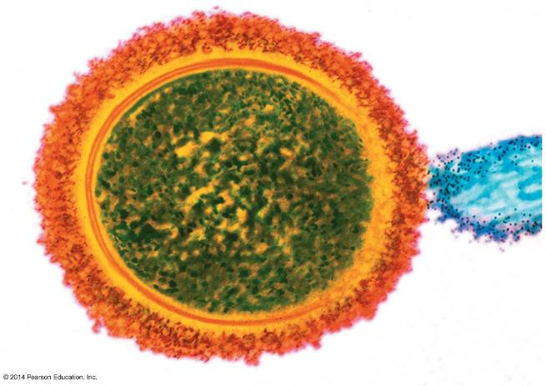
Capsule
Tonsil cell
Bacterium
Notes:
Figure 16.2c A capsule attaching a bacterium to a host cell

Slide 19
Some prokaryotes have external structures that extend beyond the cell wall:
  FLAGELLA are adaptations that enable them to move about in response to signals in their environment.
  Hair-like projections called FIMBRIAE enable prokaryotes to
    stick to a surface or each other
    latch onto the host cells they colonize.

Slide 20
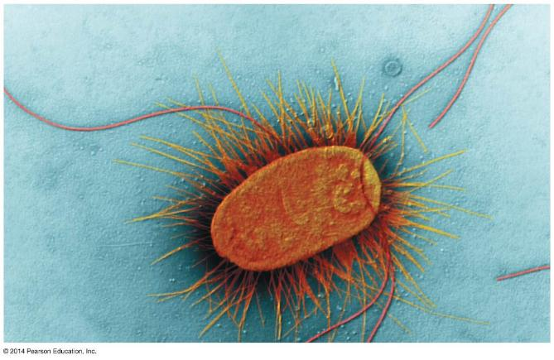
Flagella
Fimbriae
Notes:
Figure 16.2d Flagella and fimbriae

Slide 21
Prokaryotic Genome
The Genome of a Prokaryote typically
  has about one-thousandth as much DNA as a eukaryotic genome
  is ONE LONG, CIRCULAR CHROMOSOME packed into a distinct region of the cell: Nucleoid Region
Many prokaryotes also have additional small, circular DNA molecules called PLASMIDS, which replicate independently of the chromosome.

Slide 22
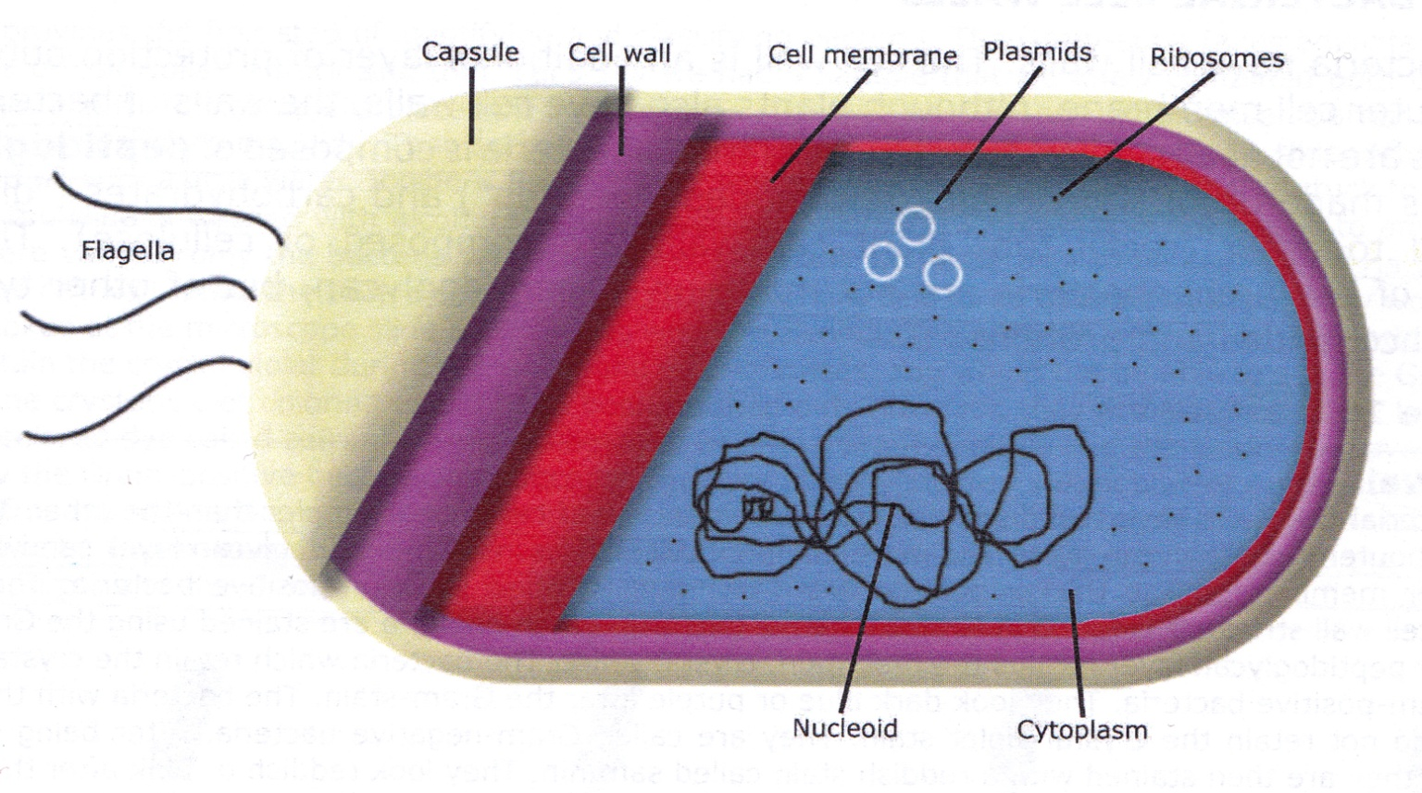
Bacterial Structure
?
?
?
?
?
?
?
?

Slide 23
Bacterial Structure

Slide 24
Prokaryotes can adapt rapidly to changes in the environment
Some prokaryotes form specialized cells called ENDOSPORES that remain dormant through harsh conditions.
Endospores can survive extreme heat or cold.
When the endospore receives environmental cues that conditions have improved, it
  absorbs water and
  resumes growth.

Slide 25
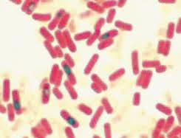
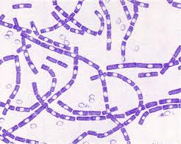
Endospores

Slide 26
Prokaryotes have unparalleled
Nutritional Diversity
Prokaryotes exhibit much more nutritional diversity than eukaryotes, allowing them to inhabit almost every nook and cranny on Earth.
Two sources of Energy are used.
  Phototrophs capture energy from sunlight.
  Chemotrophs harness the energy stored in
  chemicals, organic or inorganic (Sulfur, Ammonia, etc.)

Slide 27
Prokaryotes have unparalleled
Nutritional Diversity
Two sources of Carbon are used by prokaryotes.
  Autotrophs obtain carbon atoms from carbon dioxide.
  Heterotrophs obtain their carbon atoms from the organic compounds present in other organisms.

Slide 28
Prokaryotes have unparalleled
Nutritional Diversity
The terms that describe how prokaryotes obtain Energy and Carbon are combined to describe their modes of nutrition:
  Photoautotrophs harness sunlight for energy and use CO₂ for carbon.
  Photoheterotrophs obtain energy from sunlight but get their carbon atoms from organic sources.
  Chemoautotrophs harvest energy from inorganic chemicals and use carbon from CO₂ to make organic molecules.
  Chemoheterotrophs acquire energy and carbon from organic molecules ; Largest and most diverse group of Prokaryotes.

Slide 29
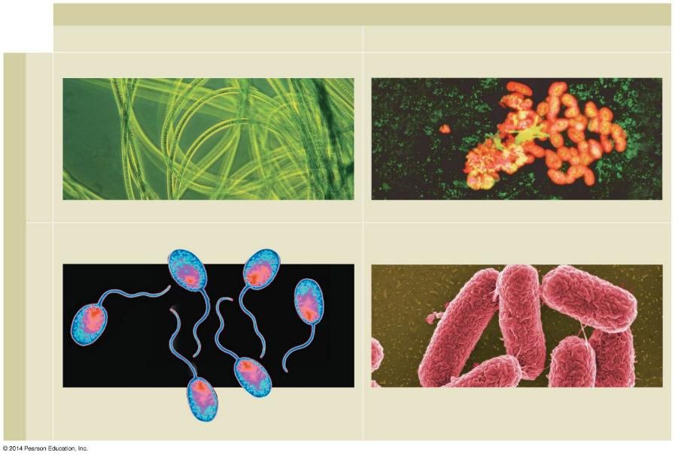
Energy source
Sunlight
Chemicals
Photoautotrophs
Chemoautotrophs
CO₂
Oscillatoria
Unidentified “rock-eating” bacteria
Carbon source
Photoheterotrophs
Chemoheterotrophs
Organic compounds
Salmonella typhimurium
Rhodopseudomonas
Notes:
Figure 16.4-0 Sources of energy and carbon in prokaryotic modes of nutrition
Photoautotrophs - Cyanobacteria
Photoheterotrophs - Purple non-sulfur bacteria in aquatic sediment
Chemoautotrophs - Do not depend on sunlight but usually in sulfur compounds as sources of energy; thrive in conditions totally inhospitable to life: Near hydrothermal vents, soil, etc.
Chemoheterotrophs - Largest and most diverse group of Prokaryotes

Slide 30
Bacteria and Archaea are the Two Main Branches of Prokaryotic Organisms
Studies of representative genomes of prokaryotes and eukaryotes strongly support the Three-Domain view of life.
  Eukaryotes belong to the domain EUKARYA.
  Prokaryotes are now classified into two domains:
    Eubacteria
    ArchaeaBacteria

Slide 31
Archaea thrive in Extreme Environments —and in other habitats
Archaea inhabitants of extreme environments have unusual proteins and other molecular adaptations that enable them to metabolize and reproduce effectively.
  Extreme Halophiles thrive in very salty places.
  Extreme Thermophiles thrive in very hot water, such as geysers.

Slide 32
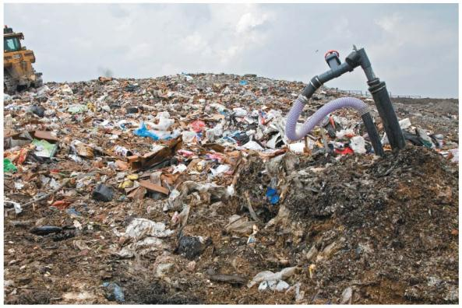
Archaea thrive in Extreme Environments—and in other habitats
Methanogens
  live in anaerobic environments
  give off methane as a waste product from
    the digestive tracts of cattle and deer
    decomposing materials in landfills

Slide 33
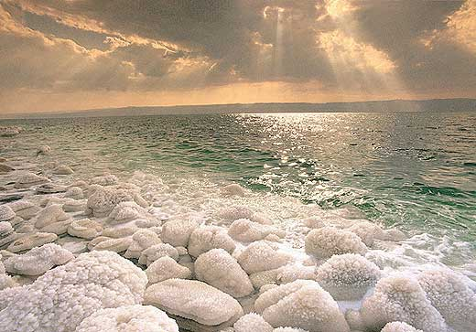
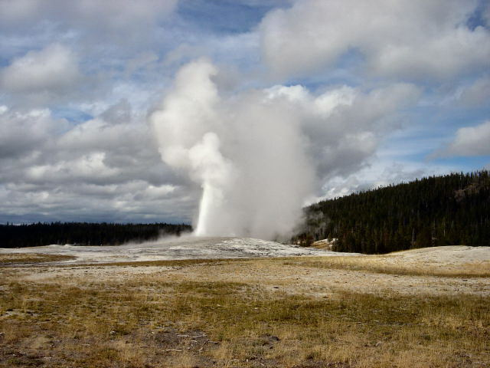
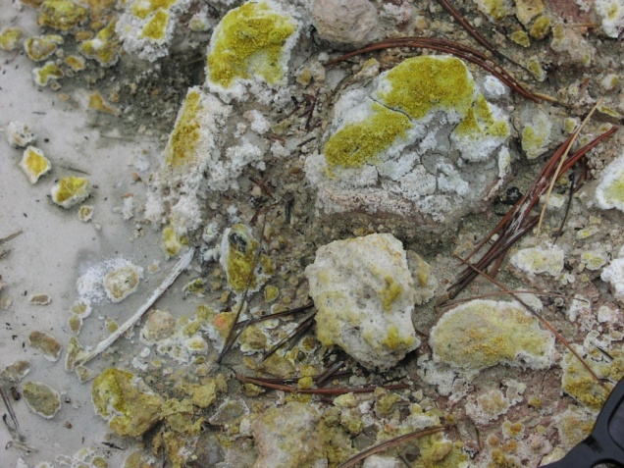
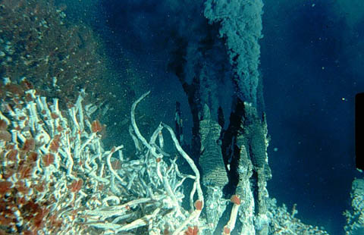
Archaebacteria

Slide 34
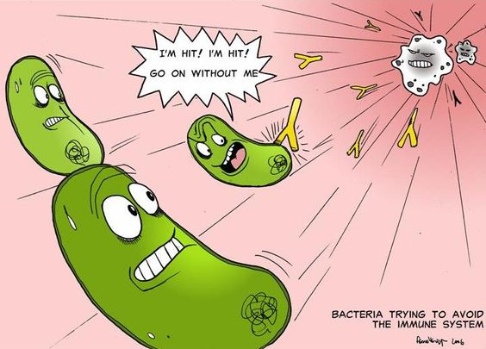
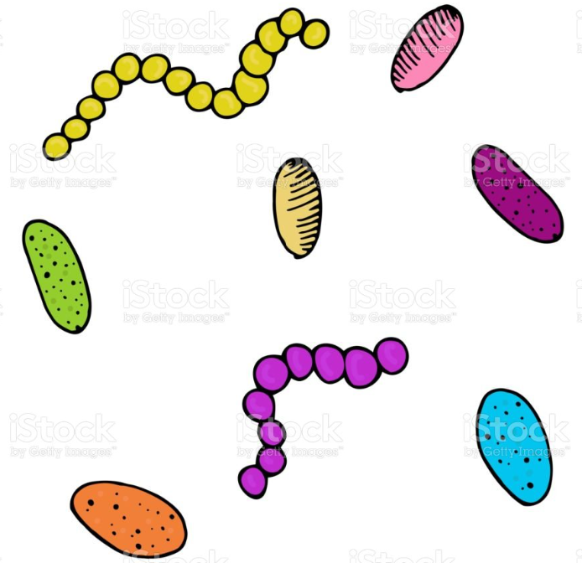
Some Bacteria Cause Disease
All organisms are almost constantly exposed to Pathogenic Bacteria.
Most often, our body’s defenses prevent pathogens from affecting us.

Slide 35
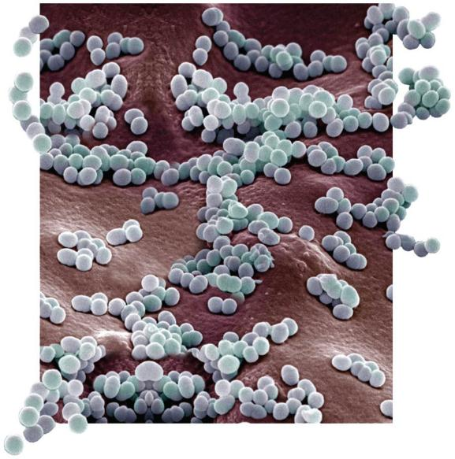
Some Bacteria Cause Disease
Most bacteria that cause illness do so by producing a Toxin (poison).
  Exotoxins are proteins that bacterial cells secrete into their environment.
  Examples
    Bacteria that produce diphtheria or tetanus
Notes:
Staphylococcus aureus, an exotoxin producer

Slide 36
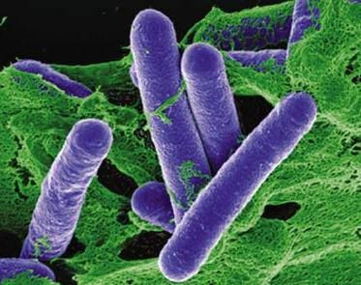
Some Bacteria Cause Disease
Endotoxins are components of the cell wall of gram-negative bacteria that are released when the cell dies.
All endotoxins induce the same general symptoms: fever, aches, and sometimes a dangerous drop in blood pressure.
Examples:
    Bacteria that produce Typhoid Fever or Meningitis

Slide 37
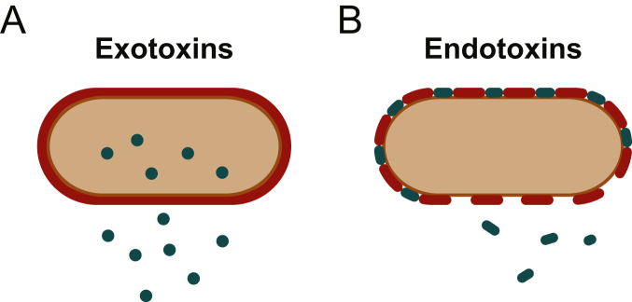
Endotoxins cause Gram-negative sepsis.
Exotoxins are mostly secreted by Gram-positive bacteria.
While endotoxins are membrane compounds of Gram-negative bacteria which elicit an inflammatory response in host, exotoxins are secreted proteins which act locally and at distance of the bacterial colonization site.

Slide 38
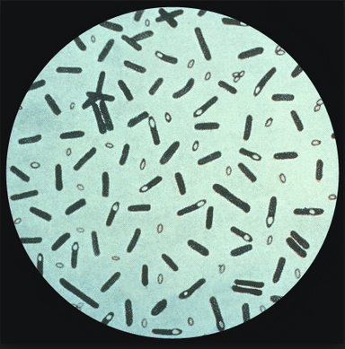
Some Bacteria Cause Disease
The weapon form of Clostridium botulinum is the exotoxin it produces, Botulinum, which is the deadliest poison known.
Botulinum blocks transmission of the nerve signals that cause muscle contraction, resulting in paralysis of the muscles required for breathing.

Slide 39
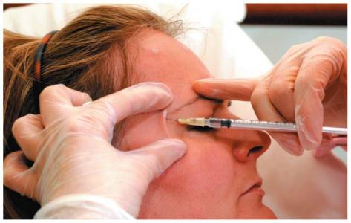
This effect is also responsible for a more benign use of botulinum— relaxing facial muscles that cause wrinkles.
Notes:
Figure 16.10b Injecting Botox, which contains a minute amount of botulinum, to smooth wrinkles

Slide 40
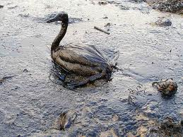
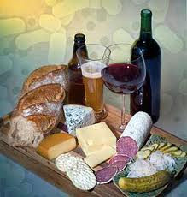
Human Uses For Bacteria
Bacteria are used to produce a wide variety of foods and beverages.
Examples: sour cream, yogurt, cheese.
Some bacteria can digest oil and are helpful in cleaning up oil spills.

Slide 41
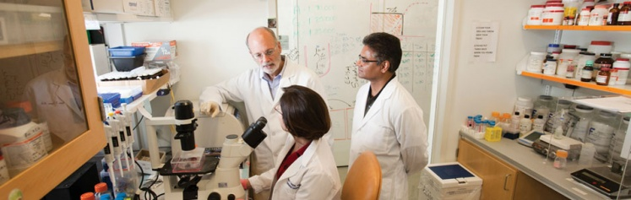
Bacteria can Transfer DNA in Three Ways
Bacteria are very valuable as microbial models in genetics research:
  Most of a bacterium’s DNA is found in a single, closed-loop chromosome.
  Bacterial cells divide by replication of the bacterial chromosome and then by binary fission.
  Because binary fission is an asexual process, bacteria in a colony are genetically identical to the parent cell.

Slide 42
Bacteria can Transfer DNA in Three Ways
Bacteria use three mechanisms to move genes from cell to cell.
  Transformation is the uptake of DNA from the surrounding environment.
  Transduction is gene transfer by bacteriophages.
  Conjugation is the transfer of DNA from a donor to a recipient bacterial cell.

Slide 43
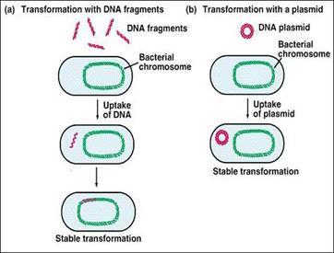
Bacteria can Transfer DNA in Three Ways
  Transformation is the uptake of DNA from the surrounding environment.

Slide 44
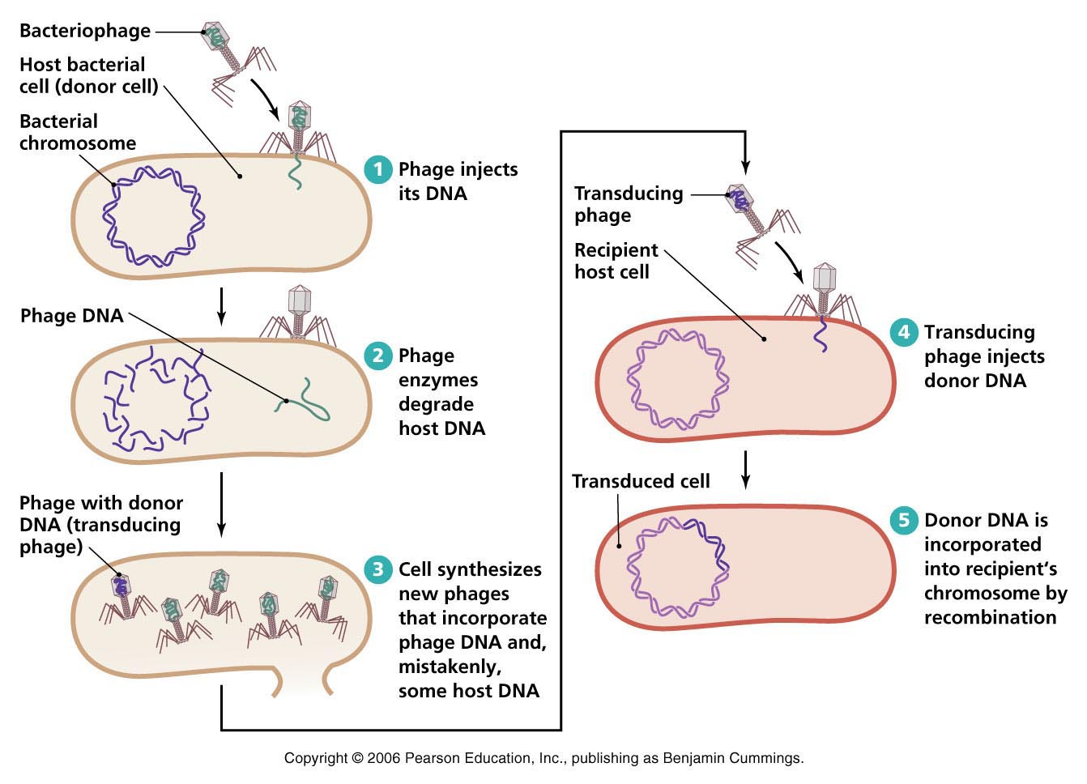
Bacteria can Transfer DNA in Three Ways
Transduction is gene transfer by bacteriophages

Slide 45
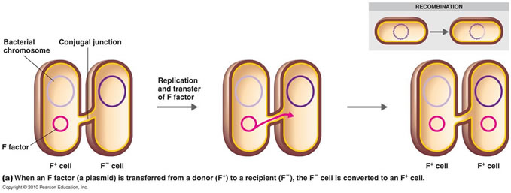
Bacteria can Transfer DNA in Three Ways
Conjugation is the transfer of DNA from a donor to a recipient bacterial cell.

Slide 46
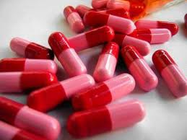
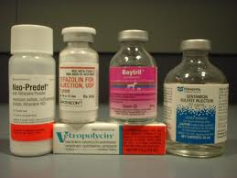
Antibiotics
Antibiotics are compounds that:
kill bacteria.
They are effective against bacteria, but have no effect on viruses.

Slide 47
How do Antibiotics Work?
They work to inhibit a bacterial function that the host does not perform.
That way they are able to kill the bacteria and not harm the host.
Some antibiotics work by inhibiting the bacteria’s ability to make the cell wall (penicillin, cephalosporin).

Slide 48
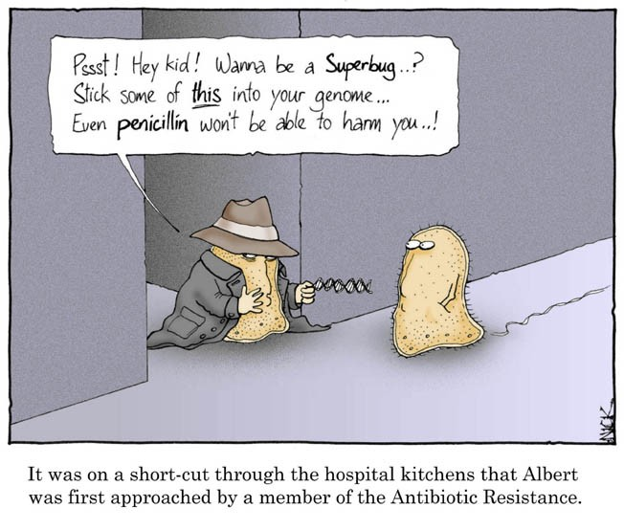
How do Antibiotics Work?
Antibiotic Resistance: Most occur by bacteria acquiring resistance plasmids

