Slide 1
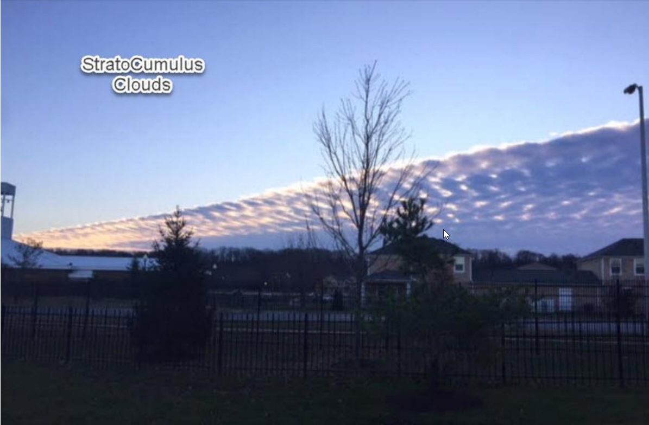
To View Slide Show
Click on “Slide Show” above
  Click on “From Current Slide”

Slide 2
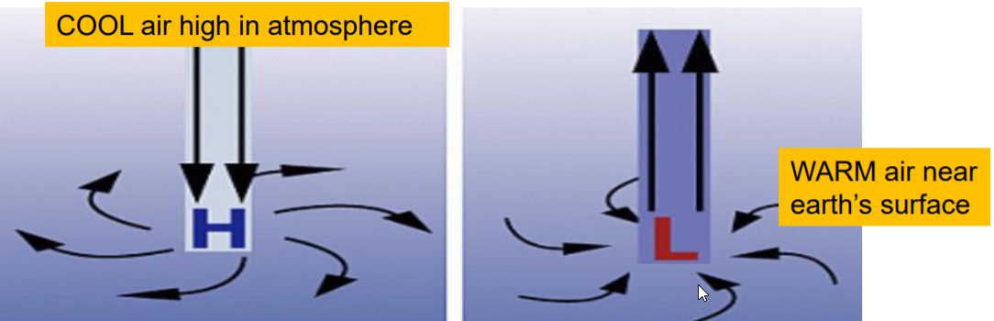
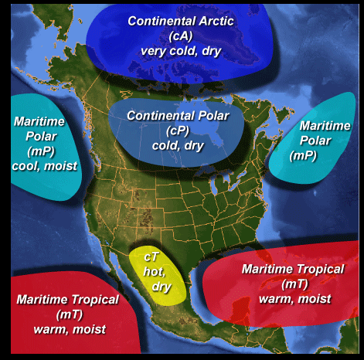
Weather Patterns

Slide 3
List Factors Affecting Weather & Climate
T__________ (especially unequal distribution of heat on the earth)
Earth’s T____ (on its axis)
Earth’s r___________ (around the sun)
H________ (amount of water vapor in atmosphere)
L________ (lines running N & S across the earth)
E_________ (distance above the earth’s surface)
T________ and G________ (mountains, ocean, etc.)

Slide 4
List Factors Affecting Weather & Climate
Temperature (especially unequal distribution of heat on the earth)
Earth’s Tilt (on its axis)
Earth’s revolution around the sun
Humidity (amount of water vapor in atmosphere)
Latitude (lines running N & S across the earth)
Elevation (distance above the earth’s surface)
Topography and Geography (mountains, ocean, etc.)

Slide 5
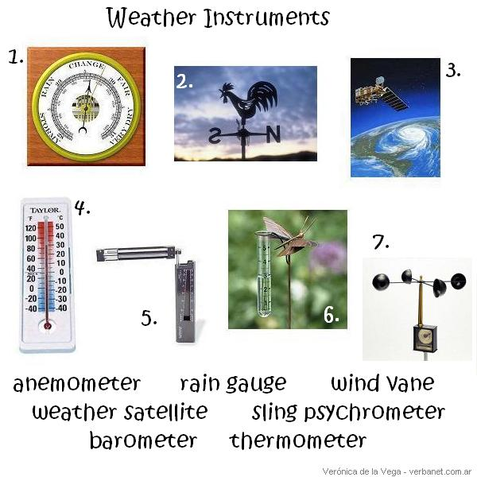
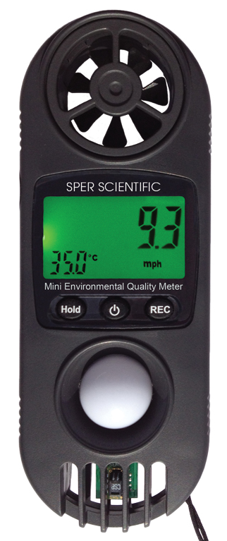
Weather Instruments
weather satellite
barometer
wind vane
Sling
psychrometer
anemometer
rain guage

Slide 6
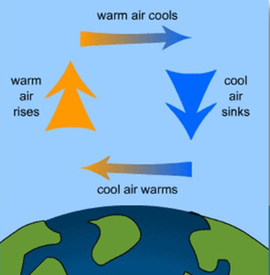
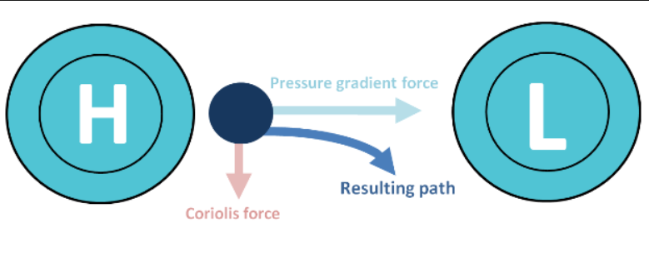
What Causes Wind?
Unequal Distribution of ____
___ air rises (___ dense), leaving a deficit of air and thereby lowering the air pressure – “___s”
Cold air ___ (more ___), creating a buildup of air and thereby raising the air pressure – “___s”
Unequal Distribution of ____
Pressure differences create a pressure ___ and causes the wind to blow.
The direction of wind motion is always from ___ pressure towards ___ pressure.
The greater these differences, the greater the wind velocity.

Slide 7
What Causes Wind?
Unequal Distribution of Temperature
Warm air rises (LESS dense), leaving a deficit of air and thereby lowering the air pressure – “LOWs”
Cold air sinks (more dense creating a buildup of air and thereby raising the air pressure – “HIGHs”
Unequal Distribution of PRESSURE
Pressure differences create a pressure GRADIENT and causes the wind to blow.
The direction of wind motion is always from HIGHER pressure towards LOWER pressure.
The greater these differences, the greater the wind velocity.

Slide 8
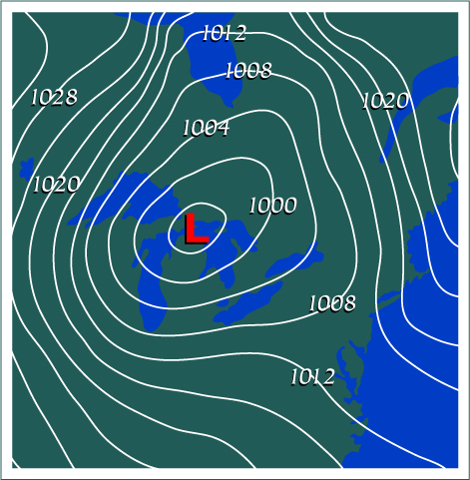
?
? are lines on a map that connect areas of ___ air ___.
The closer the lines, the steeper the pressure ___, the ___ the wind.

Slide 9
Isobars
Isobars are lines on a map that connect areas of equal air pressure.
The closer the lines, the steeper the pressure gradient, the stronger the wind.

Slide 10
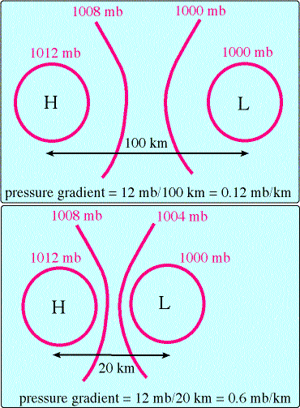

Slide 11
Objectives
List and define factors that affect wind.
Latitude, Frictional Forces, Coriolis Effect, Specific Heat of land versus water.
What happens to air as it rises or sinks?
Describe wind patterns that exist around the globe.
Explain Pressure Centers (Low vs. High).
Name & define Earth’s major air masses.
Understand & describe the four major weather fronts.
Define & describe thunderstorms (severe weather).

Slide 12
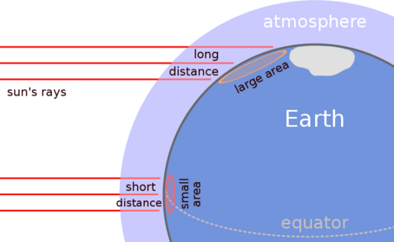
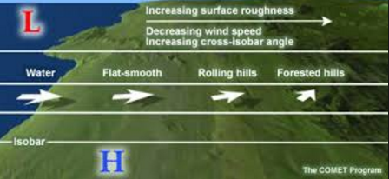
Factors That Affect Wind (and weather)
Latitude
Frictional Forces
Coriolis Effect
Specific Heat of Land Versus Water

Slide 13
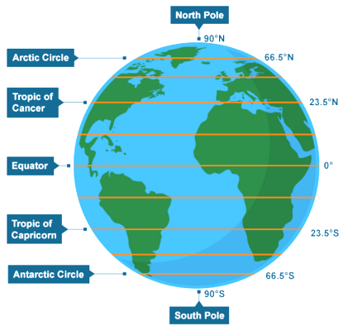
Factors That Affect Wind (and weather)
Latitude
Specifies the north-south position of a point on the Earth's surface.
Latitude is an angle ranging from 0° at the Equator to 90° (North or South) at the poles.

Slide 14
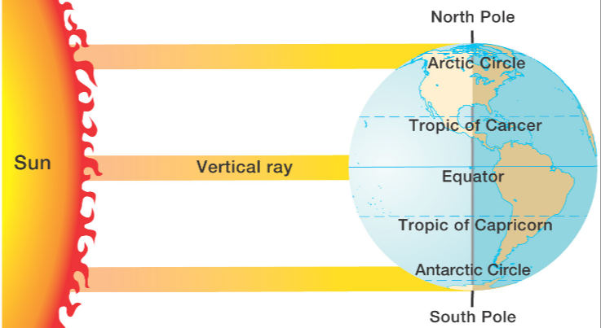
Factors That Affect Wind (and weather)
Latitude
The angle at which the sun’s rays strike the earth affects heat.
The sun’s rays are most direct at the equator (more heat) and less direct at the poles (less heat).

Slide 15
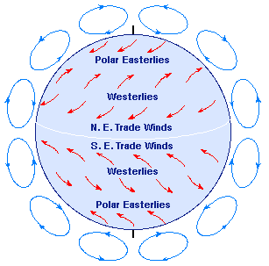
Latitude and Wind
Warm air at the equator 0◦ rises from the earth’s surface, leaving LESS air behind (LOW pressure).
Remember that pressure is related to collisions. If there are less air molecules, there are less collisions, creating LOW pressure.
Air travels north latitude (away from the equator) and cools.
Cool air is MORE dense so it sinks. Now there are MORE air molecules (more collisions) and therefore, creating HIGH pressure ~30◦ N.
90◦ N
60◦ N
30◦ N
HIGH
0◦
LOW

Slide 16
Latitude and Wind
90◦ N
Air at the North Pole 90◦ N is cold so it sinks, creating HIGH pressure near the earth’s surface.
Cool air from the North Pole moves southward (near earth’s surface) towards 60◦ N . It warms going south and rises (less dense).
Warmer air at 60◦ N rises from the earth’s surface, leaving LESS air behind, creating LOW pressure.
60◦ N
HIGH
LOW
30◦ N
0◦

Slide 17
Latitude and Wind
90◦ N
Loops of wind at the mid latitudes react to the equatorial and polar loops.
Air at 60º N rises, causing a LOW. Air moves from High to Low.
Air at 30º N sinks, causing a HIGH.
60◦ N
HIGH
LOW
30◦ N
HIGH
0◦
LOW

Slide 18
Latitude and Wind Summary
Cool air from the North Pole moving south near earth’s surface. As it warms (going south) it rises.
90◦ N
60◦ N
HIGH
LOW
Loop of wind reacting to the other two loops. Air at 60º N rises, causing a LOW. Air at 30º N sinks, causing a HIGH. Air moves from High to Low.
30◦ N
HIGH
0◦
LOW
Warm air at the equator rises, leaving LOW pressure, and travels north, cooling as it does … and sinks, creating HIGH pressure.

Slide 19
Factors That Affect Wind (and weather)
Global Wind Circulation
(2:05)
http://somup.com/cF6hoTnVWZ

Slide 20
Producing Highs and Lows
Cold Air SINKS
Therefore, there is MORE air at the earth’s surface
Therefore, MORE collisions occur between air particles
More Collisions = HIGHer Pressure
Warm Air RISES
Therefore, there is LESS air at the earth’s surface
Therefore, LESS collisions occur between air particles
LESS Collisions = LOWer Pressure

Slide 21
Factors That Affect Wind (and weather)
Frictional Forces
Frictional forces act to slow wind movement and to change the wind direction.
Winds in the lowest layers of atmosphere (at or near the earth's surface) are greatly influenced by the frictional force.
  The effect of friction is to reduce the wind speed.
  Friction is relatively low over the ocean surface.
  Different layers of the atmosphere have different wind velocities and these winds can affect each other as they intersect.

Slide 22
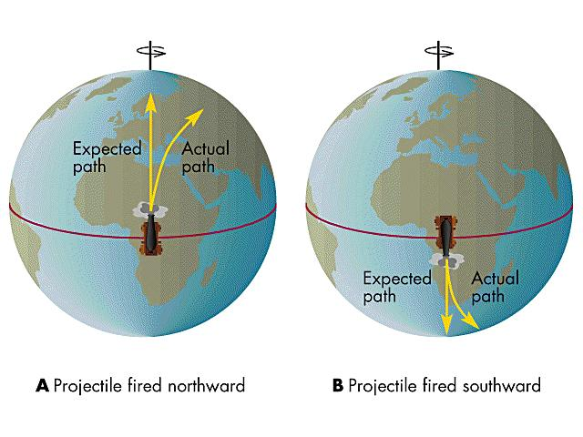
Factors That Affect Wind (and weather)
Coriolis Force (Effect)
Winds are curved or deflected to the right in the Northern Hemisphere due to Earth’s rotation.

Slide 23
Coriolis Force (Effect)
Winds are curved or deflected to the left in the Southern Hemisphere due to Earth’s rotation.
The Coriolis force is zero at the equator and maximum at the North Pole.

Slide 24
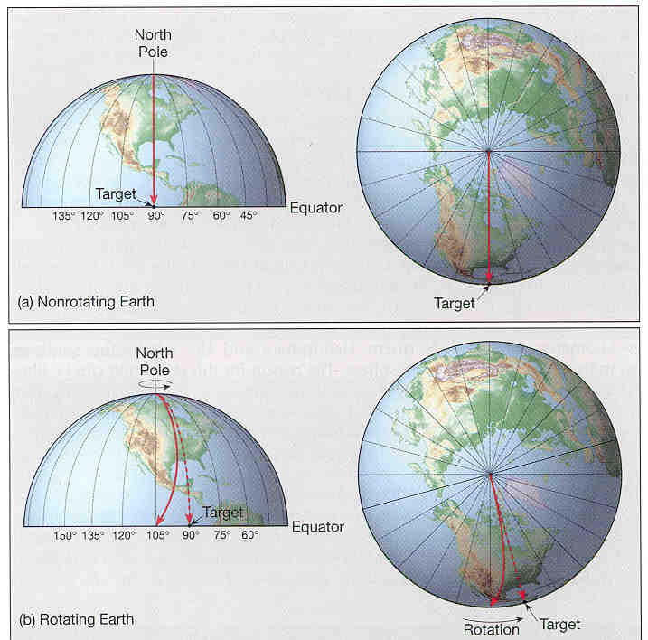
Coriolis Effect

Slide 25
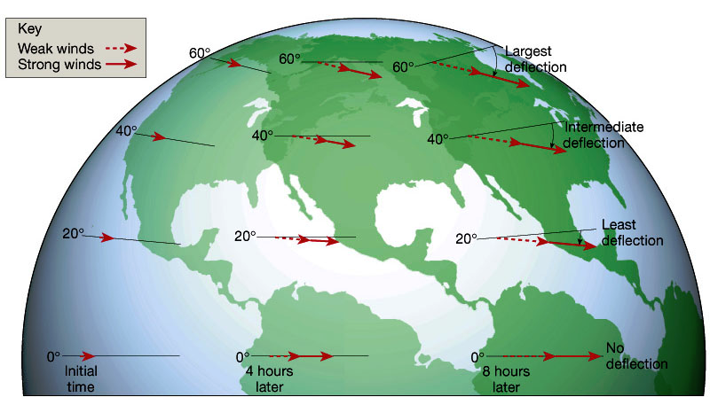
Winds are affected by the Coriolis Effect

Slide 26
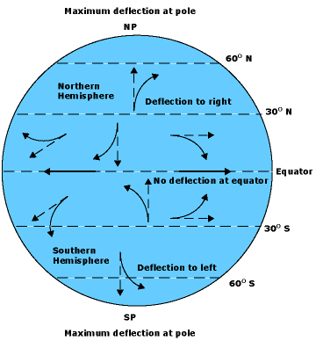
General Global Wind Belts
Air moves from higher pressure to lower pressure.
Global pressure belts move air in a pattern.
The Coriolis Effect deflects wind, generating the global wind patterns.

Slide 27
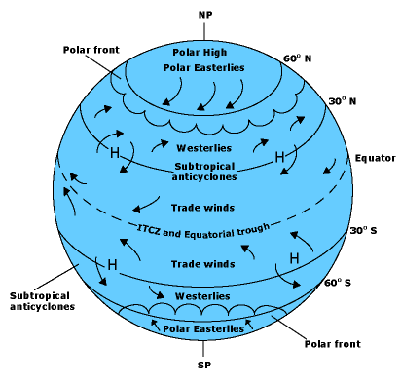
General Global Wind Belts
Winds are named based on their ORIGIN (e.g. Westerlies originate from the west and move eastward).
Earth rotates counterclockwise (looking from N pole).
Earth spins fastest at the equator, and slowest at the poles.
SLOW
FAST

Slide 28
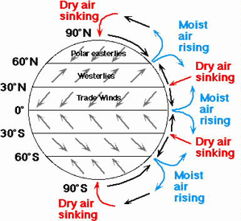
What are the Lines from 0º to 90º N S?
Explain the wind pattern between 60º & 90º N
Explain the wind pattern between 30º & 60º N
Name the winds in the orange boxes
Explain the wind pattern between 0º & 30º N

Slide 29
Latitude (0º – 90º N S)
Cool air from the North Pole moving south near earth’s surface. As it warms (going south) it rises leaving LOW pressure.
90◦ N
60◦ N
HIGH
LOW
Loop of wind reacting to the other two loops. Air at 60º N rises, causing a LOW. Air at 30º N sinks, causing a HIGH. Air moves from High to Low.
30◦ N
HIGH
0◦
LOW
Warm air at the equator rises, leaving LOW pressure, and travels north, cooling as it does … and sinks, creating HIGH pressure.

Slide 30
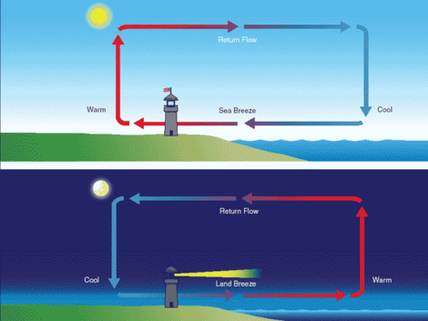
Factors That Affect Wind (and weather)
Specific Heat of Land Versus Water
Land heats faster than water; land also cools faster than water. Air moves from HIGH to LOW pressure areas.
During the Day
Land warms up faster than water so air rises leaving a LOW. On the water the air is cooler and sinks leaving a HIGH.
LOW
HIGH

Slide 31
Factors That Affect Wind (and weather)
During the Night
Land cools down faster than water so air sinks leaving a HIGH. On the water the air is warmer and rises leaving a LOW.
HIGH
LOW

Slide 32
Factors That Affect Wind (and weather)
Specific Heat of Land Versus Water
Land heats faster than water; land also cools faster than water. Air moves from HIGH to LOW pressure areas.
During the Day
Land warms up faster than water so air rises leaving a LOW. On the water the air is cooler and sinks leaving a HIGH.
During the Night
Land cools down faster than water so air sinks leaving a HIGH. On the water the air is warmer and rises leaving a LOW.
LOW
HIGH
HIGH
LOW

Slide 33
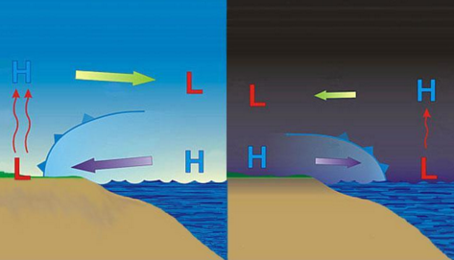
Factors That Affect Wind (and weather)
Specific Heat of Land Versus Water
http://somup.com/cFQ3lQVWWz (0:38)
Wind changes direction from day to night.

Slide 34
____ air rises, ____ air sinks.
Air moves from _____ to _____ pressure areas.
What causes wind and regions of HIGH and LOW pressure? Explain how latitude affects this.
Name and describe the THREE general global winds.

Slide 35
Warm air rises, cold air sinks.
Air moves from HIGH to LOW pressure areas.
What causes wind and regions of HIGH and LOW pressure? Explain how latitude affects this.
Unequal distribution of temperature and pressure.
Warm air rises and expands, leaving LOW pressure at earth’s surface; cold air sinks and contracts producing HIGHs.
Sunlight hits the equator more directly than at the poles. Therefore, the air is warmer, rises, leaving LOW pressure. At the poles air is colder, sinks, producing HIGH pressure.
Name and describe the THREE general global winds.
Polar Easterlies (come from the east & move westward)
Mid latitude Westerlies (come from the west & move eastward)
Trade Winds (near equator)

Slide 36
  F____________ forces act to _____ wind movement and to change the wind __________. The effect of friction is to reduce the wind ________.
Where is this phenomenon greatest? Least? Explain.
What does the picture show? Why does this happen? What is the impact?

Slide 37
  Frictional forces act to slow wind movement and to change the wind direction. The effect of friction is to reduce the wind speed.
Where is this phenomenon greatest? Least? Explain.
The Coriolis Effect is greatest at the Poles because the earth’s spin has the most perpendicular component (90º). It is least at the equator since the earth’s spin has the least perpendicular component (0º).
What does the picture show? Why does this happen? What is the impact?
Coriolis Effect due to the earth’s rotation. Winds are curved to the right in the northern hemisphere and to the left in the southern hemisphere.

Slide 38
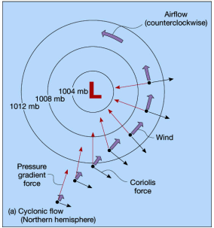
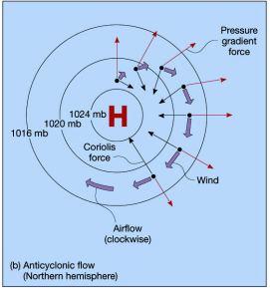
Pressure Centers
Low Pressure Systems are called cyclones and bring inclement (bad) weather.
  Wind around low pressure moves in towards the center in a counterclockwise direction.
High Pressure Systems are called anticyclones and bring fair weather.
  Wind around a high pressure center moves out and in a clockwise direction.

Slide 39
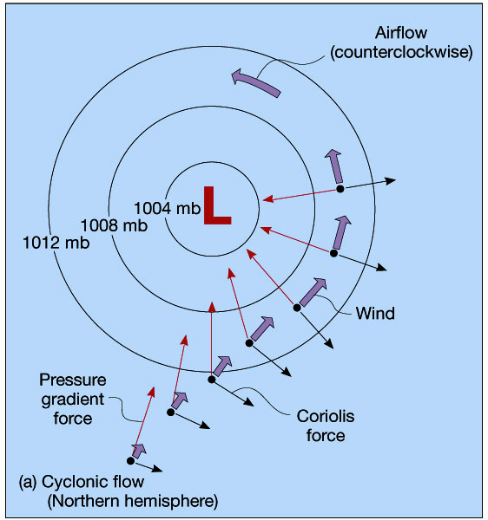
Cyclone Flow
X

Slide 40
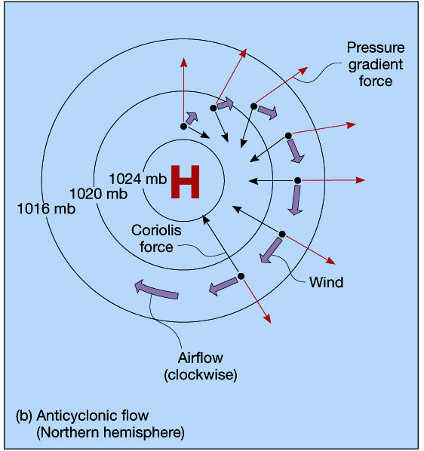
Anticyclone Flow
X

Slide 41
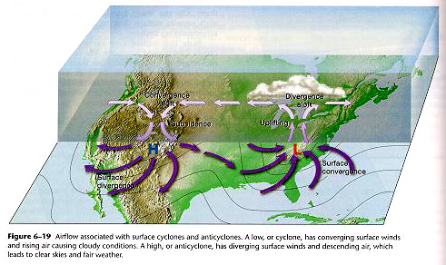
cyclone
anticyclone
IN
OUT
fair weather
Poor weather

Slide 42
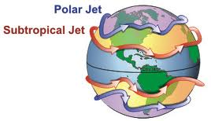
Wind Patterns
Winds higher in the atmosphere have less friction, and travel at a higher speed.
The fastest stream of these winds is called the Jet Stream.
The Jet Stream drives low pressure centers.
The Jet Stream dictates the movement of these systems. Weather forecasters try to use the jet stream, it’s position, and predicted position to predict the weather.

Slide 43
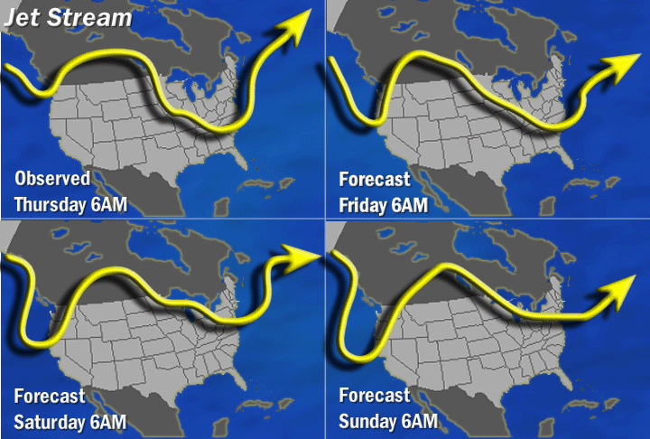

Slide 44
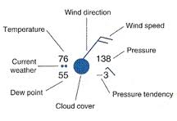
Weather Station Models
Station models are a shortened version of describing the weather conditions that exist at a given location at a given time.
Meteorologists created the station model to show a number of weather elements in a small space on weather maps using symbols.

Slide 45
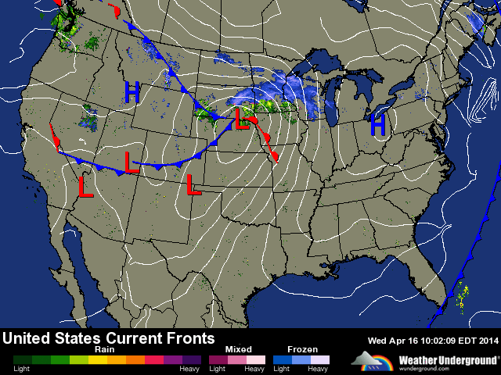
Weather Maps

Slide 46
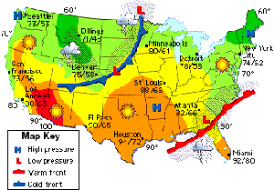
Weather Map
Air pressure
Rainfall
Fronts
Amount of sunlight

Slide 47
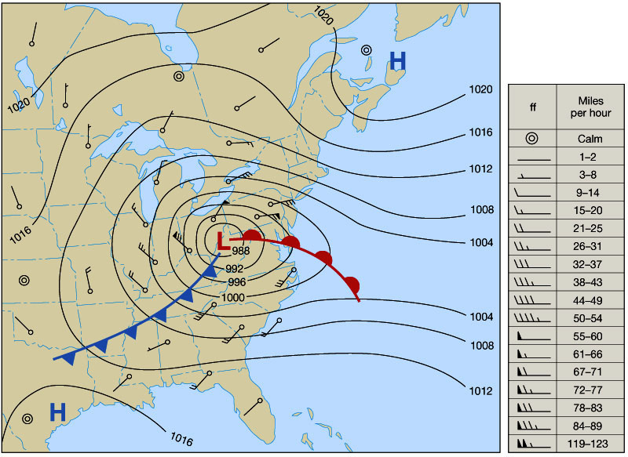
Pressure, Wind Speed & Direction, Fronts

Slide 48
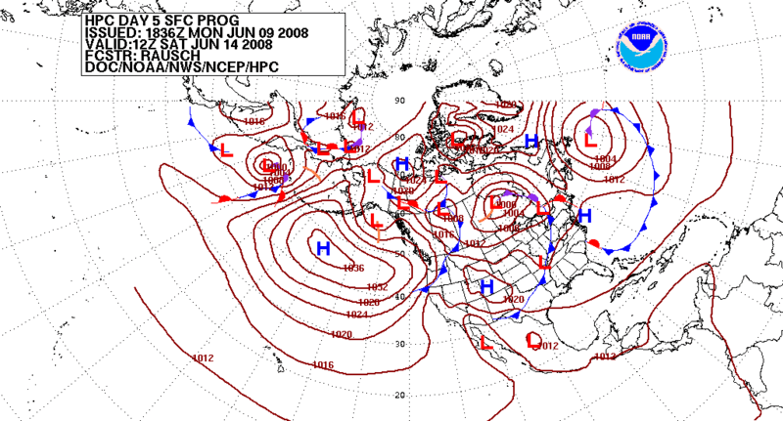
Pressure Forecast

Slide 49
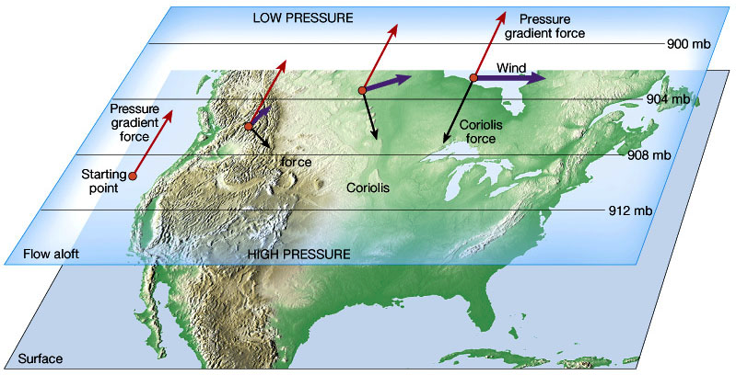
Pressure Differences
Produce Winds

Slide 50
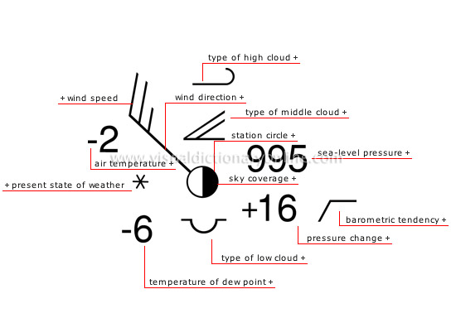

Slide 51
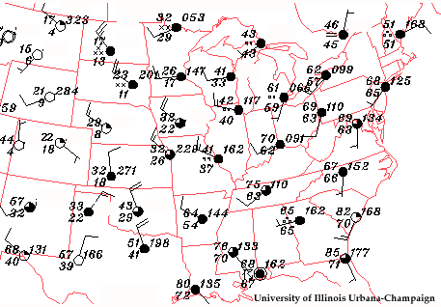
Weather Station Examples
Notice the station at Detroit is showing the air temperature &the dew point being very close, and the cloud cover is 100%.
This is not the case with locations to the west, like in Colorado, or Nebraska.

Slide 52
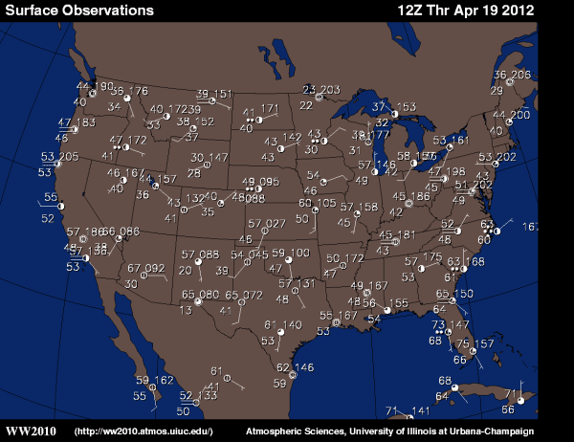
Station Model Examples

Slide 53
Air Masses
In meteorology, an air mass is a volume of air defined by its temperature and water vapor content.
Air masses cover many hundreds or thousands of square miles, and adopt the characteristics of the surface below them.

Slide 54
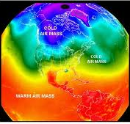
Air Masses
Air that sits over a section of the planet will take on characteristics of the surface that they sit over.
Sections of air with similar humidity, temperature and air pressure are called air masses.

Slide 55
Air Masses
Air masses are classified according to latitude and their continental (land) or maritime (ocean) source regions.
Colder air masses are termed polar or arctic.
Warmer air masses are termed tropical.
Continental and superior air masses are dry while maritime and monsoon air masses are moist.

Slide 56
North American Air Masses
Types of air masses that affect the weather of North America
The air masses come from six regions
  Maritime (moist)
  Continental (dry)
  Polar (cold)
  Tropical (warm)
  Combinations

Slide 57
North American Air Masses

Slide 58
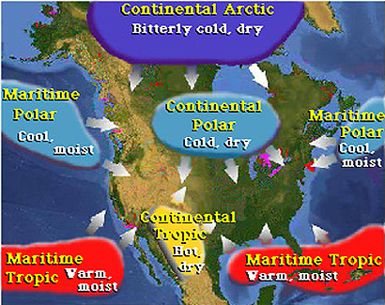
Movement of Air Masses

Slide 59
Weather Fronts
Weather fronts separate air masses with different density, temperature and/or moisture characteristics.
Different air masses which affect North America, as well as other continents, tend to be separated by frontal boundaries.

Slide 60
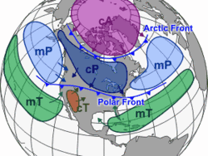
Air Masses and Fronts
Continental Arctic
Maritime Polar
Continental Polar
Maritime Tropical
Continental Tropical

Slide 61
Fronts
Fronts are the boundaries between different air masses.
Fronts generally cause a change in the atmospheric conditions which often causes precipitation to occur.
There are four main types of fronts:
  Cold
  Warm
  Occluded
  Stationary

Slide 62
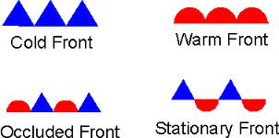
Symbols for Fronts
The triangles and circles point in the
direction the front is moving

Slide 63
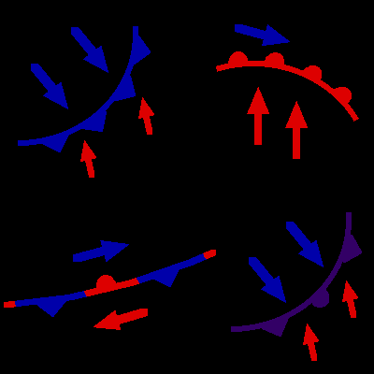
cold
warm
occluded
stationary

Slide 64
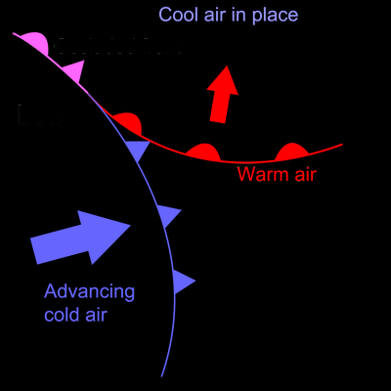
Development of Fronts
Warm Front
a warm air mass replaces a cold air mass.
warmer and moister air than the air ahead of it.
Cold Front
a cold air mass replaces a warm air mass.
colder and dryer air than the air ahead of it.

Slide 65
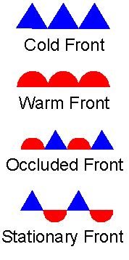
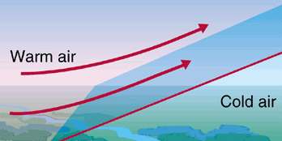
Warm Fronts
Warm fronts are warm air masses moving into a region of cold air.
Warm fronts have gradual profiles,
and will often be preceded by high wispy cirrus clouds, then a longer period of gentle rain or snow.

Slide 66
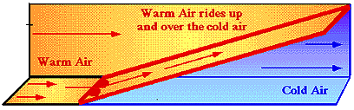
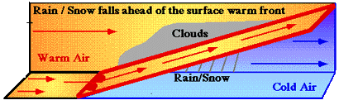
Warm Fronts

Slide 67
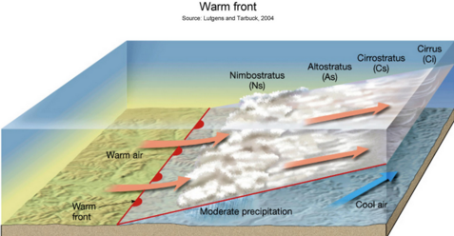
Warm Fronts
Warm fronts usually start out with cirrus clouds (high, wispy)
→ cirrostratus clouds → altostratus clouds → stratus clouds, and finally nimbostratus clouds (long lasting storms).
initial
Final

Slide 68
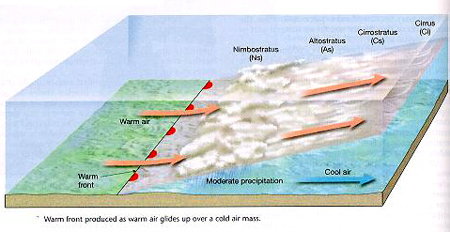
initial
Final

Slide 69

Cold Fronts
A cold front is a region of cold air moving into a region of warm air.
Cold Fronts have a steep profile, and will displace the warmer air upward in a short period of time.

Slide 70

Cold Fronts
Cold air (more dense) wedges under the warm air (less dense).
Cold fronts are generally the cause of severe weather (e.g. thunderstorms).

Slide 71


Cold Fronts

Slide 72


Slide 73


Stationary Fronts
A stationary front is a collision between two different air masses, neither of which is strong enough to replace the other.

Slide 74

Stationary Fronts
They tend to remain essentially in the same area for extended periods of time (days).
Often associated with clouds, prolonged or repeated precipitation or storms.

Slide 75

Occluded Front
When two air masses are moving in the SAME direction and overlap.
Cold air moves faster than warm air.
https://screencast-o-matic.com/watch/cFlfIGrUZf (0:51)

Slide 76

Formation of an Occluded Front
A warm front develops from warm moist air
Above the warm front is a mass of cooler air
A cold front overtakes a warm front

Slide 77

Occluded Fronts
A developing cyclone (LOW) typically has a preceding warm front and a faster moving cold front
As the storm intensifies, the cold front rotates around the storm and catches the warm front.
This forms an occluded front

Slide 78
Occluded Fronts

Slide 79

Occluded Front
When a cyclone (LOW) develops behind a warm front, the cold front that was formed behind the warm front moves towards it.
Heavy rains often come (e.g. wringing out a sponge that is saturated).

Slide 80

Occluded Front
Initially weather & clouds of a warm front.
Eventually the cold front takes over, “occluding” the warm front (forced upwards).

Slide 81
Animation of Fronts
http://somup.com/cF6hodnVWH (3:50)

Slide 82
Complete the table:
Front | Description | Weather | Symbol
 | Colder, dryer air replaces warm, moist air | Severe, abrupt
Warm |  | Gentle, lasts a day
 | Two air masses collide and stop moving
 | Both air masses move in same direction, but colder air overtakes warmer air | Cirrus to stratus to nimbostratus to cumulonimbus clouds

Slide 83
Complete the table:
Front | Description | Weather | Symbol
Cold | Colder, dryer air replaces warm, moist air | Severe, abrupt
Warm | Warmer, moister air replaces colder, dryer air | Gentle, lasts a day
Stationary | Two air masses collide and stop moving | Lasts several days
occluded | Both air masses move in same direction, but colder air overtakes warmer air | Cirrus to stratus to nimbostratus to cumulonimbus clouds

Slide 84

Severe Weather

Slide 85

Severe and Unusual Weather
Weather that results from the two distinctly different air masses meeting can become violent.
Thunderstorms can develop along cold front boundaries.

Slide 86

Severe and Unusual Weather
Thunderstorms that are severe, and that have the possibility of forming tornadoes, are called supercells.

Slide 87

Thunderstorms
A thunderstorm, also known as an electrical storm, a lightning storm, thundershower or simply a storm.
Forms of turbulent weather characterized by the presence of lightning and thunder.

Slide 88

Lightning

Slide 89

Up Close & Personal
Lightning Strike (0:28) https://screenpal.com/watch/cF6h2RYoU7

Slide 90

Lightning
After a strike count: the lightning is about one mile away for every five seconds
Voltage of up to 1.2x10⁸ volts
Kills more than 60 people and
Injures more than 400 people a year in the US.

Slide 91

Charges are polarized
During thunderstorm conditions, the turbulence in the cloud causes the charges to separate in such a way that the negative charges concentrate in the base of the cloud.
Since like charges repel, some of the negative charges on the ground are pushed down away from the surface, leaving a net positive charge on the surface.

Slide 92

Just prior to lightning striking…
Opposite charges attract, so the positive and negative charges are pulled toward each other.
Since the negative charges are smaller, they move quicker and easier.

Slide 93

Lightning Strike
As soon as the negative and positive parts of the stepped leader connect there is a conductive path from the cloud to the ground and the negative charges rush down it causing the visible stroke.

Slide 94


Slide 95


Slide 96

Thunderstorm Development
Masses of moisture are lifted upwards into the atmosphere.
The moisture rapidly cools into liquid drops of water due to the cooler temperatures at high altitude, which appears as cumulus clouds.

Slide 97

Thunderstorm Development
The warmed air continues to rise until it reaches an area of warmer air and can rise no farther.
The simultaneous presence of both an updraft and downdrafts marks the mature stage of the storm, and produces Cumulonimbus clouds.

Slide 98
Thunderstorm Development
The thunderstorm is dominated by the downdraft, which will push down out of the thunderstorm, hit the ground and spread out.
This phenomenon is known as a downburst.

Slide 99
Thunderstorm Development

Slide 100
Severe Weather
The next two sections on Tornadoes and Hurricanes is ENRICHMENT.
The following sections will NOT be included on the weather test.

Slide 101

Tornadoes
The winds can be as strong as 300 miles per hour.
There are many types of tornadoes, and each type of tornado can have several different methods of formation.

Slide 102
Tornado Development
For a tornado to develop, several conditions must be present in the atmosphere at the same time:
  abundant low-level moisture
  atmospheric instability
  and a "trigger" such as a cold front or other low-level zone of converging winds that acts to lift moist air aloft.

Slide 103

Tornado Development
Wind shear (red) sets air spinning (green).

Slide 104

Tornado Development
The updraft (blue) 'tips' the spinning air upright.

Slide 105

Tornado Development
The updraft then starts rotating.

Slide 106


Slide 107

Tornado Alley

Slide 108


Slide 109


Slide 110
Seasonal Variations in Severe Weather
During Spring, the Northern part of our continent is still very cold, but the southern portion of the continent begins to warm up.
The differences between these two air masses often can cause severe weather, that would not likely occur at other times of the year.

Slide 111

Birth of a Hurricane
A Tropical cyclone has different names, depending on its size and strength.
Hurricanes form as the result of very warm ocean water warming the air above it.
This creates a low pressure region which can be developed by the continued exposure to warm water.

Slide 112

Hurricanes
A hurricane will develop around a low pressure region and go through stages of being a tropical depression and storm based on wind speed.

Slide 113


Slide 118

Hurricane Location
Hurricanes generally form between 5 and 20 degrees latitude – where the ocean water temperature is warm enough.

Slide 119

Hurricane Bands
Rainbands surround the eye of the storm in concentric circles.
Bordering the eye of a mature hurricane is the eye wall, a ring of tall thunderstorms that produce heavy rains and very strong winds.

Slide 120


Slide 121

Categories of Hurricanes

