Slide 1
Go to the “Slide Show” shade above
Click on “Play from Beginning”

Slide 2
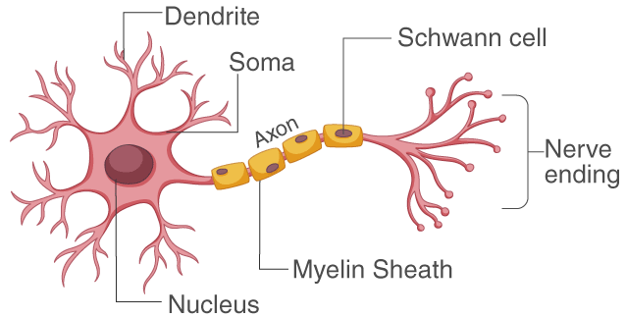
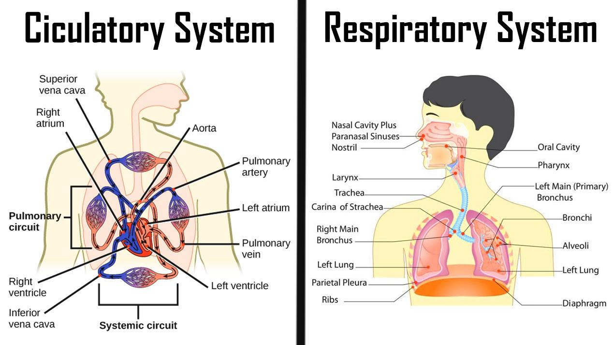
Human Anatomy & Physiology Nerves, Circulation, Respiration
Chapter 32

Slide 3
Lesson Objectives
  By the end of this lesson, you should be able to:
Recognize, identify, and define the anatomy and function of the human nervous system.
  Central vs. Peripheral Nervous System
  Neurons, Synapses
  Membrane Potential
Recognize, identify, and define the anatomy and function of the human circulatory system.
  Blood Vessels
  The Heart
  Types of Blood
Recognize, identify, and define the anatomy and function of the human respiratory system.
  Inhalation vs. Exhalation
  Transport and exchange of Gases
  Science Practice: Labelling Skin, Muscle, and Bones
Notes:
#frame
instructional video
Timing ≈ 0.5 minutes
Living organisms need energy to accomplish the wide variety of tasks they attempt each day.
You will begin learning about how energy is captured from the Sun and stored in organic molecules.
[read objectives]

Slide 4
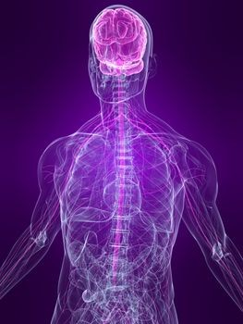
The Nervous System
The following slides are enrichment for HONORS students.

Slide 5
Neurons communicate at Synapses
Neurotransmitter molecules are in membrane-enclosed sacs called Synaptic Vesicles in the sending neuron’s synaptic terminals
An Action Potential arrives at the synaptic terminal
The Action Potential causes some synaptic vesicles to fuse with the plasma membrane of the sending neuron.
The fused vesicles release their neurotransmitters by exocytosis into the synaptic cleft, and the neurotransmitter rapidly diffuses across the cleft.
The released neurotransmitter binds to receptors on Na+ ion channel proteins in the receiving cell’s plasma membrane.

Slide 6
Neurons communicate at Synapses
5) This binding of neurotransmitter to receptor opens the Na+ ion channel proteins in the receiving neuron’s membrane. Na+ ions start diffusing into the receiving neuron, where they may trigger new action potentials.
6) The neurotransmitter is broken down by specific enzymes and the Na+ channels close.

Slide 7
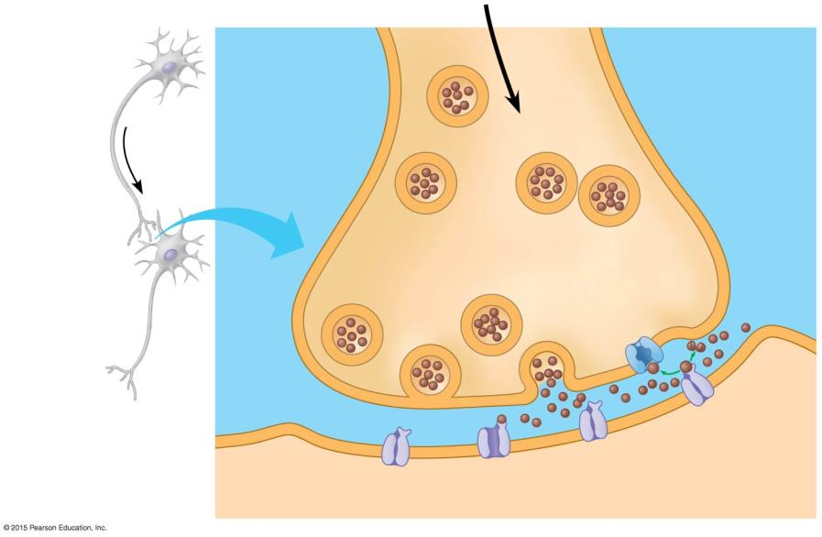
Axon of
sending
neuron
Sending neuron
1
Neurotransmitter
molecules
Synaptic
vesicles
Synaptic
terminal
of sending
neuron
Synaptic
terminal
2
3
Vesicle fuses
with plasma
membrane
Neurotransmitter
is released into
synaptic cleft
Dendrite
of receiving
neuron
Synaptic
cleft
Receiving
neuron
4
Neurotransmitter
binds to receptor
Ion
channels
Notes:
Figure 28.6-1 Neuron communication at a typical chemical synapse (part 1)

Slide 8
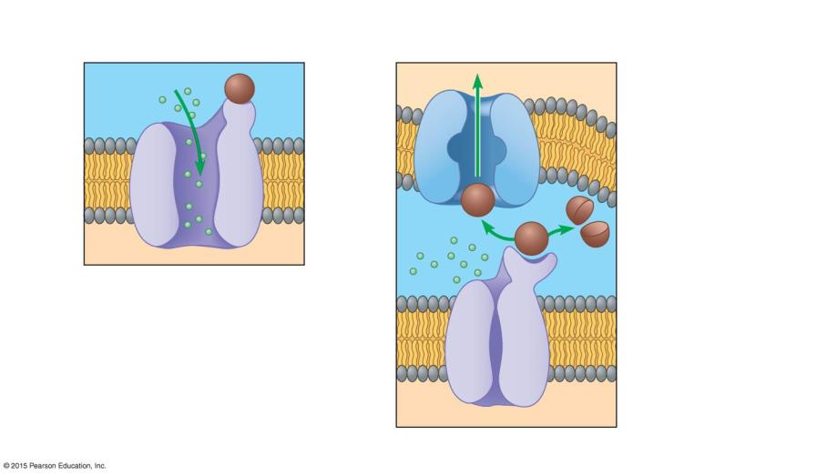
Neurotransmitter
reuptake
Neurotransmitter
Receptor
Na⁺ ions
Neurotransmitter
broken down by
enzyme
5
Ion channel opens
6
Ion channel closes
Notes:
Figure 28.6-2 Neuron communication at a typical chemical synapse (part 2)

Slide 9
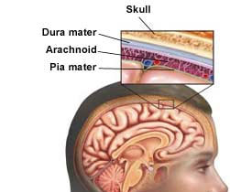
The Central Nervous System
Function:
  relays messages, processes information, and analyzes information
Consists of the brain and spinal cord
  Meninges
    three layers of connective tissue that surround the brain and spinal cord for protection
Meninges

Slide 10
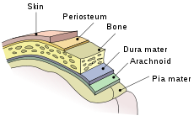
The Central Nervous System
Cerebrospinal fluid
  Made in the ventricles of the brain
  Fills space between the meninges and the CNS
  acts as a shock absorber that protects the central nervous system
  permits exchange of nutrients and waste products between blood and nervous tissue
The dura mater and arachnoid mater hold in cerebrospinal fluid.

Slide 11
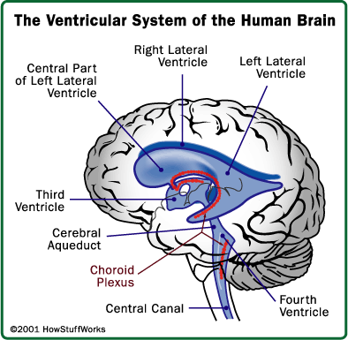

Slide 12
The Brain
  The brain is the place to which impulses flow and from which impulses originate
  Consists of 3 main areas
    Cerebrum
    Cerebellum
    Brain Stem

Slide 13
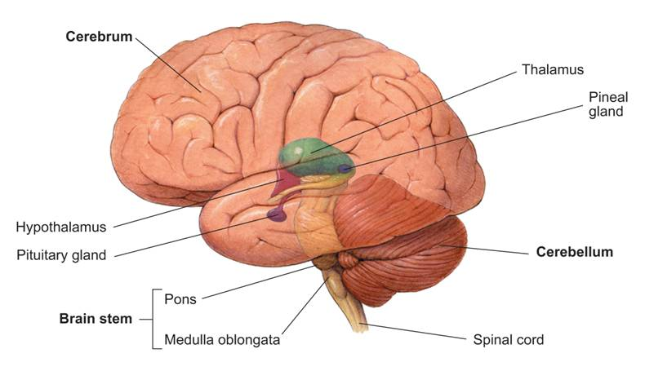
Parts of the Human Brain
Cerebrum
Thalamus
Pineal gland
Hypothalamus
Pituitary gland
Cerebellum
Pons
Brain stem
Medulla oblongata
Spinal cord
Notes:
The brain helps to relay messages, process information, and analyze information. The brain consists of the cerebrum, cerebellum, and brain stem.

Slide 14
The Brain: Cerebrum
  largest and most prominent region of the human brain
  controls the voluntary (conscious) activities of the body
  site of intelligence, learning, and judgment
  Central Fissure
    deep groove that divides the cerebrum into hemispheres (halves)
  Folds and grooves increase surface area
    Gyrus: fold (like a hill)
    Sulcus: groove (like a valley)

Slide 15
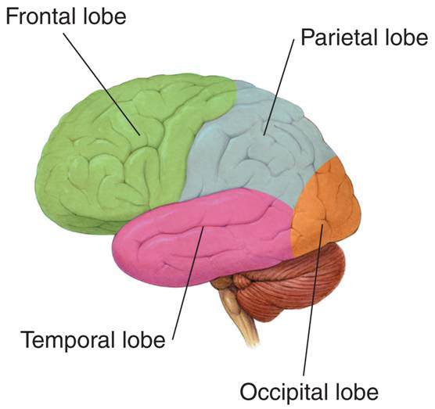
Cerebrum
Each hemisphere is divided into regions called lobes
Frontal lobe
  Decision making, problem-solving, planning
Parietal lobe
  Reception and processing of sensory info from the body
Temporal lobe
  Memory, emotion, hearing, language
Occipital lobe
  vision

Slide 16
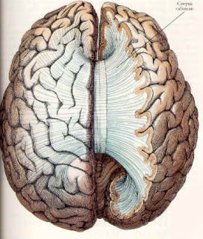
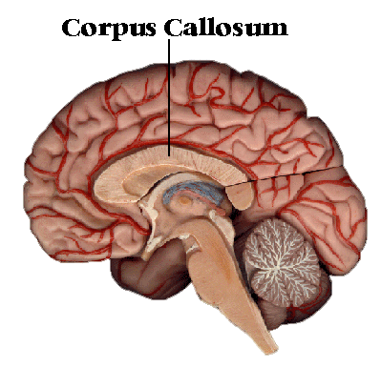
The Brain
Each half of the cerebrum deals with the opposite side of the body
  The left half of the cerebrum controls the right side of the body.
  The right half of the cerebrum controls the left side of the body.
Corpus Callosum
  band of tissue that connects the hemispheres

Slide 17
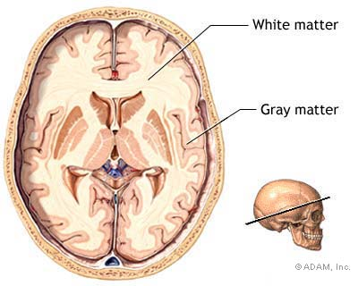
The Brain
Cerebral cortex
  outer layer of the cerebrum
  consists of gray matter
    Densely packed nerve cell bodies
The inner layer of the cerebrum consists of white matter
  bundles of axons with myelin sheaths

Slide 18
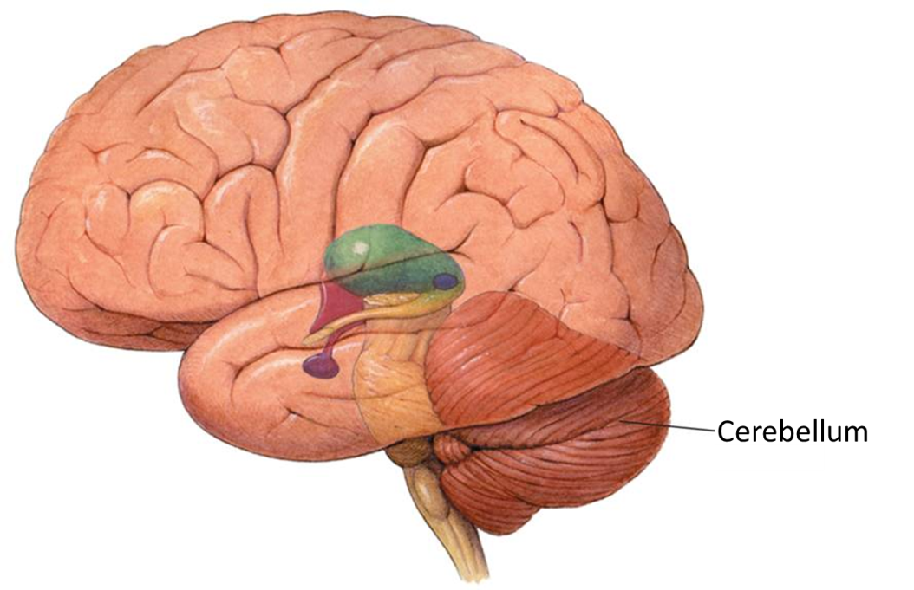
The Brain: Cerebellum
    Second largest region of the brain
    Coordinates smooth movements (so you are not jerky when you move)

Slide 19
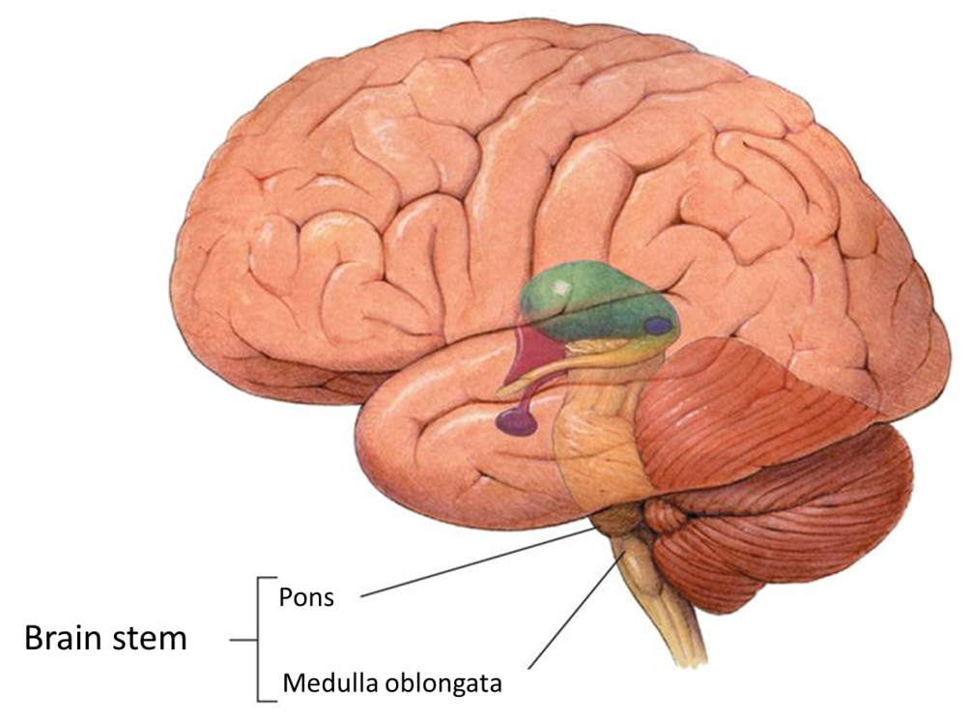
The Brain: Brain Stem / Hind Brain
    Connects the brain and spinal cord
    Consists of the pons and the medulla oblongata
    Pons: transfers messages to the brain/spinal cord (e.g. switchboard)
    Medulla: controls involuntary functions (cardiovascular, respiration, consciousness, etc.)

Slide 20
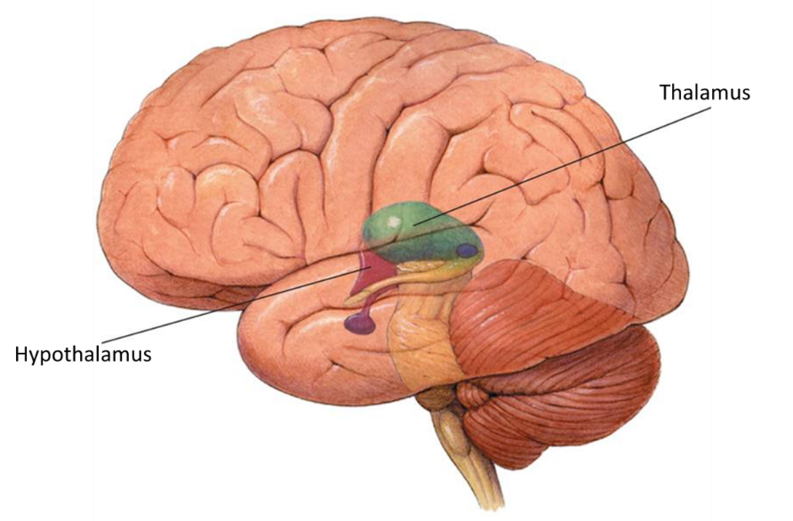
The Brain
  Thalamus
    receives messages from all sensory receptors throughout the body and relays the information to the proper region of the cerebrum (cortex) for further processing

Slide 21
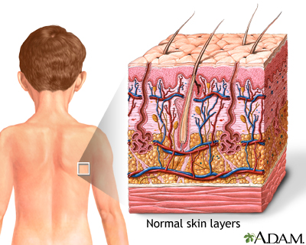
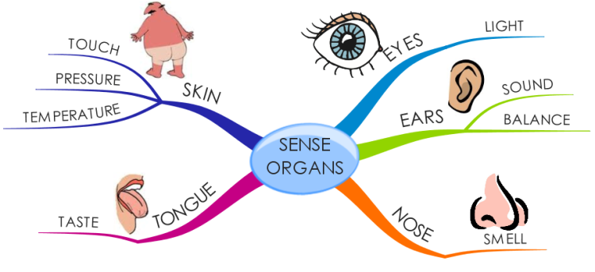

Slide 23
The Brain
  Hypothalamus
    controls recognition and analysis of hunger, thirst, fatigue, anger, and body temperature
    One of the most important functions of the hypothalamus is to link the nervous system to the endocrine system via the pituitary gland (hypophysis).

Slide 24
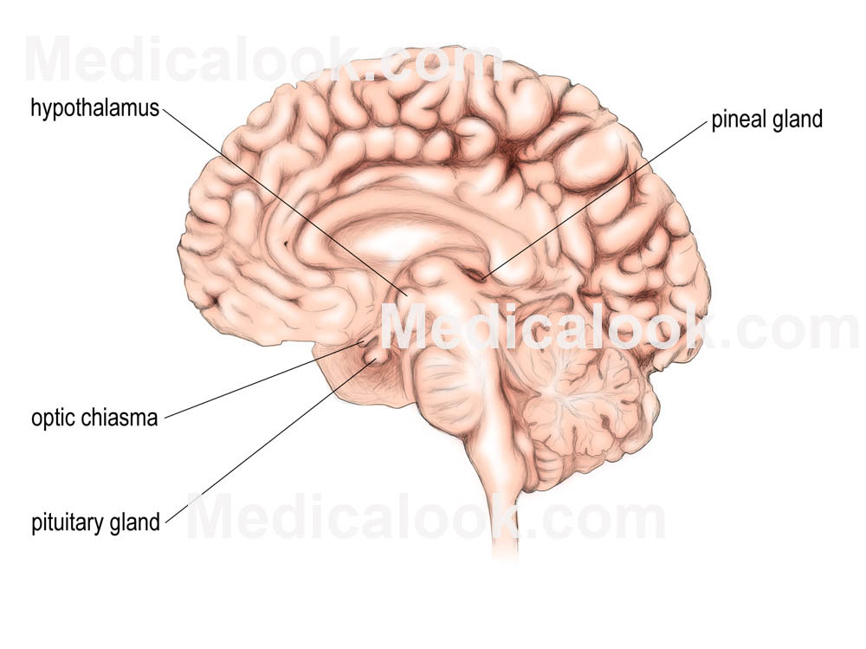
Pituitary Gland
Endocrine gland about the size of a pea
Hormones secreted from the pituitary gland help control: growth, blood pressure, certain functions of the sex organs, thyroid glands and metabolism as well as some aspects of pregnancy, childbirth, nursing, water/salt concentration and the kidneys, temperature regulation and pain relief.

Slide 25
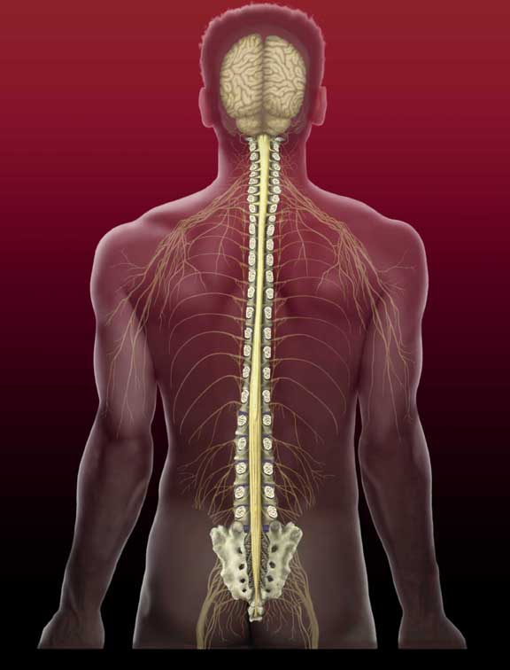
The Spinal Cord
  The spinal cord is the main communications link between the brain and the rest of the body

Slide 26
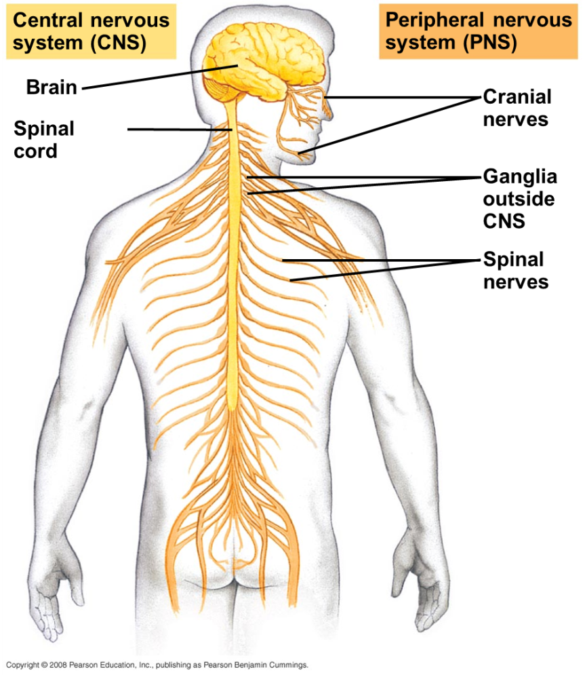
The Peripheral Nervous System
  The peripheral nervous system is all of the nerves and associated cells that are not part of the brain and the spinal cord
  Includes:
    Cranial nerves (12 pairs)
    Spinal nerves (31 pairs)
    Ganglia
      collections of nerve cell bodies

Slide 27
The Peripheral Nervous System
  The PNS is divided into two parts:
  Sensory division
    transmits impulses from sense organs to the CNS
  Motor division
    transmits impulses from the CNS to the muscles or glands
    consists of:
      somatic nervous system
      autonomic nervous system

Slide 28
PNS: Somatic Nervous System
    regulates activities that are under conscious control, such as the movement of skeletal muscles
    some somatic nerves are involved with reflexes
    Reflex: quick, automatic response to a stimulus
    Reflex arc
      includes a sensory receptor, sensory neuron, motor neuron, and effector that are involved in a quick response to a stimulus
        Effector: muscle or organ that responds to commands of the nervous system

Slide 29
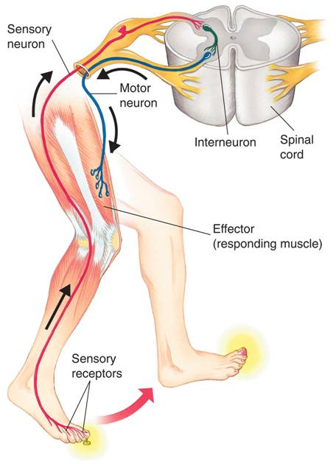
PNS: Reflex Arc
Sensory neuron
Motor neuron
Interneuron
Spinal cord
Effector (responding muscle)
Sensory receptors
Notes:
The peripheral nervous system transmits impulses from sense organs to the central nervous system and back to muscles or glands. When you step on a tack, sensory receptors stimulate a sensory neuron, which relays the signal to an interneuron within the spinal cord. The signal is then sent to a motor neuron, which in turn stimulates a muscle in your leg to lift your leg.

Slide 30
PNS: Autonomic Nervous System
  The autonomic nervous system regulates involuntary activities
  Subdivided into two parts:
    sympathetic nervous system
      Speed up body activity
      ‘fight or flight’

Slide 31
PNS: Autonomic Nervous System
  Subdivided into two parts:
    parasympathetic nervous system
      Slows down body activity
  Two parts have opposite effects on the same organ system
    Helps maintain homeostasis

Slide 32
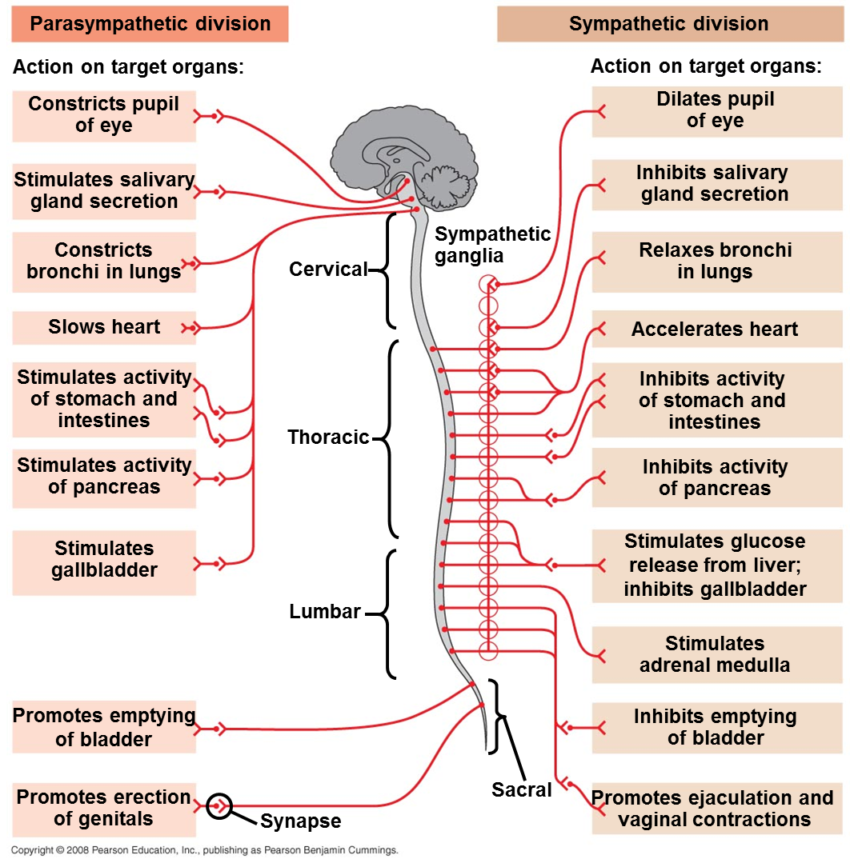
Autonomic Nervous System

Slide 33
Summary of the Human Nervous System
PNS
CNS
12 pairs of Cranial Nerves
31 pairs of Spinal
Nerves
Brain
Spinal Cord
Sensory
Motor
Somatic
Autonomic
Sympathetic
Parasympathetic

Slide 34
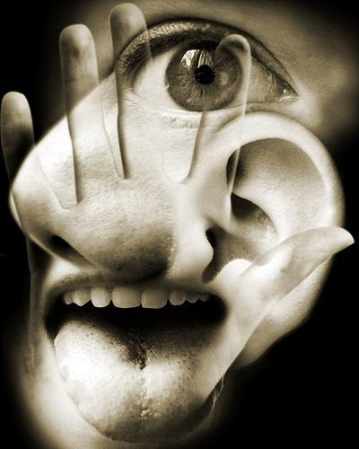
The Senses
Sense organs send information about stimuli to the CNS
Sense organs respond to stimuli by generating Action Potentials
Senses help the body maintain homeostasis

Slide 35
Vision
Human Eye has 3 Main Layers:
  Sclera: Outer layer that forms the transparent Cornea in the front of the eyeball.
  Choroid: Mid-layer that supplies nutrients to Retina.
    At the front of the eye, the choroid holds the muscle that controls the shape of the Lens, which focuses light on the Retina.
    Iris adjusts the amount of light entering the eye by constricting or dilating the Pupil.

Slide 36
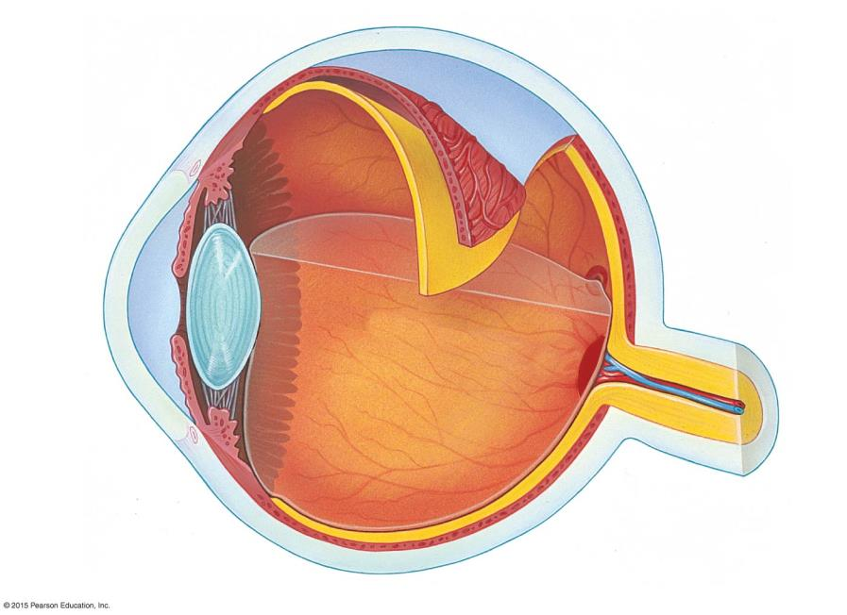
Sclera
Choroid
Retina
Ligament
Fovea
(center of
visual field)
Cornea
Iris
Optic
nerve
Pupil
Aqueous
humor
Lens
Artery
and vein
Vitreous
humor
Blind spot
Notes:
Figure 29.7c The single-lens eye of a vertebrate

Slide 37
Vision
RETINA
Innermost layer that has the Photoreceptors.
  These Photoreceptors contain light-sensitive pigments associated with membranes:
    Rod-Cells: Provide Black and White Vision in dim light.
    Cone-Cells: Provide Color Vision in brighter light.

Slide 38
Vision
Light stimulation alters the pigments embedded in the membranes of Rods and Cones (after passing through several layers of cells)
The resulting change in the membrane charge may generate an action potential
Photoreceptor cells synapse with multiple layers of neurons in the Retina
Eventually, axons of some of these neurons leave the retina as the Optic Nerve, which carries information to the Brain

Slide 39
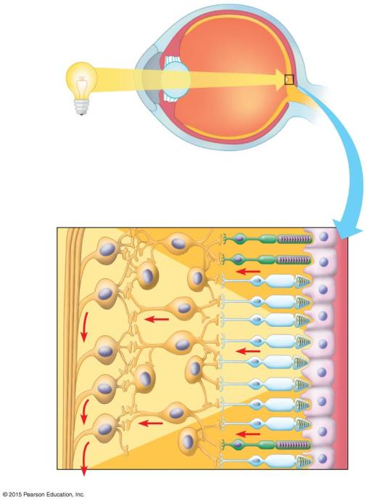
Retina
Optic
nerve
Retina
Neurons
Photoreceptors
Rod
Cone
Optic
nerve
fibers
To the brain
Notes:
Figure 29.10b-0 The vision pathway from light source to optic nerve

Slide 40
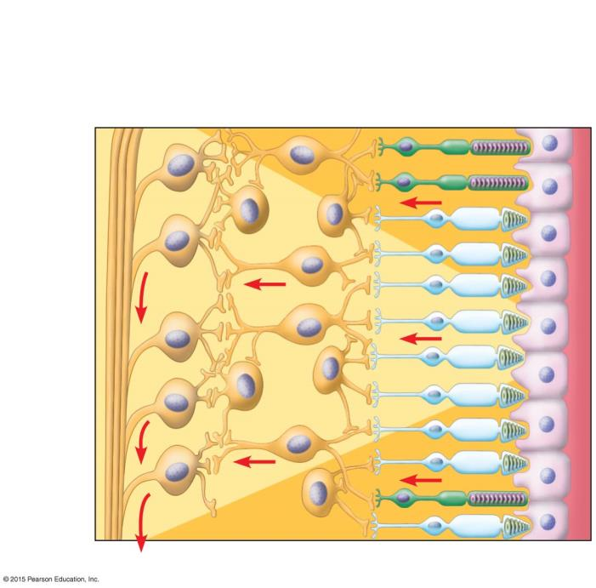
Retina
Neurons
Photoreceptors
Rod
Cone
Optic
nerve
fibers
To the brain
Notes:
Figure 29.10b-1 The vision pathway from light source to optic nerve (detail)

Slide 41
Hearing
Ear detects Sound Waves traveling through the air.
Sound Waves enter the Auditory Canal, vibrating the Eardrum.
3 Bones in the Middle Ear amplify these vibrations.
Movement of these bones are transmitted through the Oval Window, changing the pressure in the fluid within the Cochlea (Inner Ear).
At the base of the Cochlea, vibration bends Hair Cells in the Organ of Corti producing an Action Potential.
Auditory Nerve transmits impulses to the Brain.
Brain perceives the pitch of the sound through the location of the bending hair cells in the cochlea.
Louder sounds generate more action potentials than softer ones.

Slide 42
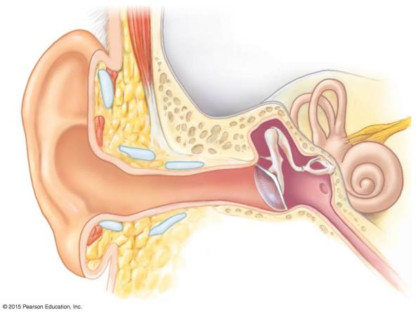
Outer ear
Inner ear
Middle ear
Pinna
Eardrum
Auditory
canal
Eustachian
tube
Notes:
Figure 29.4a An overview of the human ear

Slide 43
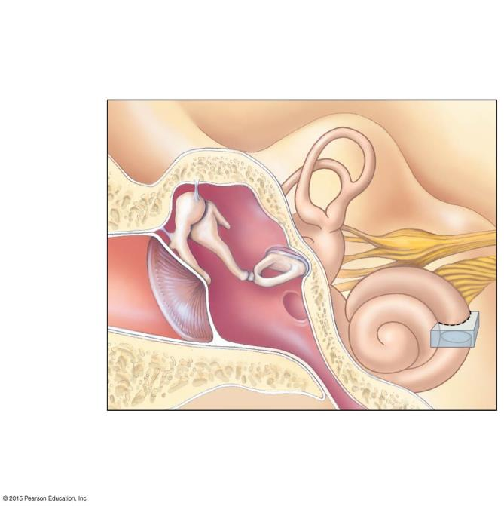
Semicircular
canals
(function in
balance)
Auditory
nerve, to
the brain
Oval window
(behind the stirrup)
Skull
bones
Hammer
Anvil
Stirrup
Eardrum
Round
window
Eustachian tube
(connects to the
pharynx)
Cochlea
Notes:
Figure 29.4b The middle ear and the inner ear

Slide 44
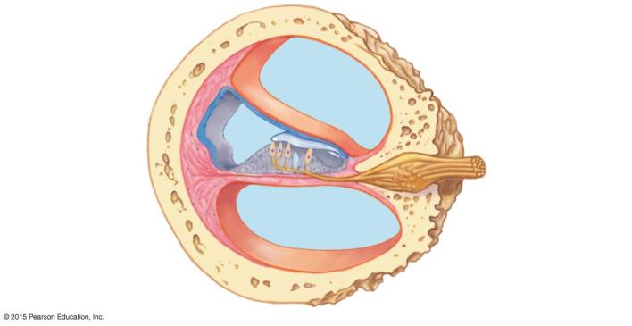
Bone
Upper
canal
Auditory nerve
Middle canal
Organ of
Corti
Lower
canal
Notes:
Figure 29.4c A cross section through the cochlea

Slide 45
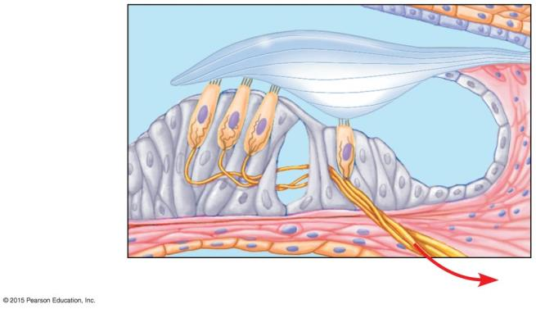
Hair
cells
Tectorial membrane
Sensory
neurons
Basilar
membrane
To the brain via the auditory nerve
Notes:
Figure 29.4d The organ of Corti

Slide 46
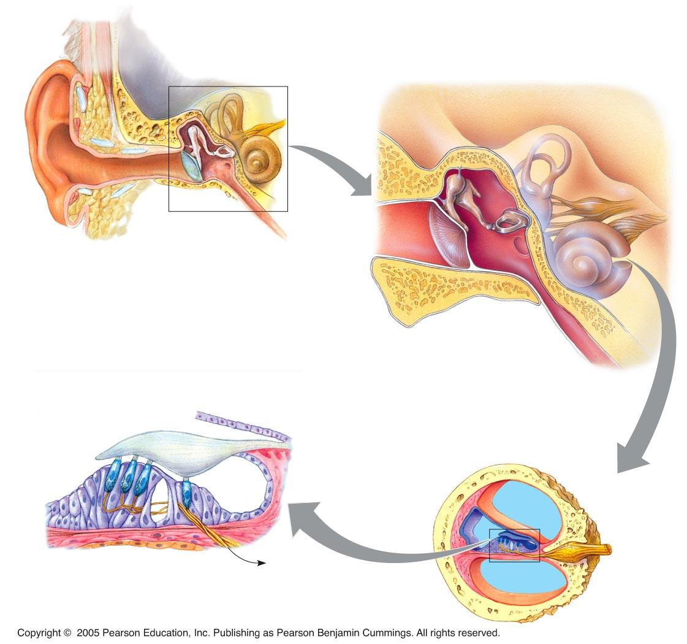
Structure of the Ear
Outer ear
Middle
ear
Inner ear
Stapes
Semicircular canals
Middle
ear
Incus
Skull bones
Malleus
Auditory nerve,
to brain
Pinna
Auditory
canal
Tympanic
membrane
Eustachian
tube
Oval
window
Cochlea
Tympanic
membrane
Round
window
Eustachian tube
Tectorial
membrane
Hair cells
Bone
Cochlea duct
Auditory
nerve
Vestibular
canal
Basilar
membrane
Axons of
sensory neurons
To auditory
nerve
Tympanic
canal
Organ of Corti

Slide 47
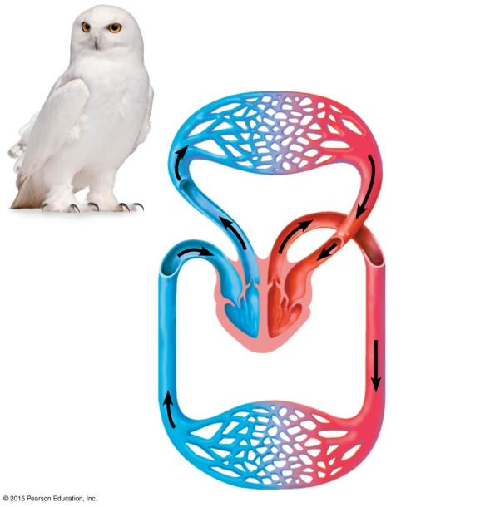
Circulatory System
Lung
capillaries
Pulmonary
circuit
Atrium
Atrium
Ventricle
Ventricle
Right
Left
Systemic
circuit
BIRDS & MAMMALS:
Double Circulation and Four-Chambered Heart
Systemic
capillaries
Notes:
Figure 23.2c The double circulation and four-chambered heart of a bird or mammal

Slide 48
The Circulatory System facilitates exchange with all Body Tissues.
The cardiovascular system of a FISH includes a Heart with Two Chambers:
  The Atrium receives blood from Veins.
  The Ventricle pumps blood to Gills via large Arteries.
These large Arteries branch into Arterioles, which give rise to Capillaries, which branch into networks called Capillary Beds, which infiltrate every organ and tissue in the body.
Capillaries converge into Venules, which in turn converge into larger Veins that return blood to the Heart.

Slide 49
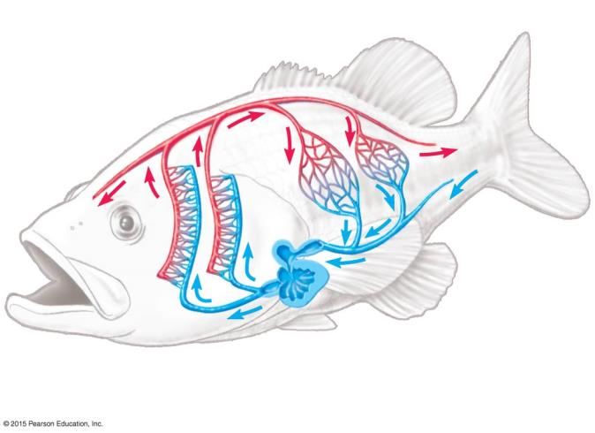
Capillary beds
Arteriole
Artery
(O₂-rich blood)
Venule
Vein
Atrium
Gill
capillaries
Artery
(O₂-poor blood)
Heart
Ventricle
Notes:
Figure 23.1b The closed circulatory system of a fish

Slide 50
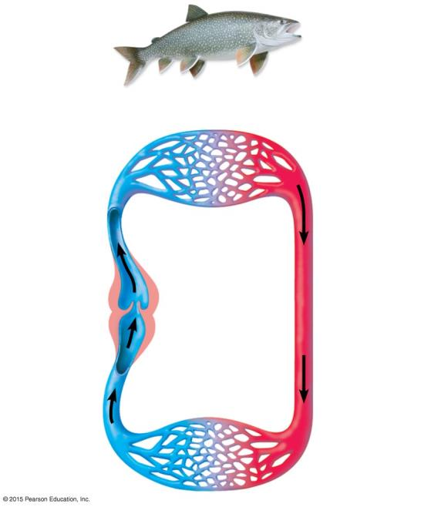
FISH:
Single Circulation and Two-Chambered Heart
Gill
capillaries
Heart:
Ventricle
Atrium
Body
capillaries
Notes:
Figure 23.2a The single circulation and two-chambered heart of a fish

Slide 51
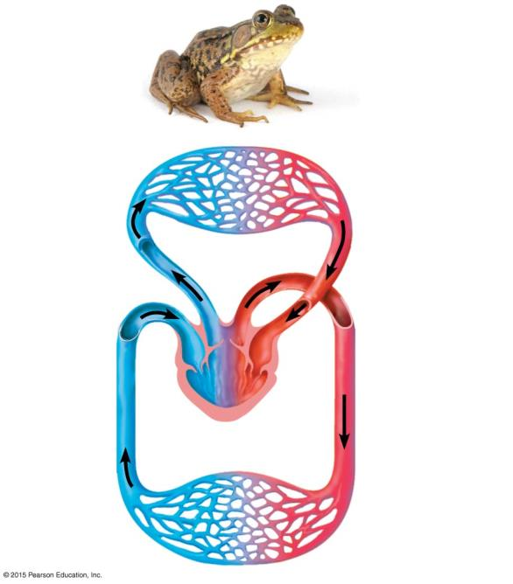
AMPHIBIANS:
Double Circulation and Three-Chambered Heart
Lung and Skin capillaries
Pulmonary
circuit
Atrium
Atrium
Ventricle
Right
Left
Systemic
circuit
Systemic
capillaries
Notes:
Figure 23.2b The double circulation and three-chambered heart of an amphibian

Slide 52
The Circulatory System facilitates exchange with all Body Tissues.
Frogs and other amphibians have a three-chambered heart:
  The right atrium receives low-oxygen blood returning from the systemic capillaries in the body’s organs
  The single ventricle pumps this blood to the lungs and skin.
  After being oxygenated, blood returns to the left atrium
  Although blood coming from the two atria mixes in the single ventricle, a ridge diverts most of the low-oxygen blood to the pulmonary circuit and most of the oxygen-rich blood to the systemic circuit.

Slide 53
Lung
capillaries
Pulmonary
circuit
Atrium
Atrium
Ventricle
Ventricle
Right
Left
BIRDS and MAMMALS:
Double Circulation and Four-Chambered Heart
Systemic
circuit
Systemic
capillaries
Notes:
Figure 23.2c The double circulation and four-chambered heart of a bird or mammal

Slide 54
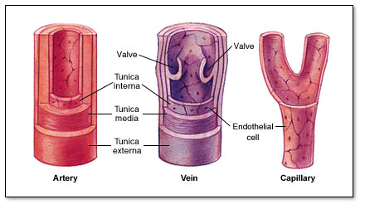
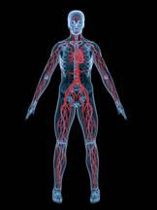
Blood Vessels
Multilayered, muscular tubes that carry blood to and from all parts of body.
3 Main Types:
  Arteries
  Capillaries
  Veins

Slide 55
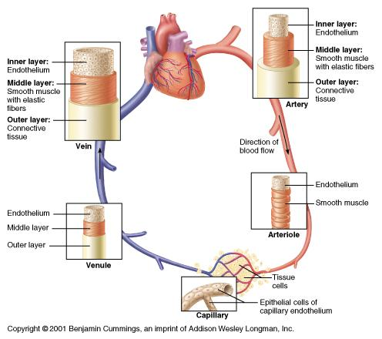
ARTERIES
Blood vessels that carry blood from the heart throughout the body.
Thick elastic walls that can withstand the powerful surges of blood produced by the heart.
As they lead farther from the heart, arteries branch into smaller vessels called arterioles.

Slide 56
VEINS
Vessels that carry blood from the capillaries of the organs and tissues toward the heart.
They have small valves that open to let blood through and close to prevent it from flowing backwards.
Many are located close to skeletal muscles so the contractions of these muscles help to push the blood along to the heart.
Walls not as thick or elastic as arteries.

Slide 57
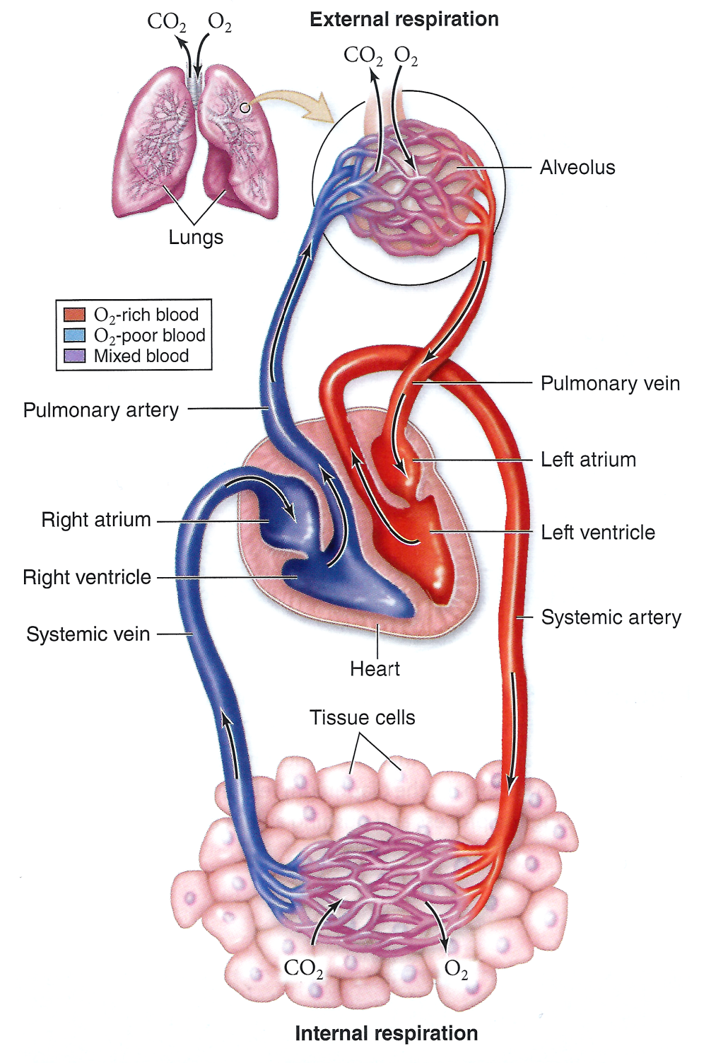
CAPILLARIES
Smallest of blood vessel types
Exchange of nutrients and wastes takes place here.
Walls only ONE CELL THICK
As blood flows through capillaries in the lungs, carbon dioxide (waste) is released and oxygen is absorbed.
As blood flows through capillaries in the tissues, carbon dioxide (waste) is picked up and oxygen is delivered to the cells.

Slide 58
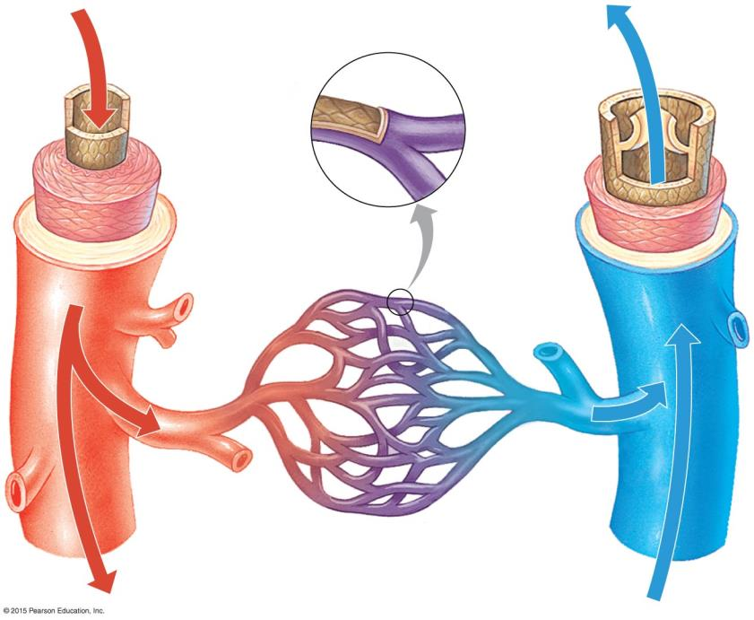
Epithelium
Capillary
Basal lamina
Valve
Epithelium
Epithelium
Smooth
muscle
Smooth
muscle
Connective
tissue
Connective
tissue
Artery
Vein
Venule
Arteriole
Notes:
Figure 23.7c Structural relationships of blood vessels

Slide 59
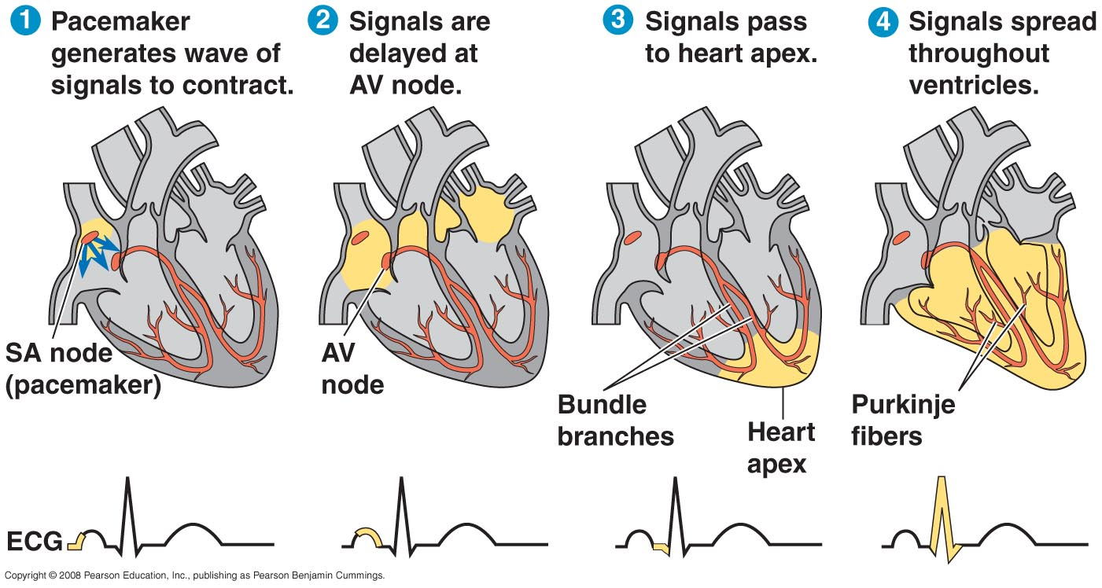
Control of Heartbeat
SA (Sinoatrial) Node
  “Pacemaker”
  Generates electrical signal
AV (Atrioventricular) Node
  Receives signal from SA Node
  Sends signal to rest of heart

Slide 60
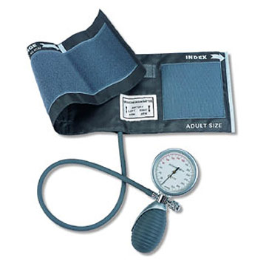
Blood Pressure
sphygmomanometer (blood pressure cuff)
healthy blood pressure is 120/70 for humans
Systolic pressure is highest
  - blood is forced out of heart and into the circulation
Diastolic pressure represents the lower number (in denominator)

Slide 61
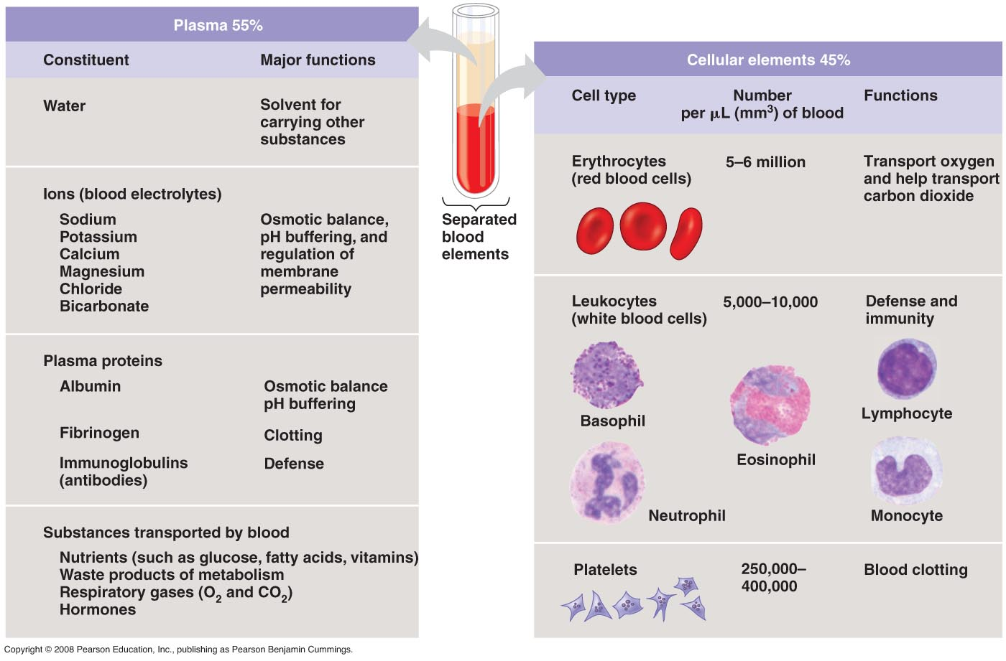
Blood Cells: 45%
RBC (Erythrocytes)
  Live 120 days
  No nucleus
  No mitochondria
  Hemoglobin
  Transport O₂/CO₂
WBC (Leukocytes)
  Immune Defense
  Many different types
Platelets (Thrombocytes)
  Fragments of blood cells
  Help with clotting

Slide 62
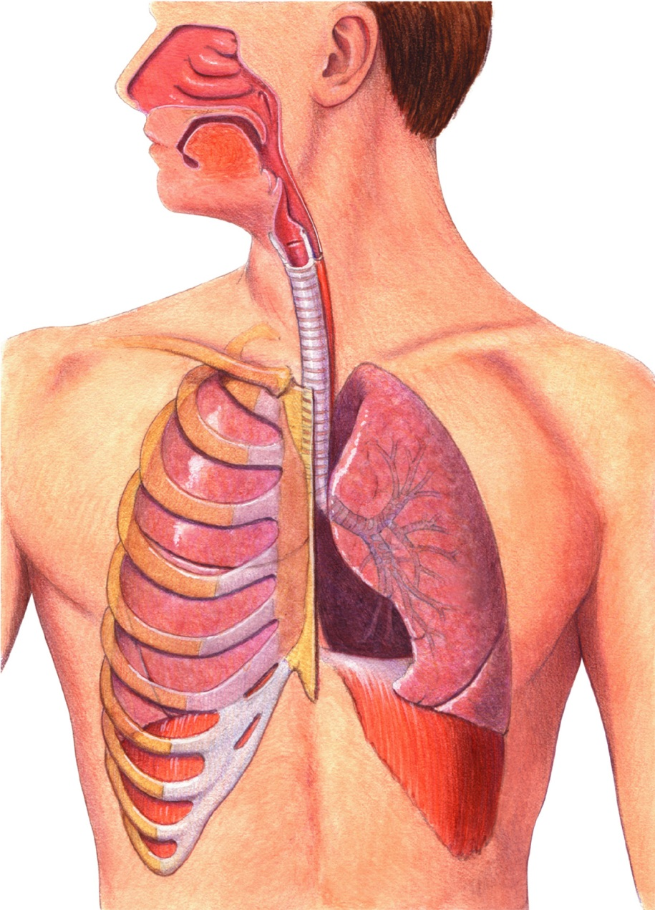
The Respiratory System

Slide 63
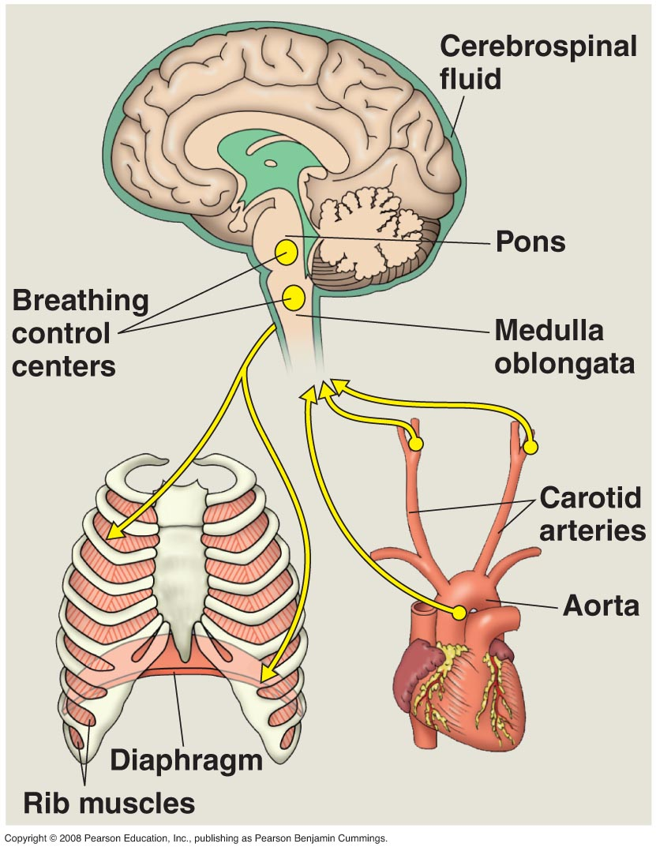
How Breathing Is Controlled
  Breathing is controlled by a structure in the brain called the medulla oblongata
    monitors carbon dioxide in the blood

Slide 64
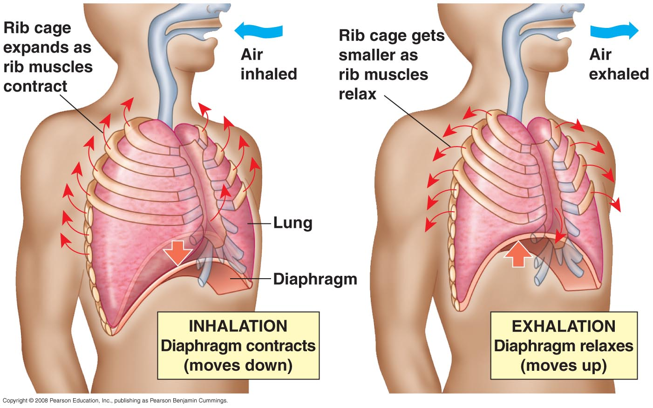
Lungs are sealed in two sacs (pleural membranes)
Diaphragm is a muscular organ that aids breathing
Inhalation (breathing in)
  1. Diaphragm contracts (increasing chest volume)
  2. Ribs rise (increasing chest volume)
  3. Air enters lungs
Exhalation (breathing out)
  1. Diaphragm relaxes (decreasing chest volume)
  2. Ribs lower (decreasing chest volume)
  3. Air exits lungs
Mechanics of Breathing

Slide 65
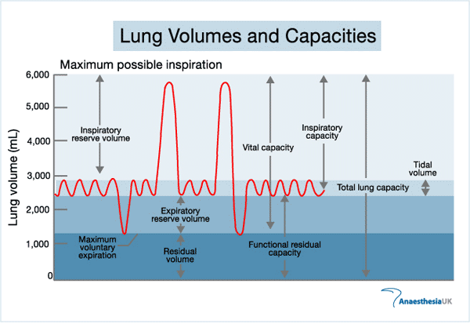
Gas Exchange Volumes
Tidal Volume
- Volume of air exchanged at rest
Vital Capacity
- Maximum volume of air inhaled and exhaled
Residual Volume
- Volume of air left in lungs after completely exhaling

Slide 66
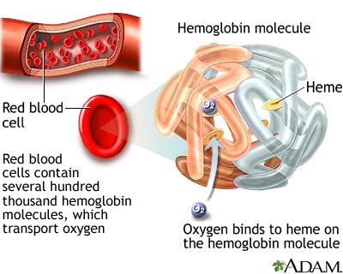
How is O₂ carried through the body?
Hemoglobin

Slide 67
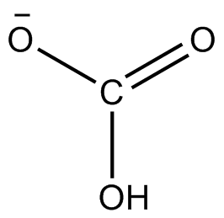
How is CO₂ carried through the body?
1. Most (70%) is in the form of bicarbonate (HCO₃)
- helps maintain blood pH
2. Some is carried by hemoglobin
3. Small amount is dissolved in blood plasma

