Slide 1
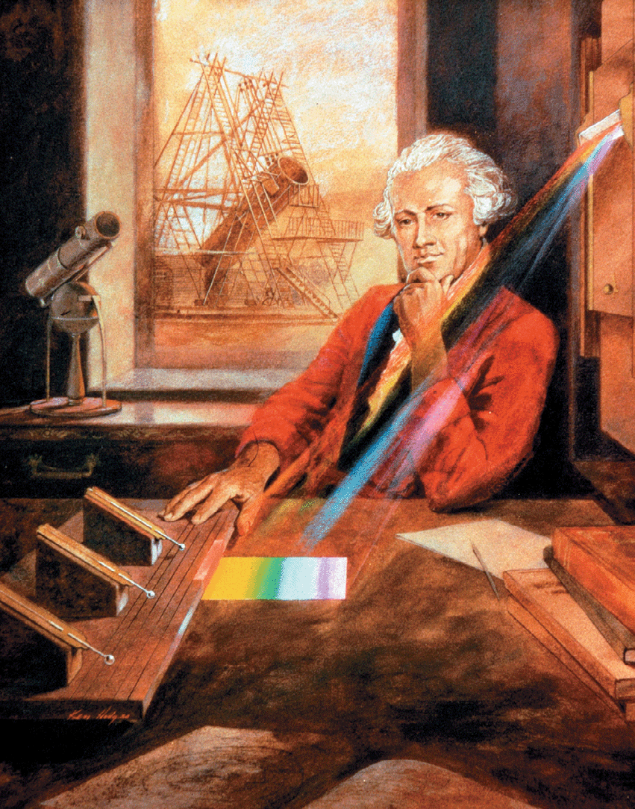
William Herschel measured the temperature of different colors of light. The temperature was lowest at the blue end and highest at the red end. Curiosity led Herschel to discover evidence of radiation past the red end of the band of visible light.

Slide 2


The Waves of the Spectrum
What waves are included in the electromagnetic spectrum?
The electromagnetic spectrum includes radio waves, infrared rays, visible light, ultraviolet rays, X-rays, and gamma rays.

Slide 3
The Waves of the Spectrum
The full range of frequencies of electromagnetic radiation is called the electromagnetic spectrum.
  Visible light is the only part of the electromagnetic spectrum that you can see, but it is just a small part.
  Each kind of wave is characterized by a range of wavelengths and frequencies. All of these waves have many useful applications.

Slide 4
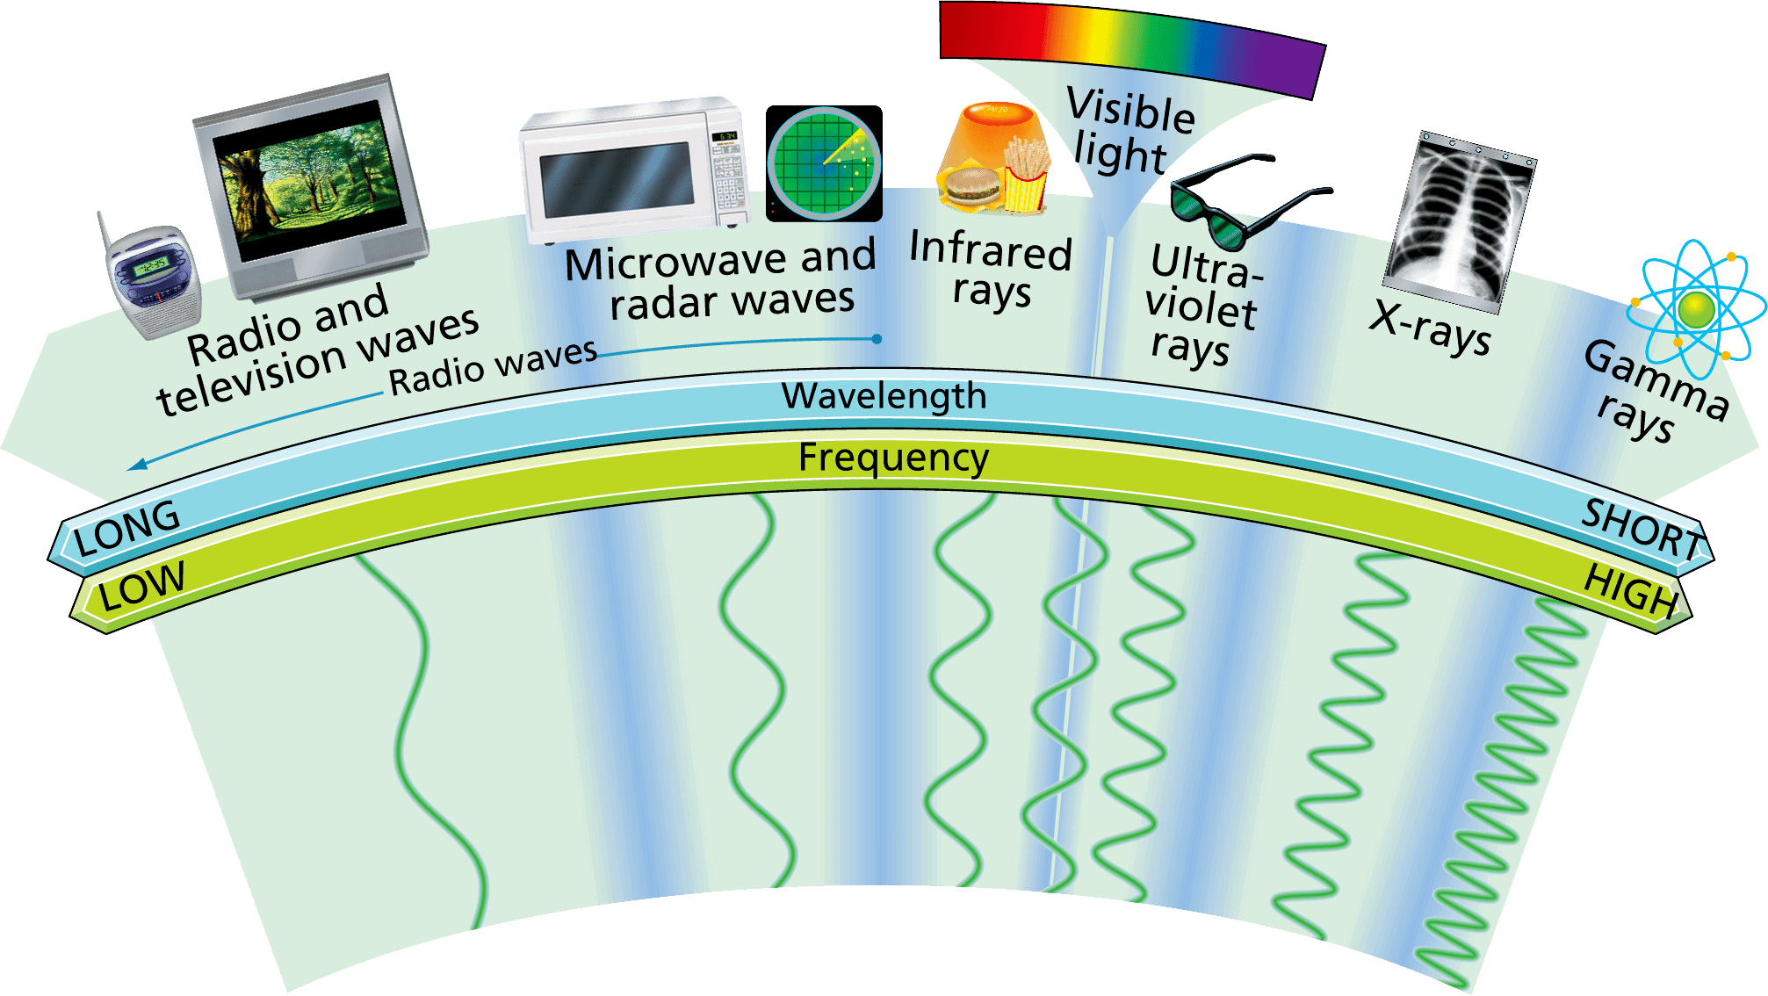
The Waves of the Spectrum
The electromagnetic spectrum consists of radio waves, infrared rays, visible light, ultraviolet rays, X-rays, and gamma rays.

Slide 5
Radio Waves
How are radio waves used?
Radio waves are used in radio and television technologies, as well as in microwave ovens and radar.

Slide 6
Radio Waves
Radio waves have the longest wavelengths in the electromagnetic spectrum. Wavelengths range from 1 millimeter to as much as thousands of kilometers or longer.
Radio waves also have the lowest frequencies in the spectrum—300,000 megahertz (MHz) or less.

Slide 7
Radio Waves
Radio
In a radio studio, sound is changed into electronic signals that are coded onto radio waves and then broadcast.
Your radio receives the radio signal, decodes it, and changes it back into sound waves you can hear.

Slide 8
Radio Waves
There are two ways that signals are encoded for radio.
  In amplitude modulation, the amplitude of the wave is varied. The frequency remains the same. AM radio stations broadcast by amplitude modulation.
  In frequency modulation, the frequency of the wave is varied. The amplitude remains the same. FM stations broadcast by frequency modulation.

Slide 9
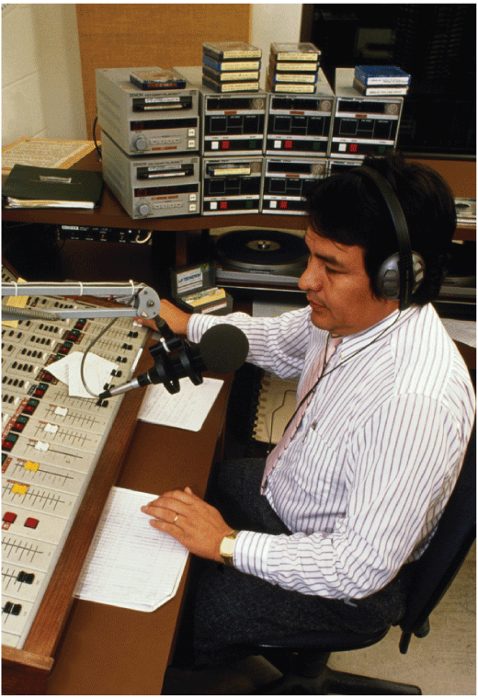
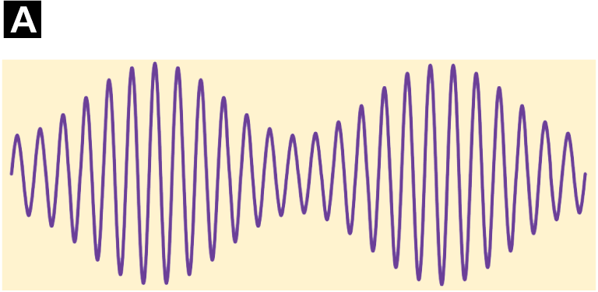
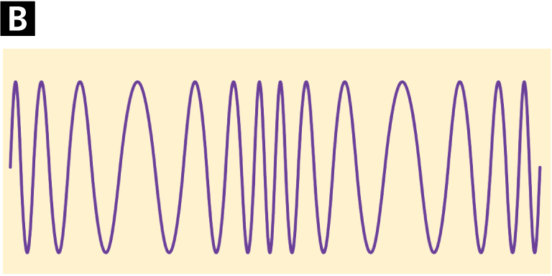
Radio Waves
The announcer’s voice and the music on CD leave the radio studio as electronic signals. Those signals are used to produce a wave with either a varying amplitude or a varying frequency.
  AM waves have a varying amplitude.
  FM waves have a varying frequency.
Amplitude modulation
Frequency modulation

Slide 10
Radio Waves
FM radio signals do not travel as far as AM signals along Earth’s curved surface.
  AM frequencies are from 535 kilohertz to 1605 kilohertz.
  FM frequencies are from 88 megahertz to 108 megahertz.
  Particles in Earth’s upper atmosphere reflect the lower-frequency AM radio waves much better than the FM radio waves. The reflection helps transmit AM signals farther.

Slide 11
Radio Waves
Television
Radio waves also carry signals for television programming. The radio waves carry information for pictures as well as for sound.
Location and weather can affect the reception of television signals by an antenna.

Slide 12
Radio Waves
With satellite transmission, TV broadcasts are sent to satellites, which then retransmit the signals back to Earth.
Signals can go to home satellite receivers or to cable services that receive the signals and send them through cables.

Slide 13

How Long Does an Antenna Need to Be?
Have you ever noticed how the lengths of antennas vary from quite short (cell phones) to very long (radio transmitters)? The length of an antenna depends in part on the length of the waves it transmits. Each letter in the graph (A–E) represents an antenna of a different length. The graph shows the wavelengths that can be transmitted by antennas of a few different lengths.

Slide 14
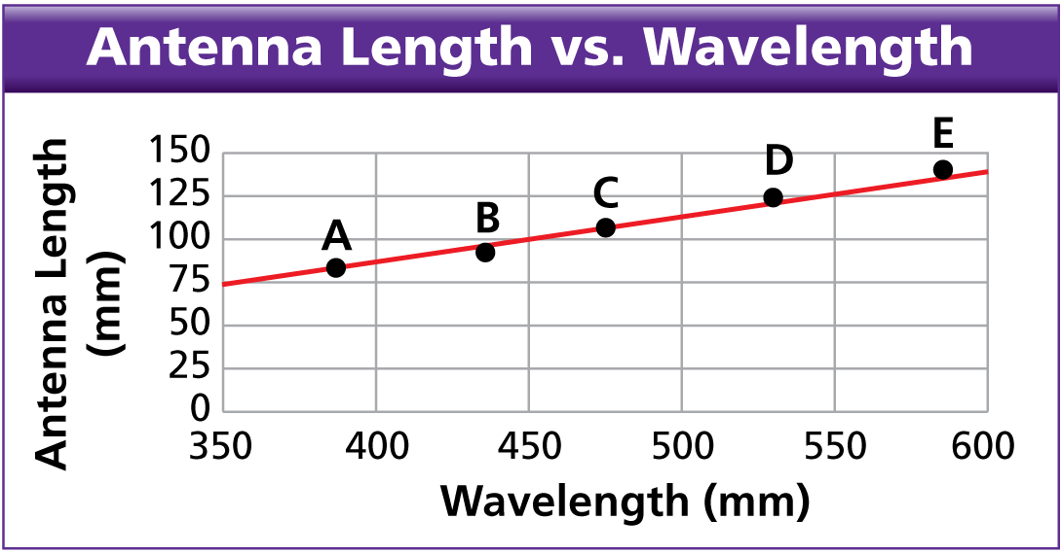
How Long Does an Antenna Need to Be?
Calculating What is the frequency of the wave that antenna B transmits? (Hint: Assume the wave travels at the speed of light.)

Slide 15
How Long Does an Antenna Need to Be?
Calculating What is the frequency of the wave that antenna B transmits? (Hint: Assume the wave travels at the speed of light.)
Answer: The wavelength is about 435 mm. Thus, the frequency = (3.00 × 10⁸ m/s)/(0.435 m) = 6.9 × 10⁸ Hz = 690 MHz.

Slide 16
How Long Does an Antenna Need to Be?
Drawing Conclusions What relationship is there between antenna length and wavelength?

Slide 17
How Long Does an Antenna Need to Be?
Drawing Conclusions What relationship is there between antenna length and wavelength?
Answer: There is an approximately linear relationship between antenna length and wavelength. The wavelength is about four or five times the antenna length.

Slide 18
How Long Does an Antenna Need to Be?
Inferring At an outdoor concert, a singer is using a wireless microphone with antenna C. Speakers broadcast her performance. Now and then the speakers also broadcast an employee taking an order at a fast food restaurant nearby. What is the approximate wavelength of the transmissions from the restaurant? How do you know?

Slide 19
How Long Does an Antenna Need to Be?
Inferring At an outdoor concert, a singer is using a wireless microphone with antenna C. Speakers broadcast her performance. Now and then the speakers also broadcast an employee taking an order at a fast food restaurant nearby. What is the approximate wavelength of the transmissions from the restaurant? How do you know?
Answer: The restaurant transmissions are about the same wavelength as the singer’s, about 105 MHz, because the antenna is picking up both transmissions.

Slide 20
How Long Does an Antenna Need to Be?
Predicting If you used a microphone that transmitted waves at 600 MHz, approximately how long would its antenna need to be?

Slide 21
How Long Does an Antenna Need to Be?
Predicting If you used a microphone that transmitted waves at 600 MHz, approximately how long would its antenna need to be?
Answer: The transmitted wavelength is about (3.00 × 10⁸ m/s)/(6.0 × 10⁸ Hz) = 0.50 m, or 500 mm. On the graph, this is about halfway between the wavelengths used by antennas C and D. Therefore, the antenna length used should be about 115 mm.

Slide 22
Radio Waves
Microwaves
The shortest-wavelength radio waves are called microwaves. Microwave wavelengths are from about 1 m to about 1 mm.
  Frequencies vary from about 300 MHz to about 300,000 MHz.
  Microwaves cook and reheat food. Microwaves also carry cell phone conversations. The process works much like a radio broadcast.

Slide 23
Radio Waves
Radar
The word radar is an acronym for radio detection and ranging. Radar technology uses a radio transmitter to send out short bursts of radio waves.
  The waves reflect off the objects they encounter and bounce back toward where they came from.
  The returning waves are then picked up by a radio receiver.

Slide 24
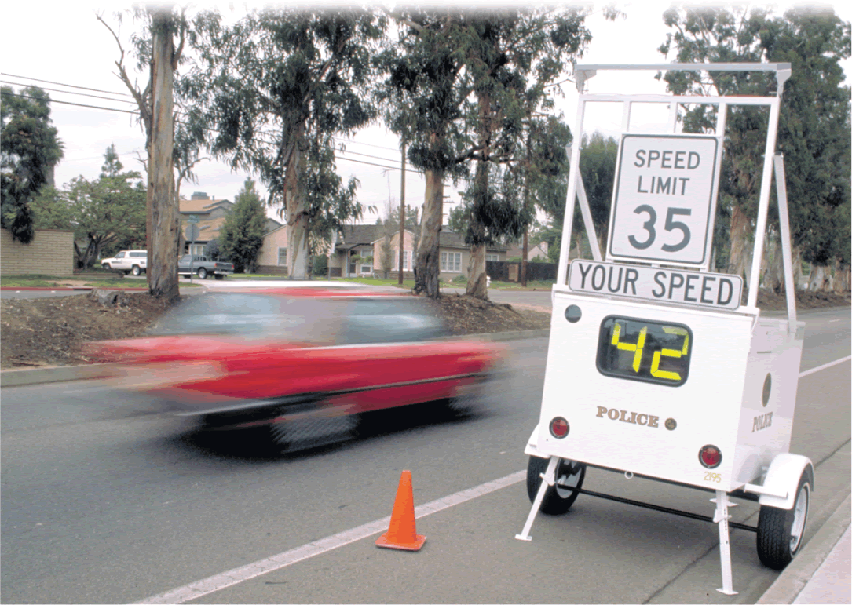
Radio Waves
A speed-monitoring trailer uses radar to measure the speed of an approaching car.

Slide 25
Infrared Rays
How are infrared rays used?
Infrared rays are used as a source of heat and to discover areas of heat differences.

Slide 26
Infrared Rays
Infrared rays have higher frequencies than radio waves and lower frequencies than red light. Infrared wavelengths vary from about 1 millimeter to about 750 nanometers (10^{–9} meter).
Your skin senses infrared radiation as warmth. Restaurants use infrared lamps to keep foods warm.

Slide 27
Infrared Rays
Warmer objects give off more infrared radiation than cooler objects.
A device called a thermograph uses infrared sensors to create thermograms, color-coded pictures that show variations in temperature.
Search-and-rescue teams use infrared cameras to locate people who are trapped during disasters.

Slide 28
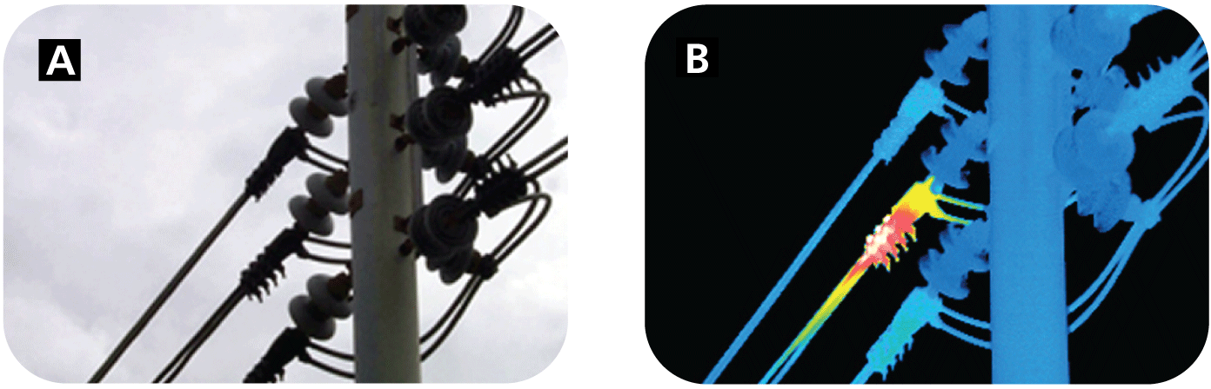
Infrared Rays
A thermogram can be used to diagnose problems in a utility line.
  When viewed in visible light, the wires all look the same.
  The colors in the thermogram image show that the electric current in the center wire is not flowing as it should.

Slide 29
Visible Light
How is visible light used?
People use visible light to see, to help keep them safe, and to communicate with one another.

Slide 30
Visible Light
The visible part of the electromagnetic spectrum is light that the human eye can see.
Each wavelength in the visible spectrum corresponds to a specific frequency and has a particular color.

Slide 31
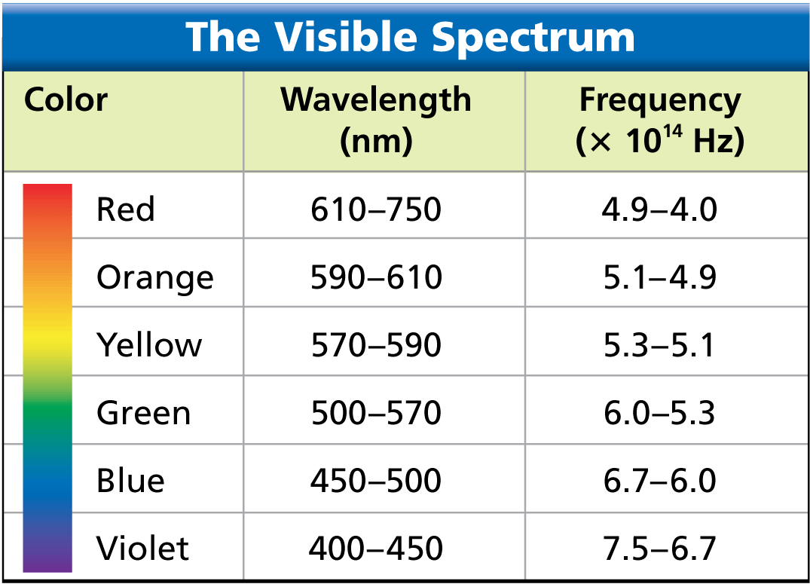
Visible Light
Each color of light corresponds to a different range of wavelengths. The wavelengths of visible light are quite small. Wavelengths of red light, for example, are about one hundredth the thickness of a human hair.

Slide 32
Ultraviolet Rays
How are ultraviolet rays used?
Ultraviolet rays have applications in health and medicine, and in agriculture.

Slide 33
Ultraviolet Rays
Ultraviolet rays vary from about 400 nm to about 4 nm.
  Some exposure to ultraviolet rays helps your skin produce vitamin D, which helps the body absorb calcium from foods.
  Excessive exposure can cause sunburn, wrinkles, skin cancer, and eye damage.
  Ultraviolet rays are used to kill microorganisms. In winter, plant nurseries use ultraviolet lights to help plants grow.

Slide 34
X-Rays
How are X-rays used?
X-rays are used in medicine, industry, and transportation to make pictures of the inside of solid objects.

Slide 35
X-Rays
X-rays have very short wavelengths, from about 12 nm to about 0.005 nm.
X-rays have high energy and can penetrate matter that light cannot.
Too much exposure to X-rays can kill or damage living tissue.

Slide 36
X-Rays
Your teeth and bones absorb X-rays. X-ray photographs show softer tissue as dark, highly exposed areas. Bones and teeth appear white.
The lids on aluminum cans are sometimes inspected with X-rays to make sure they are sealed properly.
X-rays can be used to identify the contents of entire truck trailers.

Slide 37
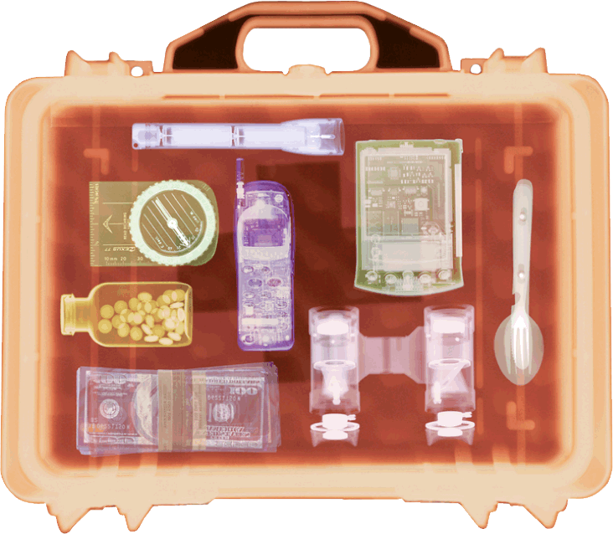
X-Rays
Airport security screeners use X-rays to search baggage for potentially dangerous objects.

Slide 38
Gamma Rays
How are gamma rays used?
Gamma rays are used in the medical field to kill cancer cells and make pictures of the brain, and in industrial situations as an inspection tool.

Slide 39
Gamma Rays
Gamma rays have the shortest wavelengths in the electromagnetic spectrum, about 0.005 nm or less.
They have the highest frequencies, the most energy, and the greatest penetrating ability of all the electromagnetic waves.
Exposure to tiny amounts of gamma rays is tolerable, but overexposure can be deadly.

Slide 40
Gamma Rays
Gamma rays are used in radiation therapy to kill cancer cells without harming nearby healthy cells.
Gamma rays are also used to make pictures of the human brain, with different levels of brain activity represented by different colors.
Pipelines are checked with machines that travel on the inside of a pipe, taking gamma ray pictures along the entire length.

Slide 41
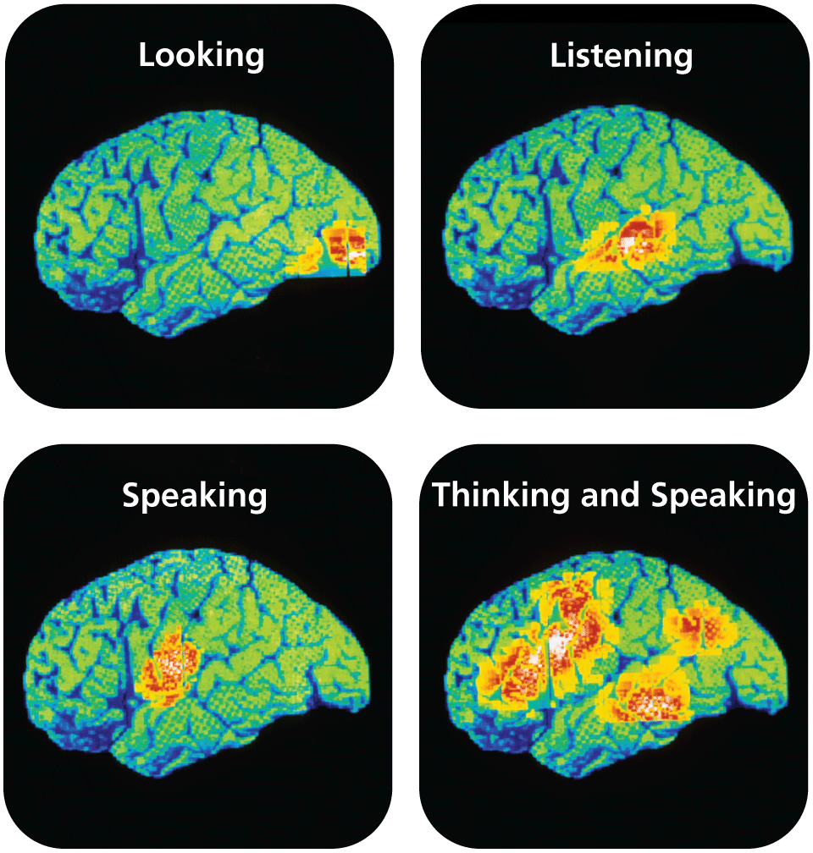
Gamma Rays
Gamma rays emitted by radioactive tracers in the brain are used to produce color-coded images. Areas of high activity show up in red.

Slide 42
Assessment Questions
Which waves have the longest wavelength?
  radio waves
  infrared rays
  visible light
  ultraviolet rays

Slide 43
Assessment Questions
Which waves have the longest wavelength?
  radio waves
  infrared rays
  visible light
  ultraviolet rays
  ANS: A

Slide 44
Assessment Questions
What type of electromagnetic radiation is used to keep prepared foods warm in a serving area?
  ultraviolet rays
  infrared rays
  X-rays
  gamma rays

Slide 45
Assessment Questions
What type of electromagnetic radiation is used to keep prepared foods warm in a serving area?
  ultraviolet rays
  infrared rays
  X-rays
  gamma rays
  ANS: B

