Slide 1
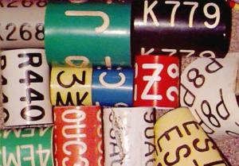

Bands and Tags
Various leg bands
Various ear tags

Slide 2
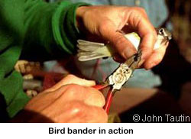
The pliers have a recessed arc.

Slide 3
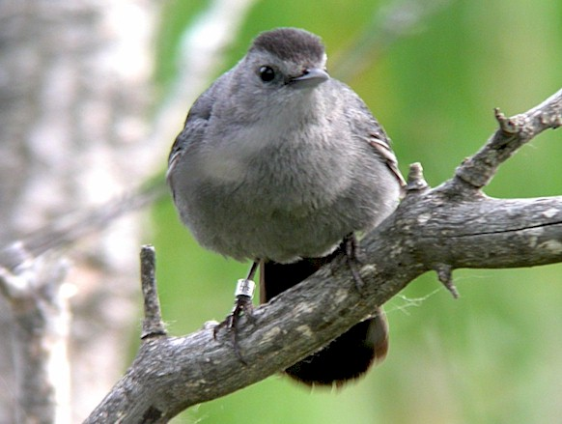
Grey Catbird with a leg band

Slide 4
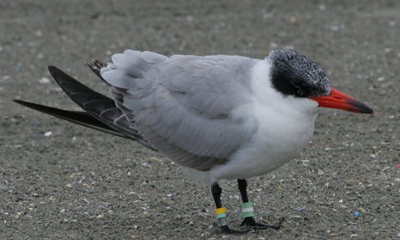
Caspian Tern with leg bands
I love my 80’s
leg warmers.

Slide 5
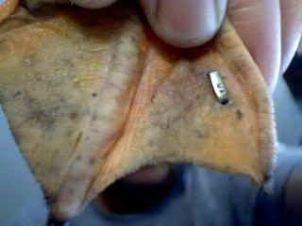
A web tag on the foot of a Mallard duck.

Slide 6
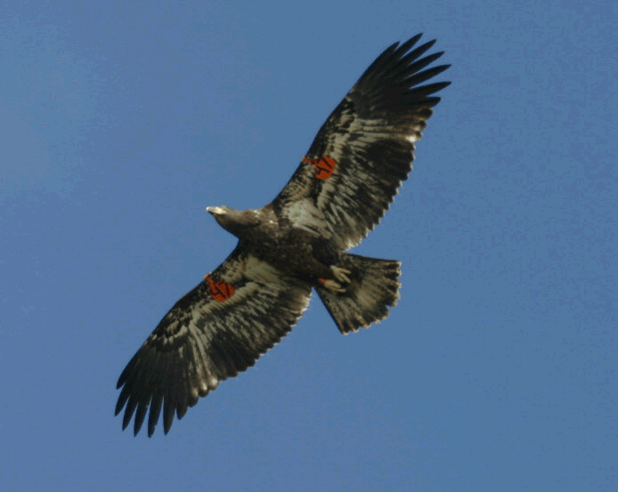
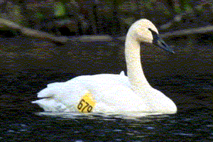
Patagial markers can be seen from the ground.
Patagial markers are attached to the front (patagial) part of the wing on larger flight birds.

Slide 7
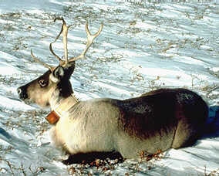
Caribou with a radio transmitting collar.

Slide 8
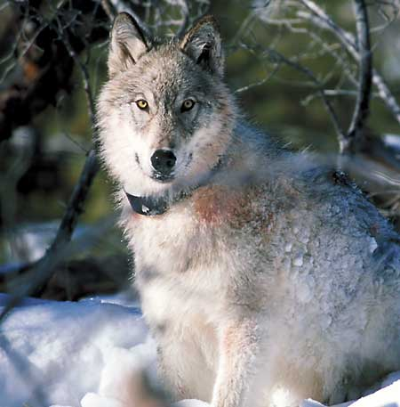
A wolf with a radio transmit-ting collar.

Slide 9
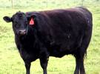
An ear tag on a cow.
Bovine bling!

Slide 10
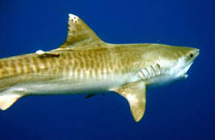
Tiger Shark tag below the dorsal fin

Slide 11
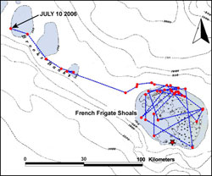
Charted path of a tiger shark over time.

Slide 12
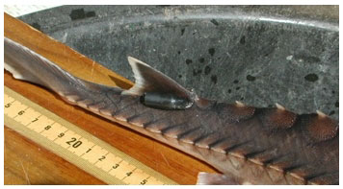
A radio transmitter on a sturgeon

Slide 13
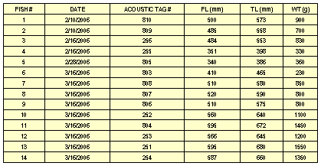
Data from the tagged sturgeon.

Slide 14
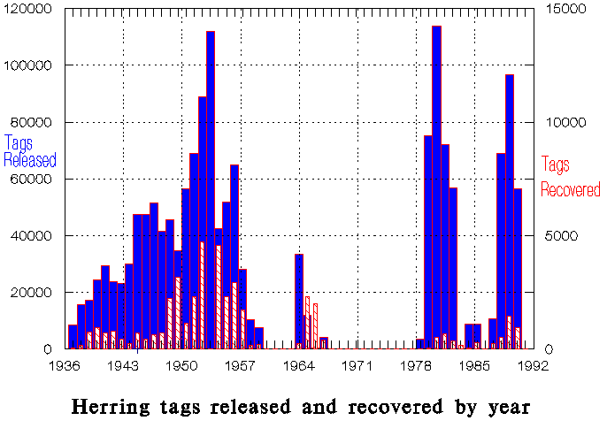
Annual sequential sampling of Herring.

Slide 15
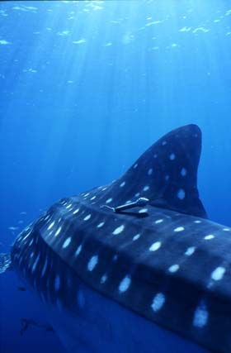
A whale shark with an archival tag (smart tag).

Slide 16
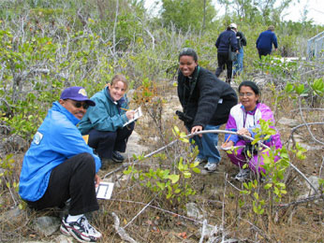

Plant sampling in quadrants
The string is the border for the search area.

Slide 17
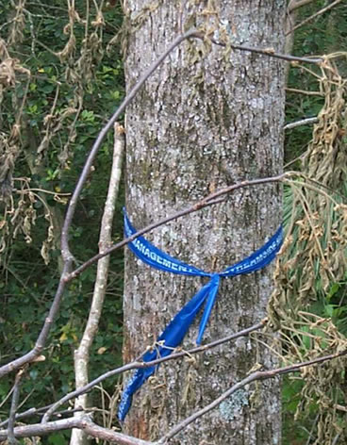
A tree marked and counted using a ribbon.

Slide 18
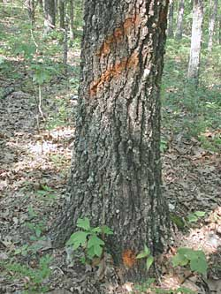
A tree marked with spray paint.

Slide 19
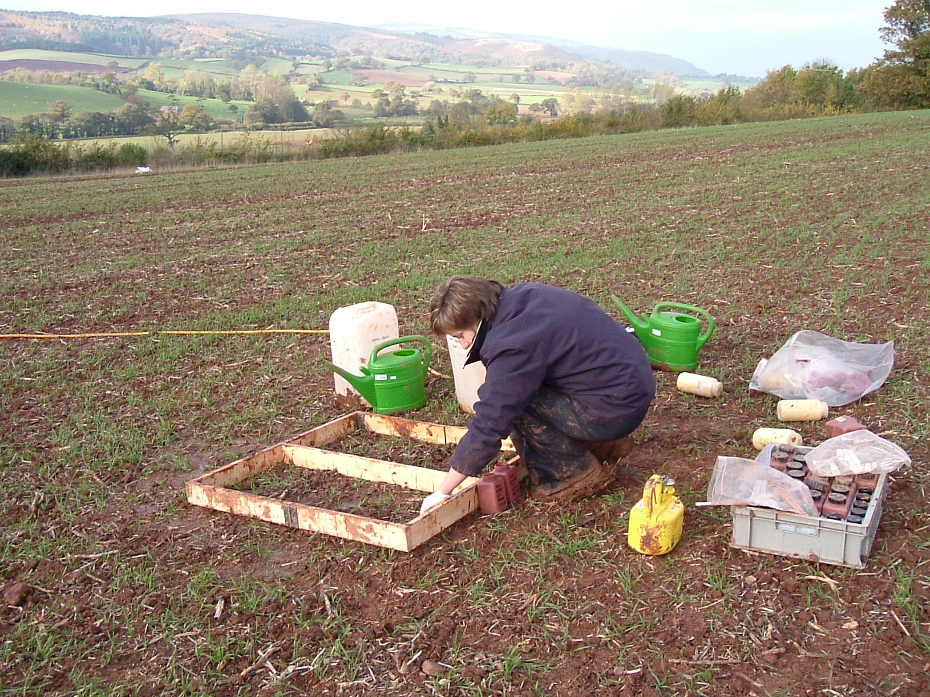
Using a form to sample earthworms.

