Slide 1
Go to the “Slide Show” shade above
Click on “Play from Beginning”

Slide 2
The Grid System & the
2003 Blackout

Slide 3
Grid System
The grid system coordinates several sources of energy production so that a particular home may actually receive electricity that came from a
nuclear power plant,
a hydroelectric plant,
a fossil fuel plant,
a wind generator
or even solar collectors.

Slide 4
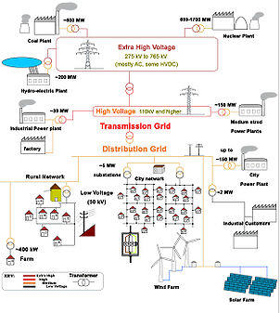

Slide 5
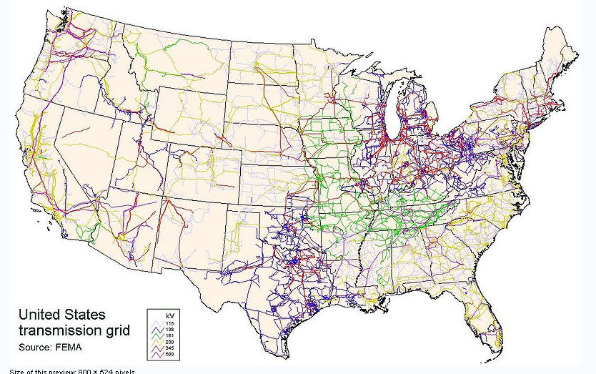
US Grid System

Slide 6
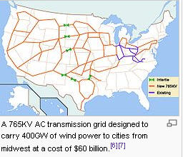
AC Grid System
Alternating Current

Slide 7
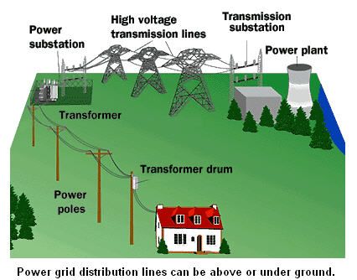
Neighborhood
Nuclear

Slide 8
This figure shows a nuclear power plant as the only source of electrical production for the home.
Notice however, that the high voltage transmission lines carry electricity far beyond that home.
It is likely that this nuclear power plant supplies energy to many homes, industries and communities.

Slide 9
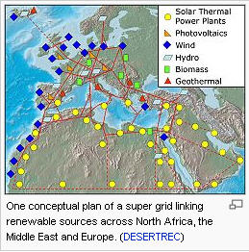
European Grid
Again, notice several sources

Slide 10
Peakload vs. Baseload
Demands for power vary greatly during the day and night.
These demands vary considerably from season to season, as well.
For example, the highest peaks are usually found during the summer daylight hours when air conditioners are running.

Slide 11
Nuclear & Fossil Fuel Plants
Nuclear and fossil fuel plants are not efficient for producing power for the short periods of increased demand during peak periods.
Their operational requirements and their long startup times make them more efficient for meeting baseload needs.

Slide 12
Hydro, Wind & Solar Power
Since hydroelectric generators can be started or stopped almost instantly, hydropower is more responsive than most other energy sources for meeting peak demands.
Water can be stored overnight in a reservoir until needed during the day, and then released through turbines to generate power to help supply the peakload demand.

Slide 13
Why the Grid?
Mixing of power sources offers a utility company the flexibility to operate steam plants most efficiently as base plants while meeting peak needs with the help of hydropower.
This technique can help ensure reliable supplies and may help eliminate brownouts and blackouts caused by partial or total power failures.

Slide 14
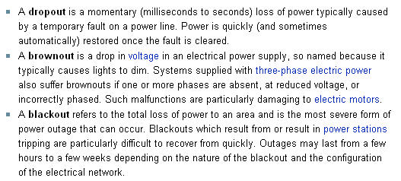

Slide 15
2003 Blackout
In August, 2003, a series of missteps led to a catastrophic blackout in a large portion of the eastern and midwestern United States.
That it occurred on a very hot day meant maximum discomfort for many who lived through the experience, and was in part responsible for the problem itself.

Slide 16
The American continent was electrified, but in electric utility “islands.”
Cleveland got its electricity from the Cleveland Electric Illuminating Company,
Columbus from Columbus-Southern Ohio Electric Company,
Pittsburgh from Duquesne Power,
Newark, New Jersey from the Public Service Electric and Gas Company,
New York from Consolidated Edison (known as Con Ed), and so forth. Most utilities were self-contained monopolies.

Slide 17
Gradually, interconnections were extended.
By the nineteen-sixties, there were many more high-tension transmission lines, and so many more interconnections.
The utilities were still monopolies, but even in the East, electricity could be sent long distances.
New York City, for example, might be partly supplied by electricity originating in Canada.
Connecticut was connected to New York, to Rhode Island and Massachusetts, to Vermont and New Hampshire.

Slide 18
Interconnections are good, because they bring stability to the system.
An interconnected system can reroute energy where it is needed, protecting against problems when a generator is lost.
At this time, most of North America part way into Mexico is connected together in a gigantic system.

Slide 19
However, the larger system also brings complexity.
It’s similar to the difference between an America’s Cup racer and an oil tanker—the racer can turn very quickly, the tanker will have gone some kilometers before it has been able to turn appreciably.
The added complexity makes it difficult to respond to catastrophic failures, especially in the times before computers were widely used.

Slide 20
The 2003 East-Midwest blackout
In many developing countries, electricity may fail catastrophically in specific areas because demand exceeds supply
(supply may be unavailable or demand too great)
or because of trouble with the distribution system (these troubles may even be due to sabotage in some cases).

Slide 21
The 2003 East-Midwest blackout
The blackout affected about 50 million people in the northeast, the midwest, and Canada.

Slide 22
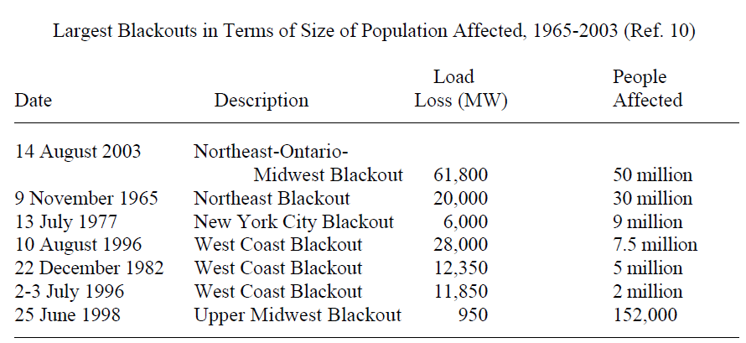
Populations Affected

Slide 23
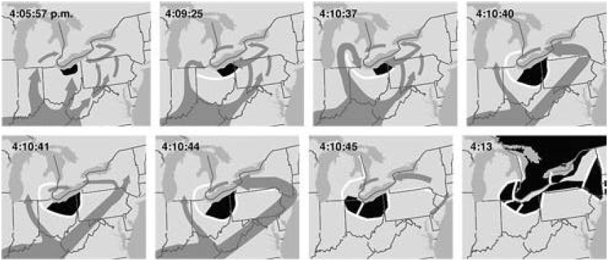
Progression of the blackout from the Cleveland area
1
2
3
4
5
6
7
8

Slide 24
Electricity is not easily stored and is used essentially as it is generated.
This implies that there is a constant dance of supply and demand

Slide 25
Note that the August, 2003 blackout was an unprecedented event both in terms of
the population affected and
the loss of load.

Slide 26
The grid was built over a long period of time, and many of the parts of the grid are quite antiquated.
Restructuring the grid is needed.

Slide 27
So What Happened?
The prolonged heat wave was taking its toll.
The Task Force examined FirstEnergy records and found that actual measured voltage levels on the transmission system on August 14 were below 100% starting early in the day.”

Slide 28
The loss of the transmission lines as the afternoon progressed led to more and more difficulty in maintenance of reactive power demand.
Load reserves were gone by 4 o’clock, and the overextended system soon crashed, dragging the rest of the region along with it.

Slide 29
Relays (transfer electricity)
Relays sense even small power surges and shut down automatically in “cascades,” carrying large swaths of the grid along.
This is both good and bad; good because it isolates the systems’ generators, transmission lines, and substations in small failures;
bad because it exacerbates the crash, shutting down even if the relay is far removed from the actual problem, in large ones.

Slide 30
Another Blackout Coming!
We see that human frailties, translated into lack of attention to crucial details, played a significant role in the blackout.
This fact, the apparent inability of load management to learn lessons from earlier blackouts,
and the complexity of the system itself all make another blackout inevitable someday.

Slide 31
Work on new transmission lines have still not begun.
And Congress during the intervening year failed to pass legislation to make the regulations mandatory because of political disagreements that have nothing to do with the blackouts.
If we do really learn the lessons of 14 August 2003, we will be better prepared to make it a localized and short one rather than a regional or national problem.

