Slide 1
Go to the “Slide Show” shade above
Click on “Play from Beginning”

Slide 2
Interior of the Frog
You may use the Dissection Videos and
Accompanying PowerPoint Presentation to do a simulated dissection
OR
Purchase a preserved frog from a reputable science store. You will also need a scalpel, probe, forceps, nitrile gloves, and scissors.
DO NOT try to dissect a frog from nature or anyplace that is not licensed to sell preserved specimen. Unpreserved specimen may have parasites.

Slide 3
Interior of the Frog
Reasons to Use the Dissection Video and
Accompanying PowerPoint Presentation:
Increase the quality of the dissection for the students.
Review opportunity, increasing the learning experience for the students.
Student unable to dissect due to pregnancy or hypersensitivity to the preservatives.
Student chooses not to dissect due to ethical/moral reasons.
Open the WORD document of this lab and do the simulated or actual dissection, labelling the anatomy of the frog.

Slide 4
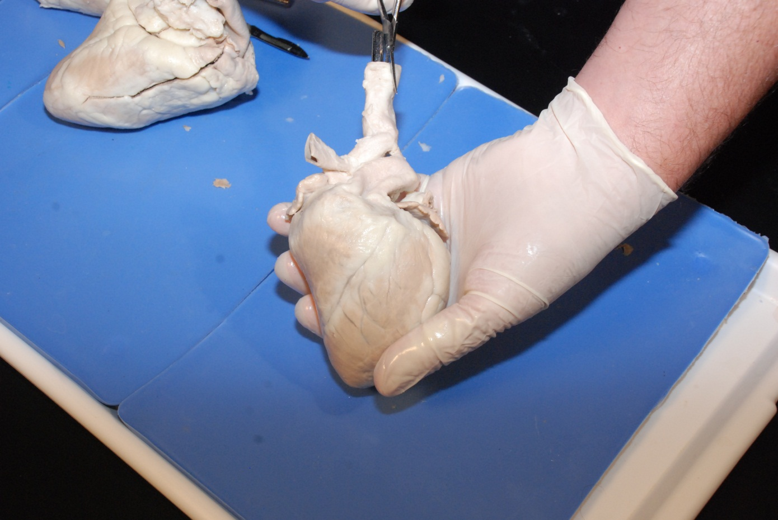
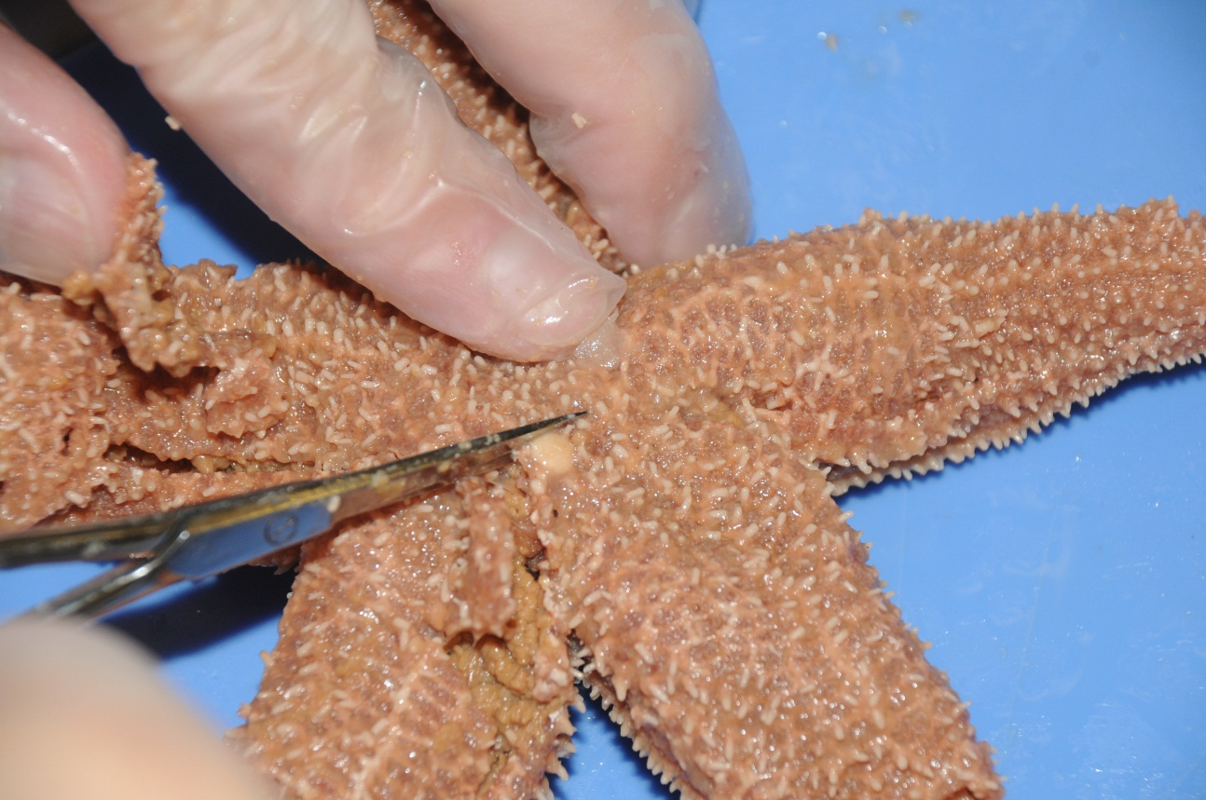
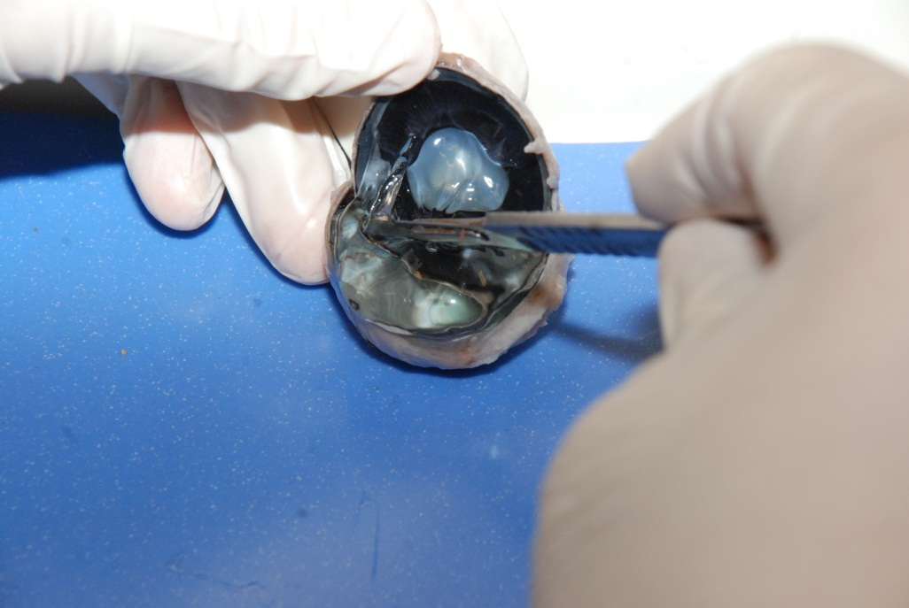
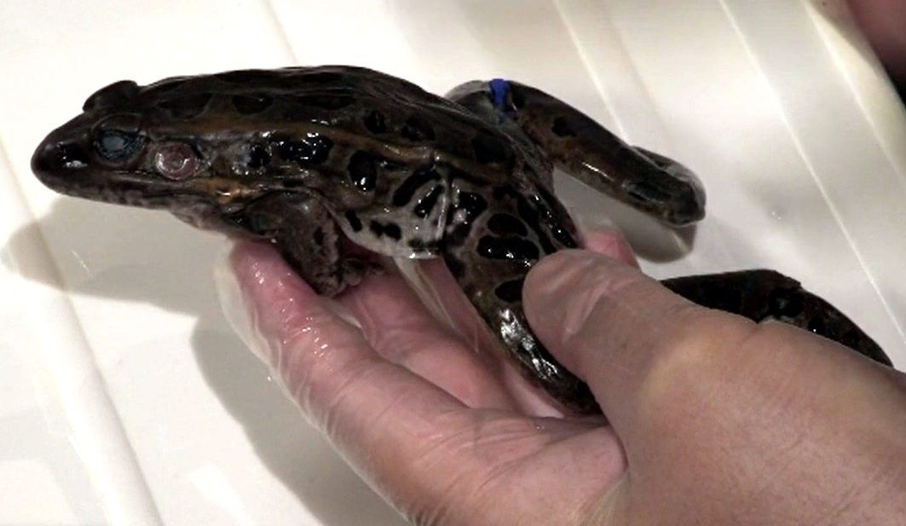
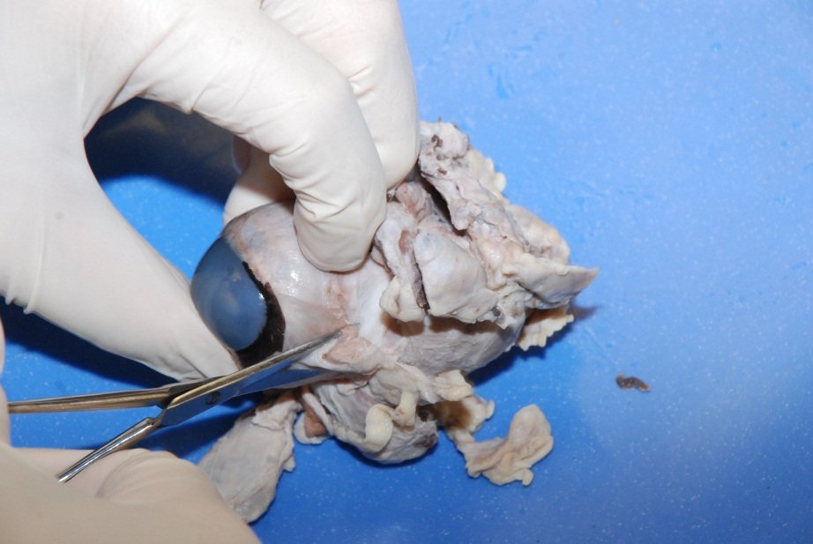
Interior of the Frog
Frogs are vertebrates in a class called Amphibians, living in water and on land.
Frogs have similar body systems (like the digestive and circulatory systems) to other vertebrates like humans, making them a nice specimen for comparative anatomy.
Along with toads, they make up the largest group of Amphibians.

Slide 5
Interior of the Frog
Characteristics of Frogs
Atypical Amphibian because they lack a tail; in a group called Anurans (without tail).
Unlike other tetrapod (4 limbed) vertebrates, Amphibians have smooth, moist, scaleless skin which is used for respiration (also have lungs).
Modified, extended back legs for jumping.
Ectothermic (cold-blooded).

Slide 6
Interior of the Frog
Getting Started
Use water to rinse the excess preservative from your specimen.

Slide 7
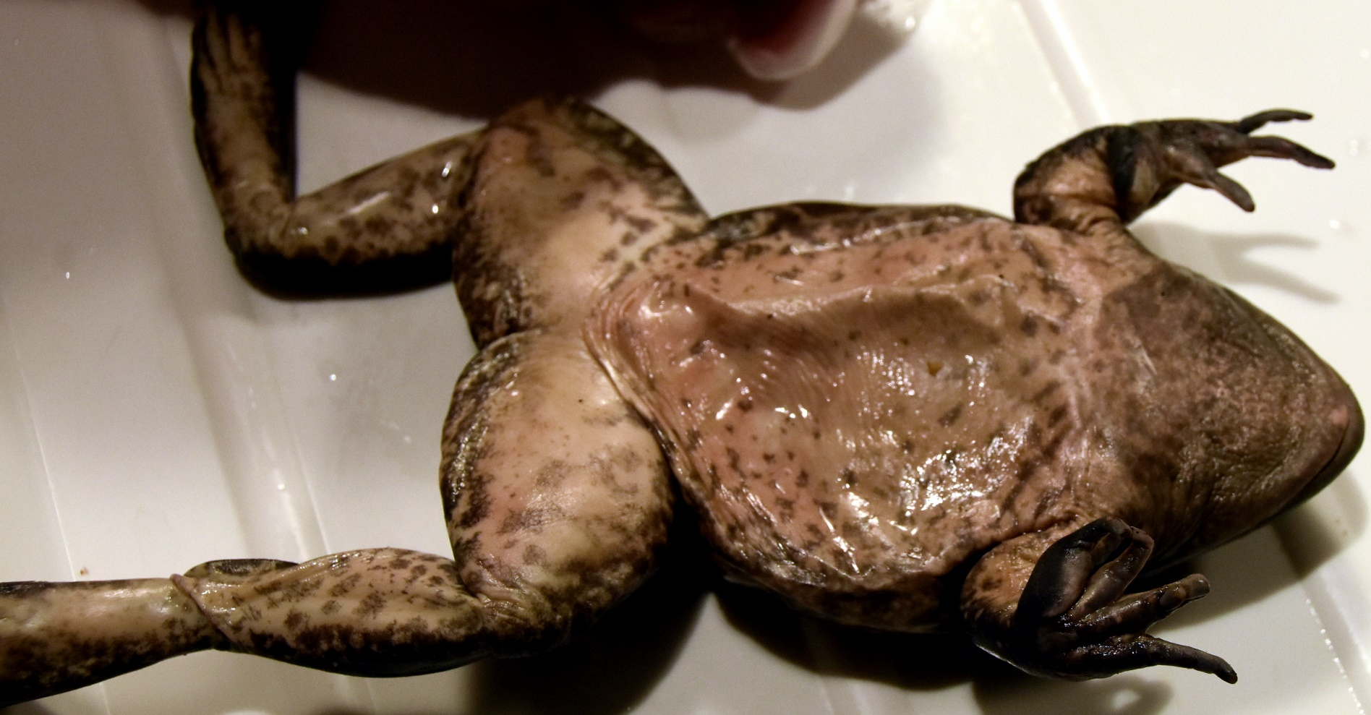
Interior of the Frog
2
4
3
1
5
Do NOT start dissecting until the next TEN slides.
You will make 5 cuts to expose the coelom (body cavity) and going through the muscle layer.
Always cut AWAY from yourself.

Slide 8
Interior of the Frog
Skin Cuts
Place the frog on its back.
Make a small incision in the abdomen near the legs (enough to get the scissors inside the abdomen).
Place the scissors in the incision and press upward with lower part of the scissors against the skin to prevent cutting too deep.
X

Slide 9
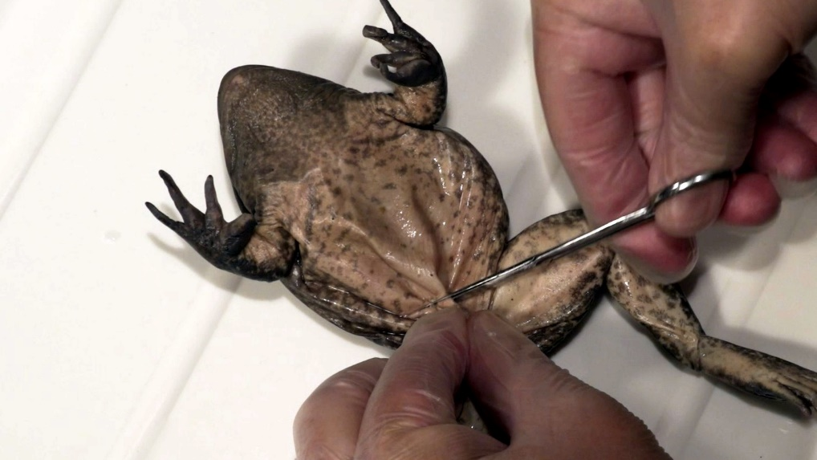
Interior of the Frog
1
1.
Make Cut #1.

Slide 10
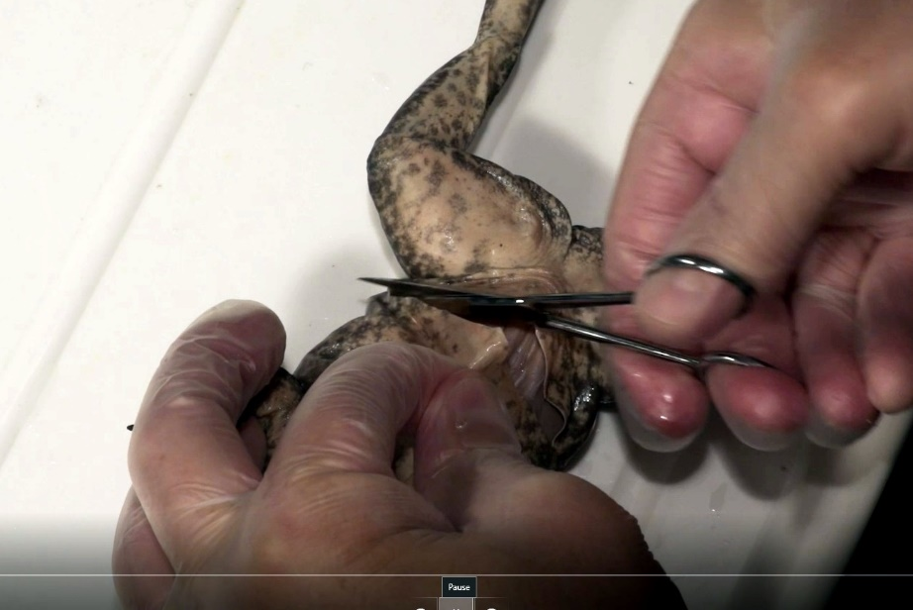
Interior of the Frog
2
2.

Slide 11
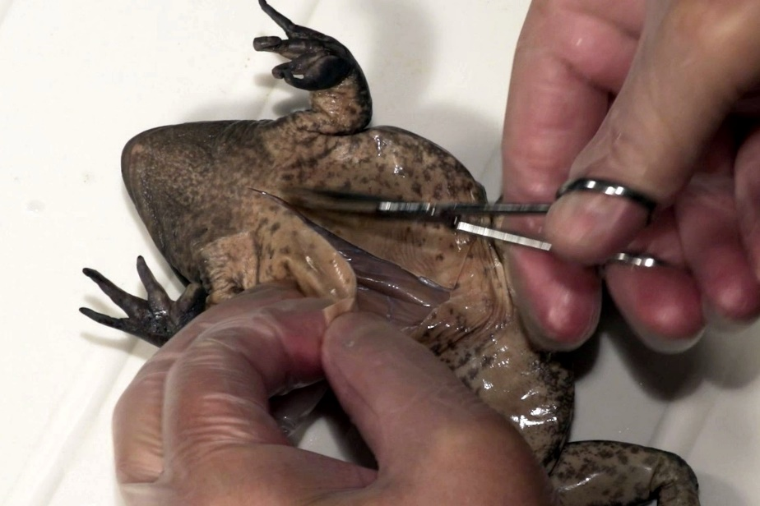
Interior of the Frog
3
3.

Slide 12
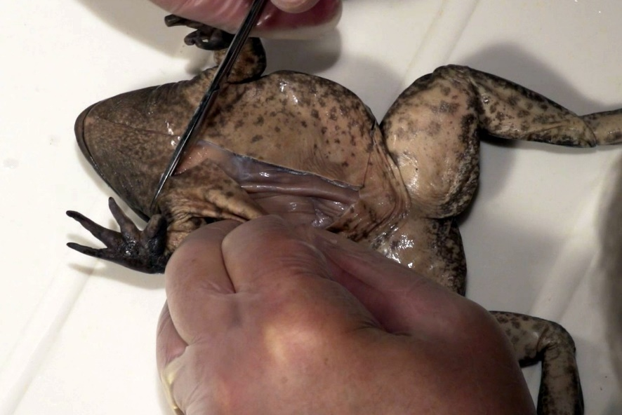
Interior of the Frog
4
4.

Slide 13
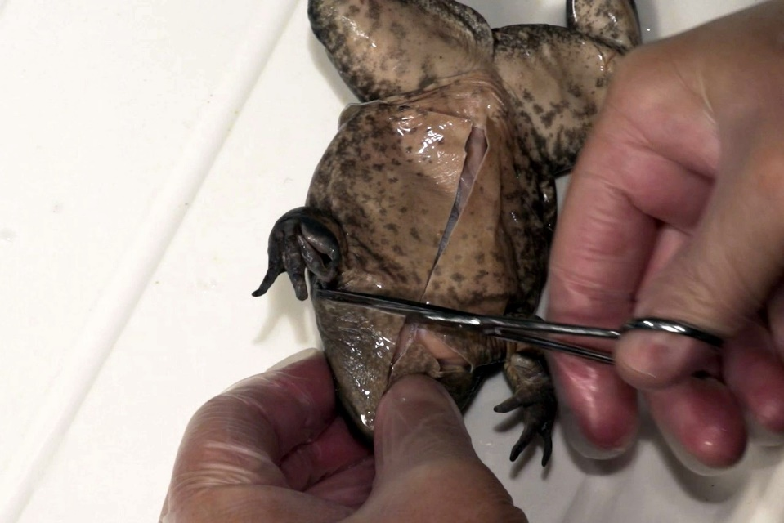
Interior of the Frog
5
5.

Slide 14
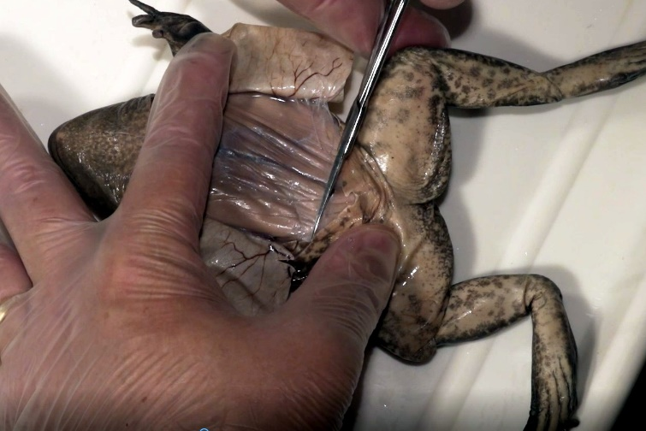
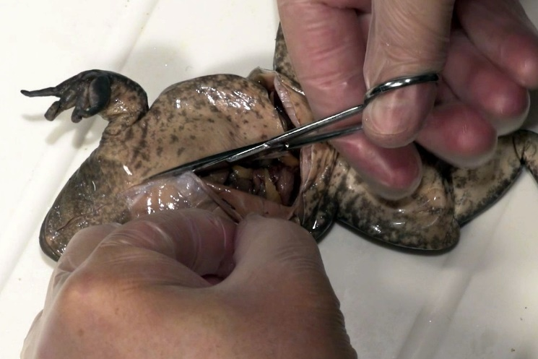
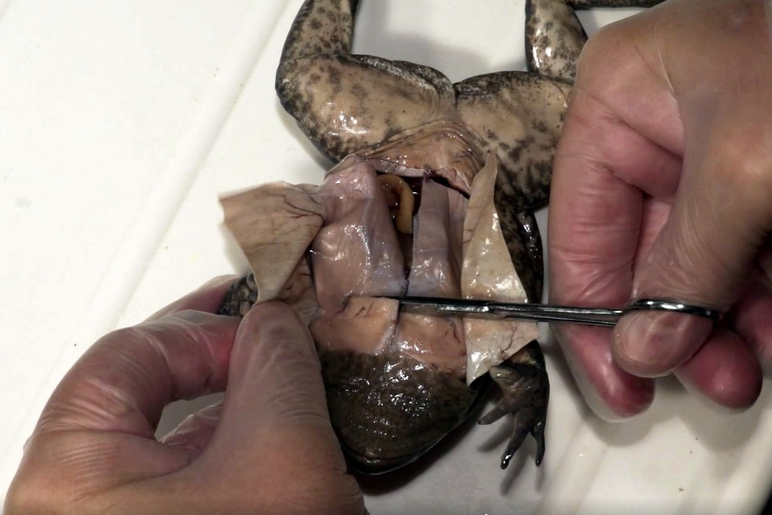
Always cut away
from yourself
Interior of the Frog
Video of Cuts (view)
5.
Open Cavity

Slide 15
Always cut away
from yourself
Interior of the Frog
The same cuts must be made for the muscles.

Slide 16
Always cut away
from yourself
Interior of the Frog
1.
2.
3.
4.
Open Cavity
5.

Slide 17
Interior of the Frog
Structure identification:
Your specimen is unique. Many of the structures will not look exactly like the photos or drawings in your book.
The following slides will identify structures using multiple views and specimens.
We will identify structures in both male and female frogs.

Slide 18
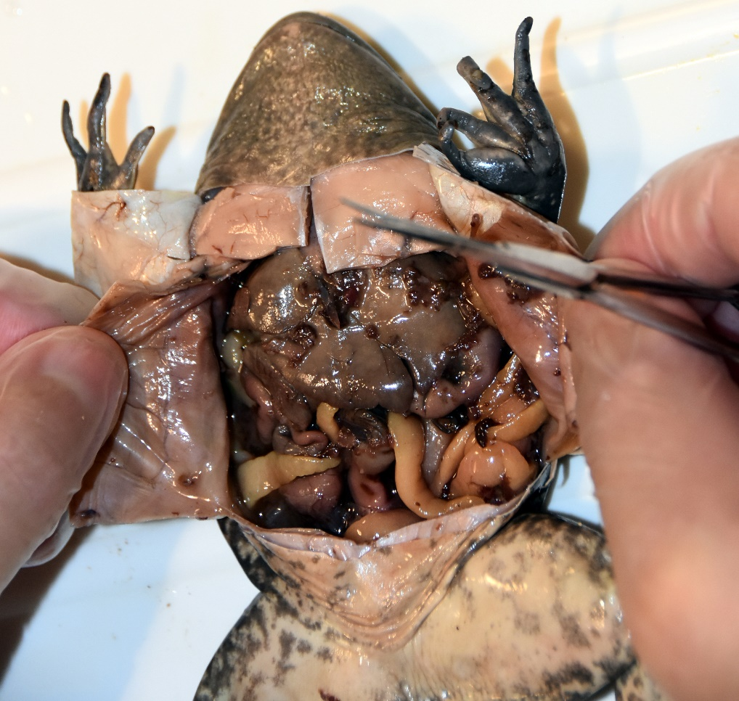
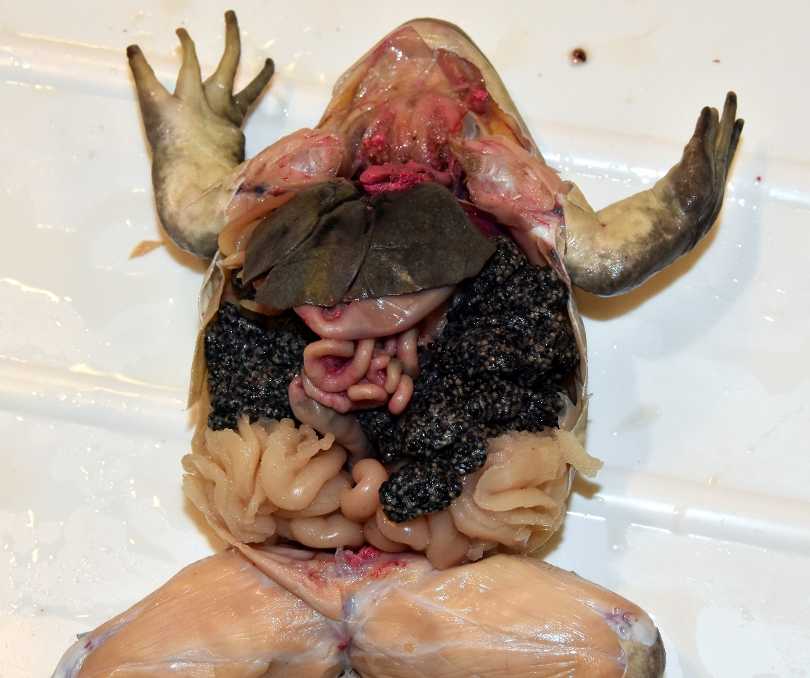
Interior of the Frog
Male
Female
Ovaries
Fat bodies
Oviducts
The frog on the left is a mature male; the frog on the right is a female.
A mature female is easy to identify because of the large paired ovaries and extensive oviducts.
Also note the difference between the oviducts and fat bodies. Fat bodies are fingerlike and found in both male and female frogs; oviducts are long tube-like structures.

Slide 19
Interior of the Frog
Male
Female
Liver
Liver – the large organ (3 main lobes) at the anterior end of the body cavity.
The liver has many functions including detoxifying blood, storing of fats for energy, and the production of bile for fat digestion in the small intestine.

Slide 20
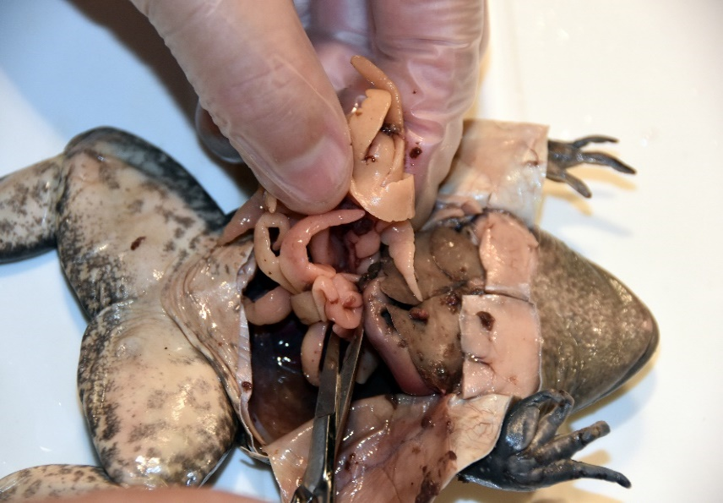
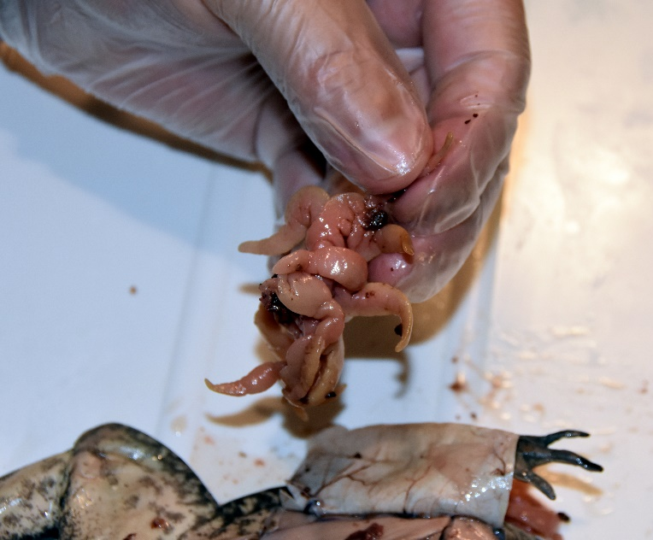
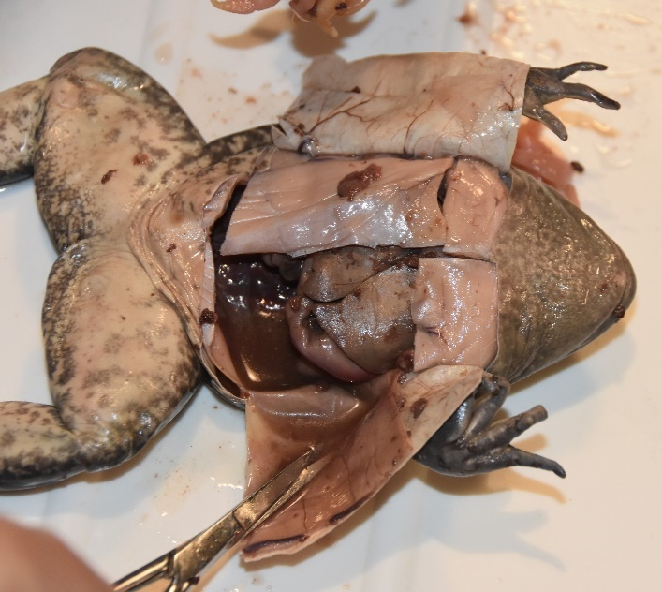
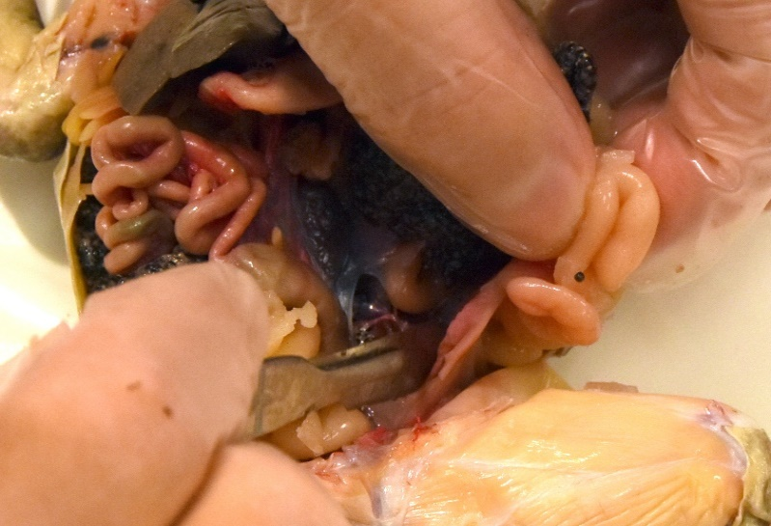
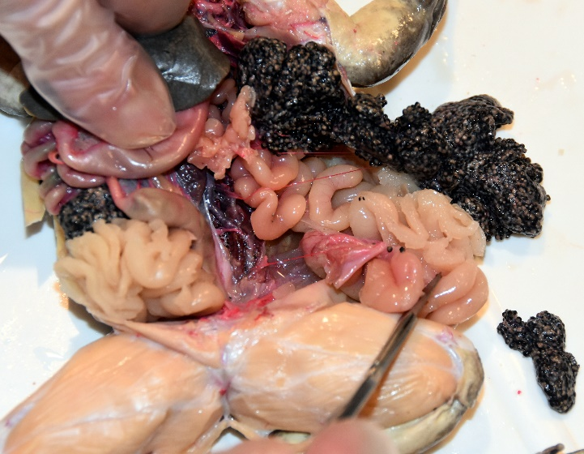
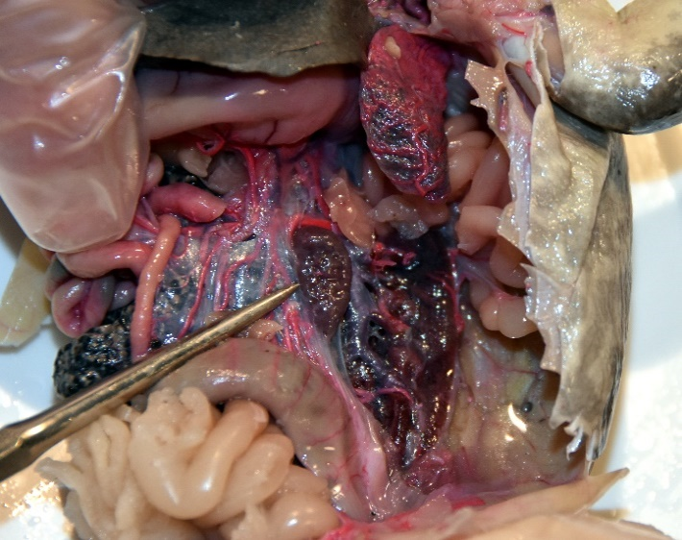
Interior of the Frog
Male – Remove fat bodies to identify additional structures.
Female - Remove fat bodies, ovaries, and oviducts.

Slide 21
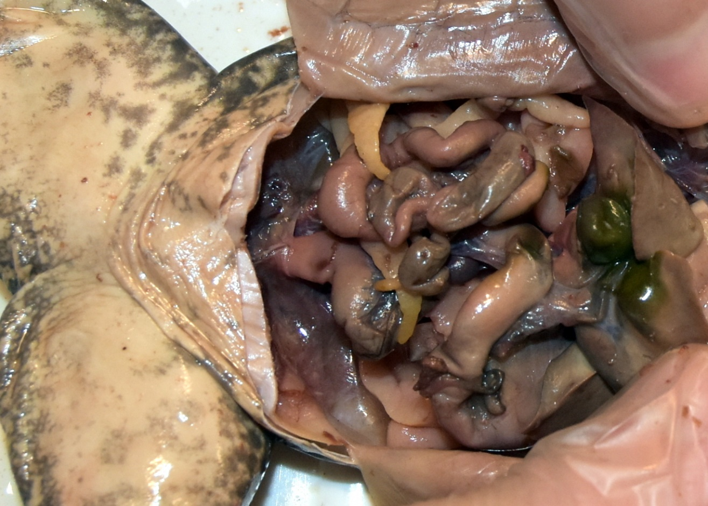
Interior of the Frog
Gallbladder –
Green in color, found within the lobes of the liver (liver pulled back in photo);
Stores bile produced by liver for fat digestion; enters small intestine.
Note: Not every specimen will have a green gallbladder like the first specimen shown.

Slide 22
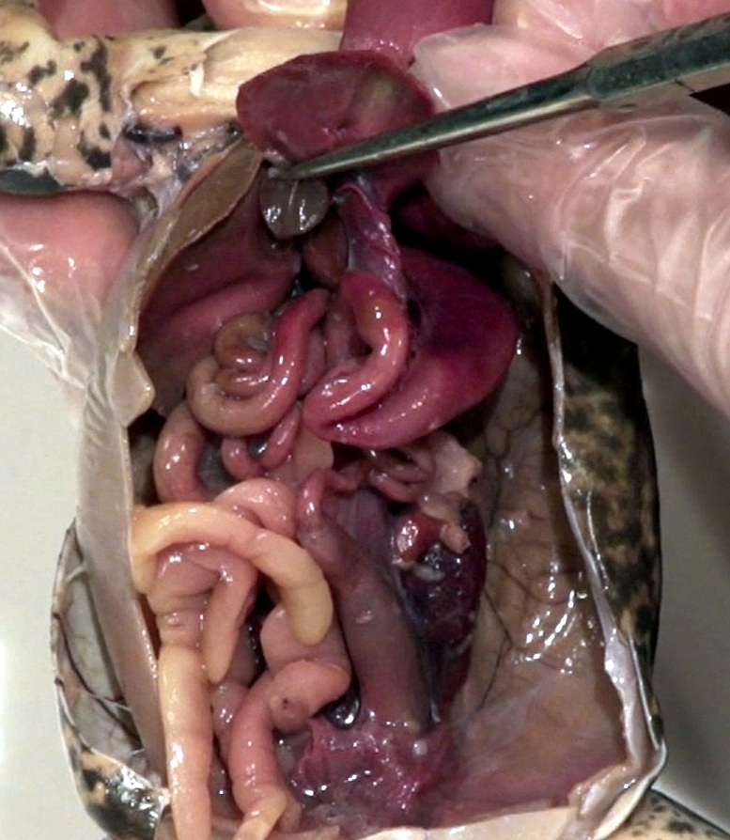
Interior of the Frog
Gallbladder

Slide 23
Interior of the Frog
Liver lifted
Stomach – Large j-shaped structure; food storage and digestion; complete digestive system.
Gallbladder
Small intestine – Long tube-like structure (increased surface area); digestion and nutrient absorption.
Large intestine (colon) - Water absorption; forms feces, excreted through cloaca.
Fat bodies
Urinary bladder – Thin walled; urine storage.

Slide 24
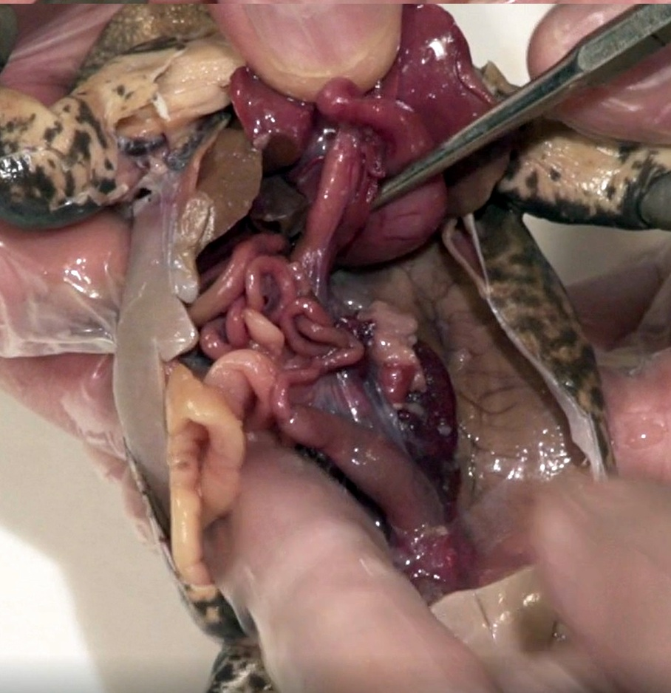
Interior of the Frog
Liver lifted
Stomach
Small intestine
Small intestine
Pancreas
Stomach
Fat bodies
Large intestine

Slide 25
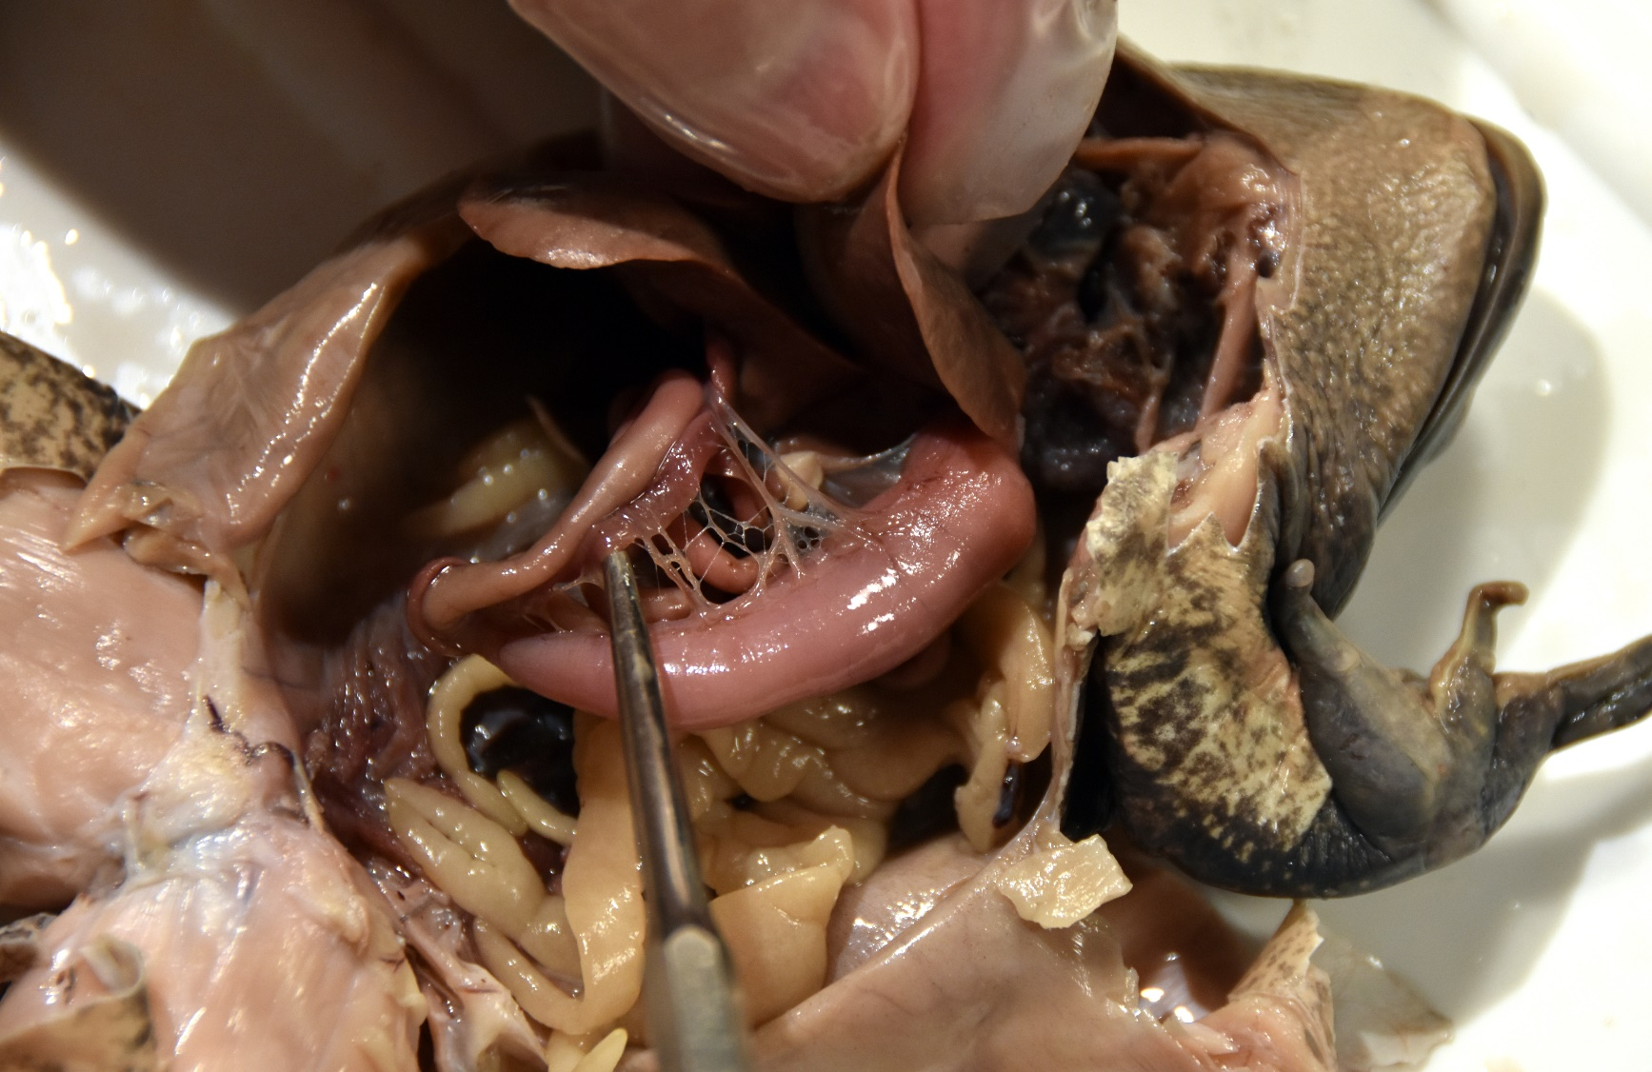
Interior of the Frog
Close-up of pancreas
Pancreas – Located at the start of the small intestine;
enzyme producing structure for digestion (pancreatic juices);
hormone production, like insulin used for blood sugar regulation.
Small intestine
Stomach

Slide 26
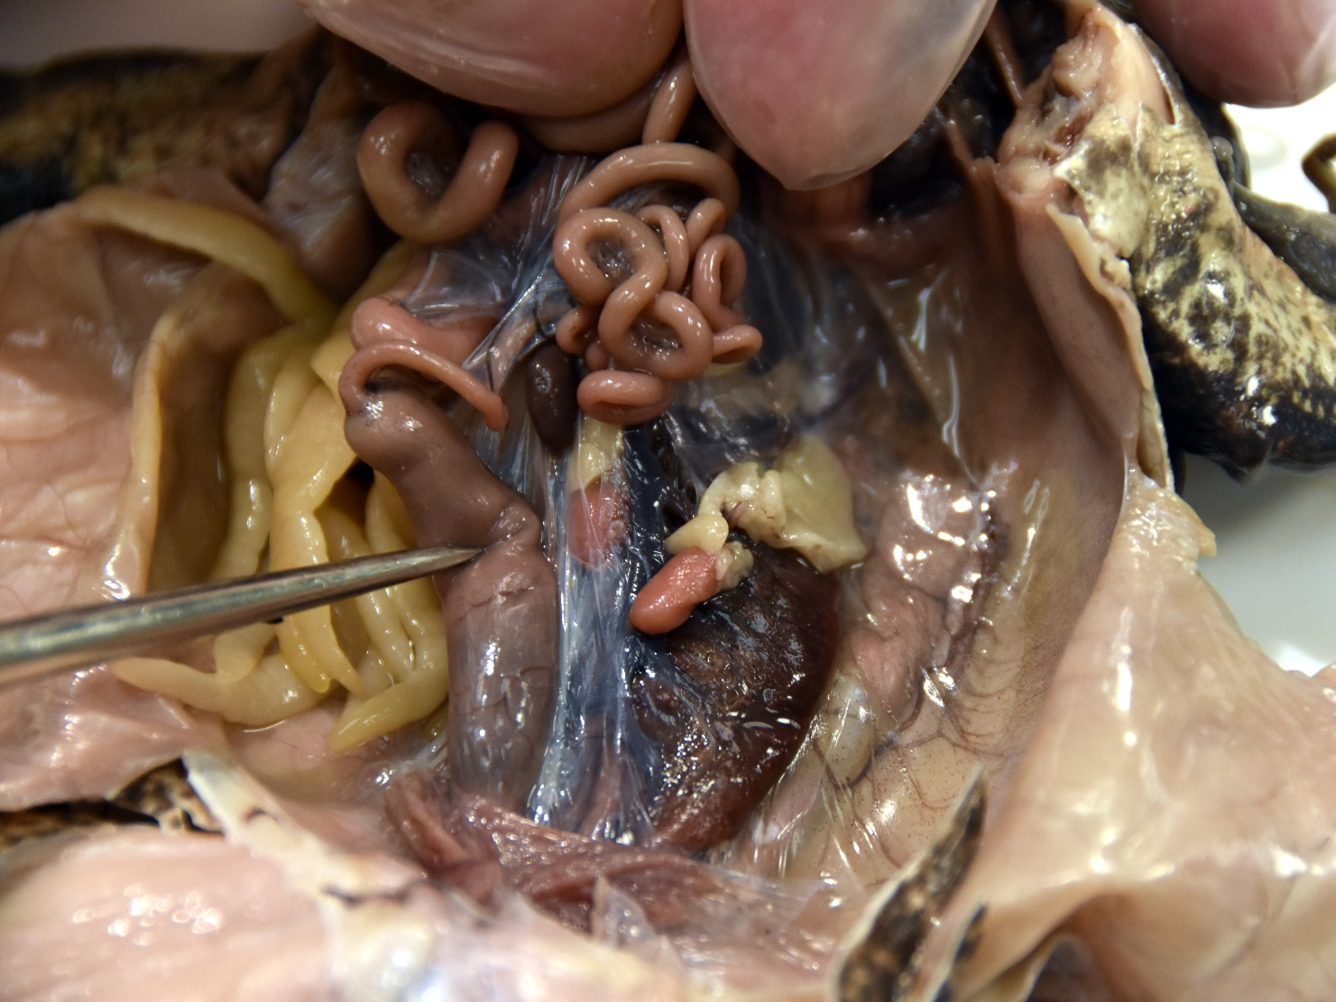
Interior of the Frog
Liver and stomach pulled back
Spleen – Immune (white blood cell production); filters and stores blood; found in mesentery; dark here, many times fleshy color.
Small intestines
Fat bodies
Testes - Paired male gonads (testis - singular) located at the cranial end of the kidneys; produce sperm (larger in mating male).
Large intestine
Mesentery – Connective tissue; houses lymphatic tissue and blood vessels.

Slide 27
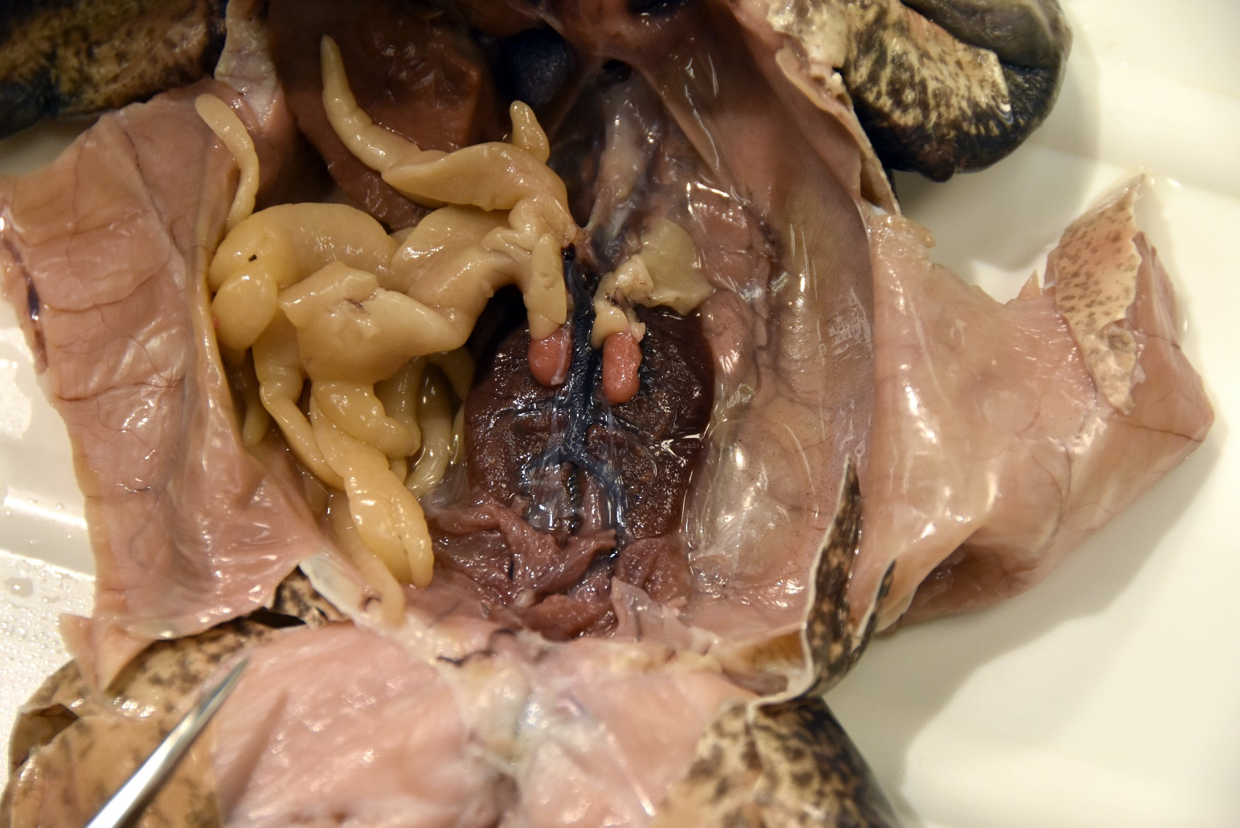
Interior of the Frog
Mesentery and Digestive System Removed (Male Shown)
Testes
Fat bodies
Kidneys –
Excrete waste from the blood, produce urine; large, paired, dark organs found against the dorsal body wall.
Urinary bladder

Slide 28
Interior of the Frog
Mesentery, Digestive System and Liver Moved Upward
Lungs (paired) – Deflated; not as complex as the human lung, have some compartmentalization but no alveoli; gas exchange for respiration, also gas exchange through skin/mouth.

Slide 29
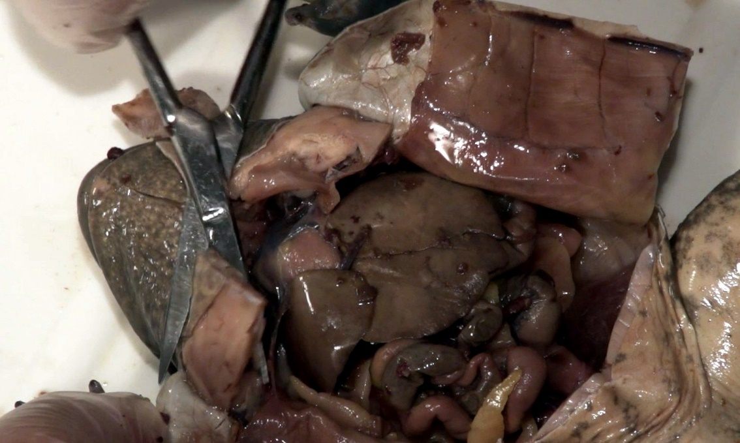
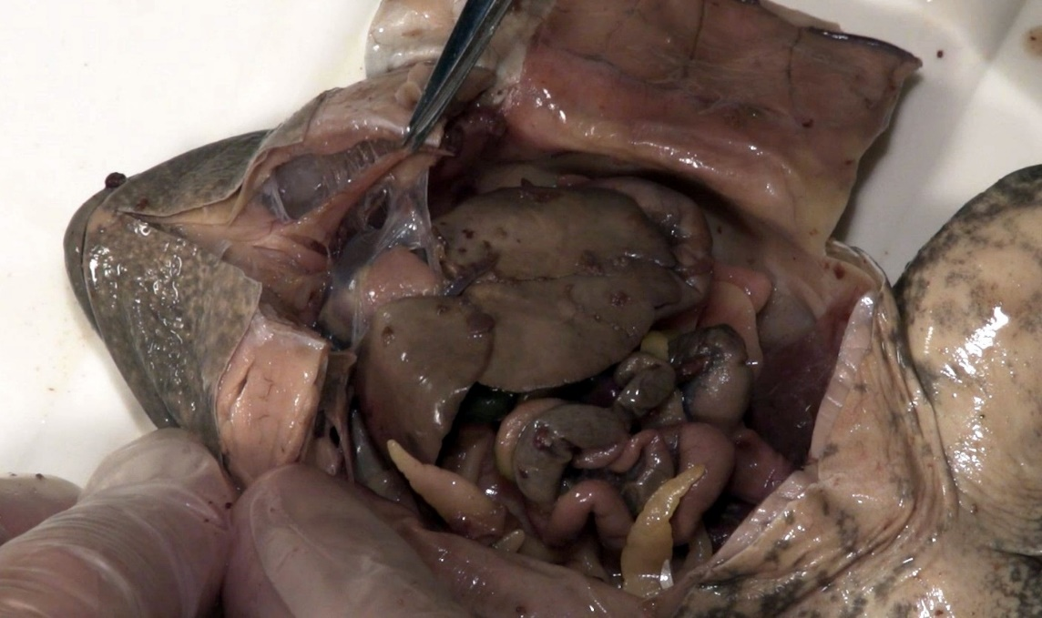
Always cut away
from yourself
Interior of the Frog
Cuts to Expose the Heart
1.
2.
3.

Slide 30
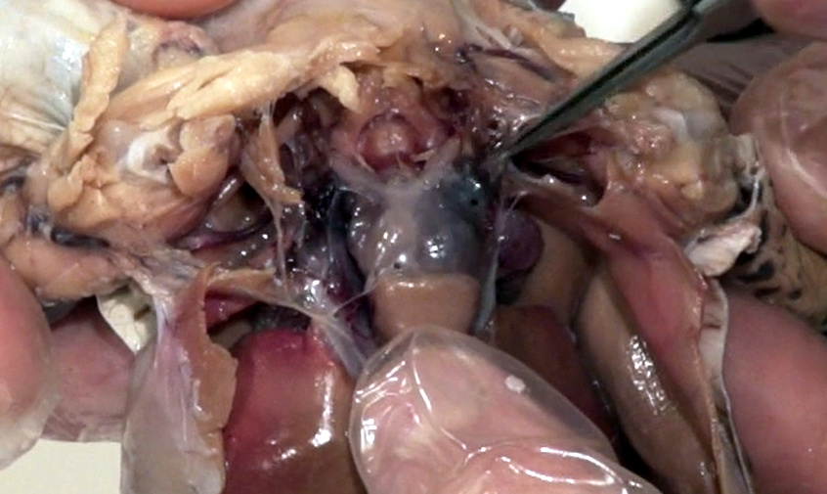
Interior of the Frog
Left Atria
Conus Arteriosus
Left Atrium
Right Atrium
Ventricle
Right Atrium
Liver
Ventricle
3 Chambered Heart

Slide 31
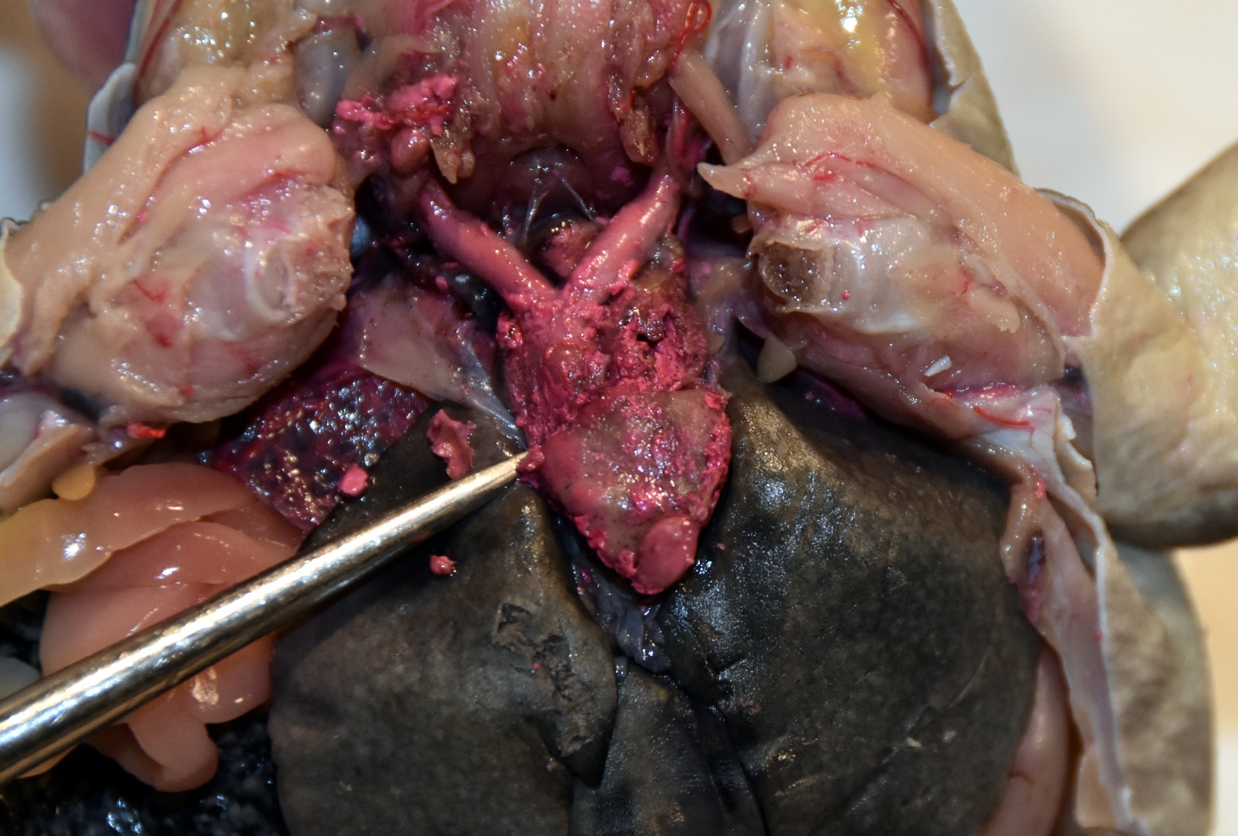
Interior of the Frog
Left Atria
Right Atrium
Liver
Heart
– Closed system; deoxygenated blood (from the body) and oxygenated blood (from the skin) enters the right atrium;
oxygenated blood (from the lungs) enters the left atrium.

Slide 32
Interior of the Frog
Conus Arteriosus
Left Atria
Right Atrium
Ventricle
Liver
Heart
Blood is then pumped from both atria to the ventricle.
The ventricle then pumps the blood through the conus arteriosus.
Oxygen-poor blood is pushed to the lungs; oxygen-rich blood is shunted to the rest of the body. The process then repeats.

